Slide 1
From In-house Simulators to Ramulator and DRAM Bender: Lessons and Implications
Jung Ho Ahn
gajh@snu.ac.kr, https://geniajh.github.io
2026/06

Slide 2
Disclaimers
I am not a native speaker.
I do not intend to offend anyone.

Slide 3





2016
2024
1996
2000
2004
2007
2009
2017
Major: Computer Architecture
Google citation count: 15,700+
Hall of fame: ISCA/HPCA/MICRO (#31 in Comp. Arch. Aggregated HoF)
Dean, GSCST @ SNU (2022/09-2024/08)
The keywords of [DRAM, memory] appear [30+, 90+] times in my homepage.

Slide 4
DRAM simulators
2016
2024
1996
2000
2004
2007
2009
2017
DRAMSim: 1 (2005 @ SIGARCH CAN), 2 (2011 @ IEEE CAL), 3 (2020 @ IEEE CAL)
USIMM (2012, https://users.cs.utah.edu/~rajeev/pubs/usimm.pdf)
Ramulator: 1 (2015 @ IEEE CAL), 2 (2024 @ IEEE CAL)
McSimA+ (2013 @ ISPASS)

Slide 5
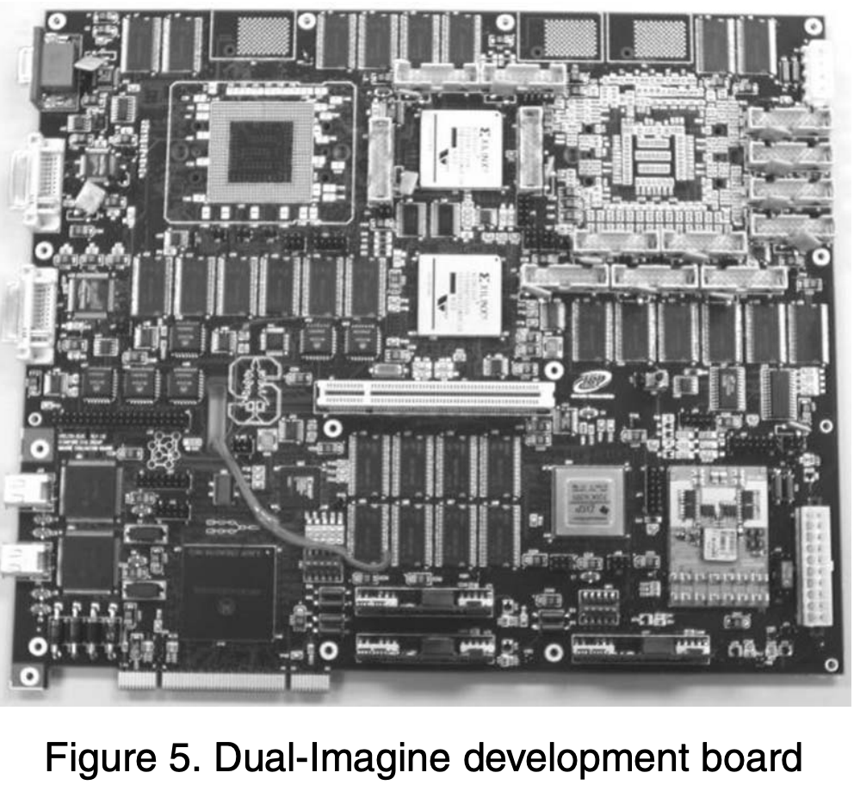
2016
2024
1996
2000
2004
2007
2009
2017
[ISCA 2004] cited 185 times
“Evaluating the Imagine Stream Architecture,”
J. Ahn, W. J. Dally, B. Khailany, U. J. Kapasi, A. Das
[SIGARCH CAN 2009] cited 88 times
“How to Simulate 1000 Cores,”
M. Monchiero, J. Ahn, A. Falcón, D. Ortega, P. Faraboschi

Slide 6
I have co-authored tool papers
[ISCA 2008] cited 327 times
“A Comprehensive Memory Modeling Tool and Its Application to the Design and Analysis of Future Memory Hierarchies,” S Thoziyoor, J. Ahn, M. Monchiero, J. B. Brockman, N. P. Jouppi
[MICRO 2009] cited 3,388 times
“McPAT: an Integrated Power, Area, and Timing Modeling Framework for Multicore and Manycore Architectures,” S Li, J. Ahn, R. D. Strong, J. B. Brockman, D. M. Tullsen, N. P. Jouppi
[ICCAD 2011] cited 402 times
“CACTI-P: Architecture-level modeling for SRAM-based structures with advanced leakage reduction techniques,” S Li, K. Chen, J. Ahn, J. B. Brockman, N. P. Jouppi
[ISPASS 2013] cited 178 times
“McSimA+: A manycore simulator with application-level+ simulation and detailed microarchitecture modeling,” J. Ahn, S. Li, S. O, N. P. Jouppi
Not an exhaustive list

Slide 7
DRAM tools I have been using while writing papers
# of papers I published
2009
2010
2011
2012
2013
2014
2015
2016
2017
2018
2019
2020
2021
2022
2023
2024
2025
2026
McSimA+ (since 2013, internally since 2009)
Ramulator (since 2015)
DRAM Bender & SoftMC (since 2023)

Slide 8
Why have I been developing my own simulator?
Training/education (DRAM and memory scheduling basics, role of main memory)
Black-box vs. white-box approaches
Customization (hands-on experiences)
Time to market (how fast we can extend the features, new standards)
Debugging
Fun

Slide 9
Why do I embrace Ramulator?
Training/education (tutorial, unit test, documentation, ease of use)
Code maintenance, community
Brand power (e.g., # of citations)
Hard to motivate students (user vs. developer)
I am getting older
[IEEE CAL 2015] cited 1050 times
“Ramulator: A Fast and Extensible DRAM Simulator,”
Y. Kim, W. Yang, O. Mutlu
[IEEE CAL 2024] cited 180 times
“Ramulator 2.0: A Modern, Modular, and Extensible DRAM Simulator,”
H. Luo, Y. C. Tuğrul, F. N. Bostancı, A. Olgun, A. G. Yağlıkçı, O. Mutlu

Slide 10
How about DRAM Bender and SoftMC?
Before graduation, I played with FPGAs.
Thus, I know the values of it.
Brave guinea pigs in my group (I appreciate them.)
Dr. Jaehyun Park, Hwayong Nam, Seungmin Baek, and Jumin Kim
Three years of sharpening the blade.
The power of sanity checks and hands-on experience.
[ISCA 2024]
“DRAMScope: Uncovering DRAM Microarchitecture and Characteristics by Issuing Memory Commands,”
H. Nam, S. Baek, M. Wi, M. J. Kim, J. Park, C. Song, N. S. Kim, J. Ahn
[ASPLOS 2025]
“Marionette: A RowHammer Attack via Row Coupling,”
S. Baek, M. Wi, S. Park, H. Nam, M. J. Kim, N. S. Kim, J. Ahn

Slide 11
Thoughts and lessons

Slide 12
What I learnt regarding architectural simulation
A simulator is a modeling tool.
Modeling is abstraction.
All the modeling tools have intended usage scopes and limitations.
Verification is a must, but rigorous verification is tough.
Simulation is not for generating absolute numbers, but for relative numbers (trends).

Slide 13

Verifying a (memory) simulator or a combination of multiple simulators against real hardware is very important, but complicated
(Hardware) prefetch
Address interleaving
Physical address to DRAM address
Channel/rank/bank-group/bank/row/column
Queue/buffer size, structure (reordering)
Row-buffer management policy
Open, close, adaptive-open, minimalist-open
Row-buffer (bank) conflicts
Uncore latency, including wiring (e.g., clock-domain crossing, asynchronous FIFO) and NoCs
Fairness (flow control)
The devil is in the details

Slide 14
A few thoughts to throw
Reporting timing discrepancy is one thing, but performance debugging is another.
ex) adjusting unloaded latency through minor modification on the code or machine description file
Why not directly reporting the issues to the simulator developers and letting them fix?
How can we do curve fitting when we do not know the internal microarchitecture (i.e., black-box) of memory controllers and the parts around those?
Bank conflict, in general, fairness
Lessons from ML (machine learning)
Dataset separation between training, validation, and test data sets

Slide 15
A few thoughts to throw
Aforementioned open-source main-memory simulators are voluntary efforts.
We must appreciate the hard labors of developing/maintaining those simulators.
What would be the implications of LLMs on this laboring?
Debugging is a norm for simulators, not a compensation or a sole topic of a research paper.
You dedication should be rewarded.
However, not necessarily through ISCA/HPCA/MICRO/ASPLOS papers.
Venues like IEEE CAL and ISPASS should be equally esteemed/recognized as venues for tool papers.

Slide 16
[MK 2004] cited 4,912 times
“Principles and Practices of Interconnection Networks,”
W. J. Dally and B. P. Towles
Processor
Src
RdReq
Addr
Dst
RdRep
Addr
Data
Src
WrReq
Addr
Data
Dst
WrRep
Addr
Req register
Rep register
From network
To network
Type
Tag
Addr
Data
Type
Tag
Data
Message
Receive
Message
format & transmit
req
$
data
evict
replace
Request Queue
hit
Protocol FSM
bypass
Status
Tag
Addr
Data
TSHRs
MSHRs
Status
Src
Addr
Data
Directory
Message
Receive
Message
format & transmit
Bank control
To network
From network
Dest
RdReq
Addr
RdRep
Addr
Data
Memory
Bank 0
Memory
Bank 1
Memory
Bank N-1
Dest
WrReq
Addr
Data
WrRep
Addr
Book of the day (Figure 20.6 & 20.7)

Slide 17
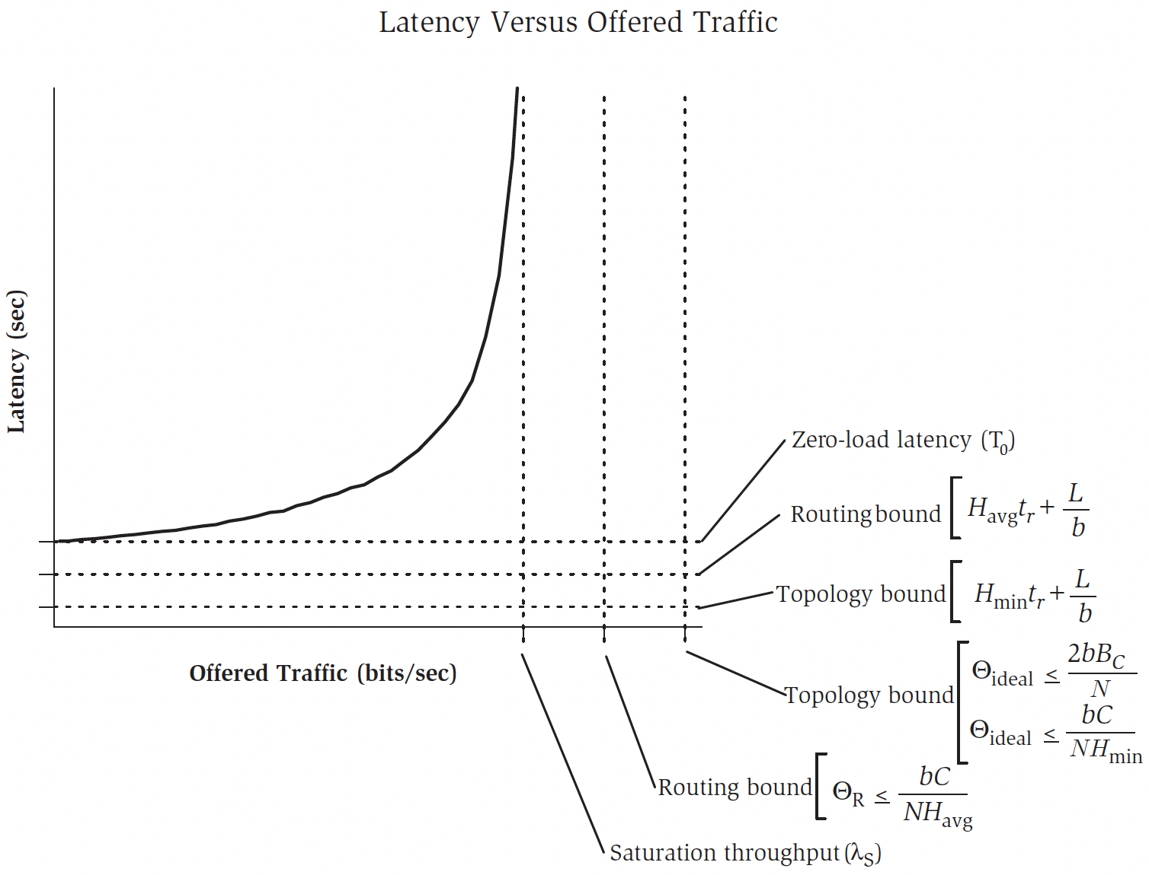
[MK 2004] cited 4,912 times
“Principles and Practices of Interconnection Networks,”
W. J. Dally and B. P. Towles
Book of the day

Slide 18
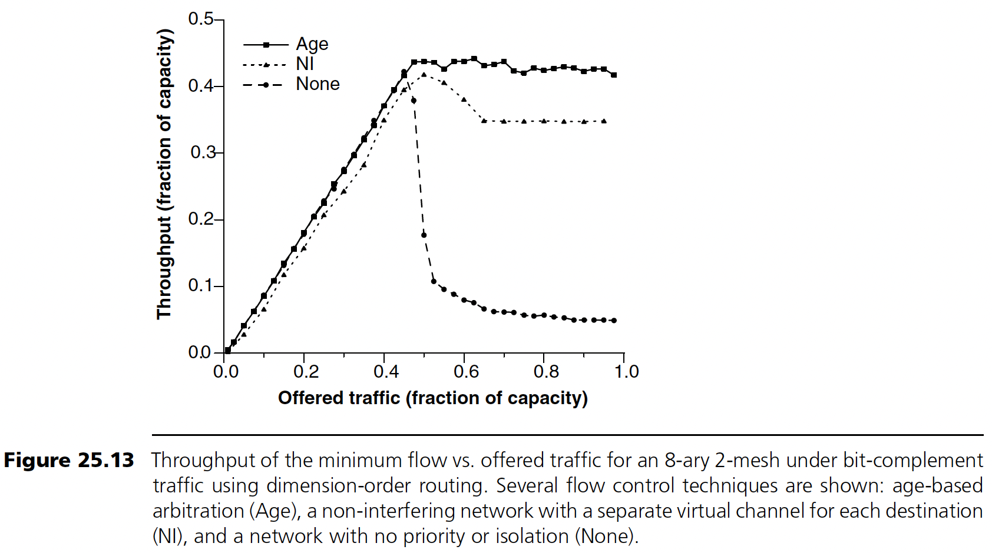
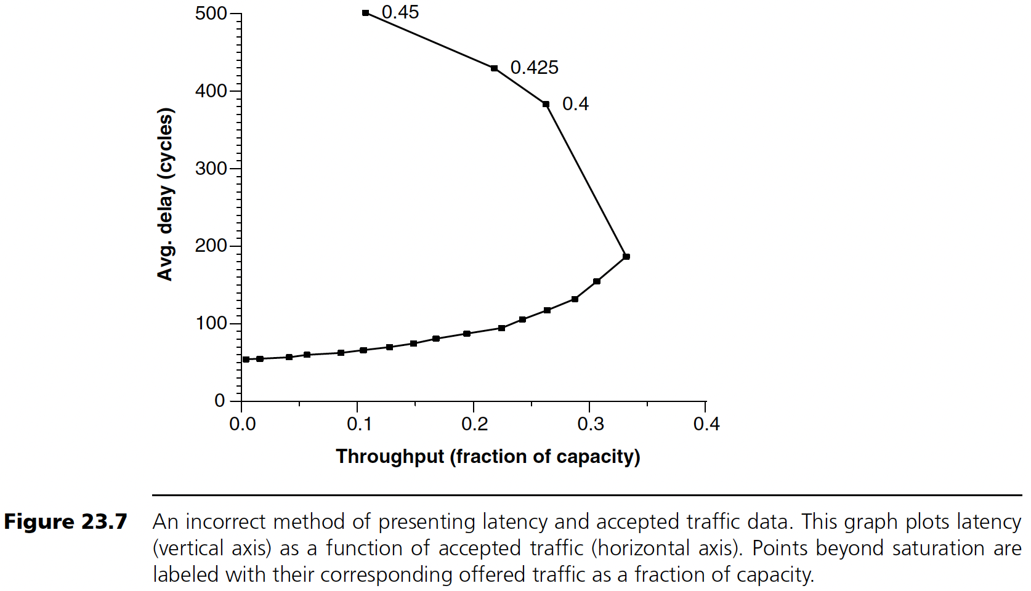
[MK 2004] cited 4,912 times
“Principles and Practices of Interconnection Networks,”
W. J. Dally and B. P. Towles
Book of the day

Slide 19
Thank you!
Back to basic.
Read textbooks like the way LLMs learn knowledge.

