Slide 1
Introduction to Ramulator 2.1
Haocong Luo
ETH Zurich
2nd R&DB Workshop and Tutorial @ ISCA’26
27.06.2026

Slide 2
Introduction
Ramulator 2.1 is a major overhaul of Ramulator 2.0
Fixes bugs identified by Github issues and internal testing
More comprehensive support for new DRAM & controller features
More comprehensive set of tests and validations
Significantly improved ease of use, configuration, and extension
Overall code quality and documentation improvements
Github main branch updated to v2.1.0
https://github.com/CMU-SAFARI/ramulator2/
codespace and devcontainer ready!
V2.0a is archived as legacy/v2.0a
Welcomes your use, contribution, and feedback!
Issues & Discussions on Github
Open PRs for bug fixes, improvements, and new features

Slide 3
Key Bug Fixes & New Features (I)
Currently modeled DRAM Standards
DDR
DDR3
DDR4
DDR5
Modeling scope & priority
Timing and functional simulation of DRAM commands
Load/Store transactions, refresh, read disturbance mitigation
High frequency operation and organization
LPDDR
LPDDR5
LPDDR6
GDDR
GDDR6
GDDR7
HBM
HBM1 (Legacy mode)
HBM2 (Pseudochannel mode)
HBM3
HBM4

Slide 4
Key Bug Fixes & New Features (II)
Major bugs from Github Issues all fixed
HBM/HBM2/HBM3 organization, timing, throughput, etc.
LPDDR5 timing, WCK2CK sync commands, etc.
Better support for new DRAM & controller features
HBMController for HBM/HBM2/HBM3/HBM4
Pseudo Channels (HBM2+)
Row and Column commands dual-issue in the same cycle
LPDDR5/6 Controller
WCK2CK sync (CAS_RD/WR) commands with sync state expiry tracking
ACT1-ACT2 separation with tAAD deadline-aware scheduling
GDDR7 Controller
Improved scheduler implementation
Add custom filtering logic to FR-FCFS via lambdas

Slide 5
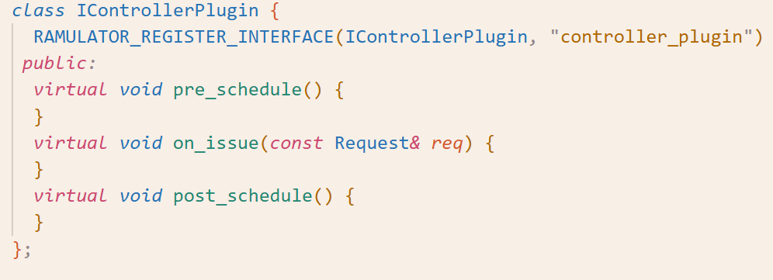
Key Bug Fixes & New Features (III)
Enhanced memory controller plugins
Standardized and modular interface to flexibly extend the functionality of existing memory controllers
Enables plug&play implementation of
Utilities like DRAM command trace recorder
RH mitigations

Slide 6
Tests & Validations (I)
Three automated test & validation workflows
Smoke tests: Quick checks to see if simulation crashes
DRAM command and request traces: Low-level verification of DRAM timings and controller scheduling
Latency-Throughput Plots: High-level validation of memory system performance

Slide 7
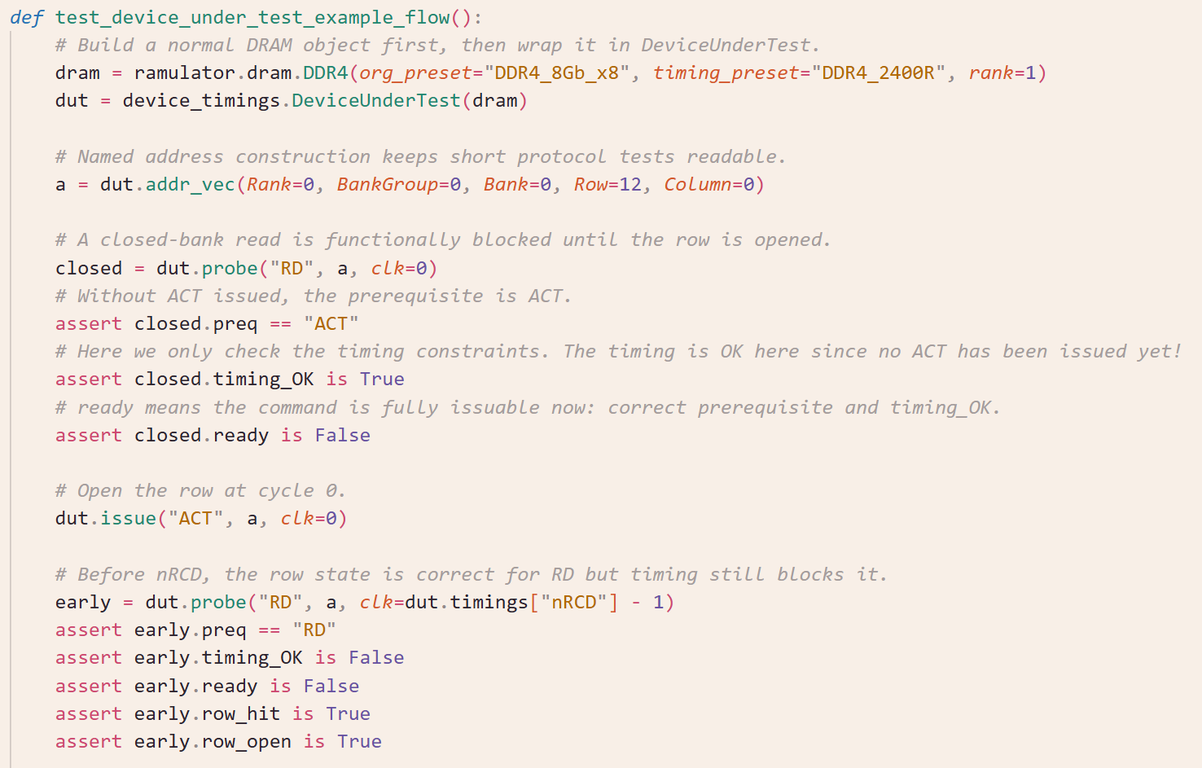
Tests & Validations (II)
DRAM Commands and Timings Test

Slide 8
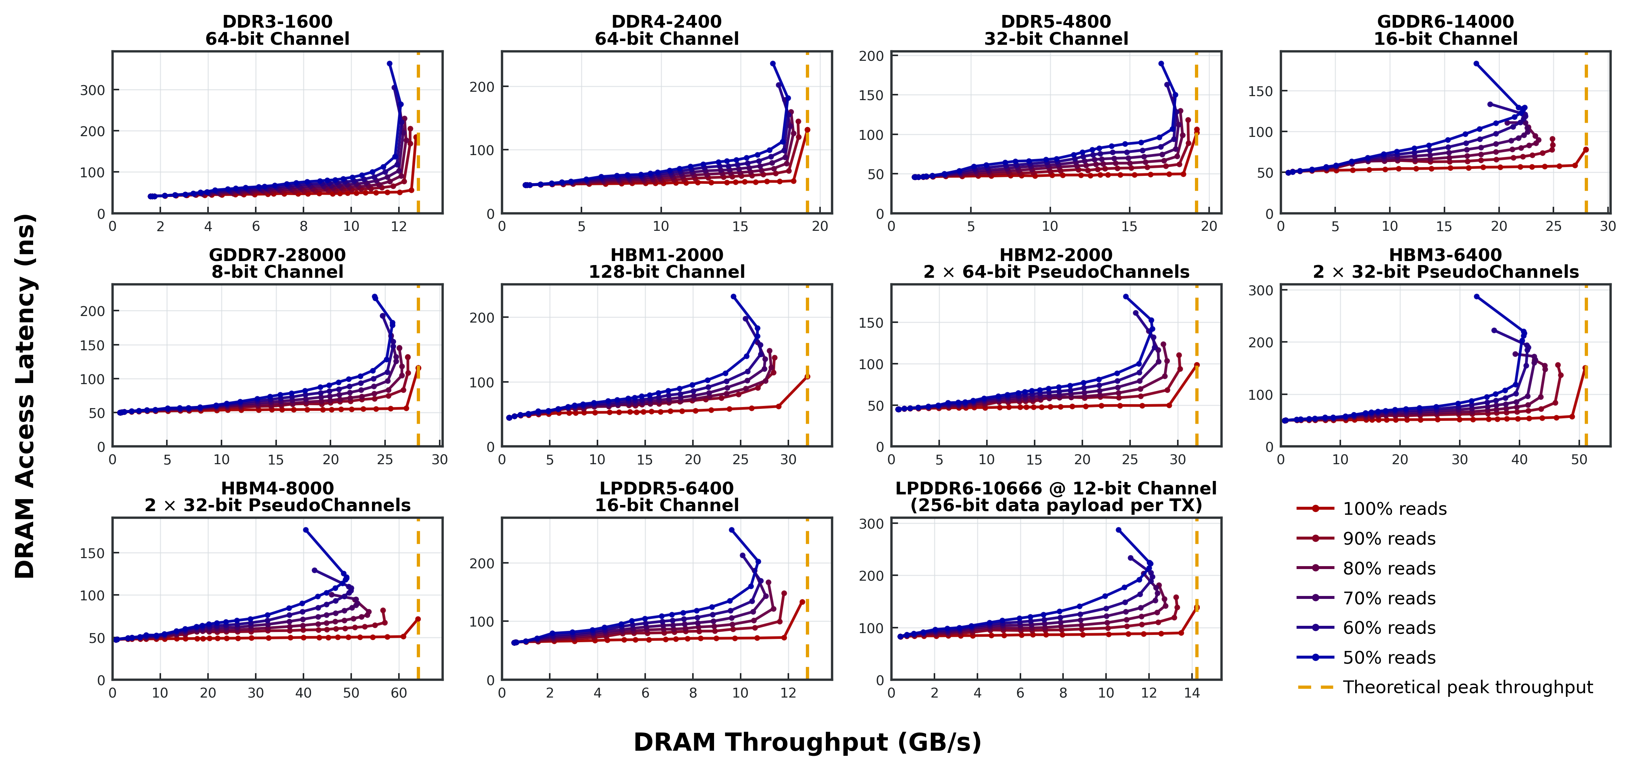
Tests & Validations (III)
Latency-Throughput Plots

Slide 9
QoL Improvements (I)
Ramulator is now a python package
C++ code with python bindings
Python driven configuration
Configuration, simulation, results parsing all in one script
Easy parameter sweeps with python flexibility
gem5 friendly
Both SE and FS works out-of-box (tested with gem5 v25.1)
No extra burden for end-user
Single-source of truth implementation
Python wrappers are automatically generated from C++
No need of manual maintenance of boilerplate code
Equivalent YAML config can be automatically generated for other pure C++ simulators

Slide 10
QoL Improvements (II)
Write code in C++
Use macros to register your interface, implementation, parameters
Ramulator 2.1’s software framework and build system automatically picks up these information to:
Understand, register, and build the object hierarchy of your interfaces and implementations
Create Python wrappers (proxy objects) with the specified parameters

Slide 11
QoL Improvements (III)
DRAM Standard Authoring in python
Replaced verbose and hacky C++ DRAM specs in Ramulator 2.0 with much cleaner python scripts
Flexible authoring of DRAM organization, commands, and timings, etc. thanks to the scriptibility of Python
Code generation utility automatically generates C++ DRAM specs that Ramulator 2’s internal modeling and simulation engine recognizes

Slide 12
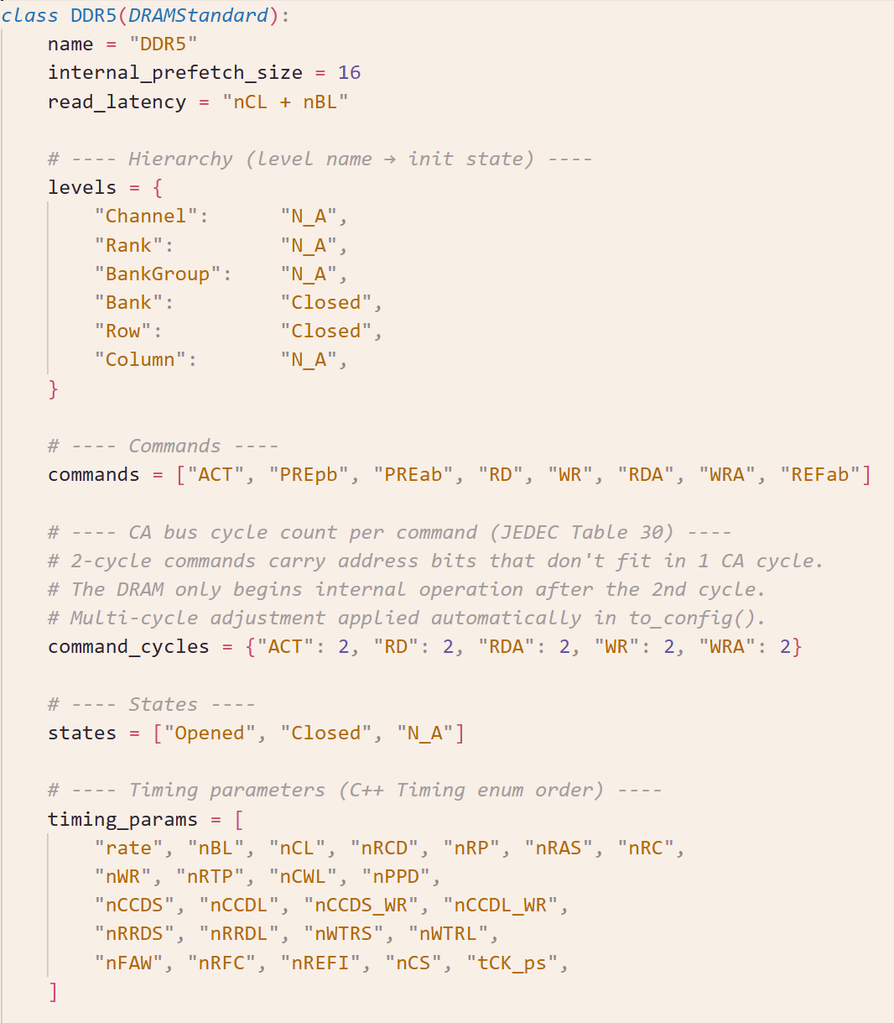
QoL Improvements (III)
DRAM Standard Authoring in python
Replaced verbose and hacky C++ DRAM specs in Ramulator 2.0 with much cleaner python scripts
Flexible authoring of DRAM organization, commands, and timings, etc. thanks to the scriptibility of Python
Code generation utility automatically generates C++ DRAM specs that Ramulator 2’s internal modeling and simulation engine recognizes

Slide 13
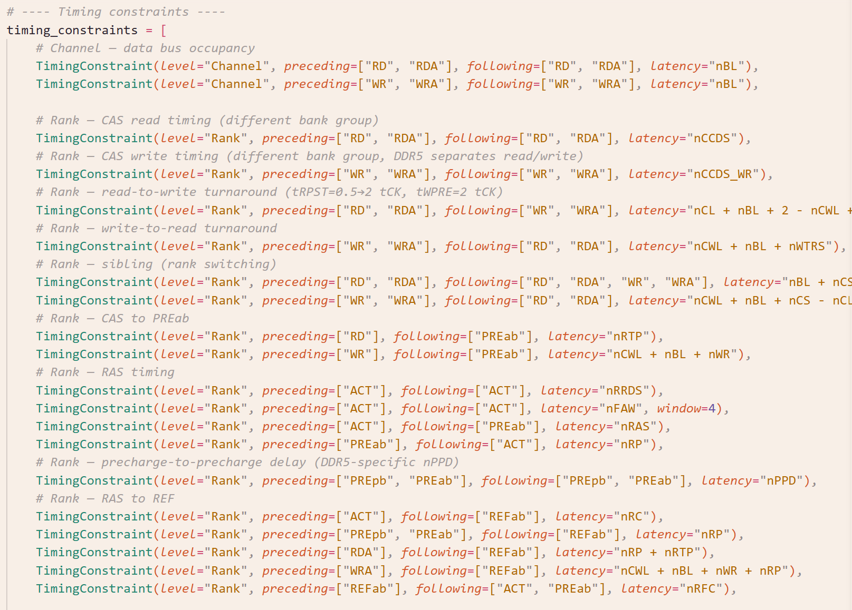
QoL Improvements (III)
DRAM Standard Authoring in python
Replaced verbose and hacky C++ DRAM specs in Ramulator 2.0 with much cleaner python scripts
Flexible authoring of DRAM organization, commands, and timings, etc. thanks to the scriptibility of Python
Code generation utility automatically generates C++ DRAM specs that Ramulator 2’s internal modeling and simulation engine recognizes

Slide 14
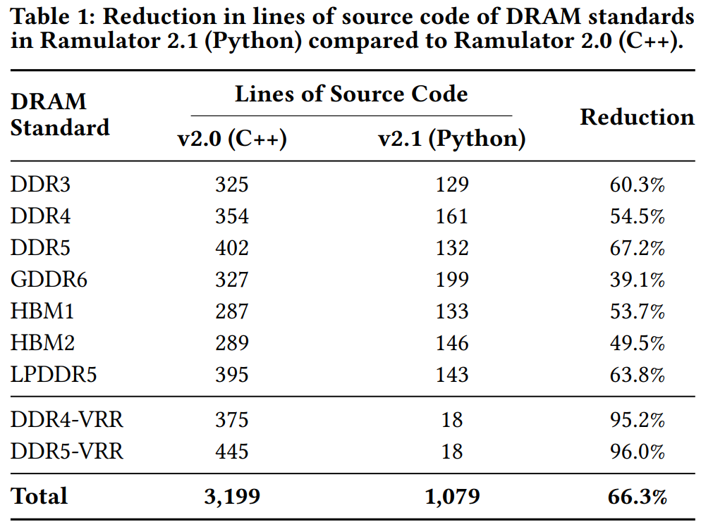
QoL Improvements (IV)
DRAM Standard Authoring in python
Significant reduction in lines of source code

Slide 15
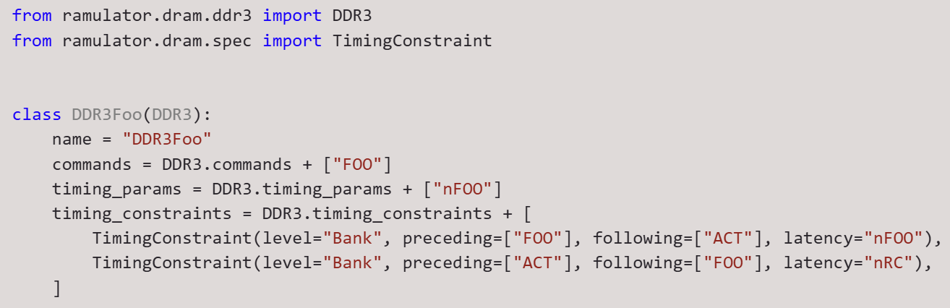
QoL Improvements (V)
DRAM Standard Authoring in python
Python scripting enables easy extension of DRAM standards by just adding what is new (i.e., no duplication of base DRAM code)
Inherit the base DRAM standard
Append just the new commands, timings, etc. to those of the base DRAM standard

Slide 16
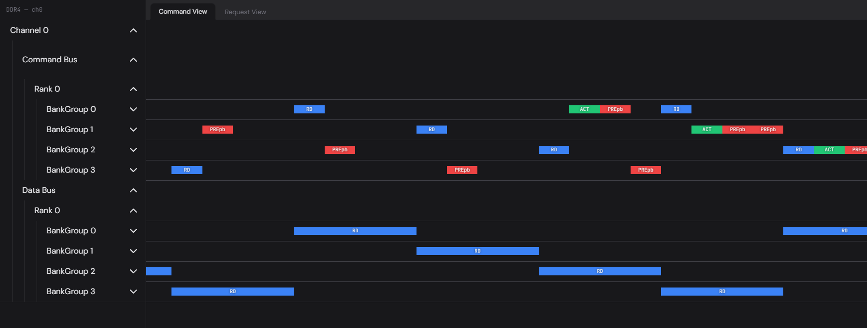
QoL Improvements (III)
Web-Based Interactive DRAM Trace Visualizer
Supports both offline (read dumped trace file) and online (from a running simulation) visualization
Inspect memory requests and DRAM commands for performance analysis & debugging (e.g., timing violation)
Many convenient and QoL features WIP
Real-time interactive rendering (tested w/ a 300MB+ trace)

Slide 17
Contribute to Ramulator 2.1 (I)
Released on Github (current tag v2.1.0)
https://github.com/CMU-SAFARI/ramulator2/
Please checkout v2.1 and let us know if you encounter any issues!
We will regularly address issues and check PRs
Earlier v2.0a version is archived at legacy/v2.0a
How to contribute to Ramulator 2.1
Use it, report any issue/feedback you have on Github
Add new features and components
Add more testcases
…
Check our detailed README and rich in-source documentation on using, extending, and integrating Ramulator 2.1

Slide 18
Contribute to Ramulator 2.1 (II)
Example directions of contributions
Better timing presets of DRAM standards
Some of the DRAM timings are our best effort “guesstimates”
We welcome your more accurate set of timings w/o breaking NDA
More DRAM request scheduling techniques
More DRAM read disturbance mitigation techniques
Make use of controller plugins and scheduler filters
More intelligent scheduling of refresh
Refresh postponing & pull-in
Dynamic choice of REFab/sb/pb
PUD/PNM modeling
More integration with other simulators
Please open an Issue/Discussion first to coordinate with potential internal development!

Slide 19
Acknowledgements
Contributors (growing)
Haocong Luo
Nisa Bostancı
Ataberk Olgun
Maria Makeenkova
Ziad Malik
Ipek Akdeniz
Kislay Arya
Roman Hoffmann
Wonhyuk Yang
@jiegec
Julien Eudine
Sangjae Park
…
Join the list!

