Slide 1
Ramulator 2.1 Tutorial
Haocong Luo
ETH Zurich
2nd R&DB Workshop and Tutorial @ ISCA’26
27.06.2026
Notes:
Hello everyone, I am Haocong, and I will be presenting our work revisiting…

Slide 2
Introduction
Ramulator 2.1 is a major overhaul of Ramulator 2.0
Fixes bugs identified by Github issues and internal testing
More comprehensive support for new DRAM & controller features
More comprehensive set of tests and validations
Significantly improved ease of use, configuration, and extension
Overall code quality and documentation improvements
Github main branch updated to v2.1.0
https://github.com/CMU-SAFARI/ramulator2/
codespace and devcontainer ready!
V2.0a is archived as legacy/v2.0a
Welcomes your use, contribution, and feedback!
Issues & Discussions on Github
Open PRs for bug fixes, improvements, and new features

Slide 3
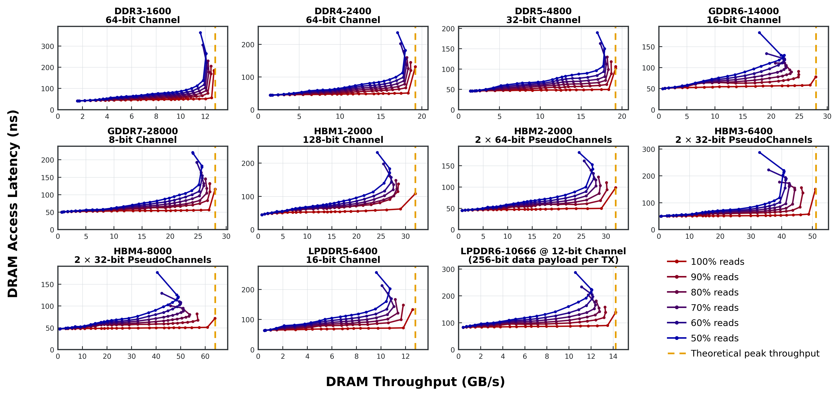
Currently Supported DRAM Standards

Slide 4
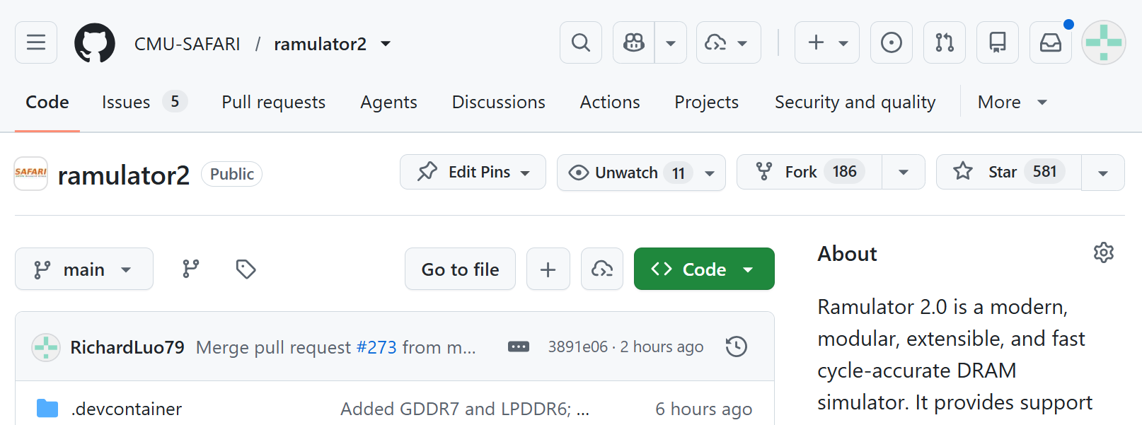
Getting Started (I)
Github codespace
https://github.com/CMU-SAFARI/ramulator2

Slide 5
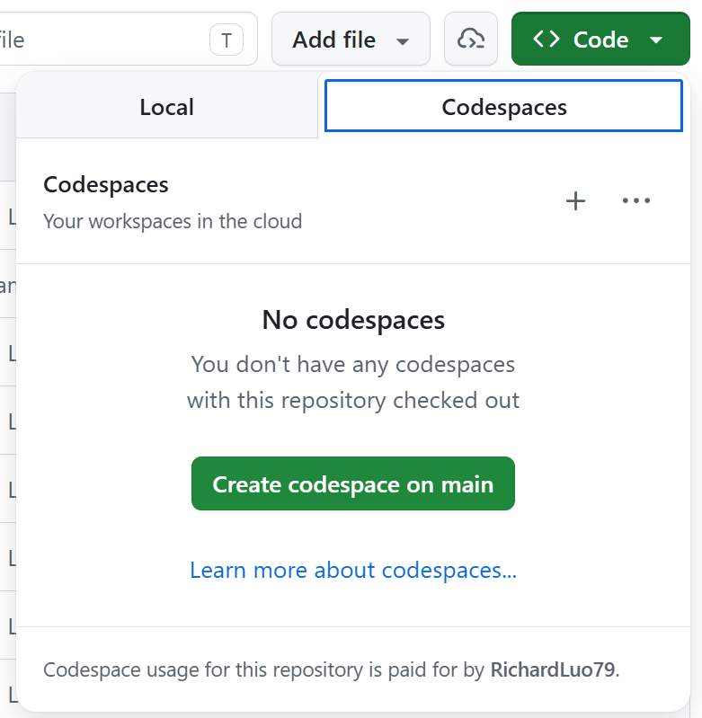
Getting Started (I)
Github codespace
https://github.com/CMU-SAFARI/ramulator2

Slide 6
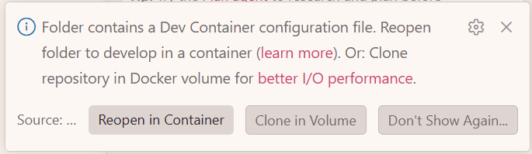
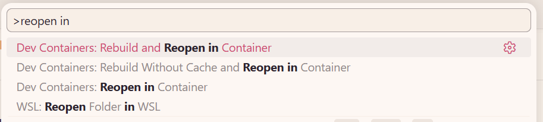
Getting Started (II)
Local (devcontainer)
Clone the repository
Open with VSCode

Slide 7
Getting Started (III)
Local
.devcontainer/Dockerfile
.devcontainer/post-create.sh

Slide 8
Navigating the Source Tree
examples/ # example configs, traces
python/ramulator/
<auto-generated python wrappers>
dram/ # source code for DRAM standards
resources/
gem5_wrappers/
src/ramulator/
base/ # sw framework of Ramulator 2.1
controller/ # source code of the mem. ctrl. Interface
i_controller.h # interface source
impl/ # implementation source
hbm34_controller.cpp
…
dram/ # auto-generated C++ source of DRAM device
…
tests/

Slide 9
Simulator Architecture (I)
Two top-level components
send
memory requests
Memory System
Frontend
callback
upon completion
Builtin core model
Memory trace parser
Wrappers for other simulators
1 or more memory controllers

Slide 10
Simulator Architecture (II)
Inside the Memory System
Memory System
Request from frontend
Channel Mapper
Strip channel bits
Dispatch to the controller
…
Controller 0
Controller K
Controller 1

Slide 11
Simulator Architecture (III)
Inside the Memory Controller
DRAM Controller
Request from memory system
Address Mapper
Addr -> Addr Vector e.g., <Ch, Ra, Bg, Ba, Ro, Co>
Completion
Callback
Req. Forwarding
Read Queue
Write Queue

Slide 12
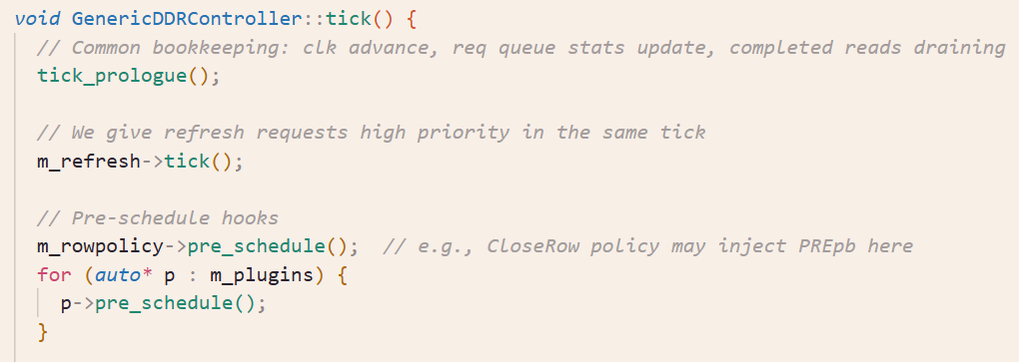
Simulator Architecture (IV)
Inside the Scheduler

Slide 13
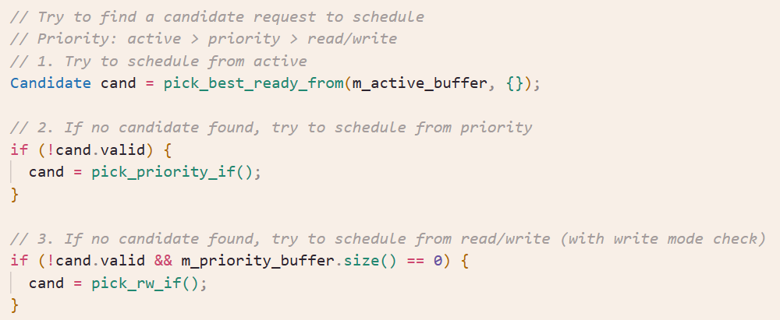
Simulator Architecture (IV)
Inside the Scheduler

Slide 14
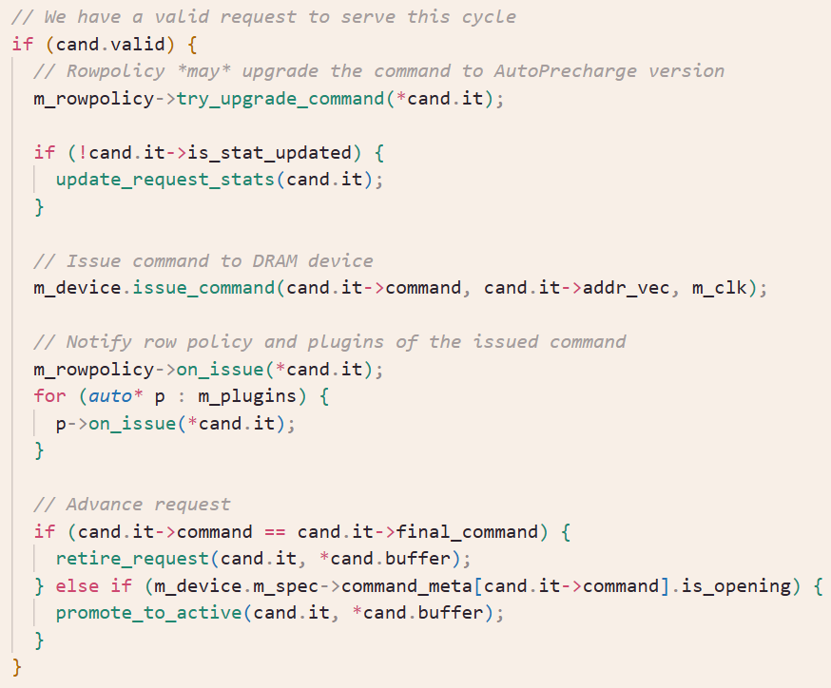
Simulator Architecture (IV)
Inside the Scheduler

Slide 15
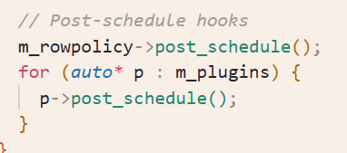
Simulator Architecture (IV)
Inside the Scheduler

Slide 16
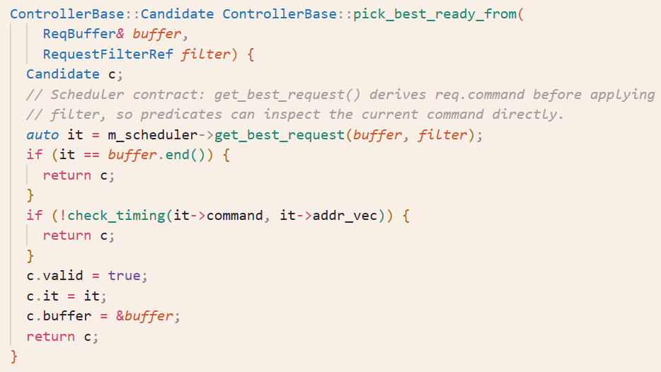
Simulator Architecture (IV)
Inside the Scheduler

Slide 17
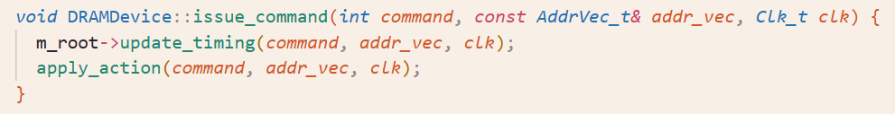
Simulator Architecture (IV)
Inside issue_command()
Recursively walks the tree hierarchy of DRAM nodes
Update timings along the way
Update the earliest ready cycle of following commands based on timing constraints
Apply the action that the issued command has on involved nodes
Node state changes

Slide 18
Hands On Material

Slide 19
Contribute to Ramulator 2.1 (II)
Example directions of contributions
Better timing presets of DRAM standards
Some of the DRAM timings are our best effort “guesstimates”
We welcome your more accurate set of timings w/o breaking NDA
More DRAM request scheduling techniques
More DRAM read disturbance mitigation techniques
Make use of controller plugins and scheduler filters
More intelligent scheduling of refresh
Refresh postponing & pull-in
Dynamic choice of REFab/sb/pb
PUD/PNM modeling
More integration with other simulators
Please open an Issue/Discussion first to coordinate with potential internal development!

Slide 20
Acknowledgements
Contributors (growing)
Haocong Luo
Nisa Bostancı
Ataberk Olgun
Maria Makeenkova
Ziad Malik
Ipek Akdeniz
Kislay Arya
Roman Hoffmann
Wonhyuk Yang
@jiegec
Julien Eudine
Sangjae Park
…
Join the list!

