Slide 1
Ramulator: A Brief Introduction
Nisa Bostancı 27.06.2026 R&DB Tutorial at ISCA’26

Slide 2
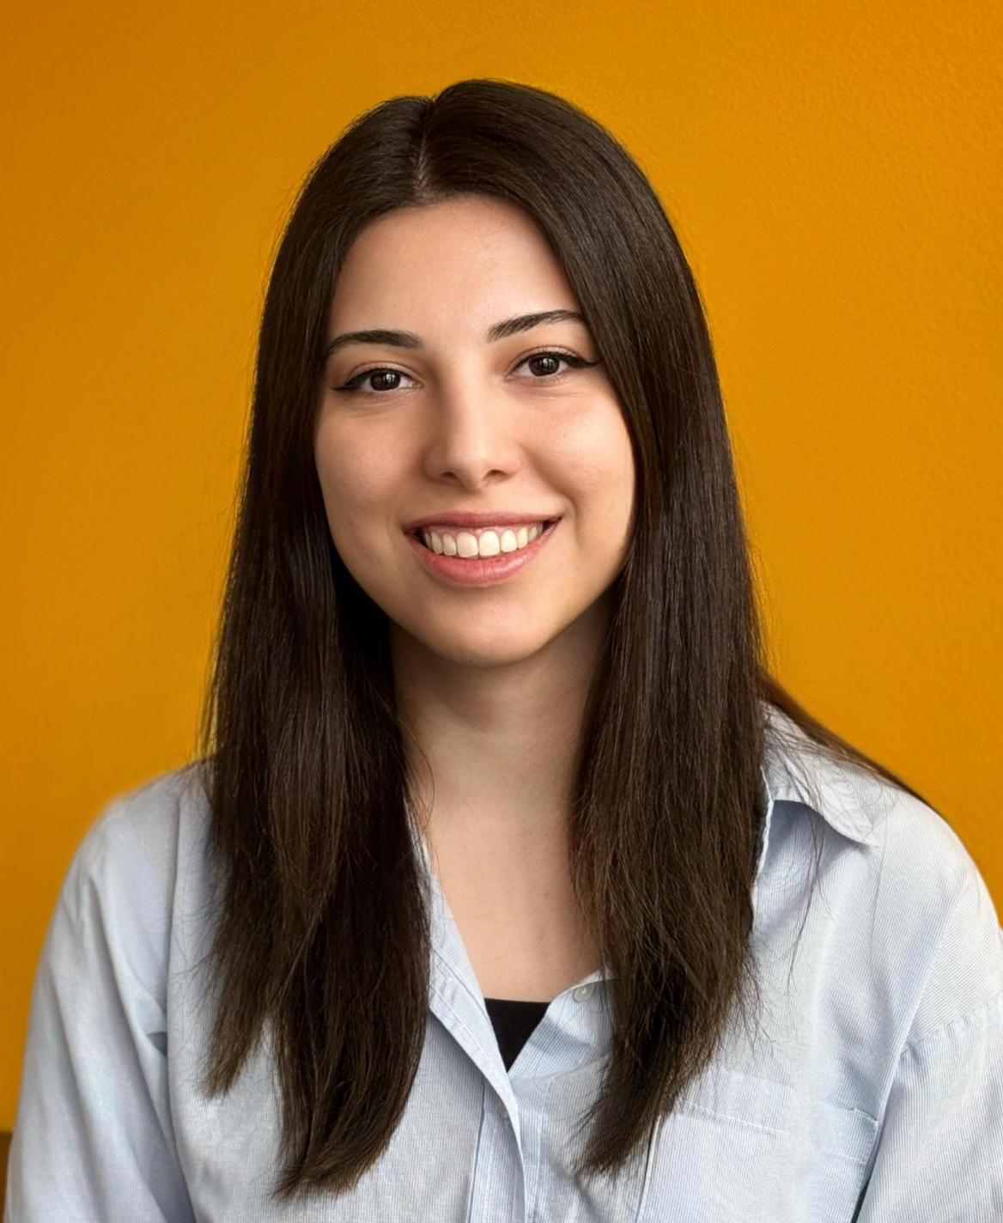
Brief Self Introduction
F. Nisa Bostanci
Researcher @ SAFARI Research Group since September 2018
PhD @ ETH Zurich (November 2022 – ongoing)
nisa.bostanci@safari.ethz.ch
https://nisabostanci.github.io/
Looking for internships for Summer-Fall 2026
Research interests:
Computer architecture
Memory system performance and robustness
Hardware security, safety, reliability, performance, availability, fairness, energy efficiency
Processing-in-memory architectures
Hardware/software cooperation
…

Slide 3
Ramulator A Fast and Extensible DRAM Simulator [IEEE Computer Architecture Letters’15]

Slide 4
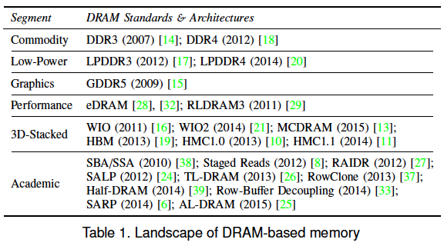
Motivation
DRAM and Memory Controller landscape is changing
Many new and upcoming standards
Many new controller designs
A fast and easy-to-extend simulator is very much needed

Slide 5
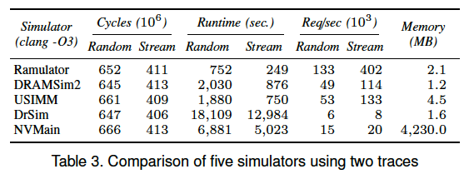
Ramulator: A Fast and Extensible DRAM Simulator
Modular and extensible to different standards
Provides out-of-the box support for many DRAM standards:
DDR3/4, LPDDR3/4, GDDR5, WIO1/2, HBM, PCM, STT-RAM
new proposals (SALP, AL-DRAM, TLDRAM, RowClone, and SARP)
~2.5X faster than fastest open-source simulator
Notes:
To address this need,
Ramulator was developed. Ramulator is a A Fast and Extensible Memory simulator.
which provides out-of-the-box support for many DRAM standards

Slide 6
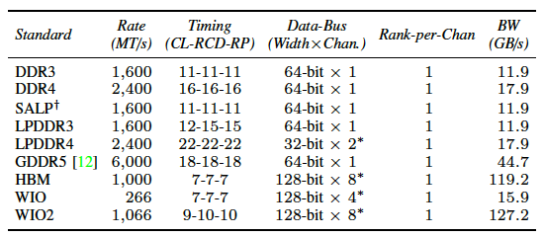
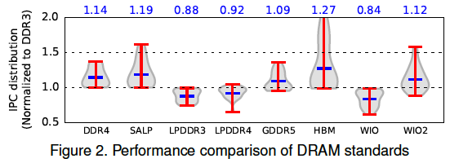
Case Study: Comparison of DRAM Standards
Across 22 workloads, simple CPU model

Slide 7
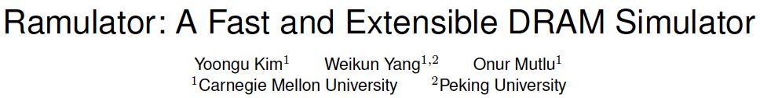
Ramulator Paper and Source Code
Yoongu Kim, Weikun Yang, and Onur Mutlu, "Ramulator: A Fast and Extensible DRAM Simulator" IEEE Computer Architecture Letters (CAL), March 2015. [Source Code]
Source code is released under the liberal MIT License
https://github.com/CMU-SAFARI/ramulator

Slide 8
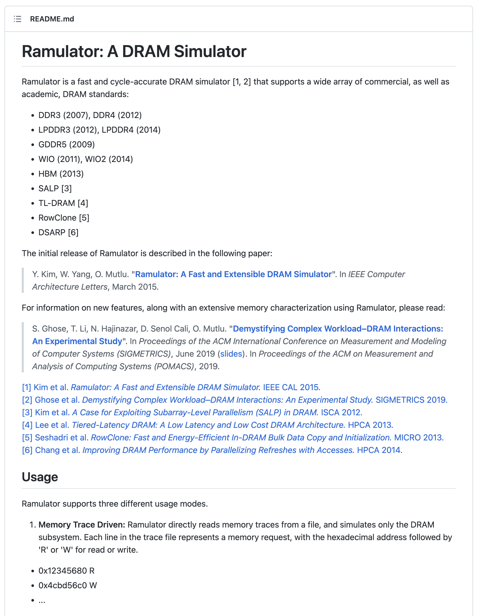
Ramulator: Free & Open Source
https://github.com/CMU-SAFARI/ramulator

Slide 9
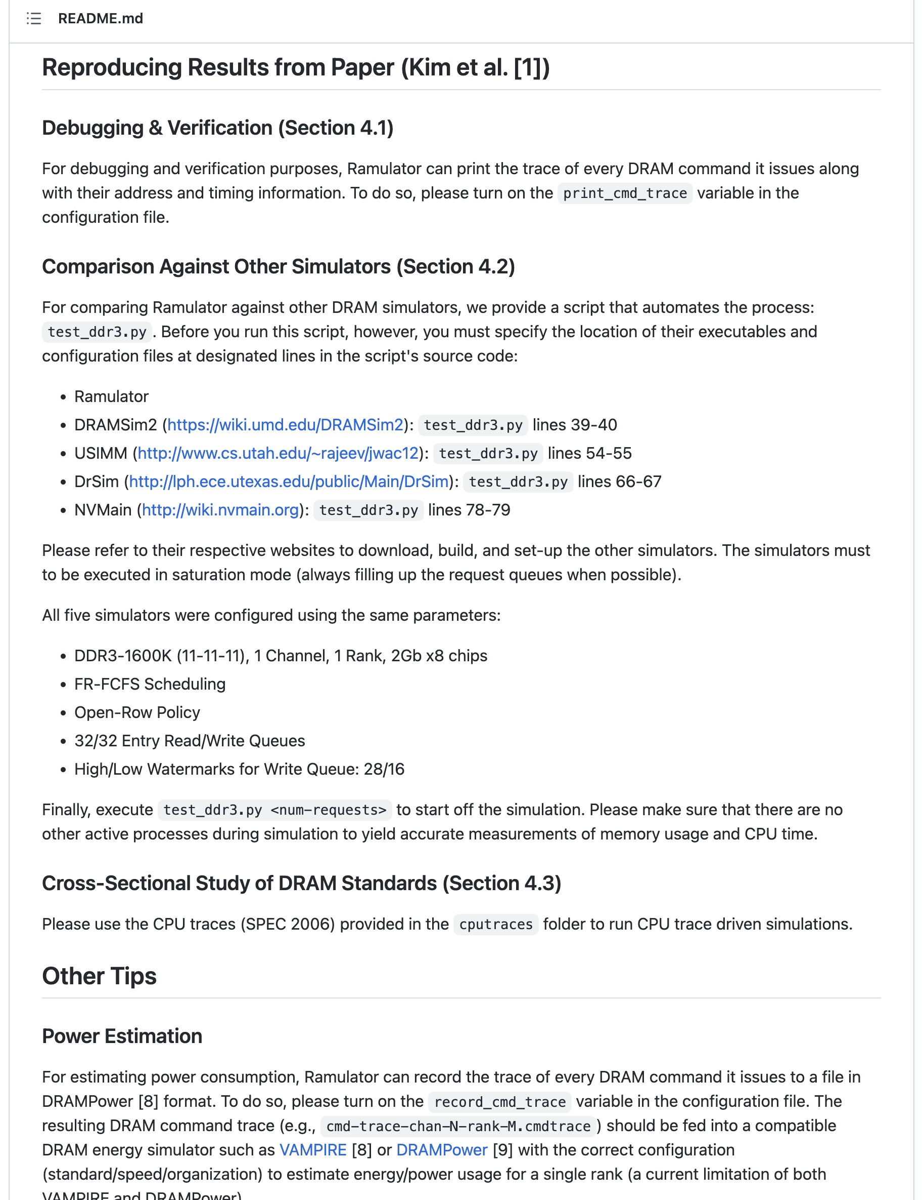
Ramulator: Reproducibility
https://github.com/CMU-SAFARI/ramulator

Slide 10
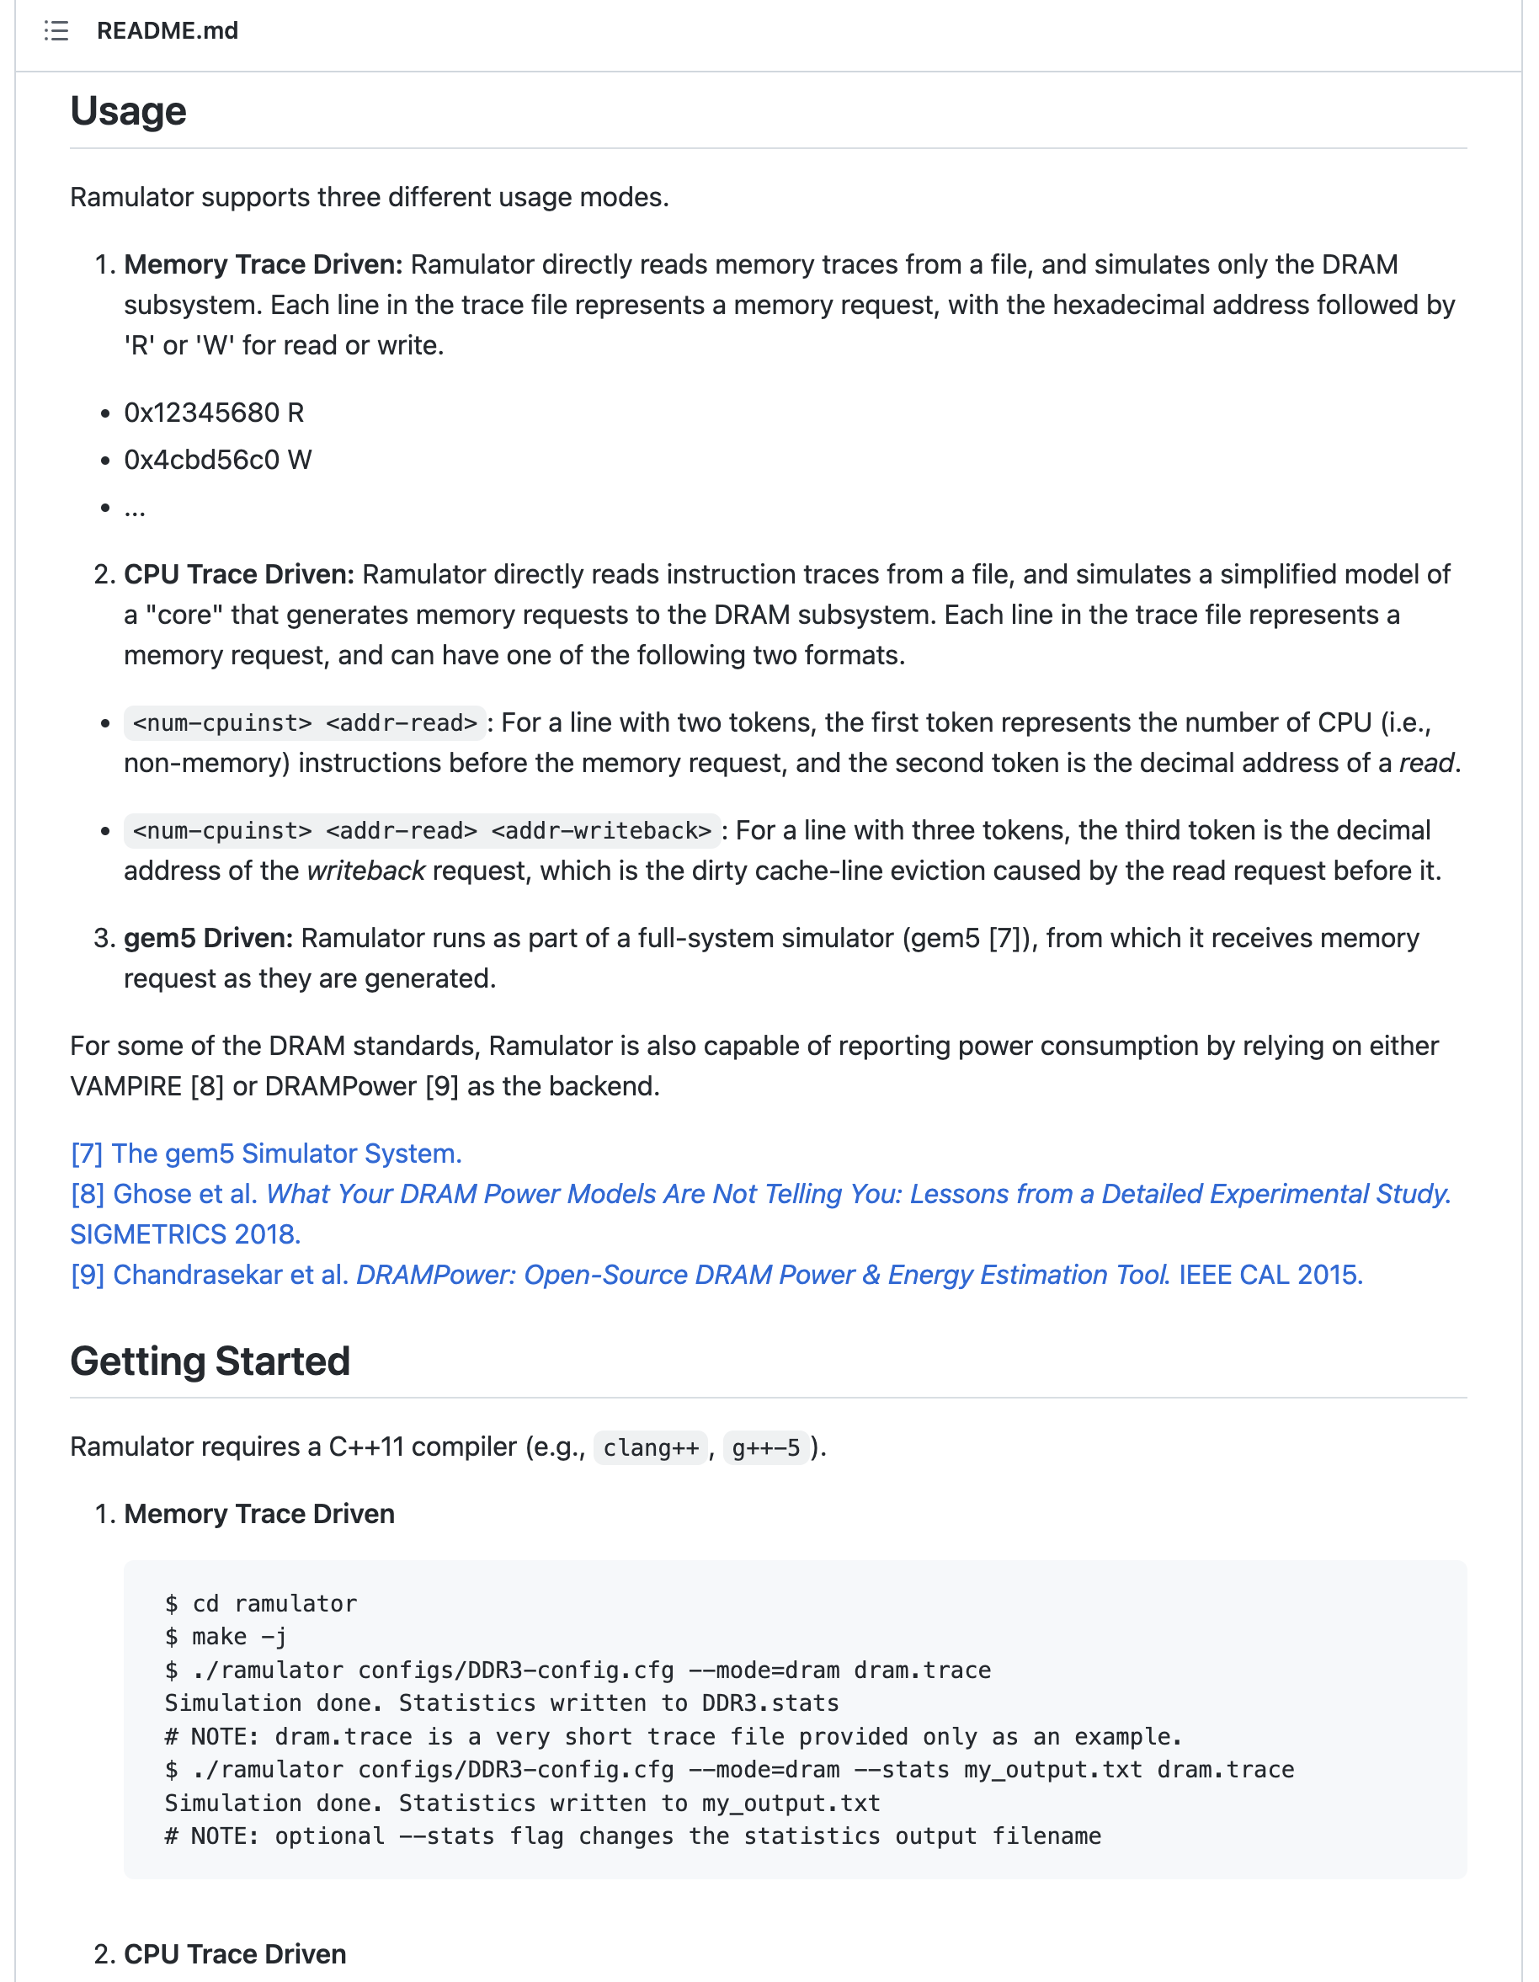
Ramulator: Integration with Other Simulators
https://github.com/CMU-SAFARI/ramulator

Slide 11
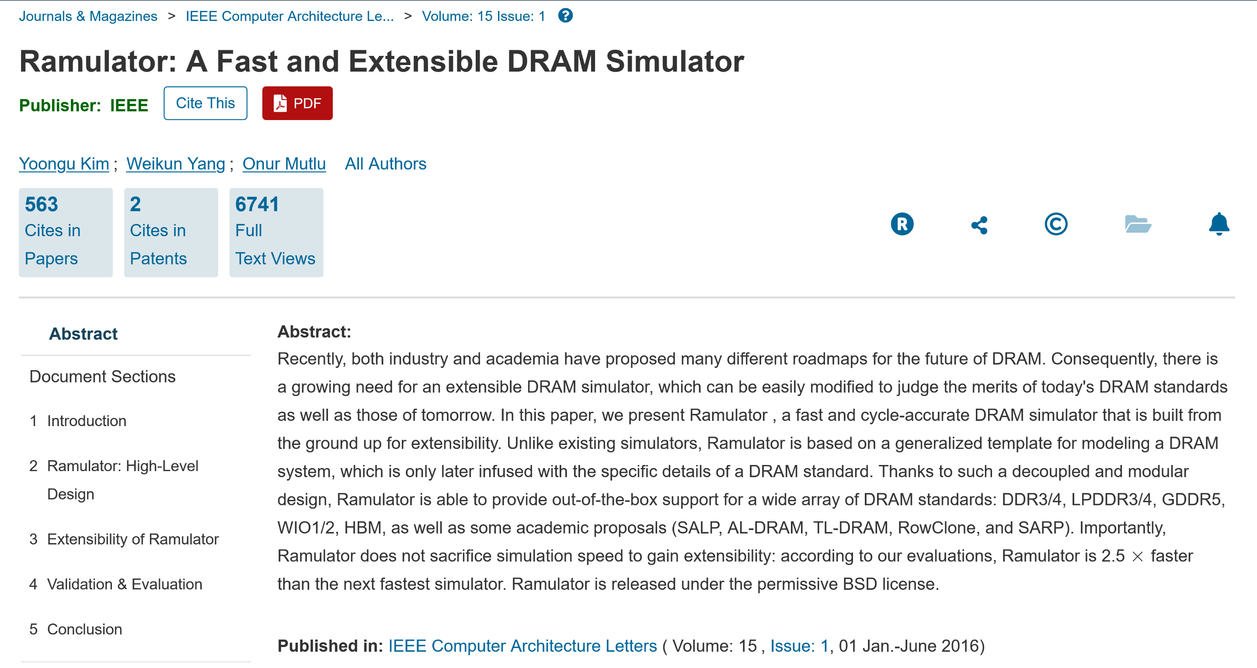
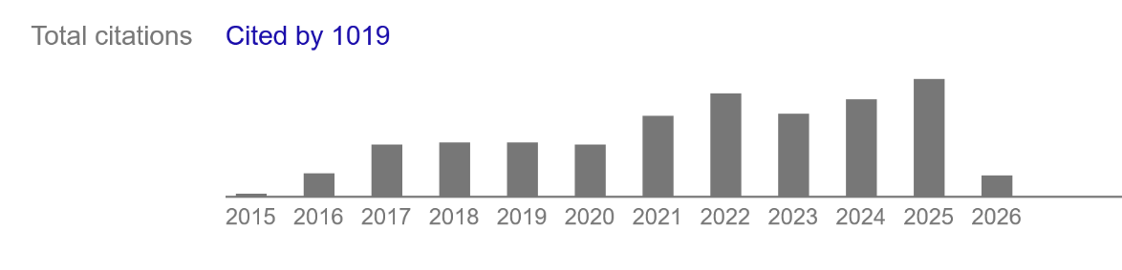
Ramulator Enabled Many Works

Slide 12
Ramulator 2.0 A Modern, Modular, and Extensible DRAM Simulator [IEEE Computer Architecture Letters’24]

Slide 13
Motivation
DRAM and Memory Controller landscape is changing
Robustness issues in DRAM
Data retention
Read disturbance (RowHammer, RowPress, ColumnDisturb etc.)
…
Performance issues in main memory system
Processing-in-Memory architectures
Emerging memory technologies
Performance overhead analysis of read disturbance mitigation techniques
…
DRAM simulation infrastructures are needed to understand, characterize, and evaluate the robustness and performance of DRAM

Slide 14
Executive Summary
Ramulator 2.0: Modern, modular, and extensible DRAM & memory system simulator
Models a wide range of DRAM standards and memory controller functionalities
Modular and extensible software architecture
Fine-grained modeling of DRAM operation (cycle-level)
Used in a wide range of research works

Slide 15
Ramulator 2.0 Design and Features

Slide 16
Key Design Concepts
Modular and extensible software architecture
All components in the memory system are modeled with two main concepts:
Interface
Implementation
SimpleO3
Generic DRAM Controller
send request
Frontend
Memory Controller
receive request call back
Notes:
An interface is an abstract C++ class defined in a .h
header file that models the common high-level functionality
of a component as seen by other components in the system.
An implementation is a concrete C++ class defined in a
.cpp file that inherits from an interface, modeling the actual
behavior of a component. Components interact with each
other through pointers to each other’s interfaces stored in
the implementations

Slide 17
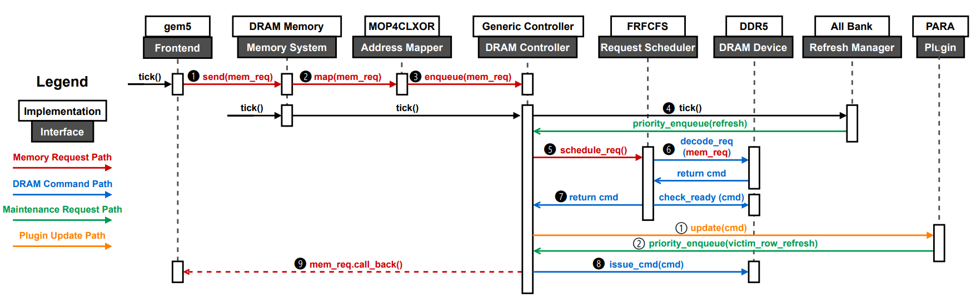
Key Design Concepts (II)
Example: The memory controller include:
Address Mapper, Request Scheduler, Refresh Manager, Row Policy, etc.
Each component can be flexibly changed without hardcoding other parts

Slide 18
Memory Controller Plugins
Observation: Many memory controller functions and utilities are triggered and updated by the currently scheduled command
validation, access pattern profiling, RowHammer mitigations, …

Slide 19
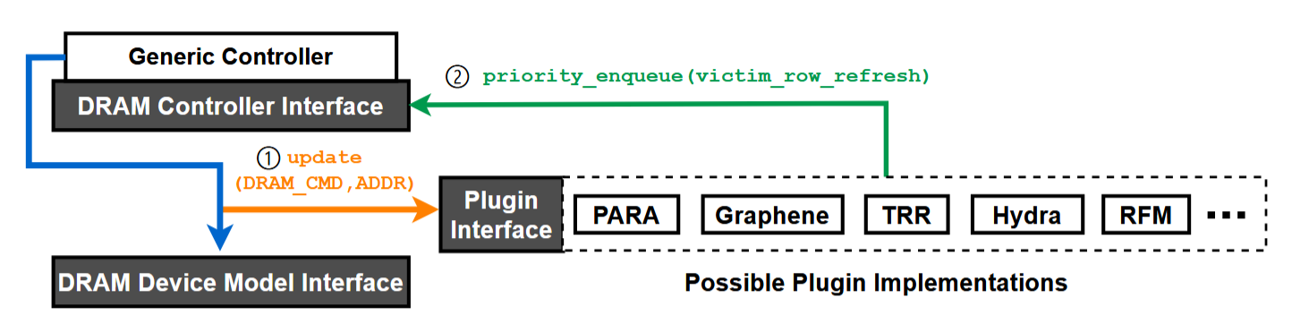
Memory Controller Plugins (II)
Memory controller updates the memory controller plugins when a new DRAM command is issued
A plugin implements design-specific tracking methods or probabilistic schemes to perform preventive actions
Enqueue victim refresh operations, trigger aggressor migration, etc.

Slide 20
Hierarchical DRAM Modeling
DRAM device interface supports implementations of many memory standards:
DDR3/4/5, LDDR5, HBM1/2/3

Slide 21
Hierarchical DRAM Modeling (II)
Hierarchical state-machine based modeling of DRAM
State of a DRAM node:
Current state: open, close, activating, etc.
Timing constraints: Earliest time in the future that each DRAM command is allowed to be issued
Energy & power: Time spent in each state and the number of DRAM commands served (DRAMPower model)
Can be extended to include more
Level: “Channel”
Id: 0
State: …
Parent
Level: “Rank”
Id: 0
State: …
Sibling
Level: “Rank”
Id: 1
State: …
Children
Level: “BankGroup”
Id: 0
State: …
Level: “BankGroup”
Id: 1
State: …

Slide 22
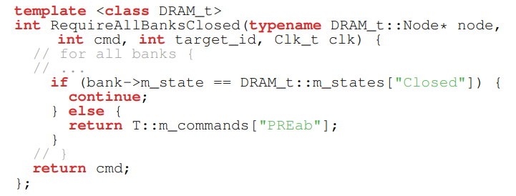
Hierarchical DRAM Modeling (III)
DRAM commands implemented as lambda functions that hierarchically traverses and updates the states of the nodes
Checks the current states of the nodes to decode which DRAM command to issue
Programmatically apply state changes
Updates the timing constraints, power metrics, etc.
Templated library of generalized DRAM command lambda functions allow reuse of command implementations across different DRAM standards
Applicable to:
DDR3, DDR4, DDR5
LPDDR4, LPDDR5
HBM (1/2/3), GDDR6
Example Function

Slide 23
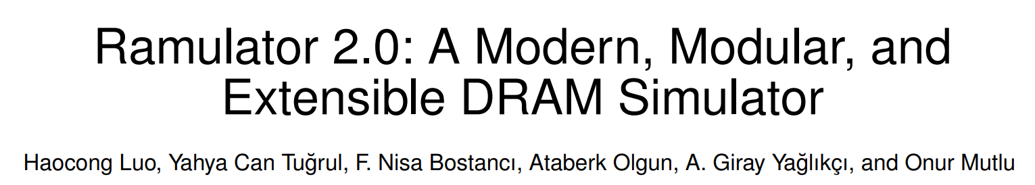


More in the Paper
More in the paper
More detailed explanation of modeling methodology
Modeling new DRAM specifications (organization, timings, etc.)
Adding memory controller plugins & RowHammer mitigations
Performance comparison with other DRAM simulators
IEEE CAL Paper
Open-source version Github repo: CMU-SAFARI/ramulator2

Slide 24
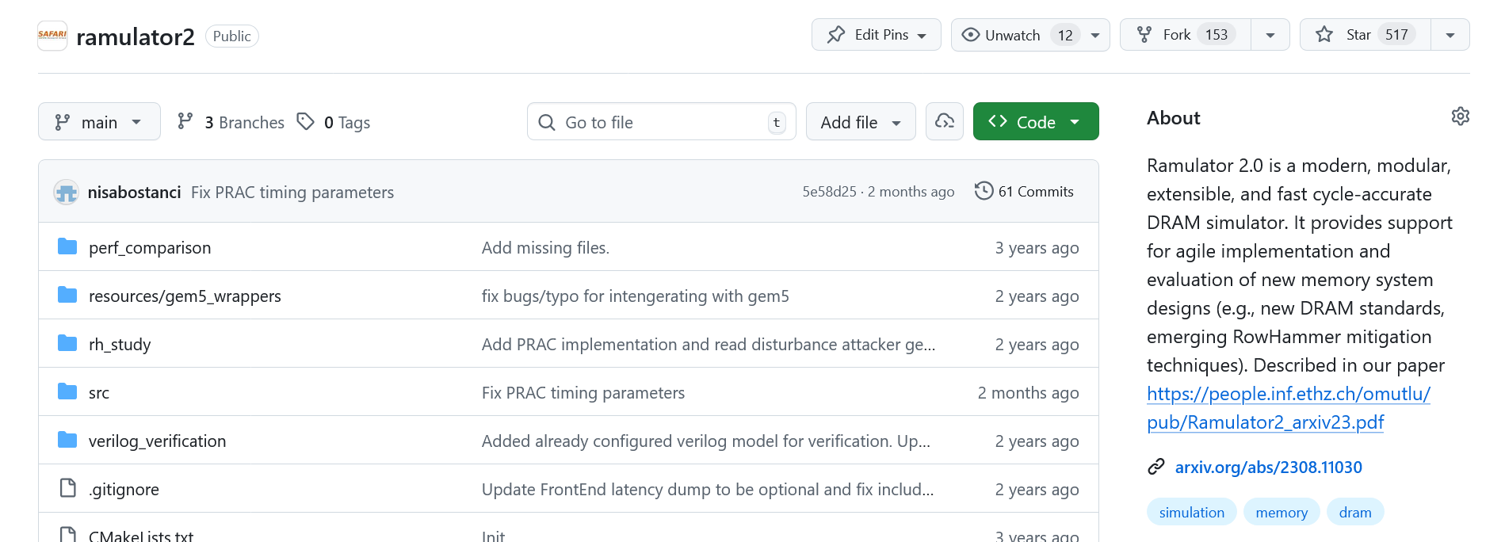
Ramulator 2.0 is Open Sourced
More detailed user guide and documentation available:
https://github.com/CMU-SAFARI/ramulator2

Slide 25
Ramulator 2.0 Validation

Slide 26
Timing Validation
Ramulator 2.0's DRAM command traces are validated against Micron's DDR4 Verilog model [1]
Across streaming- and random-access patterns with varying memory intensities
We find no timing or state transition violations
[1] Micron Technology, “Micron DDR4 Verilog Model,” 2018.

Slide 27
Further Evaluation of Latency and Throughput
"A Mess of Memory System Benchmarking, Simulation and Application Profiling", MICRO'24
A best paper runner-up with all 3 artifact badges (including "Reproducible")
Proposes a new benchmark to evaluate the real and simulated memory system performance
Makes strong negative claims about two of our simulation infrastructures, Ramulator 2.0 and DAMOV, and shows unexpected results
Contending that they "poorly resemble the actual system performance"
Notes:
A MICRO 2024 best paper runner-up publication with all 3 artifact badges, titled "A Mess of Memory System Benchmarking, Simulation and Application Profiling", which we call the Mess paper,
[CLICK] proposes a new benchmark to evaluate the real and simulated memory system performance
[CLICK] while doing so, it also makes some strong negative claims about two of our simulation infrastructures: Ramulator 2.0 and DAMOV and shows unexpected results
[CLICK] concluding that they poorly resemble the actual system performance

Slide 28
Cleaning up the Mess (ISPASS 2026)
We demonstrate that these claims and results are incorrect and are due to configuration and simulator usage errors made in the Mess paper
We describe four best practices to aid users and developers of simulation tools
To facilitate transparency and reproducibility, we open source all our code and results: https://github.com/CMU-SAFARI/Cleaning-up-the-Mess
Notes:
[CLICK] In this work, we demonstrate that these claims and results are incorrect and are due to configuration and simulator usage errors
Made in the Mess paper. We describe four best practices to aid users and developers of simulation tools
To facilitate transparency and reproducibility, we open source all our code and results: https://github.com/CMU-SAFARI/Cleaning-up-the-Mess

Slide 29
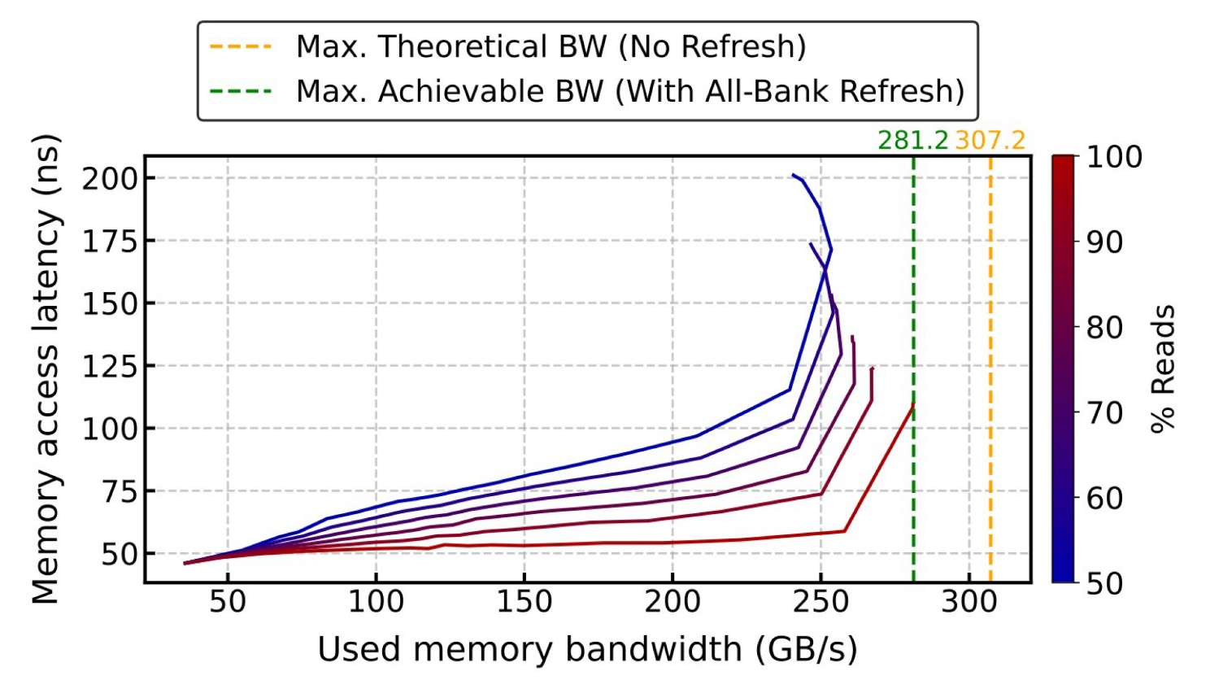
Our Key Results
When correctly configured, Ramulator 2.0’s simulated memory system performance resembles real system characteristics
https://github.com/CMU-SAFARI/ramulator2/tree/mess
Notes:
We conclude that
When correcty configured,
Ramulator 2.0's simulated memory system performance
Resembles real system characteristics

Slide 30
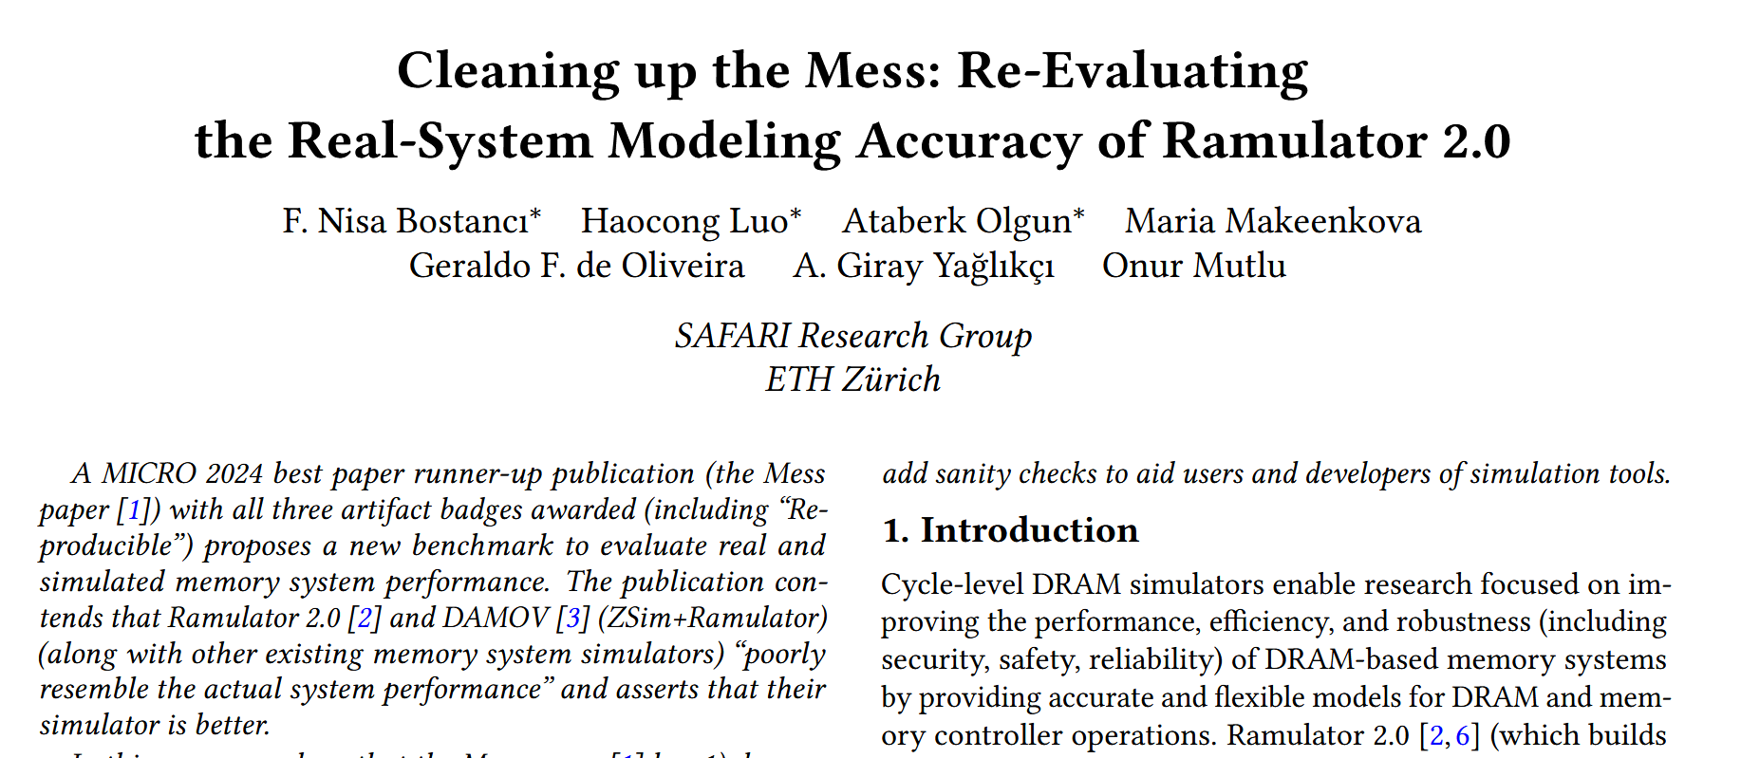
More in the next sessions
* Equal contribution
https://arxiv.org/pdf/2510.15744
Notes:
There are even more details and analyses in the extended version of our paper on arxiv which you can access it with this link

Slide 31
Ramulator 2.0 Integration with Other Simulators

Slide 32
Ramulator 2.0 Integration
Modular and extensible software architecture
Ramulator 2.0 can be packed into a library
ChampSim
SimpleO3
gem5
DRAM-Based System
Frontend
Memory System
libramulator.so
Easy integration into other simulators to support detailed memory system simulation
Notes:
An interface is an abstract C++ class defined in a .h
header file that models the common high-level functionality
of a component as seen by other components in the system.
An implementation is a concrete C++ class defined in a
.cpp file that inherits from an interface, modeling the actual
behavior of a component. Components interact with each
other through pointers to each other’s interfaces stored in
the implementations

Slide 33
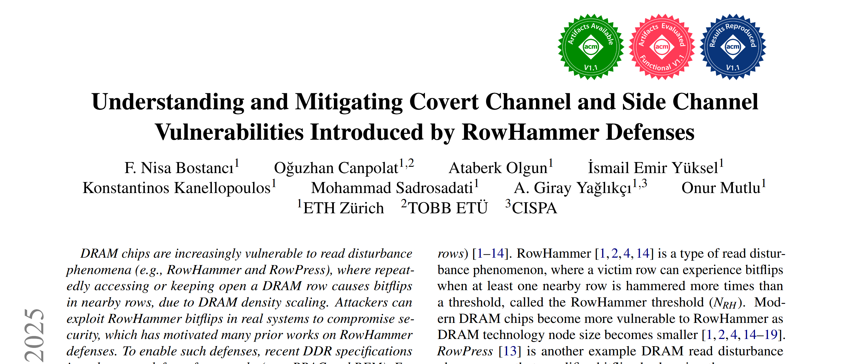
Integration with gem5
Combine a more detailed core model with Ramulator 2.0's detailed memory system simulation
MICRO 2025
https://arxiv.org/pdf/2503.17891 https://github.com/CMU-SAFARI/LeakyHammer

Slide 34
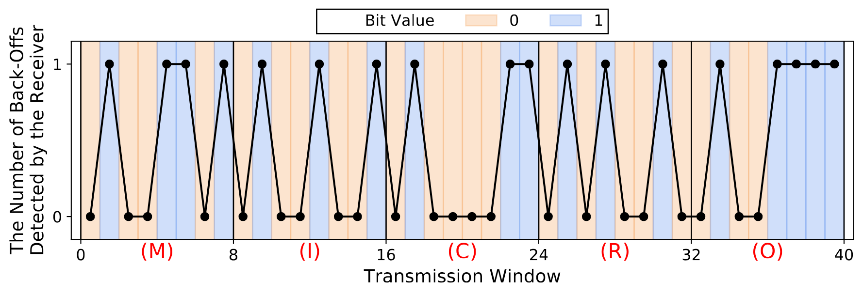
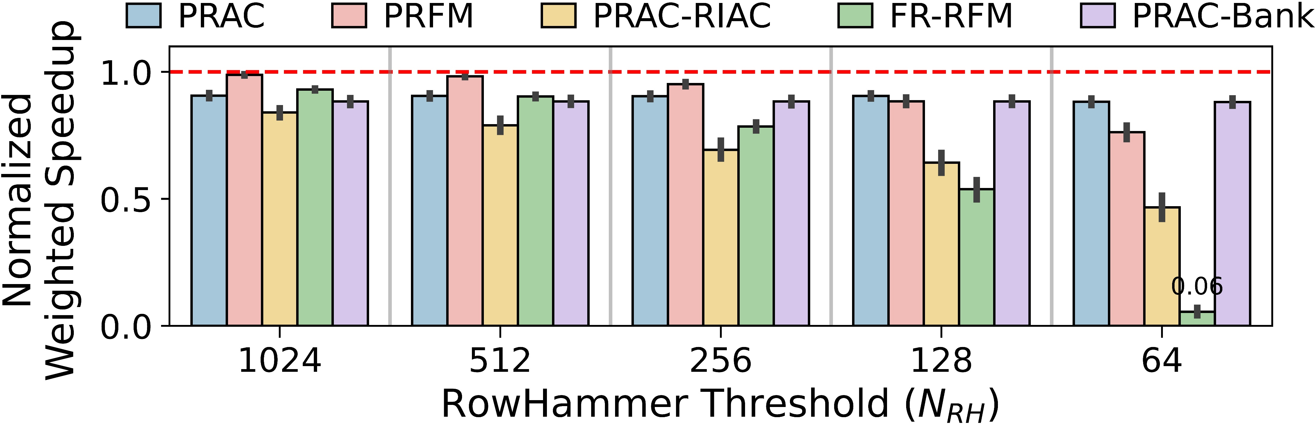
Integration with gem5 (II)
LeakyHammer: Timing Covert and Side Channels Introduced by RowHammer Defenses [Bostanci+, MICRO’25]
Integrating Ramulator2 with gem5
Demonstrating side and covert channels leveraging two latest industry solutions to RowHammer (i.e., PRAC and RFM)
Evaluating defenses against LeakyHammer

Slide 35
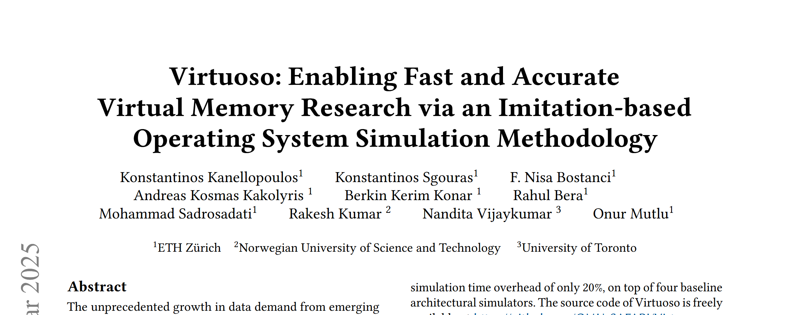
Integration with Virtuoso
Enable simulation of virtual memory functionalities
ASPLOS 2025
https://arxiv.org/pdf/2403.04635
https://github.com/CMU-SAFARI/Virtuoso

Slide 36
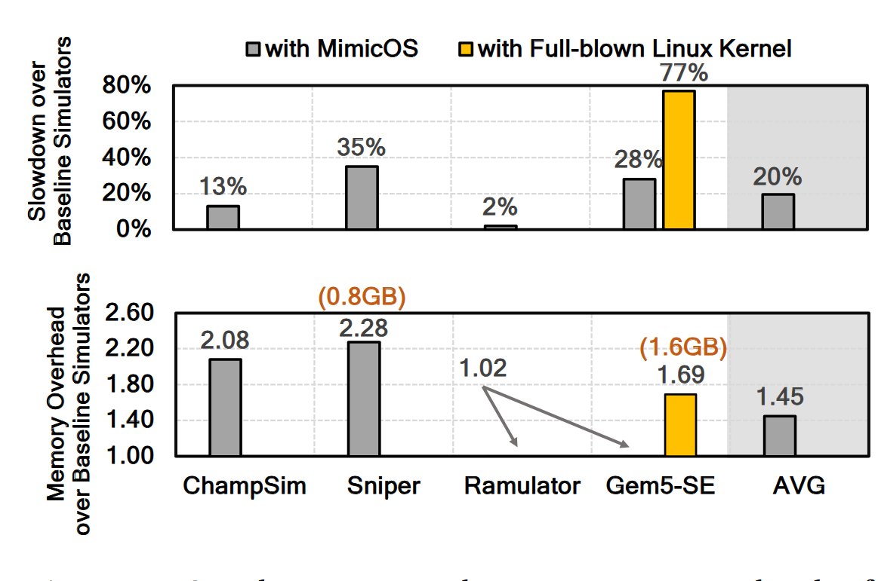
Ramulator 2.0: Integration with Virtuoso (I)
Integration with Virtuoso: A Fast and Accurate Virtual Memory Simulation Framework [Kanellopoulos, ASPLOS'25]
Enabling fast and accurate evaluation of the hardware and software components of the virtual memory subsystem with low simulation time and memory overheads

Slide 37
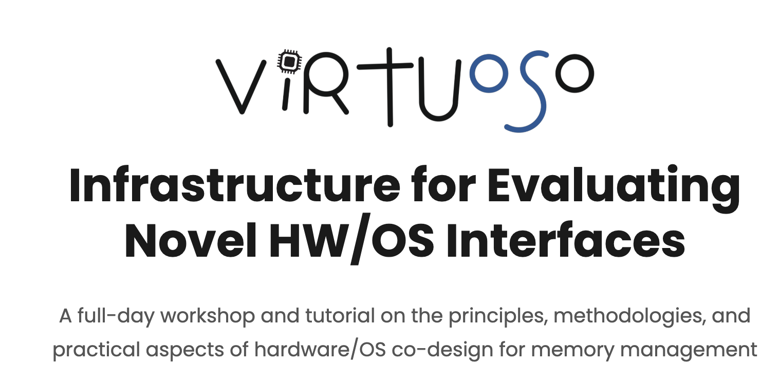
1st Workshop on Virtuoso at MICRO 2025
https://cmu-safari.github.io/Virtuoso-Workshop-MICRO25/

Slide 38
Workflow: Page Fault Handling Example
Example Userspace Kernel
1
Page Fault Handler
6
Workload
2
Binary Instrumentation
Memory
Access
7
Page Fault
5
3
MMU
Model
Core
Model
Translation Request
4
8
Intermediate Trace Creation
Ramulator

Slide 39

Ramulator 2.0
Use case:
Enabling Swap Space Studies

Slide 40
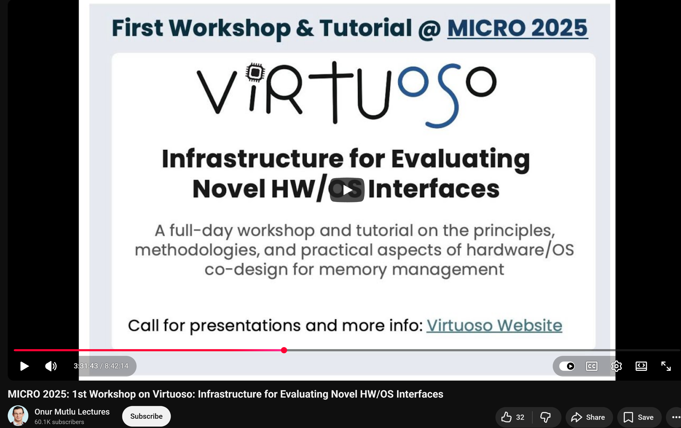
Follow the Tutorial
Virtuoso+Ramulator: 8:10:00 – 8:42:00

Slide 41

Virtuoso Workshop at ASPLOS'26

Slide 42
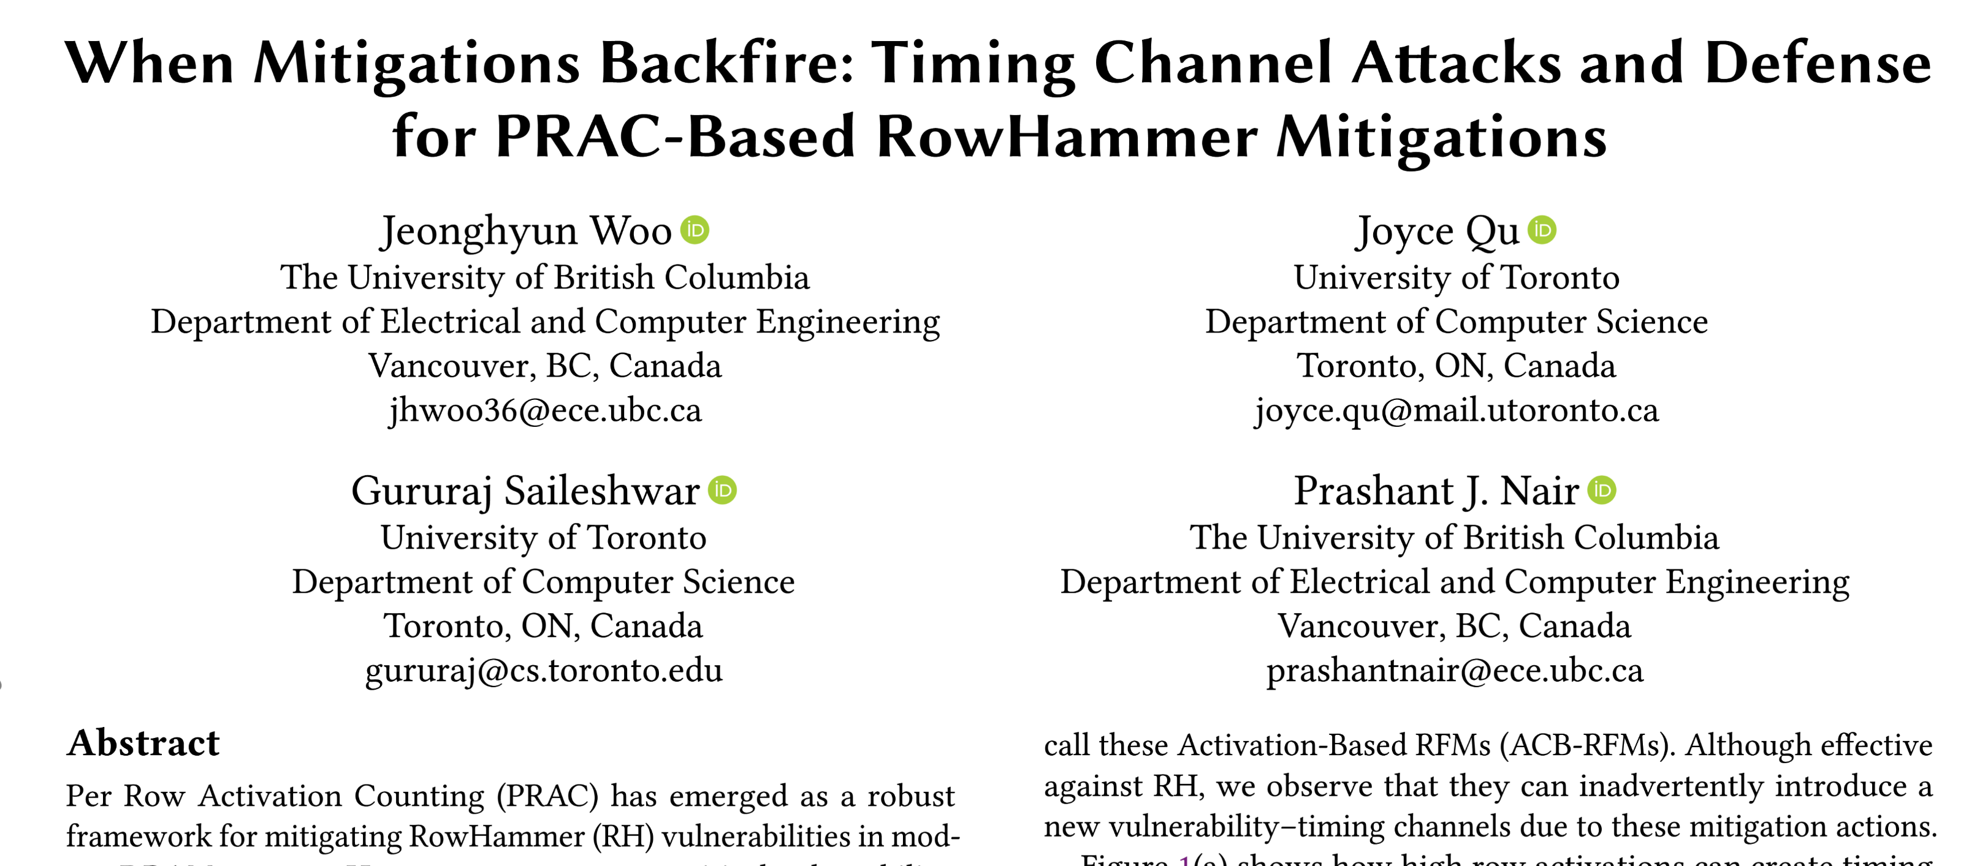
More Integrations from the Community
Integration with ChampSim (as the core model)
ISCA 2025
https://arxiv.org/pdf/2505.10111

Slide 43
Ramulator 2.0 Impact, Future Work and Conclusion

Slide 44
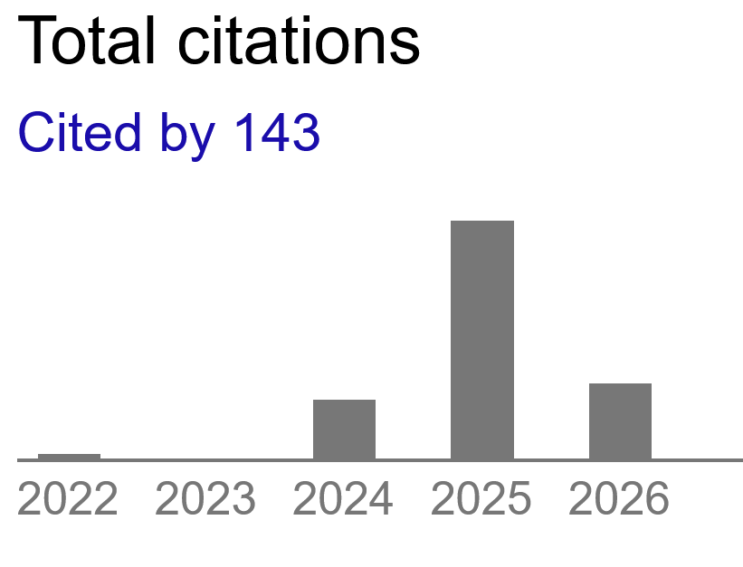
Ramulator 2.0 Already Enabled Many Works
Nam, Hwayong, et al., "RoMe: Row Granularity Access Memory System for Large Language Models", HPCA 2026.
Yuksel, Ismail, et al. "PuDHammer: Experimental Analysis of Read Disturbance Effects of Processing-using-DRAM in Real DRAM Chips" ISCA 2025.
Li, Cong, et al. "H2-LLM: Hardware-Dataflow Co-Exploration for Heterogeneous Hybrid-Bonding-based Low-Batch LLM Inference." ISCA 2025.
Canpolat, Oğuzhan, et al. "Chronus: Understanding and securing the cutting-edge industry solutions to dram read disturbance." HPCA 2025.
Olgun, Ataberk, et al. "Variable Read Disturbance: An Experimental Analysis of Temporal Variation in DRAM Read Disturbance." HPCA 2025.
Woo, Jeonghyun, et al. "QPRAC: Towards Secure and Practical PRAC-based RowHammer Mitigation using Priority Queues." HPCA 2025.
Woo, Jeonghyun, and Prashant J. Nair. "DAPPER: A Performance-Attack-Resilient Tracker for RowHammer Defense." HPCA 2025.
Wang, Cheng, and Mingyu Gao. "UniZK: Accelerating Zero-Knowledge Proof with Unified Hardware and Flexible Kernel Mapping." ASPLOS 2025.
Yun, Sungmin, et al. "Duplex: A Device for Large Language Models with Mixture of Experts, Grouped Query Attention, and Continuous Batching." MICRO 2024.
Lee, Seung Yul, et al. "VGA: Hardware Accelerator for Scalable Long Sequence Model Inference." MICRO 2024.
Zhao, Yilong, et al. "UM-PIM: DRAM-based PIM with Uniform & Shared Memory Space." ISCA 2024.
Li, Jinhao, et al. "MARCA: Mamba Accelerator with Reconfigurable Architecture." ICCAD 2024.
And many more other works…

Slide 45
What's next for Ramulator 2.0?
We have been working on:
Unit & regression test coverage
Verifying the timing constraints for all DRAM standards
More detailed memory controller modelling
HBM Controllers
More DRAM standards and emerging technologies
GDDR6, HBM4
Better tools for debugging
Some of these changes are happening soon…

Slide 46
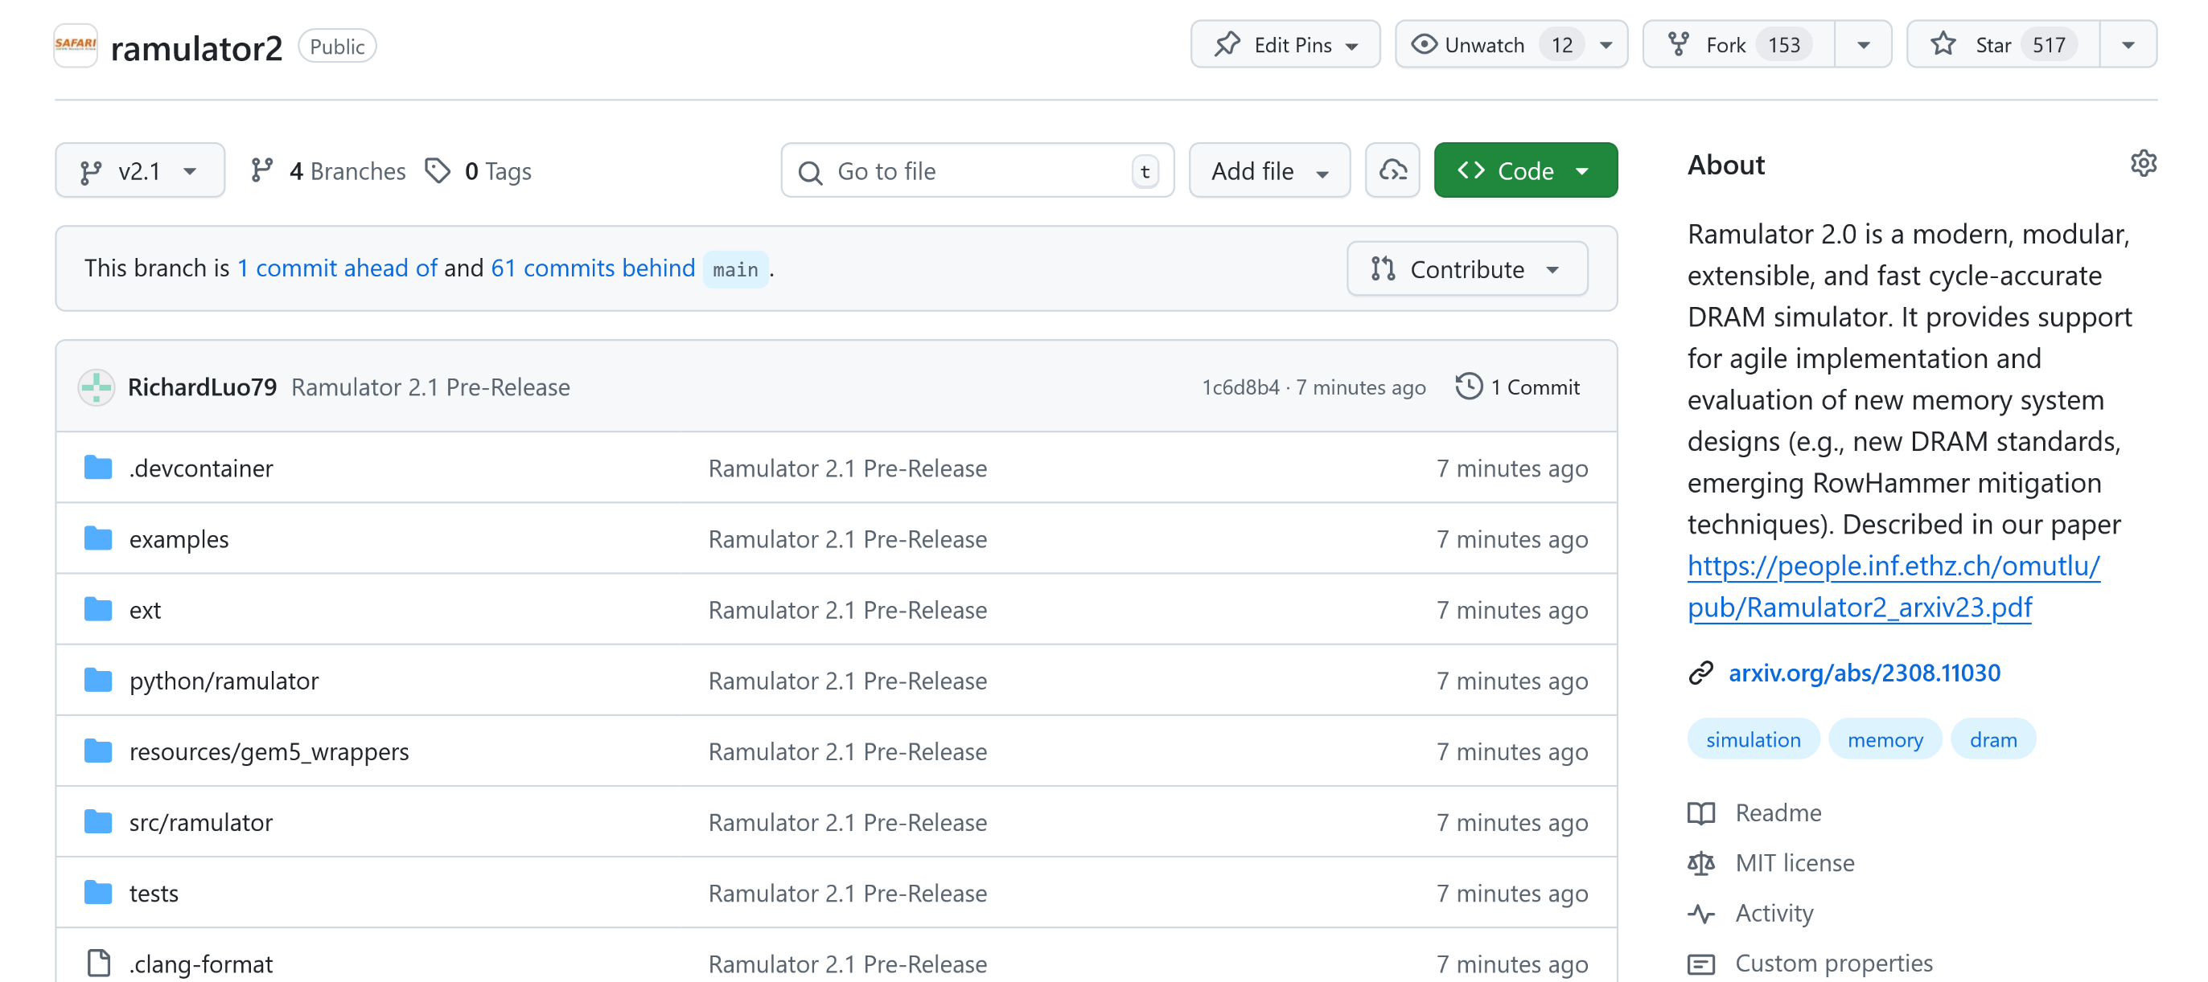
Introducing Ramulator 2.1
🎉 Ramulator 2.1 is now online!
https://github.com/CMU-SAFARI/ramulator2/tree/v2.1

Slide 47
Ramulator 2.1
Ramulator 2.1 is a major overhaul of Ramulator 2.0 that
Fixes almost all bugs identified by current Github issues and internal testing
More comprehensive support for new DRAM & controller features
More comprehensive set of tests and validations
Significantly improved the ease of use, configuration, and extension
Overall code quality improvements
Much more detailed documentation and usage guide

Slide 48
Call for Contributions
Integration with other simulators
ChampSim, Sniper, your favourite system simulator
More DRAM standards and emerging memory technologies
More DRAM timing presets
Aligning our generic memory controller models to your hardware designs
…
Further contributions are also welcome and we would be happy to help with and support all

Slide 49
Conclusion & Future Work
We are happy to support and help anyone who wants to use it
Paper
GitHub

Slide 50
Ramulator: A Brief Introduction
Nisa Bostancı 22.03.2026 R&DB Tutorial at ASPLOS'26

