Slide 1
Ramulator: Research Highlights
Nisa Bostancı 27.06.2026 R&DB Tutorial at ISCA’26

Slide 2



Cleaning up the Mess Re-Evaluating the Real-System Modeling Accuracy of Ramulator 2.0
F. Nisa Bostancı* Haocong Luo* Ataberk Olgun* Maria Makeenkova Geraldo F. de Oliveira A. Giray Yağlıkçı Onur Mutlu * Equal Contribution
Notes:
Hi everyone, I am Nisa and
Today Haocong and I are going to present our work called
Cleaning up the Mess
Re-Evaluating the Real-System Modeling Accuracy of Ramulator 2.0

Slide 3
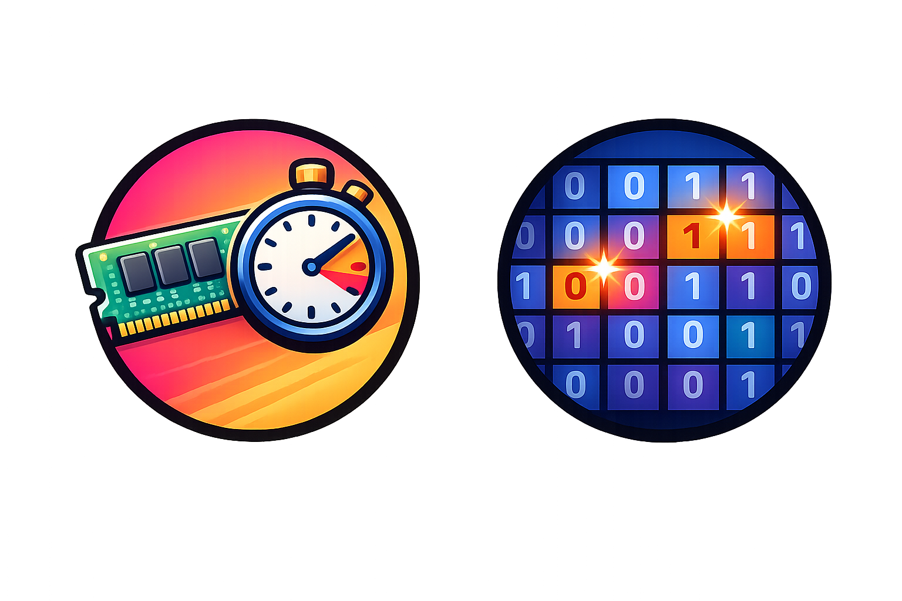

DRAM and Memory System Simulation
Cycle-level DRAM simulators provide accurate and flexible models for DRAM and memory controller operations
Enable research on current and future memory systems
Critical for improving the performance, efficiency, and robustness (security, safety, reliability) of memory systems
DRAM performance and latency
Solutions for robustness issues
Emerging architectures
Notes:
Cycle-level DRAM simulators provide accurate and flexible models for DRAM and memory controller operations
And doing so, they enable research on current and future memory systems in various areas
Such as improving DRAM latency, developing solutions for robustness issues such as retention and read disturbance
And evaluating various systems like emerging processing-in-memory architectures
Therefore, these simulators are critical for improving the performance, efficiency and robustness of memory systems

Slide 4
Mess: A MICRO'24 Best Paper Runner-Up
"A Mess of Memory System Benchmarking, Simulation and Application Profiling", MICRO'24
A best paper runner-up with all 3 artifact badges (including "Reproducible")
Proposes a new benchmark to evaluate the real and simulated memory system performance
Makes strong negative claims about two of our simulation infrastructures, Ramulator 2.0 and DAMOV, and shows unexpected results
Contending that they "poorly resemble the actual system performance"
Notes:
A MICRO 2024 best paper runner-up publication with all 3 artifact badges, titled "A Mess of Memory System Benchmarking, Simulation and Application Profiling", which we call the Mess paper,
[CLICK] proposes a new benchmark to evaluate the real and simulated memory system performance
[CLICK] while doing so, it also makes some strong negative claims about two of our simulation infrastructures: Ramulator 2.0 and DAMOV and shows unexpected results
[CLICK] concluding that they poorly resemble the actual system performance

Slide 5
Cleaning up the Mess
We demonstrate that these claims and results are incorrect and are due to configuration and simulator usage errors made in the Mess paper
We describe four best practices to aid users and developers of simulation tools
To facilitate transparency and reproducibility, we open source all our code and results: https://github.com/CMU-SAFARI/Cleaning-up-the-Mess
Notes:
[CLICK] In this work, we demonstrate that these claims and results are incorrect and are due to configuration and simulator usage errors
Made in the Mess paper. We describe four best practices to aid users and developers of simulation tools
To facilitate transparency and reproducibility, we open source all our code and results: https://github.com/CMU-SAFARI/Cleaning-up-the-Mess

Slide 6
Cleaning up the Mess
Analysis of the Evaluation of Ramulator 2.0 in the Mess Paper
Analysis of the Evaluation of DAMOV in the Mess Paper
Ramulator 2.0 and DAMOV Best Practices
Notes:
To demonstrate that these results and claims are incorrect, [CLICK] we first analyze the evaluation of Ramulator 2.0 and DAMOV in the Mess paper
[CLICK] and then describe best practices for these tools for users to avoid such issues in the future
[CLICK] Now lets talk about our analysis of the evaluation of Ramulator 2.0 in the mess paper

Slide 7
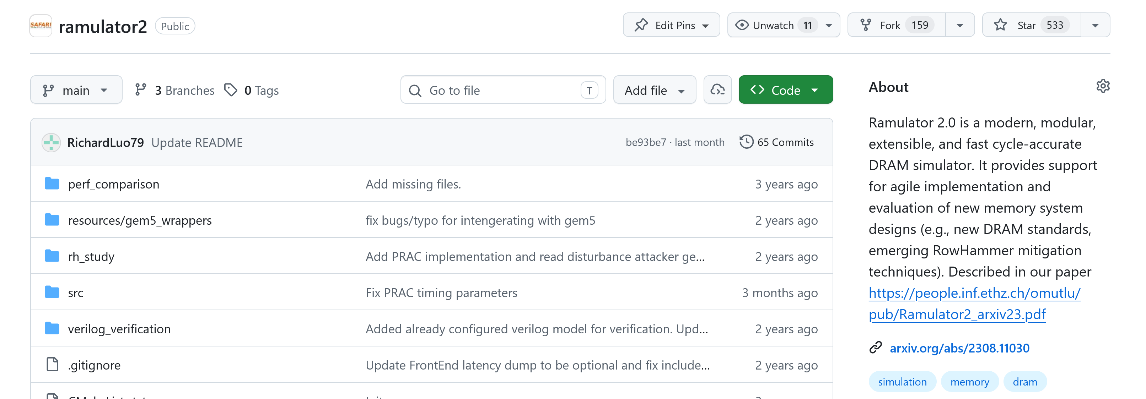
Ramulator 2.0: A Modern, Modular, and Extensible DRAM Simulator
Ramulator 2.0 [Luo+, CAL'24] models a wide range of DRAM standards and memory controller functionalities
Modular and extensible software architecture
Enables fine-grained modeling of DRAM operation (cycle-level)
Used in a wide range of research works
https://github.com/CMU-SAFARI/ramulator2
Notes:
Ramulator 2.0 is a modern modular and extensible DRAM simulator
[CLICK] that models a wide range of DRAM standards and memory controller functionalities, which are easy to extend
[CLICK] It enables fine-grained modeling of DRAM operation and [CLICK] is used by many research works since its release
[CLICK] It is open sourced and freely available on GitHub

Slide 8
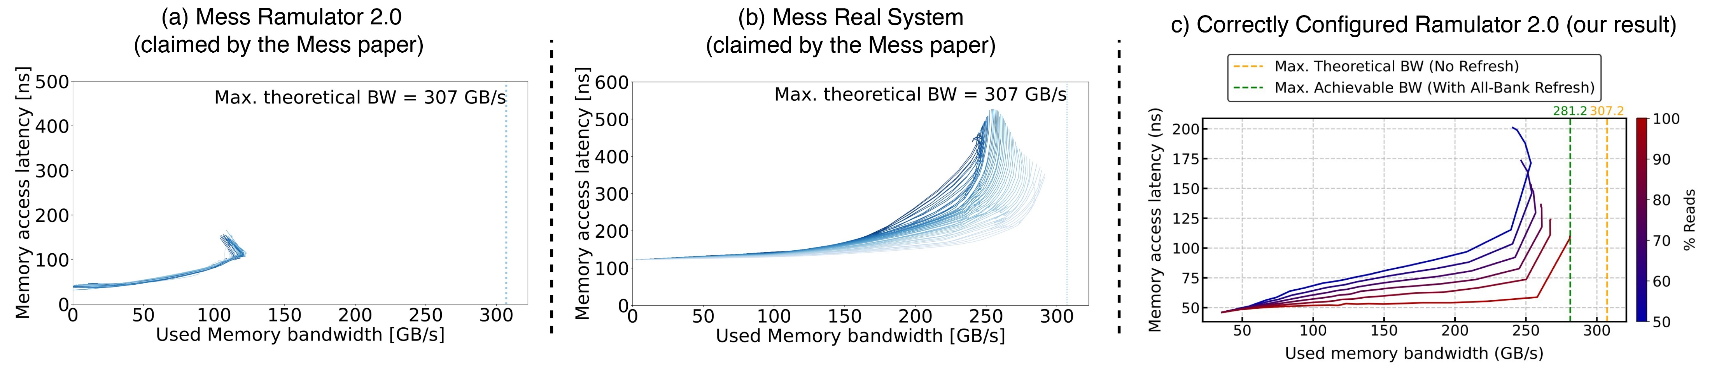
High-Level Memory System Performance Evaluation & Reasoning
The Mess benchmark aims to characterize a memory system based on a set of latency-throughput ("used bandwidth") curves
Consists of two concurrently running workloads: Streaming and Pointer-Chasing patterns
Varies the memory intensity using NOPs between requests
Evaluates a sweep of read/write intensities
(from 50% to 100% reads)
increasing memory intensity
50%
Memory Access Latency (ns)
100%
1 experiment
Used Memory Bandwidth (GB/s)
Notes:
The Mess paper evaluates memory system performance by proposing the mess benchmark:
The Mess benchmark aims to characterize a memory system, using a set of latency-throughput, or "used bandwidth" curves
[CLICK] These curves are plotted as a line figure,
[CLICK] where each data point is an experiment that performs two types of accesses concurrently : streaming and pointer-chasing patterns
[CLICK] plots the measured average memory access latency and [CLICK] the used memory bandwidth
[CLICK] The Mess benchmark then varies the memory intensity by adding NOPs between subsequent memory requests which creates "a single curve"
[CLICK] And evaluating a sweep of read write operation intensities from 50% to 100% reads
[CLICK] creates different curves

Slide 9
The Mess Paper's Evaluation of Ramulator 2.0
2
smaller
latency
1
smaller bandwidth
Contending that Ramulator 2.0 "poorly resembles the actual system performance"
Ramulator 2.0 simulation results in the Mess paper are incorrect and, at the time of the publication of the Mess paper, irreproducible
Notes:
The Mess paper comments on the accuracy of Ramulator 2.0 by first evaluating a real DDR5 system with the Mess benchmark,
[CLICK] which results in these curves in the first figure
[CLICK] and then compares them against the Ramulator 2.0 curves that it obtains
[CLICK] The Mess paper observes that Ramulator 2.0's curves show 1) smaller used memory bandwidth and [CLICK] 2) smaller memory access latency compared to the real system curves
[CLICK] And contends that Ramulator 2.0 poorly resembles the actual system performance
[CLICK] However, Ramulator 2.0 results in the Mess paper are incorrect and at the time of the publication of the paper, *were* irreproducible

Slide 10
Analysis of the Evaluation of Ramulator 2.0 in the Mess Paper
1
Reproducibility Issues:
It was not possible to reproduce any Ramulator 2.0 result from the Mess paper artifacts available at the time of publication and artifact evaluation of the paper
The missing source codes were uploaded to the Mess GitHub repository 10 months after the artifact evaluation badges
2
Fundamental Configuration Errors:
The Mess paper effectively compares an 8-channel DDR5 memory system in Ramulator 2.0 against a 16-channel real DDR5 memory system
The Mess paper uses unrealistically low cache latency configurations that lead to low memory access latency
3
Scholarship Issues:
The Mess paper does not disclose 1) modifications to the cache latency configurations, and
2) differences in evaluation methodology between simulation and real system results (identified via email exchange with Mess paper's authors)
Notes:
We analyze the Mess paper and its open-sourced artifact and identify various issues in three categories:
[CLICK] First, it was not possible to reproduce any of the Ramulator 2.0 results from the Mess paper artifacts available due to missing source codes
[CLICK] The missing source codes were uploaded only after our contact, 10 months after the artifact evaluation badges were awarded
Second,
[CLICK] We identify that Ramulator 2.0's evaluation suffers from fundamental configuration errors as
[CLICK] the Mess paper compares an 8-channel memory system in Ramulator 2.0 against a 16-channel real memory system.
[CLICK] and configures the system to have unrealistically low cache latency configurations that lead to low memory access latency
Lastly,
[CLICK] We also identified scholarship issues as the paper does not disclose
[CLICK] these modifications to the source code of Ramulator 2.0
[CLICK] and differences in evaluation methodologies of real and simulated memory systems that we will not cover in this presentation but explained in detail in our paper
In the interest of time, we will focus on the fundamental configuration errors

Slide 11
Fundamental Configuration Errors
The Mess paper's configuration errors result in the claimed Ramulator 2.0 inaccuracies
2
1
smaller
latency
smaller bandwidth
Notes:
The Mess paper's configuration errors result in the claimed inaccuracies, and lead to incorrect claims. " The mess paper's configuration errors result in incorrect claims about Ramulator 2. now we will describe how they lead to smaller bandwidth and smaller latency "

Slide 12
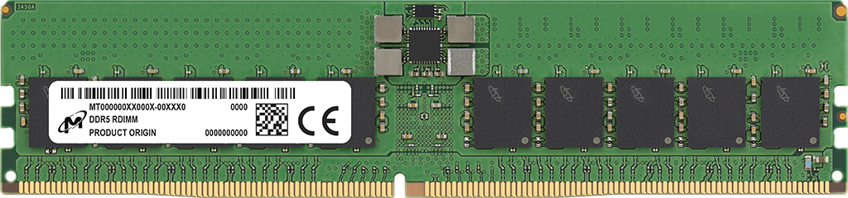
Fundamental Configuration Errors: Smaller Used Bandwidth
Mess Paper’s Ramulator 2.0 Configuration
Mess Paper’s Real System Configuration
channel: 8
“8 x DDR5”
Channel A
Channel B
8 DDR5 channels
16 DDR5 channels
Notes:
First, the smaller used bandwidth results are caused by the difference in numbers of channels available [CLICK] in simulation and in real system evaluations [CLICK] Mess Paper's Ramulator 2.0 configuration specifies 8 channels with this configuration line. And the paper specifies the real system configuration as "8 X DDR5"
This leads to Ramulator 2.0 instantiating 8 independent DDR5 channels
Whereas the real system configuration has 8 DDR5 DIMMS each of which containing 2 channels. Meaning that there are actually 16 independent DDR5 channels in the Mess paper’s real system configuration
[CLICK] And because of this mismatch,

Slide 13
Fundamental Configuration Errors: Smaller Used Bandwidth
Mess Paper’s Ramulator 2.0 Configuration
Mess Paper’s Real System Configuration
8 DDR5 channels
16 DDR5 channels
The Mess paper incorrectly assumes a DDR5 channel in Ramulator 2.0 is 64-bit, instead of the actual width of 32-bit that is consistent with JEDEC DDR5 standards (JESD79-5)
Notes:
Ramulator 2.0 results show around half the used bandwidth of real system measurements, as it has half the number of channels.
We identify that this is because, the mess paper incorrectly assumes a DDR5 channel in Ramulator 2 is 64 bits wide
Whereas the implementation clearly states a channel as 32 bits wide, which is the consistent value with the JEDEC DDR5 standards

Slide 14
Fundamental Configuration Errors: Smaller Used Bandwidth
Mess Paper’s Ramulator 2.0 Configuration
Mess Paper’s Real System Configuration
8 DDR5 channels
16 DDR5 channels
The Mess paper incorrectly assumes a DDR5 channel in Ramulator 2.0 is 64-bit, instead of the actual width of 32-bit that is consistent with JEDEC DDR5 standards (JESD79-5)
The Mess paper configures Ramulator 2.0 with half the channels of a real system, and thus, results in smaller used bandwidth
Notes:
Because of this configuration error, the mess paper configures Ramulator 2 with half the channels of a real system and thus results in smaller used bandwidth

Slide 15
Fundamental Configuration Errors: Smaller Memory Access Latency
The Mess paper's artifact hardcodes
the cache latency as 0 cycles
the number of miss-status holding registers (MSHRs) per CPU as 1024
This leads to significantly smaller DRAM round-trip latency and queueing delays, thus smaller memory access latency
The Mess paper uses unrealistically low cache latency configurations resulting in the low memory access latency that it attributes to Ramulator 2.0
Notes:
The second issue, smaller memory access latency is due to the unrealistic cache latency configurations
The mess paper's artifact hardcodes the cache latency as 0 cycles and instantiates a high number of miss-status holding registers
This configuration leads to significantly smaller DRAM round-trip latency and queueing delays, thus a low memory access latency compared to a real system so, The Mess paper uses unrealistically low cache latency configurations resulting in the the low memory access latency that it attributes to Ramulator 2.0
Transition: Now lets hear from Haocong about how *we* evaluate Ramulator 2.0

Slide 16
Our Evaluation Methodology
We independently evaluate the Mess benchmark by executing the same access pattern
Streaming and Pointer-Chasing access patterns
Sweeping memory intensity
We correctly configure Ramulator 2.0
Provide the same number of channels as the real system
Evaluate the memory access latency from the memory controller to isolate the DDR5 model's simulation accuracy
Notes:
To this end, [CLICK] we independently evaluate the Mess benchmark by executing the same access pattern
[CLICK] And configure Ramulator 2.0 correctly:
We instantiate a 16-channel DDR5 memory system
And measure the memory access latency from the memory controller

Slide 17
Our Key Results
Ramulator 2.0's memory model achieves high used memory bandwidth, close to the achievable bandwidth value, as opposed to the claims of the Mess paper
https://github.com/CMU-SAFARI/ramulator2/tree/mess
Notes:
Now lets see our results
[CLICK]
On the X axis, we see the used memory bandwidth and on the y-axis, the memory access latency.
[CLICK]
We show the maximum theoretical bandwidth as the yellow line
[CLICK]
Since this does not account for periodic refresh, we draw a second line to show the maximum achievable bandwidth that accounts for refreshes.
[CLICK]
These are our results,
We make two key observations
[CLICK]
First, Ramulator 2.0's memory model
[CLICK]
achieves a high used memory bandwidth, close to the achievable bandwidth value, as opposed to the claims of the Mess paper.

Slide 18
Our Key Results
The memory access latency of Ramulator 2.0’s model increases as the used memory bandwidth and the write ratio increases
https://github.com/CMU-SAFARI/ramulator2/tree/mess
Notes:
Second, the memory access latency [CLICK] of Ramulator 2.0’s DRAM model increases as as the used memory bandwidth and the write ratio increases

Slide 19
Our Key Results
When correctly configured, Ramulator 2.0’s simulated memory system performance resembles real system characteristics
https://github.com/CMU-SAFARI/ramulator2/tree/mess
Notes:
We conclude that
When correcty configured,
Ramulator 2.0's simulated memory system performance
Resembles real system characteristics

Slide 20
Cleaning up the Mess
Analysis of the Evaluation of Ramulator 2.0 in the Mess Paper
Analysis of the Evaluation of DAMOV in the Mess Paper
Ramulator 2.0 and DAMOV Best Practices
Notes:
Now lets look at the analysis of the evaluation of DAMOV in the Mess paper

Slide 21
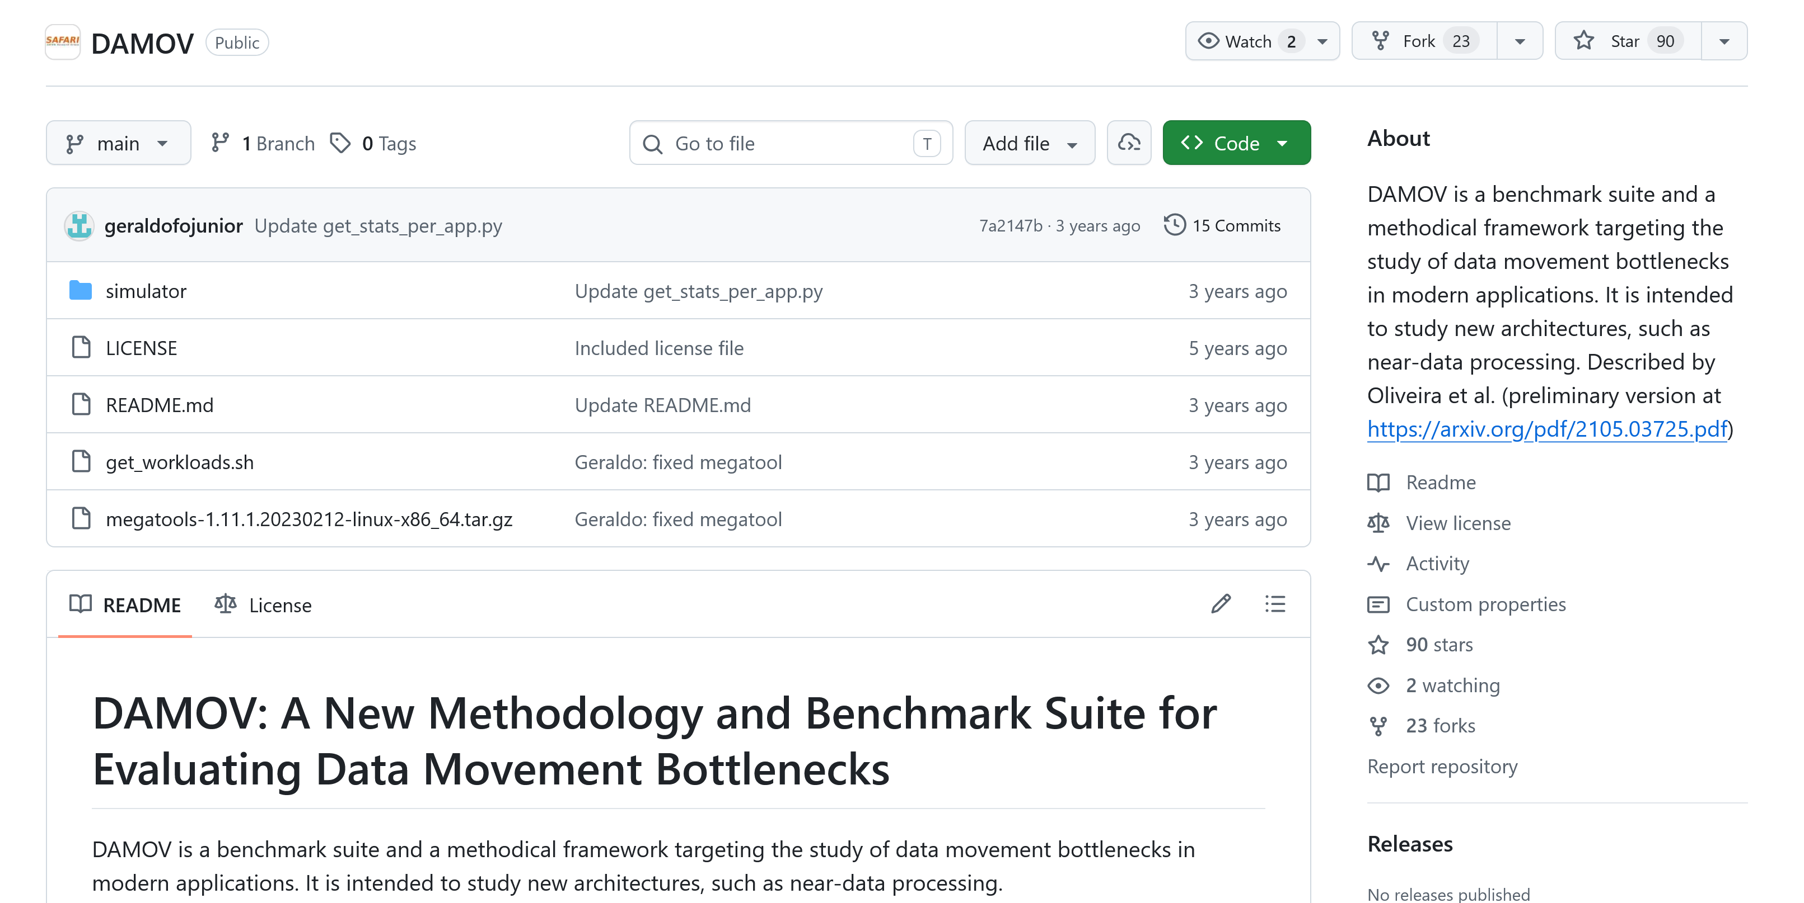
DAMOV: A Simulation Framework for PiM
DAMOV integrates ZSim [Sanchez+, ISCA'13] with Ramulator [Kim+, CAL'15]
Enables evaluating emerging processing-in-memory architectures
https://github.com/CMU-SAFARI/DAMOV
Notes:
DAMOV is another simulation framework that integrates a core model, Zsim with an earlier version of Ramulator for evaluating emerging processing-in-memory architectures
========================= second point could come later?

Slide 22
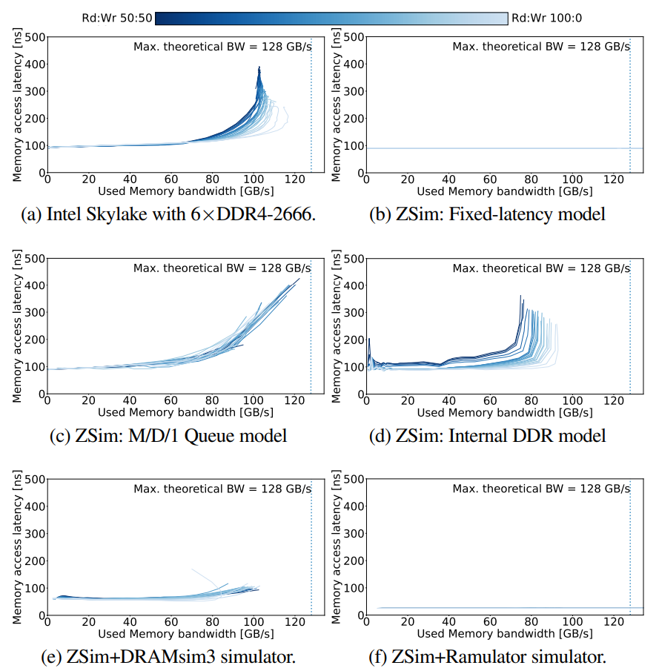
The Mess Paper's Evaluation of DAMOV
Mess Real System (claimed by the Mess paper)
Mess DAMOV (claimed by the Mess paper)
constant latency
DAMOV results in the Mess paper use incorrect simulation statistics that are unrelated to the simulated DRAM performance
Notes:
The Mess paper evaluates a real DDR4 system as shown on the left
For DAMOV, the Mess paper’s results are on the right, which shows a constant memory access latency
We identify that DAMOV results in the Mess paper use wrong simulation statistics that are unrelated to the simulated DRAM performance

Slide 23
Analysis of the Evaluation of DAMOV in the Mess Paper
Reproducibility Issues:
We could not reproduce any DAMOV results in the Mess paper, using the Mess paper's artifact due to:
​Missing source code and configurations of Ramulator
Rigid assertion failure according to the ZSim configurations
1
Technical Simulator Usage Errors:
Uses two ZSim statistics for DRAM latency: latGETnl and mGETs from the L1-D cache
These statistics are not Ramulator statistics and does not reflect simulated DRAM latency from Ramulator
2
We independently evaluate DAMOV by executing the Mess benchmark and adding missing pieces to the artifact in a best-guess manner and measure the used bandwidth statistics reported by Ramulator
Notes:
We analyzed the Mess paper and its artifact and identified 2 key issues
[CLICK]
First, we could not reproduce any DAMOV results in the Mess paper due to missing source code and configurations in their artifact
[CLICK]
Second, we identify that the Mess paper's scripts use statistics from Zsim to calculate the memory latency, but these stats are not related to DRAM latency modeled by Ramulator.
[CLICK]
Due to these issues, we independently evaluate DAMOV by executing the Mess benchmark by adding missing resources in a best-guess manner

Slide 24
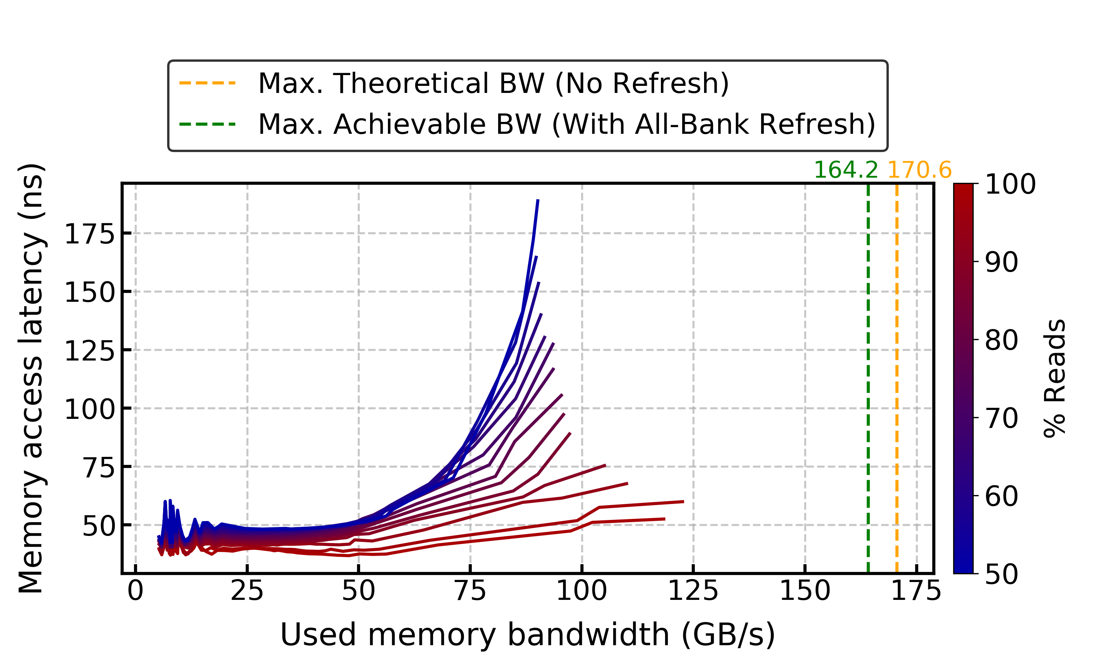
Our Key DAMOV Results
When correct statistics are used, DAMOV's memory access latency is not constant, in contrast to the claims of the Mess paper
Notes:
Here is our results
[CLICK]
We observe that when correct statistics are used DAMOV's memory access latency is not constant,
In contrast to the claims of the Mess paper

Slide 25
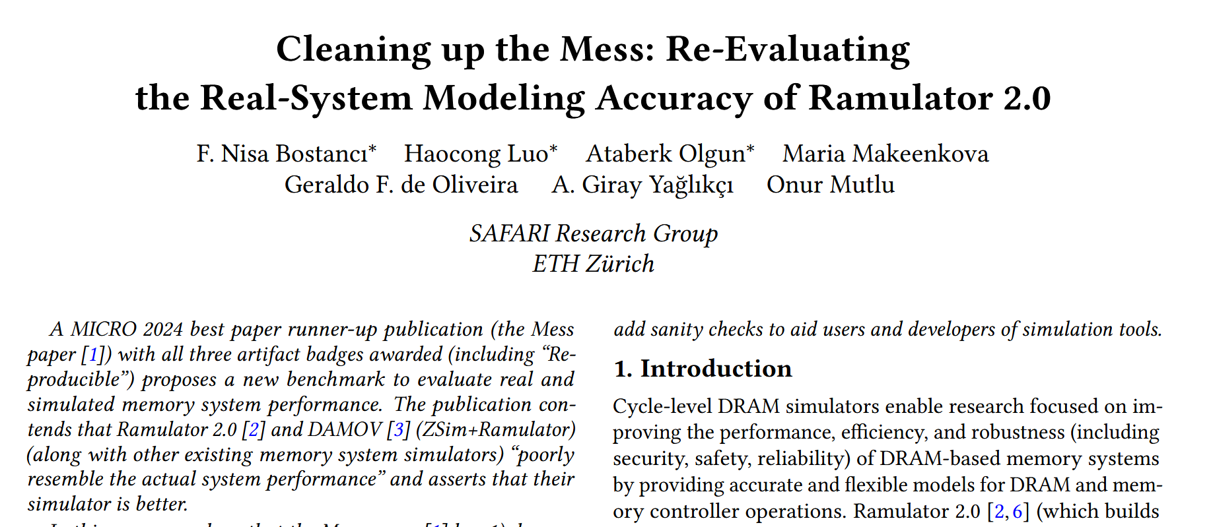
More in the Paper
* Equal contribution
https://arxiv.org/pdf/2510.15744
Notes:
There are even more details and analyses in the extended version of our paper on arxiv which you can access it with this link

Slide 26
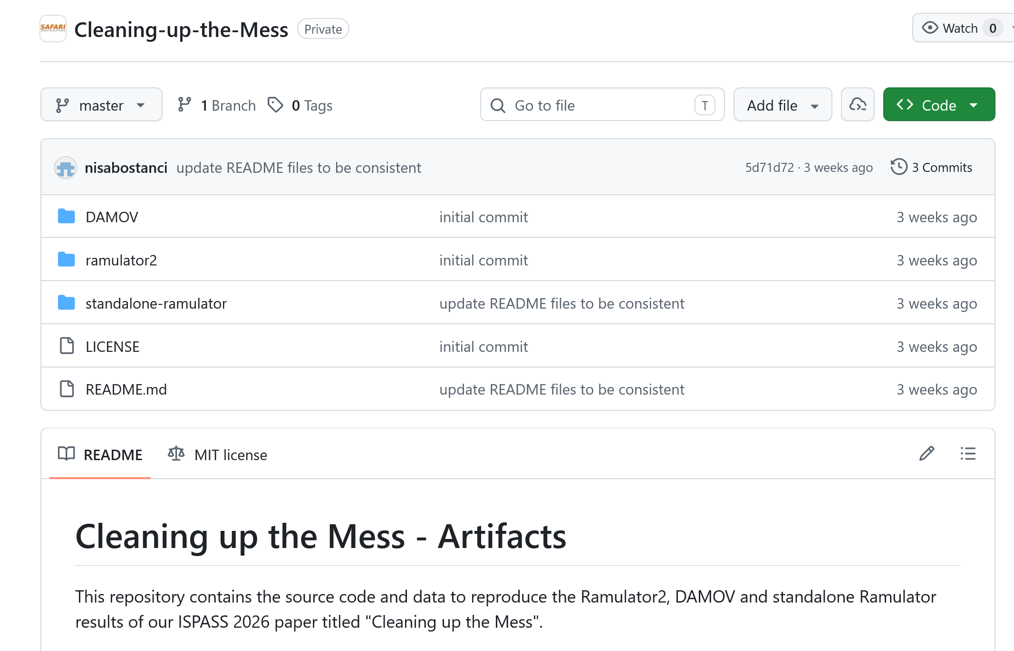
Cleaning up the Mess is Open Source
https://github.com/CMU-SAFARI/Cleaning-up-the-Mess
Notes:
All our source code and scripts are open sourced and artifact evaluated which you can check from the Github repo

Slide 27
Cleaning up the Mess
Analysis of the Evaluation of Ramulator 2.0 in the Mess Paper
Analysis of the Evaluation of DAMOV in the Mess Paper
Ramulator 2.0 and DAMOV Best Practices
Notes:
Lastly, based on these analyses, we identify best practices for Ramulator 2 and DAMOV

Slide 28
Ramulator 2.0 and DAMOV Best Practices
Be familiarized with JEDEC standard documents instead of relying on information other than the official standard or the simulator documentation
1
2
Understand Ramulator 2.0’s memory organization and configurations, which are documented in the code and in the repository
3
Understand simulation methodology and simulator implementations sufficiently to use the correct statistics
Communicate with the simulator developers or user community when unexpected results are observed to ensure correct simulator usage
4
Notes:
To avoid such configuration and usage errors,
[CLICK] First, the users should be familiarized with JEDEC standard documents
[CLICK] Second, they should understand the simulators memory organization and configurations
These two best practices would help avoiding the Ramulator 2.0 configuration error in the Mess paper
[CLICK] Third, they should understand simulation methodology and simulator implementations sufficiently to use the correct statistics
This would help avoiding the statistics usage errors in the Mess paper
[CLICK] Lastly, the users should communicate with the simulator developers or user community when unexpected results are observed to ensure correct simulator usage
This best practice would help avoid all errors in the Mess paper.

Slide 29
Conclusion
A recent paper, "A Mess of Memory System Benchmarking, Simulation and Application Profiling", MICRO'24 makes strong negative claims about Ramulator 2.0 and DAMOV and shows unexpected results
We demonstrate that these claims and results are incorrect and are due to configuration and simulator usage errors made in the Mess paper
We strongly encourage the computer architecture community to consider our corrections to the Ramulator 2.0 and DAMOV results of the Mess paper to prevent the propagation of inaccurate and misleading results
To facilitate transparency and reproducibility, we open source all our code and results: https://github.com/CMU-SAFARI/Cleaning-up-the-Mess
Notes:
Now, let us conclude our talk.

Slide 30


Cleaning up the Mess Re-Evaluating the Real-System Modeling Accuracy of Ramulator 2.0
Paper
GitHub
F. Nisa Bostancı* Haocong Luo* Ataberk Olgun* Maria Makeenkova Geraldo F. de Oliveira A. Giray Yağlıkçı Onur Mutlu * Equal Contribution

Slide 31
RowHammer Mitigation Evaluation Research Highlights

Slide 32

Implementing Many RowHammer Mitigations in Ramulator 2.0
Haocong Luo, Yahya Can Tugrul, F. Nisa Bostanci, Ataberk Olgun, A. Giray Yaglikci, and Onur Mutlu, "Ramulator 2.0: A Modern, Modular, and Extensible DRAM Simulator" Preprint on arxiv, August 2023. [arXiv version] [Ramulator 2.0 Source Code]
https://arxiv.org/pdf/2308.11030.pdf
https://github.com/CMU-SAFARI/ramulator2

Slide 33
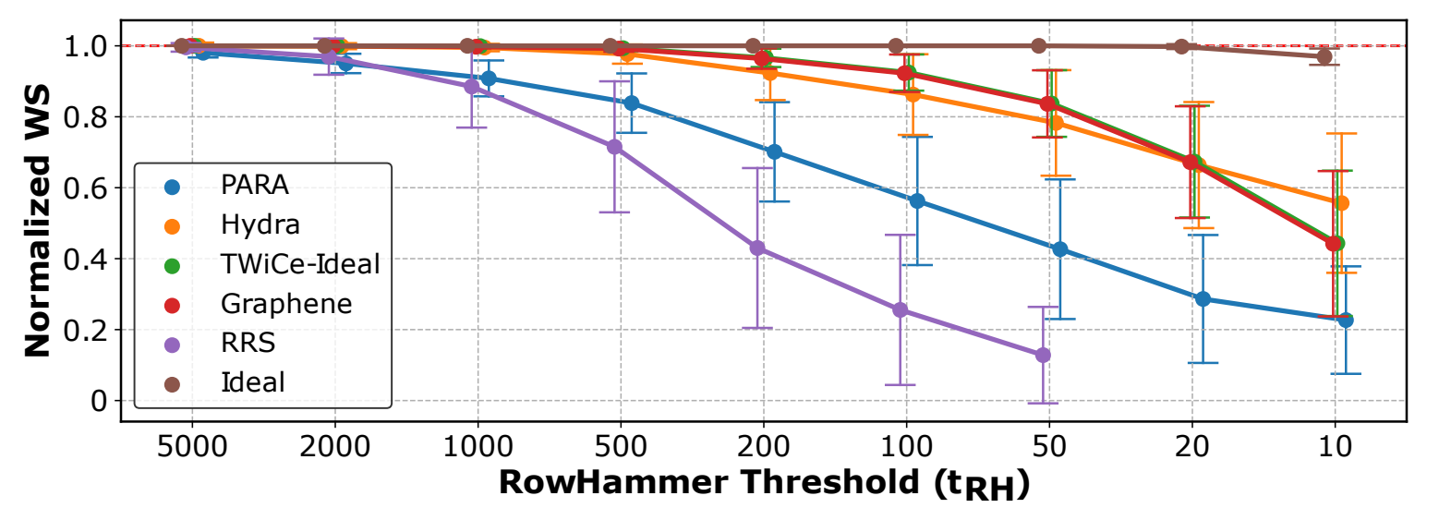
Implementing Many RowHammer Mitigations in Ramulator 2.0
Cross-section performance overhead evaluation of different RowHammer mitigation techniques
Six different RowHammer mitigation techniques all implemented as plugins to the same memory controller implementation
As DRAM becomes more vulnerable to RowHammer, evalauted RowHammer mitigations incur higher performance overheads

Slide 34

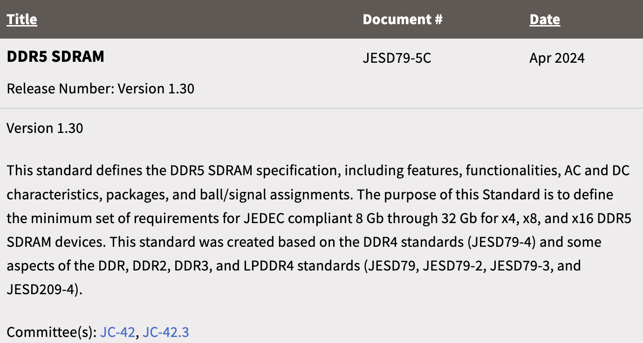
Recent Improvements in JEDEC (2024)

Slide 35
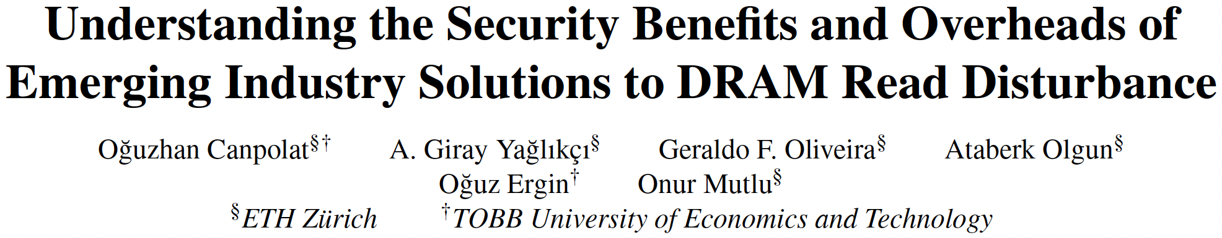
Evaluating Per-Row Activation Counting (as introduced in DDR5 standard)
Oğuzhan Canpolat, A. Giray Yağlıkçı, Geraldo F. Oliveira, Ataberk Olgun, Oğuz Ergin, and Onur Mutlu, "Understanding the Security Benefits and Overheads of Emerging Industry Solutions to DRAM Read Disturbance" 4th Workshop on DRAM Security (DRAMsec), held with ISCA, Buenos Aires, Argentina, July 2024.
https://arxiv.org/pdf/2406.19094
https://github.com/CMU-SAFARI/ramulator2

Slide 36
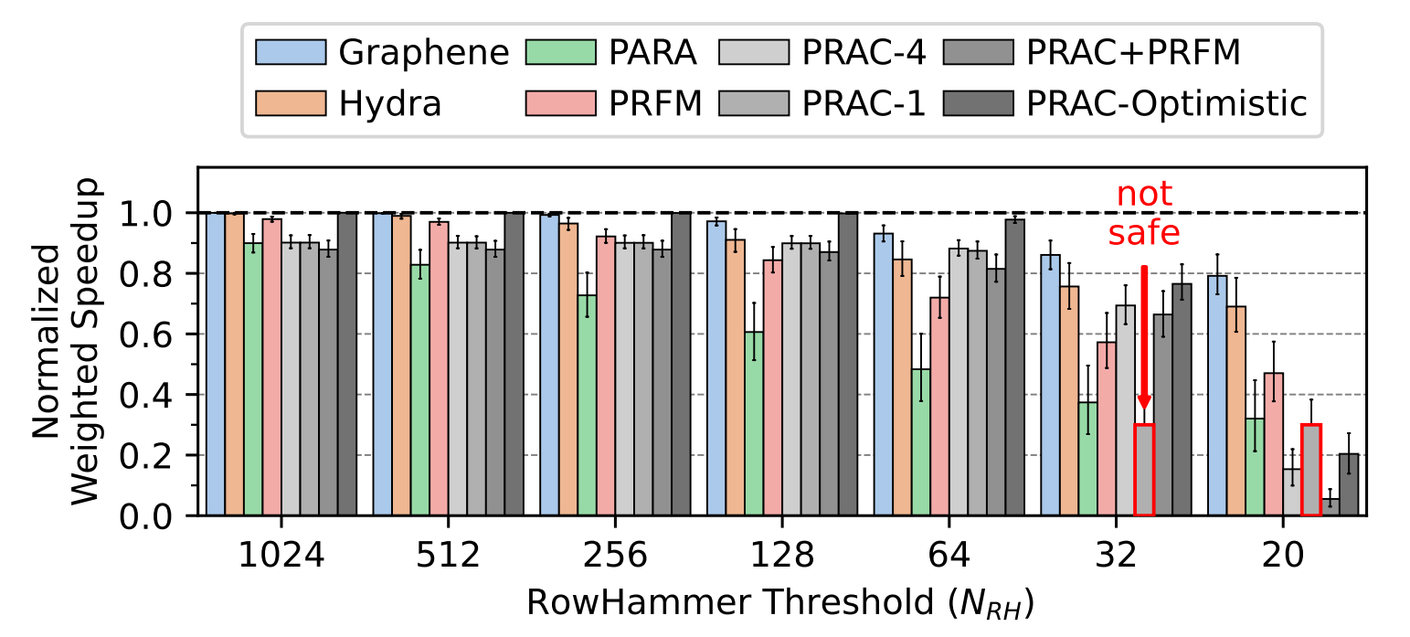
Understanding PRAC (DRAMSec'24)
Memory controller implementation extended with support for per-row activation count tracking and back-off signal
Comparing PRAC against state-of-the-art mitigations
PRAC introduces non-negligible performance overheads due to increased DRAM timing constraints

Slide 37
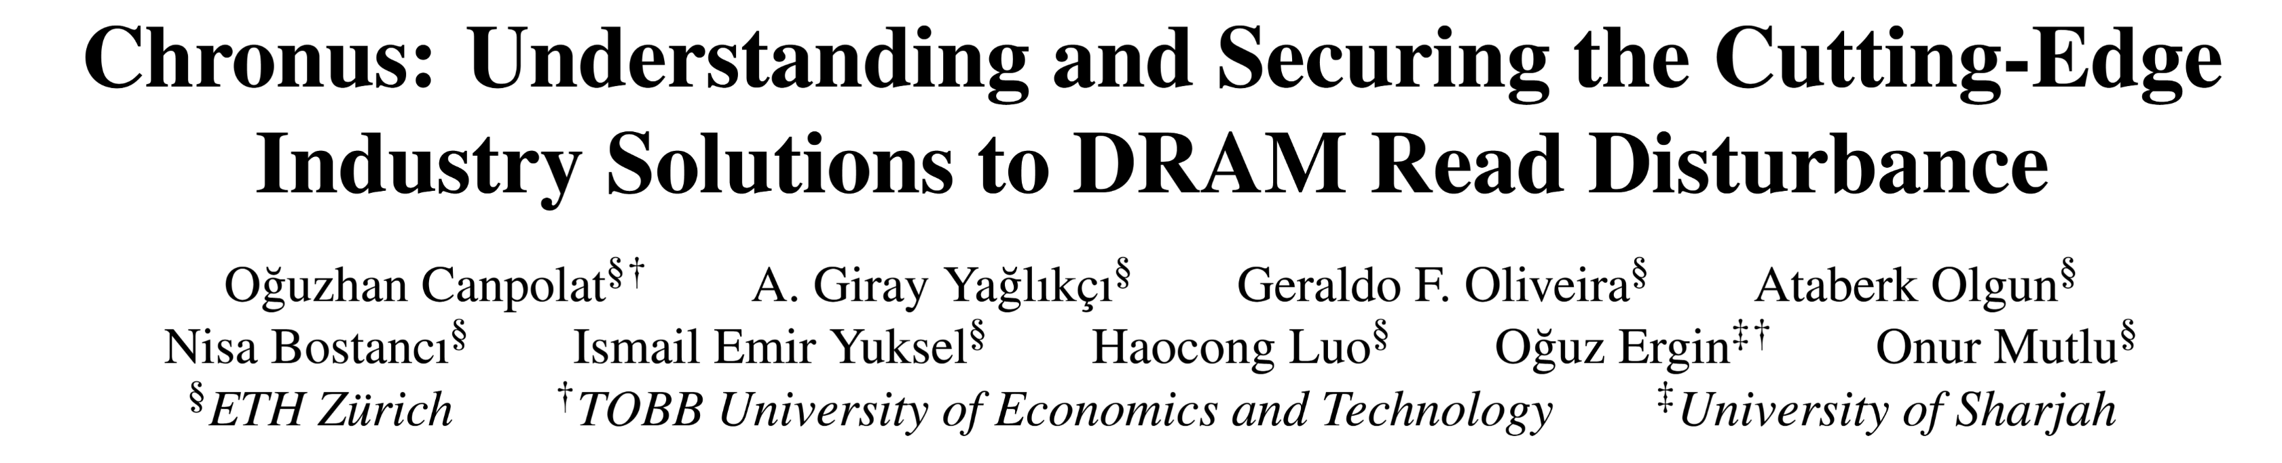
Addressing Drawbacks of PRAC
Oguzhan Canpolat, Abdullah Giray Yaglikci, Geraldo Francisco de Oliveira, Ataberk Olgun, Nisa Bostanci, Ismail Emir Yuksel, Haocong Luo, Oguz Ergin, and Onur Mutlu, "Chronus: Understanding and Securing the Cutting-Edge Industry Solutions to DRAM Read Disturbance" HPCA, Las Vegas, NV, USA, March 2025. Officially artifact evaluated as available, functional, and reproduced.
https://arxiv.org/pdf/2502.12650

Slide 38
Chronus (HPCA'25) – Extended Analysis of PRAC
Two major drawbacks of PRAC:
1
2
Increased critical
DRAM timing parameters
Wave attack vulnerability requires aggressive configuration
Large performance overhead even at high read disturbance thresholds
Poor scaling to low read disturbance thresholds

Slide 39
Chronus (HPCA'25) – Key Ideas
1
2
Concurrently update counters while serving
DRAM accesses
Prevent wave attacks by providing DRAM chip
more control over back-offs and preventive refreshes
No increase in critical
DRAM timing parameters
Better scaling to low read disturbance thresholds

Slide 40
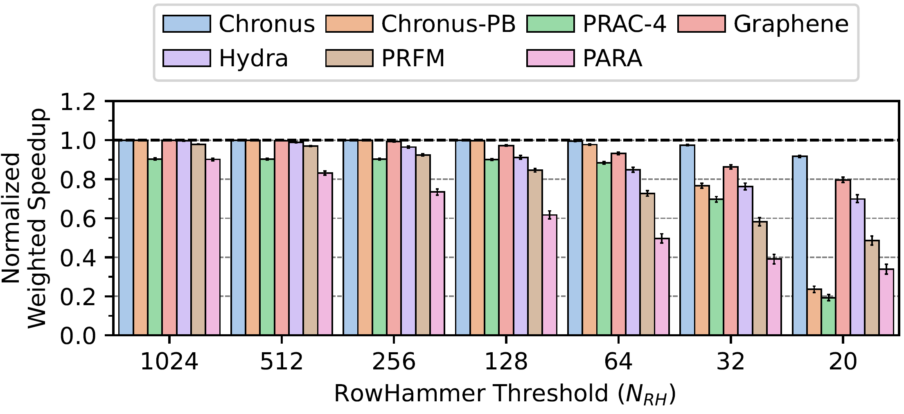
Chronus (HPCA'25) – Key Results
Comprehensive evaluation based on Ramulator 2.0
Chronus reduces the performance and energy overheads of PRAC and outperforms state-of-the-art solutions
Notes:
expand

Slide 41
Addressing Drawbacks of PRAC
Oguzhan Canpolat, Abdullah Giray Yaglikci, Geraldo Francisco de Oliveira, Ataberk Olgun, Nisa Bostanci, Ismail Emir Yuksel, Haocong Luo, Oguz Ergin, and Onur Mutlu, "Chronus: Understanding and Securing the Cutting-Edge Industry Solutions to DRAM Read Disturbance" HPCA, Las Vegas, NV, USA, March 2025. Officially artifact evaluated as available, functional, and reproduced.
https://arxiv.org/pdf/2502.12650

Slide 42
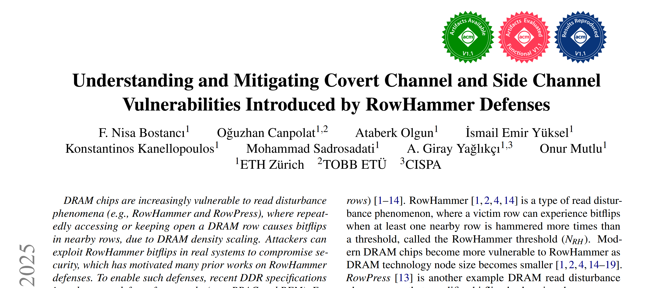
A Recent Paper using gem5+Ramulator 2.0
MICRO 2025
https://arxiv.org/pdf/2503.17891 https://github.com/CMU-SAFARI/LeakyHammer

Slide 43
Talk Outline
Motivation and Problem
Key Observation
LeakyHammer and Case Studies
Mitigating LeakyHammer
Conclusion

Slide 44

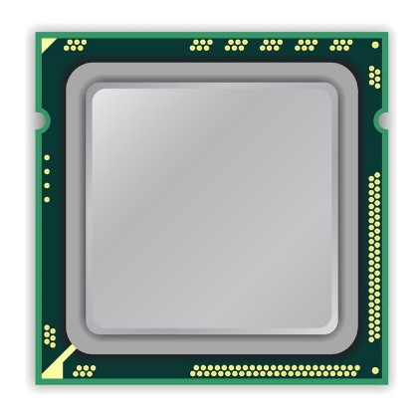
A Typical DRAM-Based Computing System
Modern systems are vulnerable to security attacks such as covert channel and side channel attacks
A set of attacks exploit hardware structures that result in different execution time for a type of operation based on the input or the current state of the structure
timing differences leak information
Computing System
Notes:
Modern computing systems are vulnerable to security attacks such as covert channel and side channel attacks where an attacker uses the shared computing system to communicate with other attacker processes or to leak security critical data of concurrently running applications
A set of attacks exploit shared hardware structures that result in different execution time for executing a type of operation based on the inpu or the current state of the structure
This means that timing differences …
Lets take a closer look at these computing systems

Slide 45
A Typical DRAM-Based Computing System
DRAM
Channel
CPU
DRAM Module
Notes:
This is a typical DRAM-based computing system with a CPU and a DRAM module connected over an off-chip link called the DRAM channel.

Slide 46
DRAM Read Disturbance
Read disturbance in DRAM breaks memory isolation
Prominent example: RowHammer
DRAM Bank
Row 1
Row 1
Row 1
Victim Row
Row 2
Row 2
Row 2
Row 2
Row 2
Row 2
open
open
open
closed
closed
Aggressor Row
Row 3
Row 3
Row 3
Victim Row
Repeatedly opening (activating) and closing (precharging) a DRAM row causes RowHammer bitflips in nearby cells
Notes:
Unfortunately, DRAM is vulnerable to read disturbance which breaks memory isolation.
A prime example of DRAM read disturbance is RowHammer, which I will show in this slide.
For example, to access a data stored in Row 2, [CLICK]
We first need to open Row 2, and then perform accesses. Once we need to access another row, we need to close Row 2 and open the other row [CLICK]
[BACK& FORTH] If we keep opening and closing this row many times, called hammering a row, [CLICK]
We observe bitflips in physically nearby DRAM rows [CLICK]
This phenomenon is called RowHammer. We refer to the hammered row as the aggressor row and the rows that are affected as victim rows. [CLICK]

Slide 47
Mitigating Read Disturbance (I): Preventive Refresh
DRAM Bank
Row 1
Row 1
Row 1
Row 1
Victim Row
Row 2
Row 2
Row 2
Row 2
Row 2
Row 2
open
open
open
closed
Aggressor Row
Aggressor Row
Row 3
Row 3
Row 3
Row 3
Victim Row
Refreshing potential victim rows mitigates read disturbance bitflips
Notes:
One way to mitigate read disturbance is to preventively refresh potential victim rows before they experience bitflips

Slide 48
Mitigating Read Disturbance (II): Preventive Refresh
DRAM Bank
Row 1
Row 1
Row 1
Row 1
Victim Row
Row 2
Row 2
Row 2
Row 2
Row 2
Row 2
open
open
open
closed
Aggressor Row
Aggressor Row
Row 3
Row 3
Row 3
Row 3
Victim Row
Defense techniques track row activation counts (of aggressor rows) to preventively refresh potential victim rows
Notes:
However, doing so requires tracking row actvation counts of aggressor rows to determine which rows to preventively refresh

Slide 49
Read Disturbance is Getting Worse
Technology node scaling
[Kim+, ISCA’14]
[Kim+, ISCA’20]
[Luo+, ISCA’23]
DRAM cells become increasingly more vulnerable to read disturbance, requiring low-cost defenses
Notes:
To make things worse:
With technology node scaling, DRAM cells get smaller in size and closer to each other[CLICK]
Such that we observe significant reductions in the minimum hammer count to induce the first bitflip in the last decade [CLICK]
Thus DRAM cells become increasingly more vulnerable to read disturbance [CLICK]

Slide 50
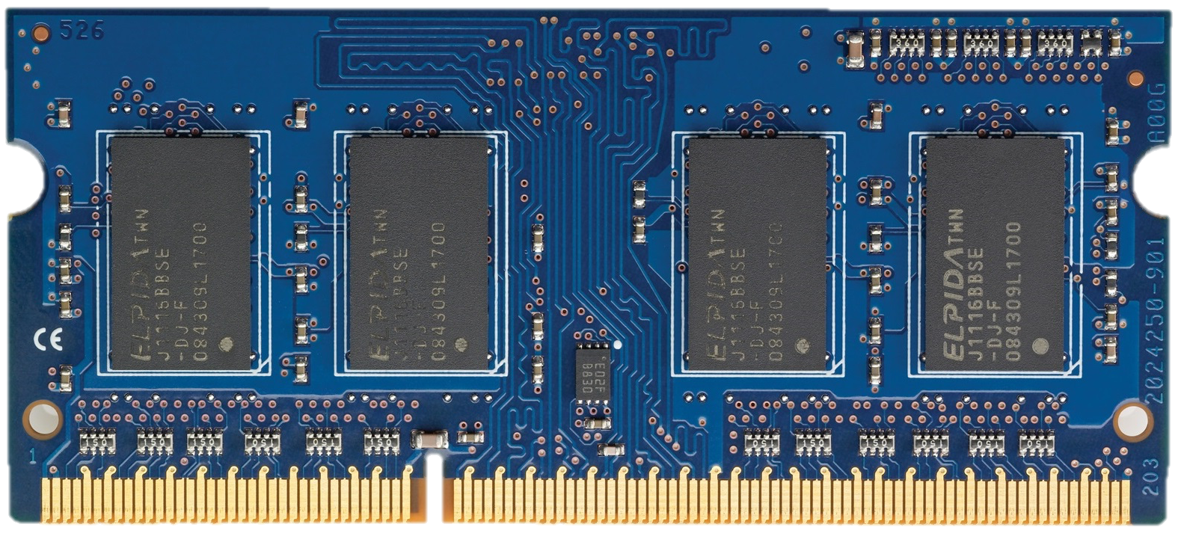
Latest Industry Defenses for RowHammer
Recent DDR5 specifications introduce two new defense frameworks to mitigate RowHammer bitflips:
Per-row activation counters to accurately track aggressor rows' activation counts
Per Row Activation Counting (PRAC)
as of April 2024
A command to provide DRAM with the time for performing preventive actions
Refresh Management (RFM)
before 2024

Slide 51
Problem
Unfortunately, yes.
Do industrial and academic RowHammer defenses introduce new covert and side channel vulnerabilities?
Notes:
The industry already standardized multiple RowHammer defenses to mitigate read disturbance bitflips, yet their full security implications are not known

Slide 52
Talk Outline
Motivation and Problem
Key Observation
LeakyHammer and Case Studies
Mitigating LeakyHammer
Conclusion

Slide 53
Key Observation (I)
Preventive actions have two fundamental features that enable covert channels and side channels:
1
Preventive actions often result in high memory access latencies for regular memory requests
Request
Request
Request
Request
higher memory access latencies
Preventive actions have high latency (e.g., 1400 ns for PRAC)
Notes:
We make the key observation that preventive actions have two fundamental features that enable covert and side channels:
[CLICK]
Preventive actions often result in significantly high memory access latencies for regular memory requests
This is because preventive actions have high latency

Slide 54
Key Observation (II)
Preventive actions have two fundamental features that enable covert channels and side channels:
2
A user can leverage memory access patterns to intentionally trigger a preventive action
Request
Request
Request
Request
higher memory access latencies
Notes:
We make the key observation that preventive actions have two fundamental features that enable covert and side channels:
[CLICK]
Preventive actions often result in significantly high memory access latencies for regular memory requests
This is because preventive actions have high latency

Slide 55
Talk Outline
Motivation and Problem
Key Observation
LeakyHammer and Case Studies
Mitigating LeakyHammer
Conclusion

Slide 56
LeakyHammer
A new class of attacks that exploit RowHammer defense-induced memory latency differences
Deterministically and intentionally impose observable latency overheads on requests via preventive actions
Accurately infer victims' memory access patterns that result in preventive actions

Slide 57
LeakyHammer Case Studies
CS1: PRAC-Based Covert Channel Attack
CS2: RFM-Based Covert Channel Attack
CS3: PRAC-Based Website Fingerprinting
Notes:
We demonstrate three different attacks as case studies of LeakyHammer
We first establish PRAC and RFM based covert communication channels
And then, we demonstrate a website fingerprinting attack that leaks which website is loaded by a victim user by just observing the preventive actions caused by the victim

Slide 58
Evaluation Methodology
Environment: System simulation using gem5 [Lowe-Power+ '20] integrated with cycle-level DRAM simulator Ramulator 2.0 [Kim+ CAL'15, Luo+ CAL'24]
System Configuration:
Processor 1-, 2-, and 4-core, out-of-order, 3GHz clock frequency
DRAM DDR5, 1 channel, 2 rank/channel, 8 bank groups,
4 banks/bank group, 128K rows/bank
Memory Ctrl. 64-entry read and write requests queues,
Scheduling policy: FR-FCFS with a column cap of 16 Last-level cache 4 MiB (per-core), 16-way
PRAC N_{BO}=128 activations, 4 RFMs per back-off
PRFM T_{RFM}=40 activations
https://github.com/CMU-SAFARI/LeakyHammer
Notes:
Even though they are standardized they are not widely available in chips

Slide 59
LeakyHammer Case Studies
CS1: PRAC-Based Covert Channel Attack
CS2: RFM-Based Covert Channel Attack
CS3: PRAC-Based Website Fingerprinting

Slide 60
Per Row Activation Counting in DDR5
Unavailable
RFM
ACT A
ACT A
ACT A
Back-off
becomes available again
DRAM Rows
0xA
PRAC Counters
back-off threshold
continues to send commands
N_{BO}
1
2
requires
preventive
action
accurately tracks activation counts of each row
allocates a fixed time for preventive refresh
Back-off
...
ACT A
ACT A
ACT A
RFM
ACT
DRAM Command Timeline
Notes:
[CLICK] Here we have a CPU with a DRAM module
[CLICK] Inside the DRAM module we have many rows
[CLICK] and each row has a dedicated activation counter
A PRAC based mitigation works as follows
[CLICK] When a row is activated, PRAC increments the counter corresponding to that row
[CLICK] and keeps incrementing the same row with each activation
after some point the counter reaches a threshold called the back off threshold
[CLICK] which means that the row requires a preventive action to prevent RowHammer bitflips and PRAC identifies the row as an aggressor row
[CLICK] and sends the memory controller a back-off signal
[CLICK] Upon receiving the back-off signal, the memory controller issues an RFM command
[CLICK] which allocates a fixed time for the DRAM module to perform preventive refreshes
[CLICK] During this time the DRAM module becomes unavailable for regular memory requests
[CLICK] and performs preventive refreshes
[CLICK] after preventive refreshes are completed, DRAM becomes available again and the memory controller can continue to send commands

Slide 61
Observing PRAC-Induced Latencies (I)
We test if an application can:
intentionally trigger a PRAC back-off
observe PRAC-induced higher memory access latencies
DRAM Bank
1
Allocate pages (0xA and 0xB) in different rows of a DRAM bank
DRAM Rows
PRAC Ctrs
0xA
…
0xB
Repeat
clflush 0xA
Read 0xA and measure access latency
2
clflush 0xB
Read 0xB and measure access latency
Row Buffer
3
Notes:
To exploit PRAC for an attack, we first need to verify if we can observe PRAC induced latencies
[CLICK] We test if an application can
[CLICK] intentionally trigger a PRAC back-off
[CLICK] and observe higher memory access latencies caused by it
To do so, we first
[CLICK] allocate pages in different rows of a DRAM bank to cause many row activations and increment their activation counts, lets say addresses A and B.
[CLICK] we then first flush address A from the cache hierarchy to ensure the next accesses to it would go to the main memory
And read address A and measure the access latency
[CLICK] We repeat this step for address B
[CLICK] since A and B are in the same bank, repeating these steps many times potentially activates both rows in an interleaved manner and increments their activation counts

Slide 62
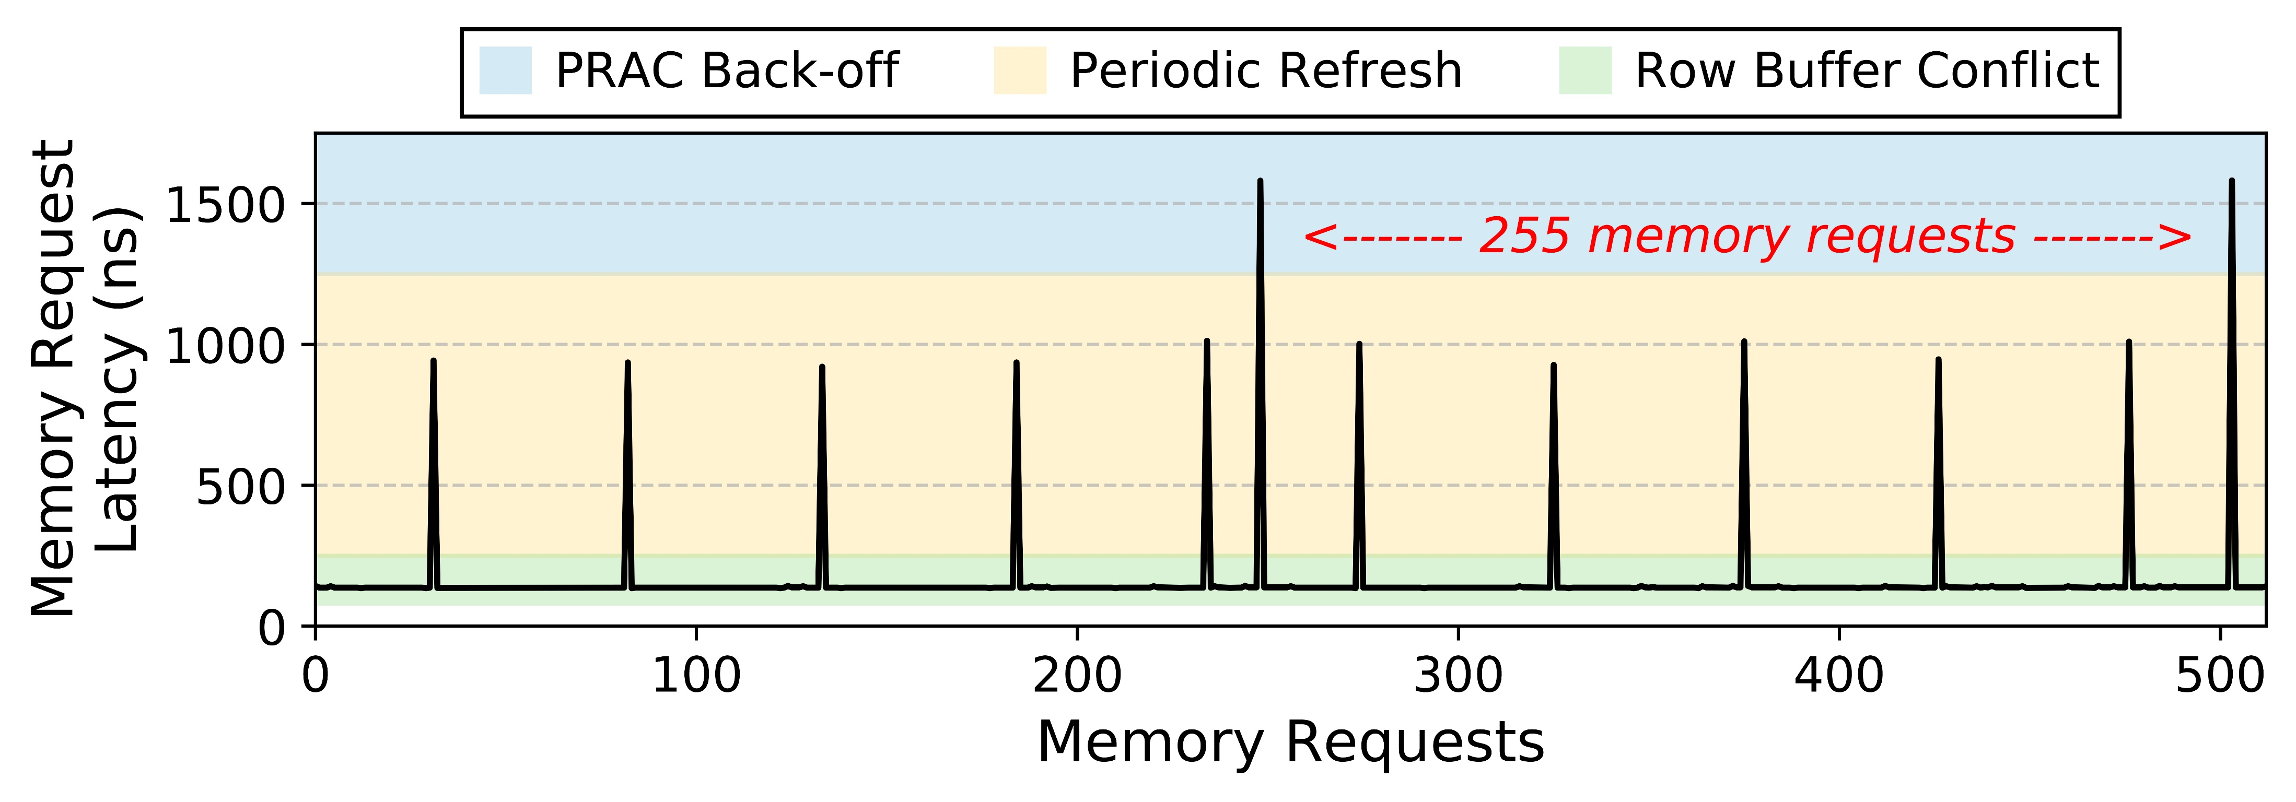
Observing PRAC-Induced Latencies (II)
N_{BO} = 128
Notes:
And now let me show you the measured request latencies.
On the X axis we see a window of 512 memory requests. And on the y axis we have the measured memory request latencies
[CLICK] and these are the results
[CLICK] We split the measured access latencies empirically into three categories, from the highest to the lowest latency, we have prac back-off, periodic refresh and row buffer conflict latencies.
We observe that…

Slide 63
Observing PRAC-Induced Latencies (II)
N_{BO} = 128
Back-off latency
The observed back-off latency is consistent with the specification and can be distinguished from regular memory operations
Notes:
… we can identify back-offs as the highest peaks in the figure
[CLICK] which is consistent with the specification and can be distinguished from regular memory requests
This experiment shows that PRAC creates a promising timing channel to build attacks.

Slide 64
PRAC-Based Covert Channel: Attack Overview
Encoding logic-1: back-off
logic-0: no-back-off
10101001
DRAM Bank
DRAM Rows
Ctrs
R_{Sender}
…
R_{Receiver}
Sender
Row Buffer
Receiver
Only 1 bit will be transmitted
Transmission Windows
Notes:
Now lets see an overview of the covert channel attack

Slide 65
PRAC-Based Covert Channel: Attack Overview
Encoding logic-1: back-off
logic-0: no-back-off
Loop: access R_{Receiver}
time( )
DRAM Bank
DRAM Rows
Ctrs
R_{Sender}
…
R_{Receiver}
Sender
Row Buffer
Receiver
Only 1 bit will be transmitted
used to determine the bit value
Recv.
Latency
Transmission Windows

Slide 66
PRAC-Based Covert Channel: Attack Overview
Encoding logic-1: back-off
logic-0: no-back-off
1 (Back-off)
1
DRAM Bank
DRAM Rows
Ctrs
R_{Sender}
…
R_{Receiver}
Sender
Row Buffer
Back-off
Receiver
back-off
Recv.
Latency
Transmission Windows

Slide 67
PRAC-Based Covert Channel: Attack Overview
Encoding logic-1: back-off
logic-0: no-back-off
0 (No Back-off)
0
Zzz
DRAM Bank
DRAM Rows
Ctrs
R_{Sender}
…
R_{Receiver}
Sender
HIT!
Row Buffer
Receiver
back-off
no back-off
Recv.
Latency
…
Transmission Windows

Slide 68
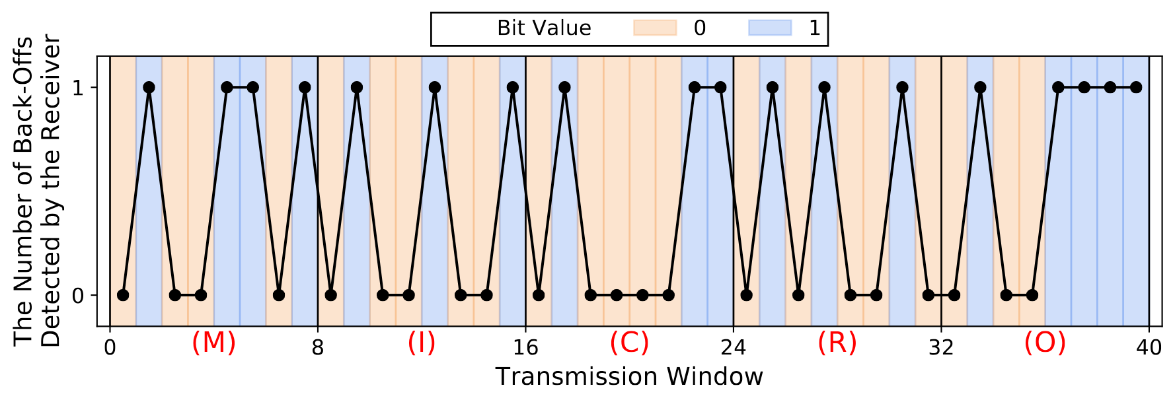
PRAC-Based Covert Channel: Proof-of-Concept and Channel Capacity
Validation with transmitting a 40-bit message
The receiver successfully decodes the sender's message
The attack achieves 39.0 Kbps raw bit rate
Notes:
When transmitting 1, the receiver detects a back-off after N_{BO} memory accesses, on average

Slide 69
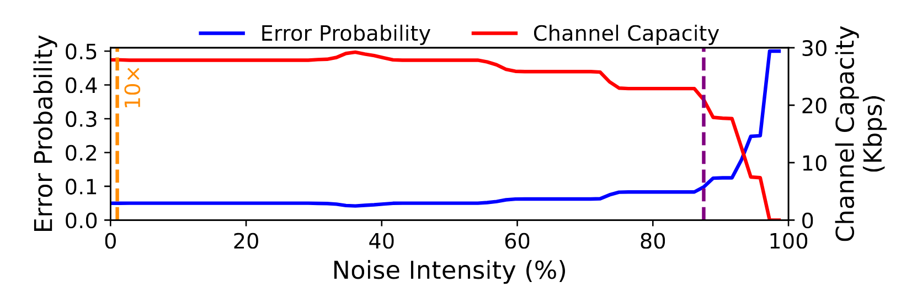
PRAC-Based Covert Channel: Noise Analysis
We use a microbenchmark that causes back-offs with varying frequencies to simulate system noise
27.8 Kbps
20.9 Kbps
0.05
0.1
1
1% = 10 x 4-core memory-intensive workload
Similar back-off intensity to memory performance attacks [Moscibroda+, USENIX Security'07]
The PRAC-based covert channel attack maintains its capacity until very high noise intensity values

Slide 70
LeakyHammer Case Studies
CS1: PRAC-Based Covert Channel Attack
CS2: RFM-Based Covert Channel Attack
CS3: PRAC-Based Website Fingerprinting

Slide 71
RFM-Based Covert Channel Summary
We exploit an RFM-based RowHammer defense that tracks the number of row activations per DRAM bank as described in the DDR5 standard
We observe that applications can intentionally trigger an RFM command and can detect it by observing the high memory latency
The attack successfully transmits the message
Due to per DRAM bank activation counting, applications can trigger RFM more easily, making the channel more susceptible to noise
Notes:
We also have a covert channel with RFM but Im not gonna talk about it

Slide 72
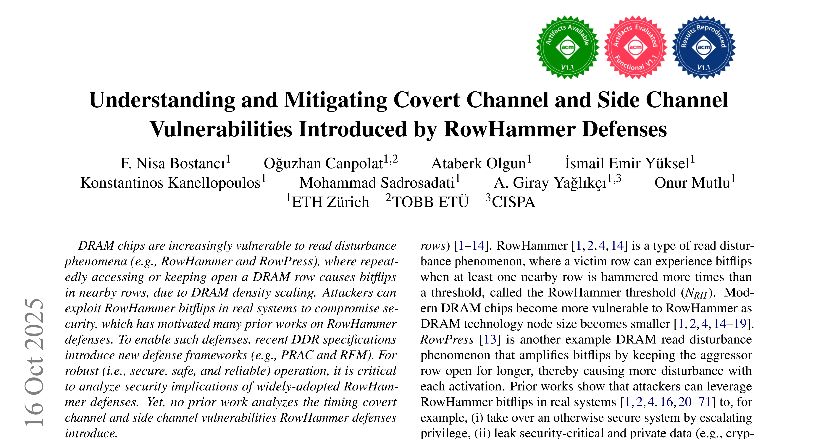
RFM-Based Covert Channel Summary
Send 1 w/ many RFMs
Count # of RFMs
Sender
Receiver
https://arxiv.org/abs/2503.17891

Slide 73
LeakyHammer Case Studies
CS1: PRAC-Based Covert Channel Attack
CS2: RFM-Based Covert Channel Attack
CS3: PRAC-Based Website Fingerprinting

Slide 74
PRAC-Based Website Fingerprinting Attack
No need to colocate in the same bank as back-off affects the whole channel
Attacker
Victim
Determines which website the victim loads
by only observing own memory request latencies
Loads websites using a web browser

Slide 75
Fingerprinting Attack Overview
Attacker
Victim
Measure memory request latencies
access test rows continuously and measure access latencies to detect back-offs
Notes:
Yellow bad

Slide 76
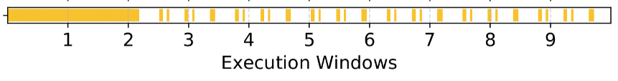
Fingerprinting Attack Overview
Attacker
Victim
Measure memory request latencies
Create fingerprints using backoffs
each line is a back-off
create fingerprint by only using the timestamps of back-offs
Notes:
Yellow bad

Slide 77
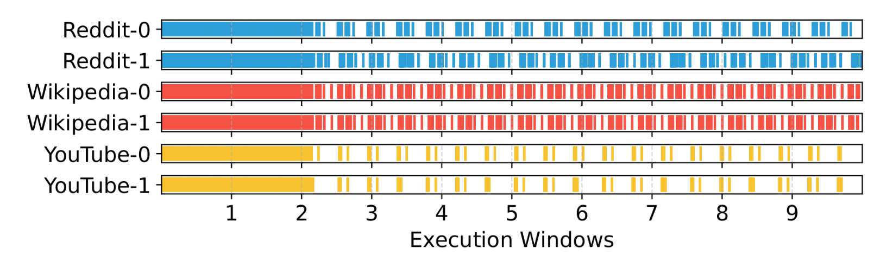
Fingerprinting Attack Overview
Attacker
Victim
Measure memory request latencies
Create fingerprints using backoffs
Collect many fingerprints
Notes:
Yellow bad

Slide 78
Launching the Attack
Attacker
Get a fingerprint when the victim loads a website
1
Victim
compare with the database and determine the website
2
Website: YouTube

Slide 79
PRAC-Based Website Fingerprinting: Evaluation
We collect back-off fingerprints of many websites
40 most-visited websites from Semrush and Similarweb top sites
A machine learning approach to classify websites:
Simple and lightweight machine learning models (e.g., decision tree, random forest, gradient boosting, k-nearest neighbors)
Using back-off-based fingerprints, classical machine learning models can classify websites with up to 75% accuracy

Slide 80
Talk Outline
Motivation and Problem
Key Observation
LeakyHammer and Case Studies
Mitigating LeakyHammer
Conclusion
Notes:
We showed that LeakyHammer can have significant implications on system security and now lets discuss how to mitigate it

Slide 81
Mitigating LeakyHammer
We propose three countermeasures against LeakyHammer:
Fixed-Rate RFM (FR-RFM) eliminates LeakyHammer by decoupling preventive actions from memory access patterns of running applications
Randomly Initialized Activation Counters (RIAC)
reduces channel capacity with a randomization method
Bank-Level PRAC (PRAC-Bank)
performs bank-level preventive actions to limit the attack scope to that of existing DRAM-based attacks

Slide 82
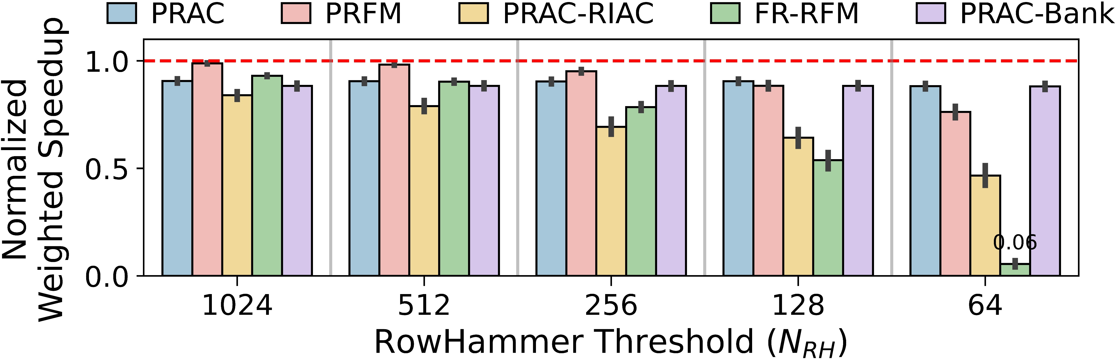
Evaluating LeakyHammer Countermeasures
60 four-core workloads: SPEC2017 and SPEC2006
not secure against LeakyHammer
reduces the capacity by 86%
secure against LeakyHammer
limits the attack scope
FR-RFM mitigates LeakyHammer and performs similar to PRAC and PRFM for near-future N_{RH} values (e.g., 1024)
As N_{RH} decreases, other countermeasures have lower performance overheads

Slide 83
More in the Paper
More details of LeakyHammer
Operational details on case studies (e.g., RFM-based covert channel)
Multibit LeakyHammer covert channels
LeakyHammer countermeasures
More results and analyses
LeakyHammer with other RowHammer mitigations
Impact of real workloads on LeakyHammer
Sensitivity of PRAC-based covert channel
Impact of RFM commands per back-off, RowHammer defense latency, larger cache hierarchy and data prefetchers
Comparison against existing cache and memory-based timing channels

Slide 84
More in the Paper
More details of LeakyHammer
Operational details on case studies (e.g., RFM-based covert channel)
Multibit LeakyHammer covert channels
LeakyHammer countermeasures
More results and analyses
Analysis of LeakyHammer with other RowHammer mitigations
The impact of real workloads on LeakyHammer
Sensitivity of PRAC-based covert channel
The impact of RFM commands per back-off, RowHammer defense latency, larger cache hierarchy and data prefetchers
Comparison against existing cache and memory-based timing channels
https://arxiv.org/abs/2503.17891

Slide 85
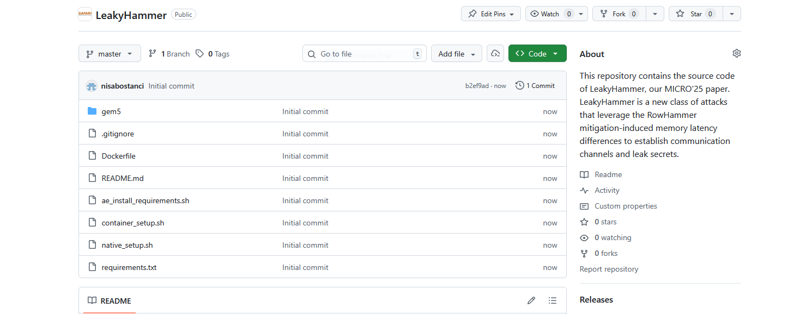
LeakyHammer is Open Source and Artifact Evaluated
https://github.com/CMU-SAFARI/LeakyHammer

Slide 86



Understanding and Mitigating Covert Channel and Side Channel Vulnerabilities Introduced by RowHammer Defenses
arXiv
GitHub
F. Nisa Bostancı
O. Canpolat A. Olgun I. E. Yüksel K. Kanellopoulos M. Sadrosadati A. G. Yağlıkçı O. Mutlu

Slide 87
Ramulator: Research Highlights
Nisa Bostancı 27.06.2026 R&DB Tutorial at ISCA’26
Notes:
Hi everyone, I am Nisa, and I will be

Slide 88
Cleaning up the Mess Re-Evaluating the Real-System Modeling Accuracy of Ramulator 2.0
Backup Slides
F. Nisa Bostancı* Haocong Luo* Ataberk Olgun* Maria Makeenkova Geraldo F. de Oliveira A. Giray Yağlıkçı Onur Mutlu * Equal Contribution

Slide 89
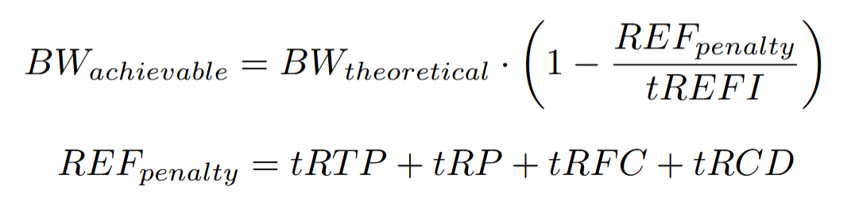
Maximum Achievable Bandwidth

Slide 90
Further Evaluation of DAMOV Results
The bandwidth gap can be caused by a combination of workload characteristics, system configuration, and the integration of the core and memory models
E.g., DRAM address mapping, core model optimizations

Slide 91
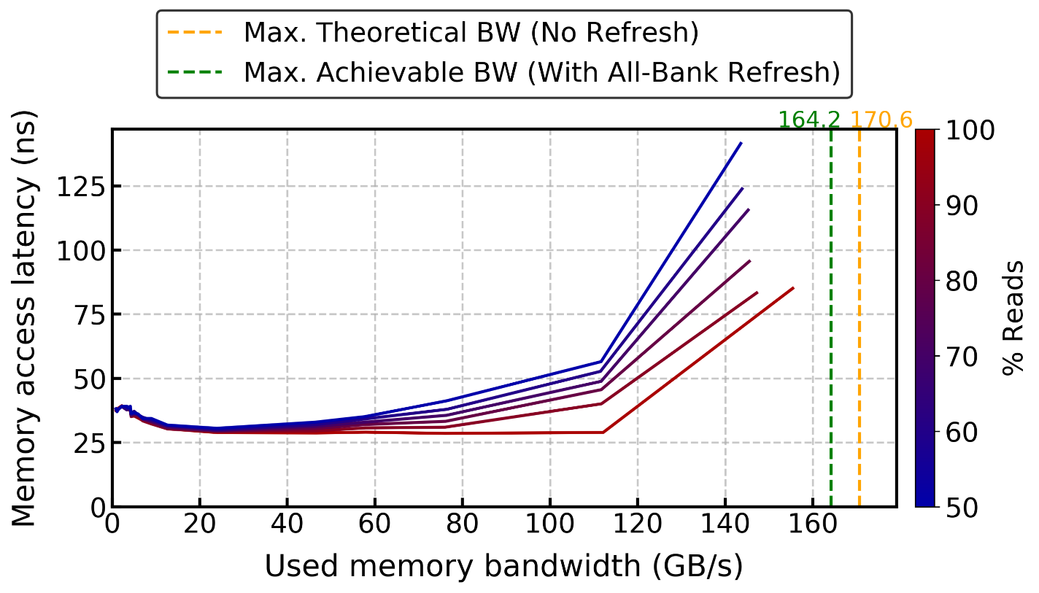
Ramulator (v1) – Mess Benchmark

Slide 92
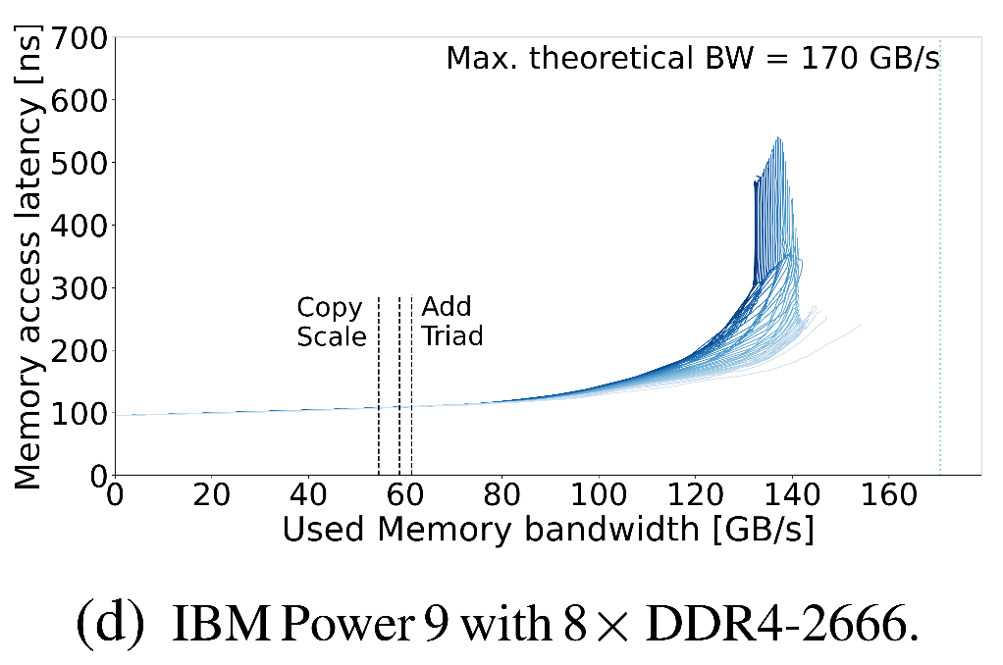
Another DDR4 Real System Result from the Mess Paper

Slide 93
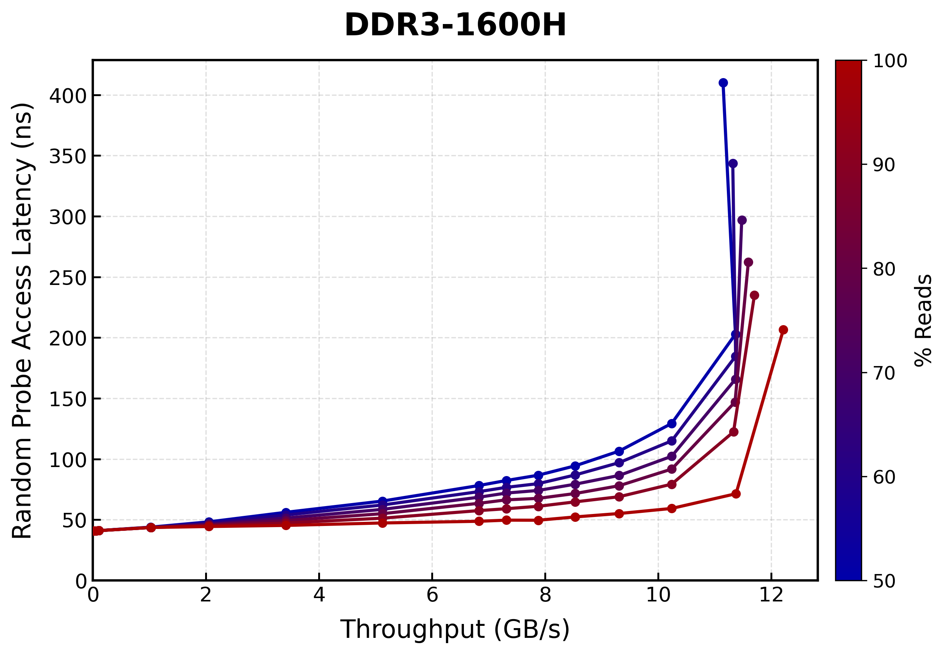
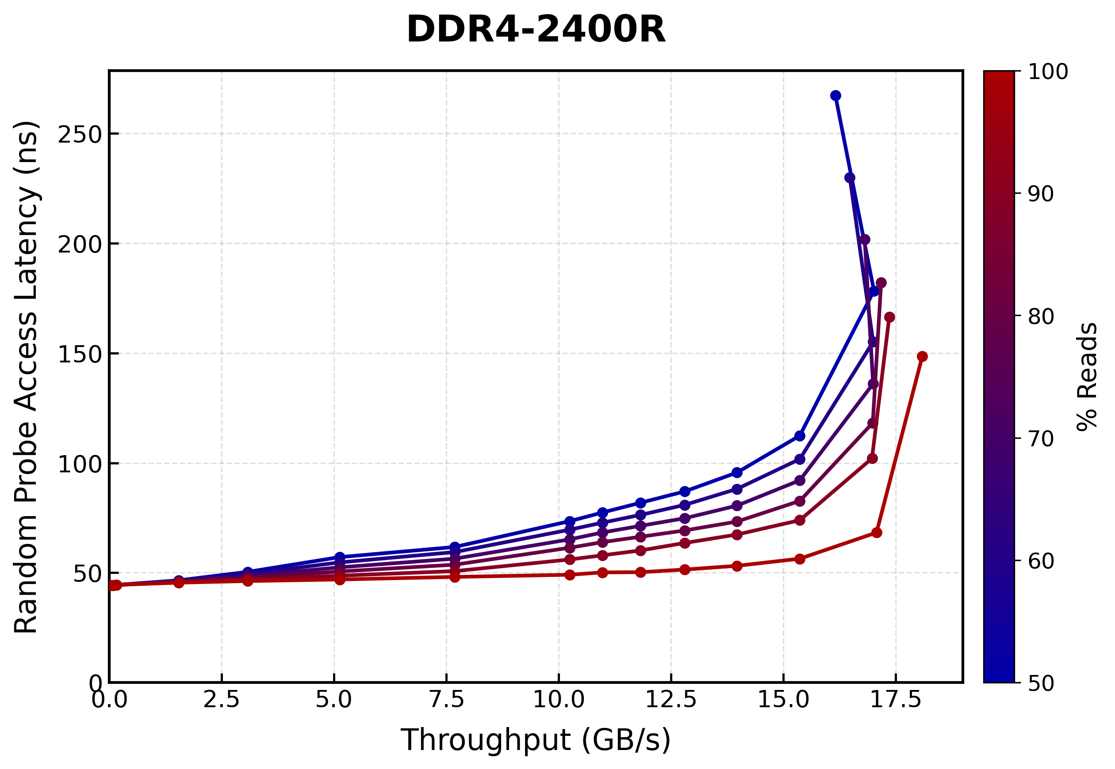
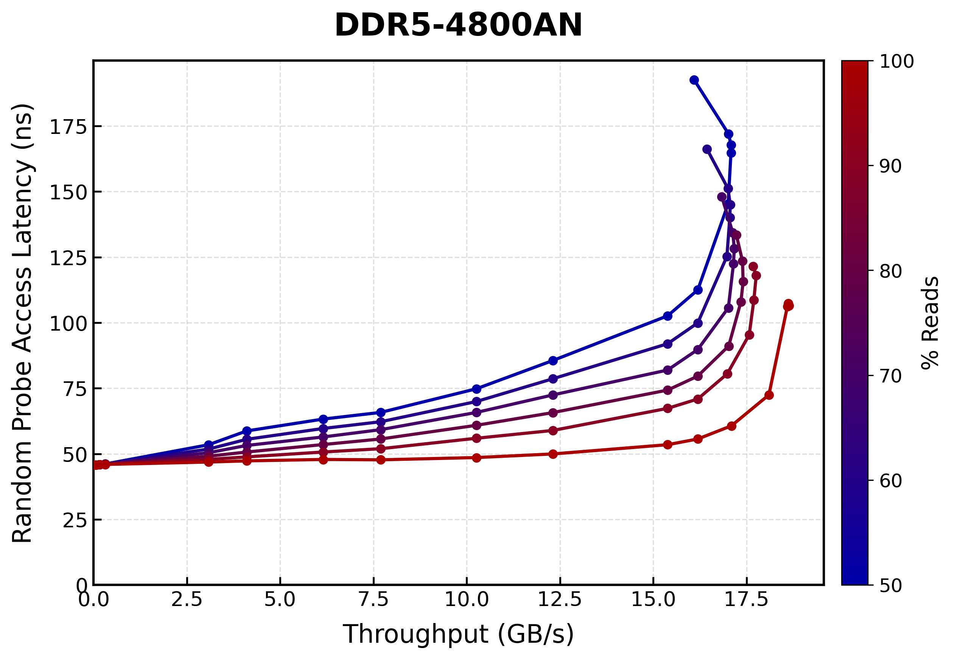
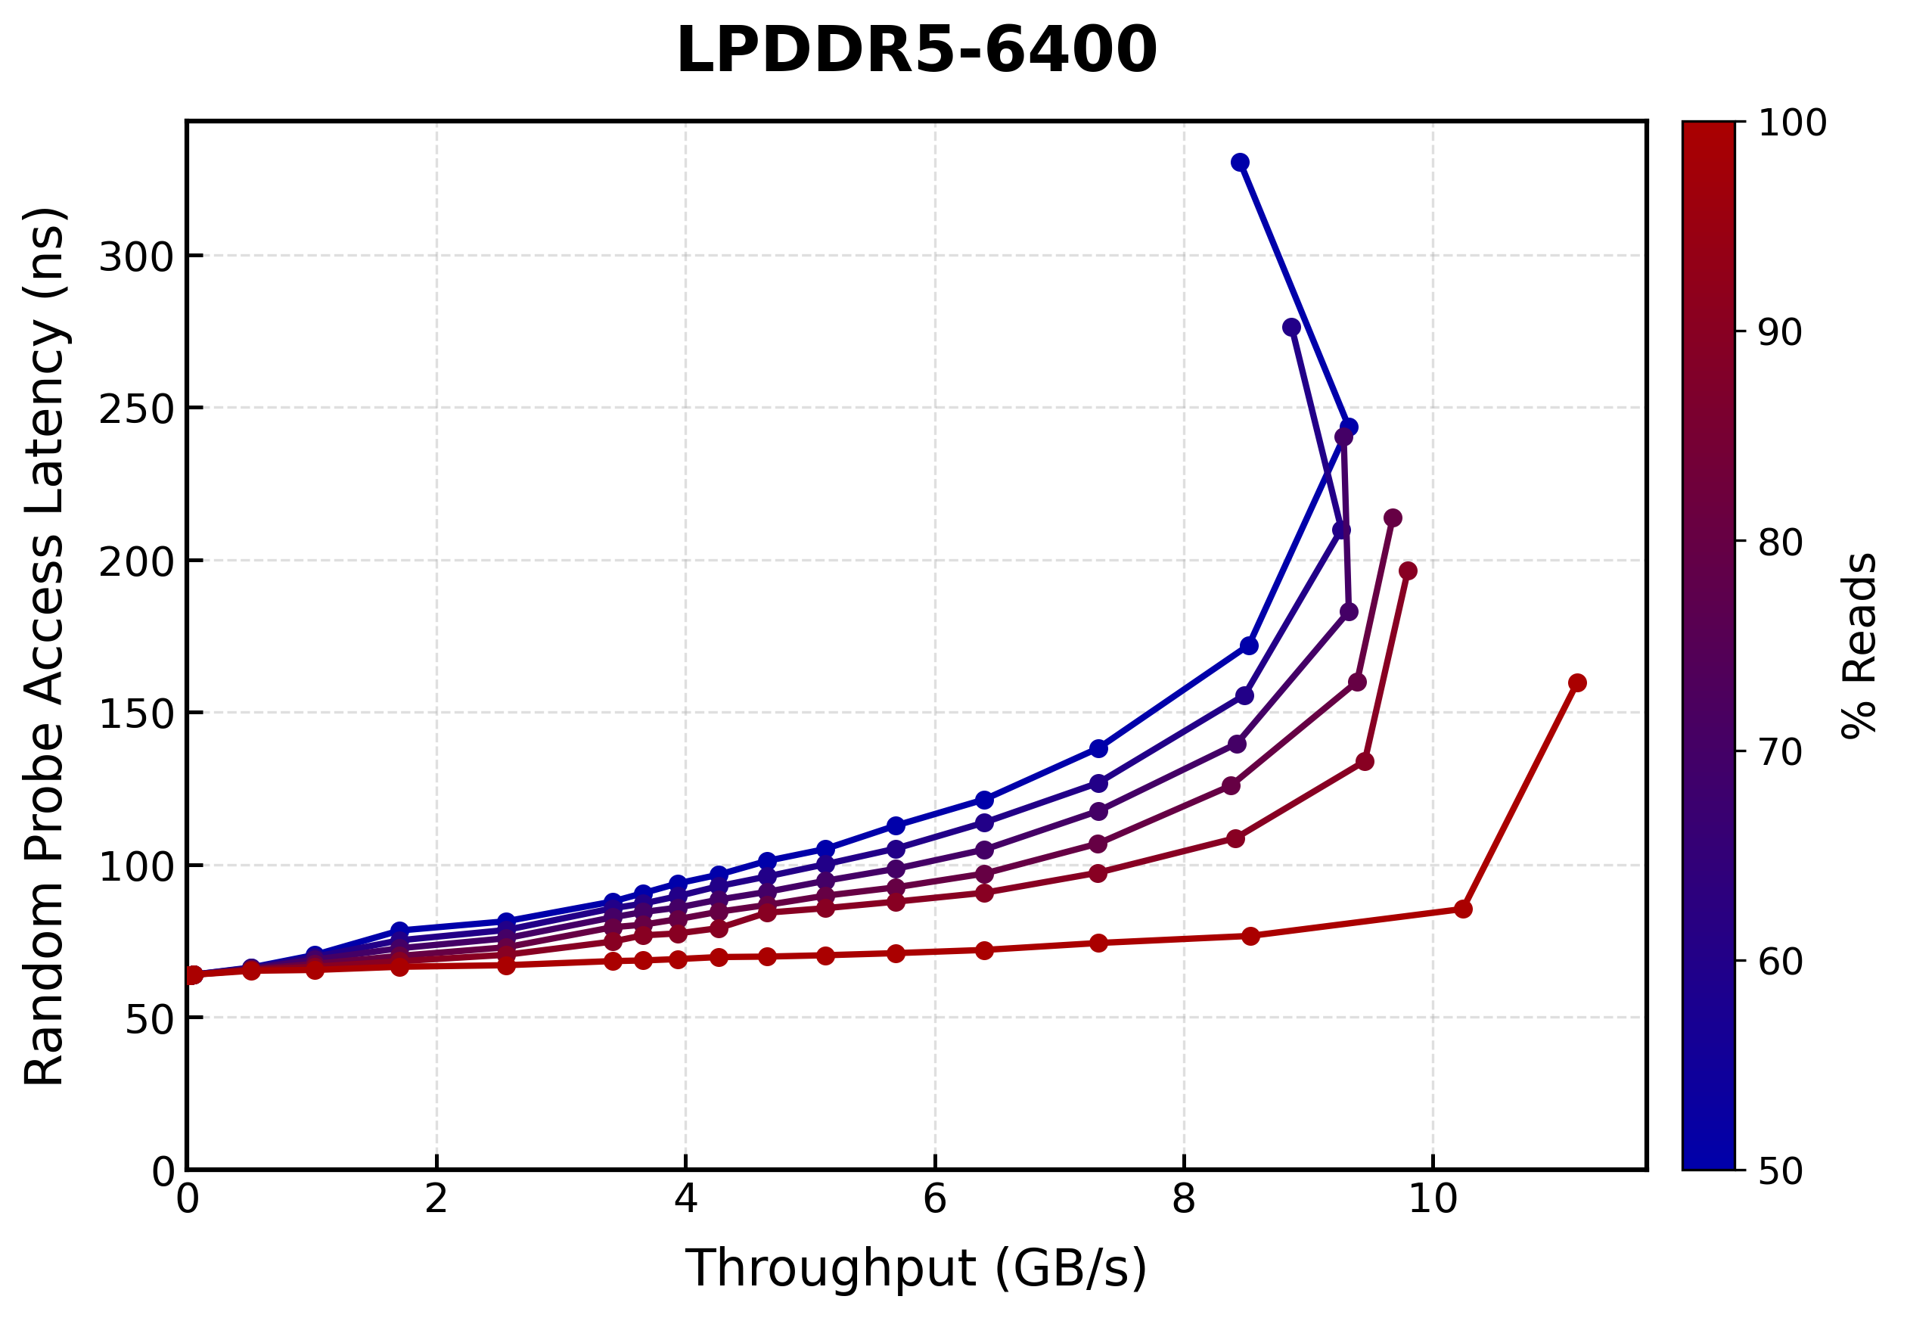
Ramulator 2.1 DRAM Standards Lat-Tp Plots

Slide 94
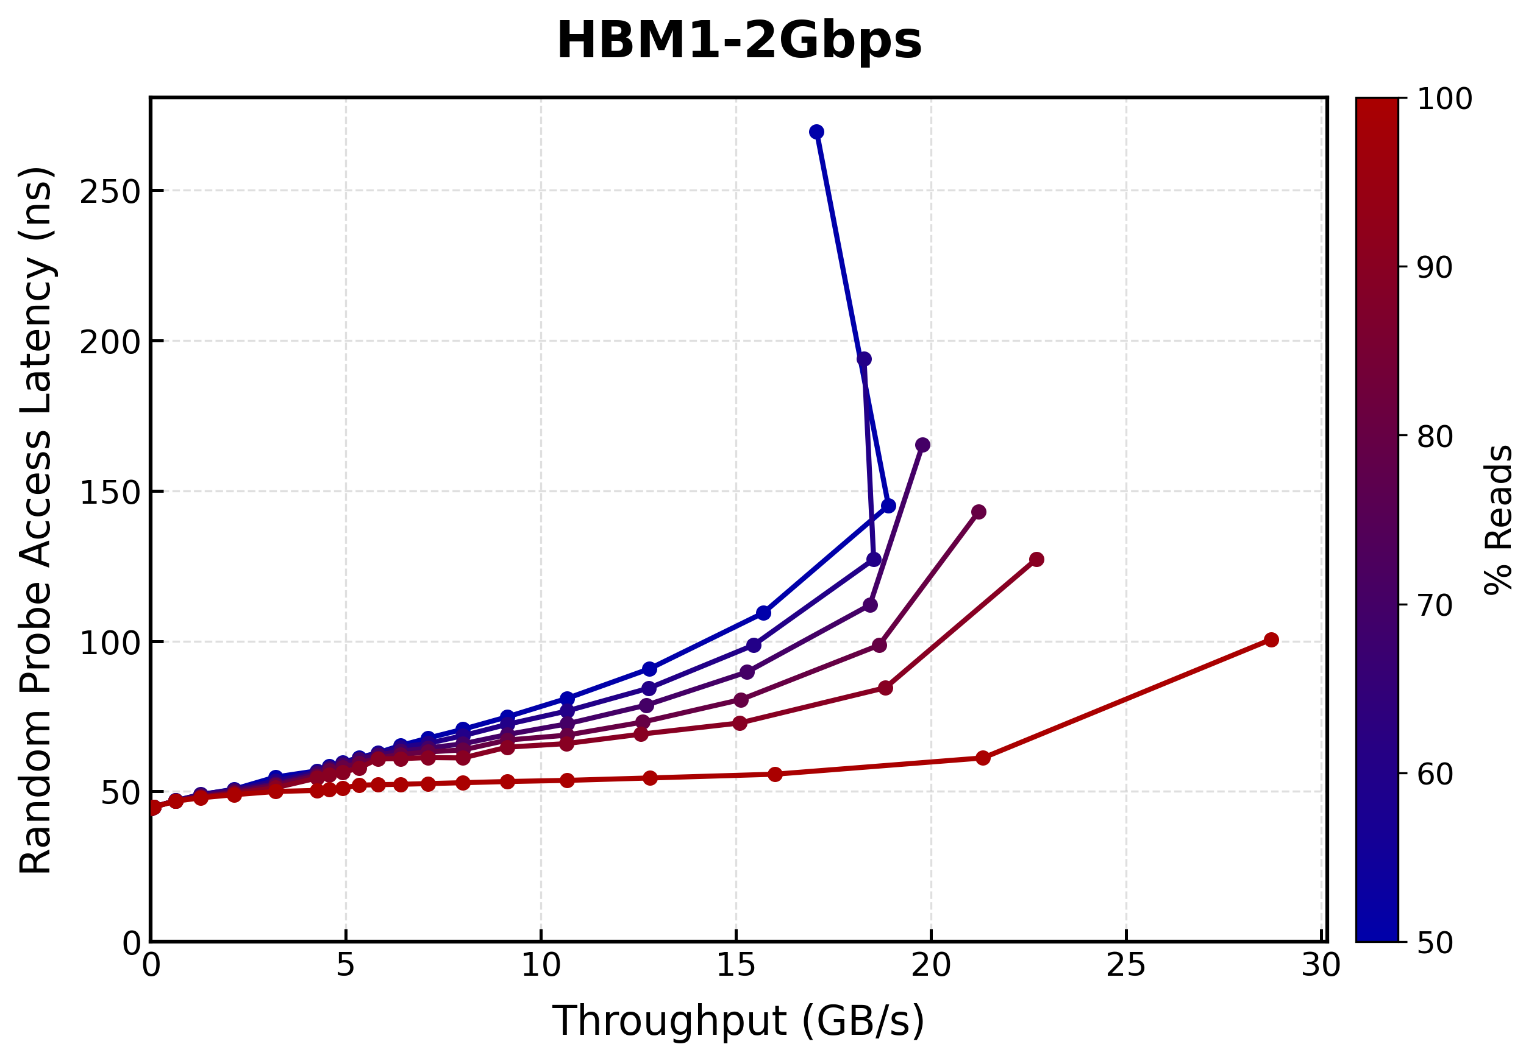
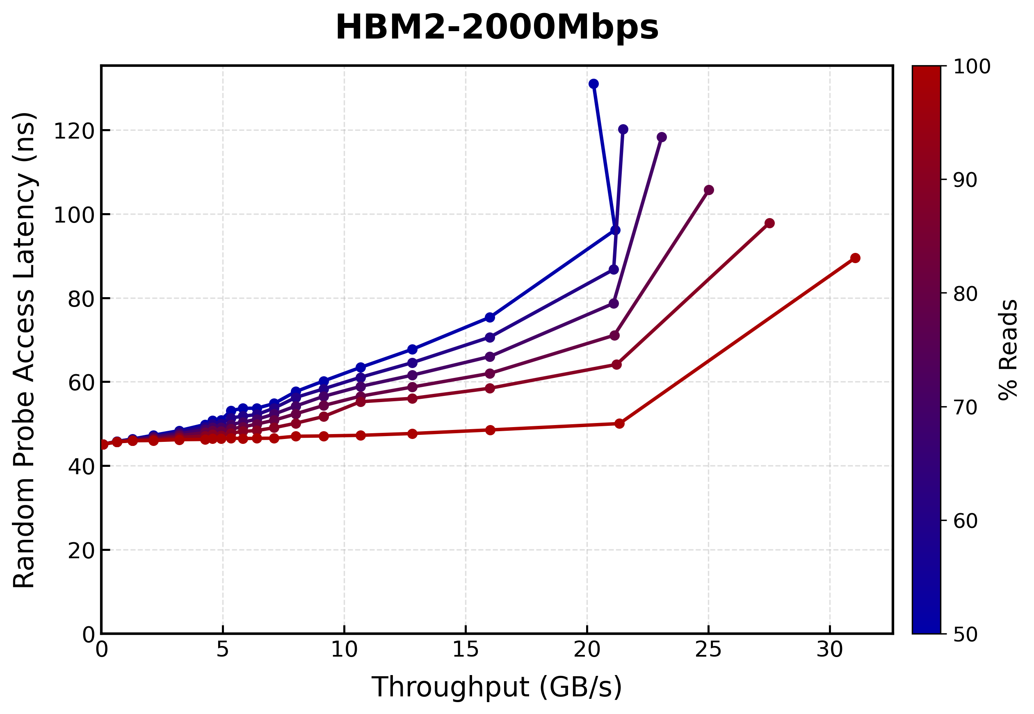
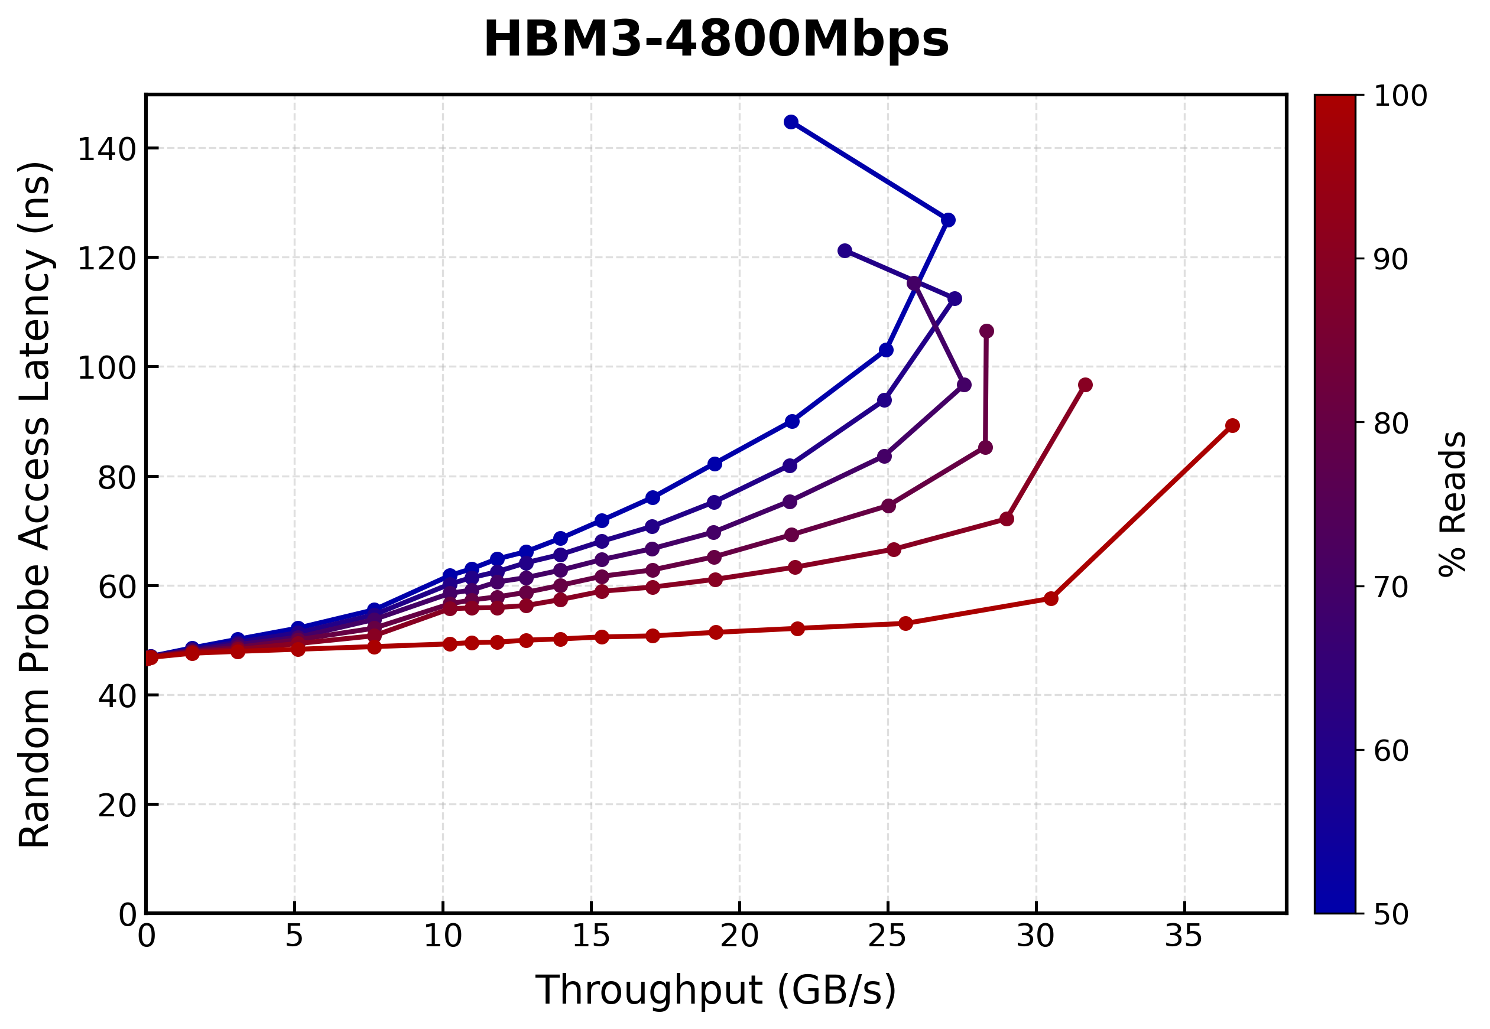
Ramulator 2.1 DRAM Standards Lat-Tp Plots
* HBM timings are guestimates

Slide 95
Ramulator 2.1
Major overhaul of Ramulator 2.0 that includes
Aggregated bug fixes and code quality improvements
Better support of newer DRAM and controller features, e.g.,
Row-Col command dual issue controller for HBM2+
WCK2CK sync and expiry tracking and ACT-1/ACT-2 split with tAAD deadline aware scheduling for LPDDR5
Significantly improved ease-of-use, configuration, and extension
More comprehensive test suite
More comprehensive documentation
Currently available as a pre-release in the v2.1 branch
Welcomes your use, contribution, and feedback!
We will be making v2.1 the default branch soon
https://github.com/CMU-SAFARI/ramulator2/tree/v2.1
Notes:
Add screenshot, reduce information and font sizes
We take this opportunity to introduce ramulator 2.1, which is a major overhaul of Ramulator 2.0 ..
And if you want to learn more about it
You can come to our workshops in ICS and ISCA
And advertise proceedings can be a separate slide for workshops? A lot of info in points, might not be necessary

Slide 96
Fundamental Configuration Errors: Smaller Used Bandwidth
The Mess paper's evaluation:
Ramulator 2.0
Real System
8 DDR5 channels
16 DDR5 channels
The Mess paper incorrectly assumes a DDR5 channel in Ramulator 2.0 is 64-bit, instead of the actual width of 32-bit that is consistent with JEDEC DDR5 standards (JESD79-5)
Notes:
Ramulator 2.0 results show around half the used bandwidth of real system measurements, as it has half the number of channels.
We identify that this is because, the mess paper incorrectly assumes a DDR5 channel in Ramulator 2 is 64 bits wide
Whereas the implementation clearly states a channel as 32 bits wide, which is the consistent value with the JEDEC DDR5 standards

Slide 97
Fundamental Configuration Errors: Smaller Used Bandwidth
The Mess paper's evaluation:
Ramulator 2.0
Real System
8 DDR5 channels
16 DDR5 channels
The Mess paper incorrectly assumes a DDR5 channel in Ramulator 2.0 is 64-bit, instead of the actual width of 32-bit that is consistent with JEDEC DDR5 standards (JESD79-5)
The Mess paper configures Ramulator 2.0 with half the channels of a real system, and thus, results in smaller used bandwidth
Notes:
Because of this configuration error, the mess paper configures Ramulator 2 with half the channels of a real system and thus results in smaller used bandwidth

Slide 98
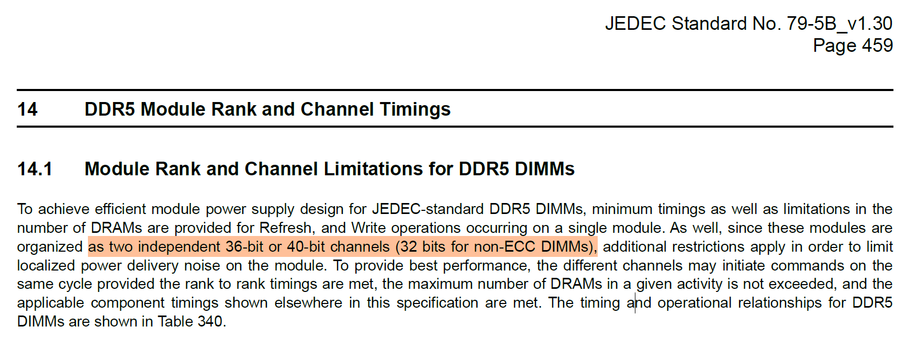
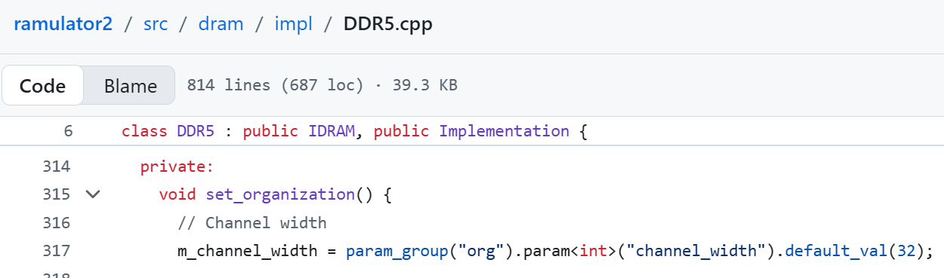
DDR5 Channel Terminology
Notes:
Add screenshot, reduce information and font sizes
We take this opportunity to introduce ramulator 2.1, which is a major overhaul of Ramulator 2.0 ..
And if you want to learn more about it
You can come to our workshops in ICS and ISCA
And advertise proceedings can be a separate slide for workshops? A lot of info in points, might not be necessary

Slide 99
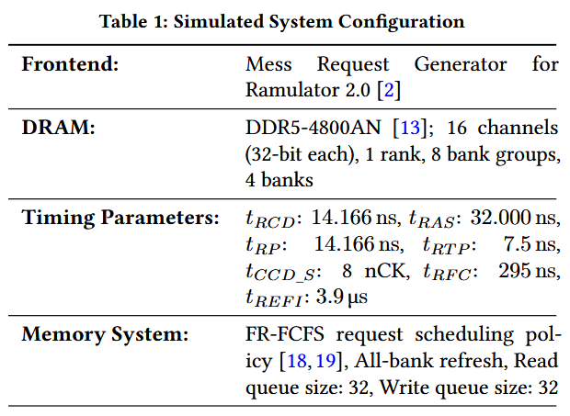
Ramulator 2.0 Simulation Configurations

Slide 100
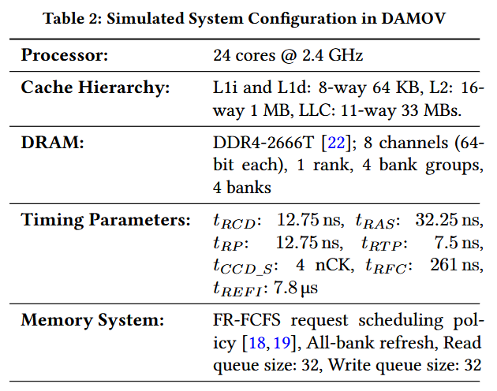
DAMOV Simulation Configurations

Slide 101
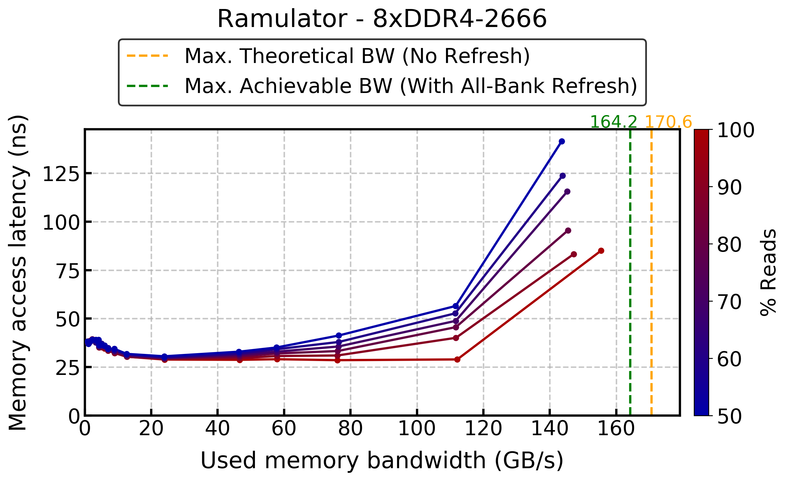
Ramulator (v1) – Mess Benchmark

