Slide 1
Fixing bugs once and for all

Slide 2
Preparations
rustup update nightly
git checkout https://github.com/oli-obk/rustfest2018_workshop.git
(oli-obk/rustfest2018_workshop)
cd rustfest2018_workshop
rustup override set nightly
cargo test
Wifi: Ionis Portal
user: event-epitech-prs
pw: Pr$3p1t3ch

Slide 3
$whoami
Clippy
Miri
Serde

Slide 4
Ftp
Wifi: Ionis Portal
user: event-epitech-prs
pw: Pr$3p1t3ch

Slide 5
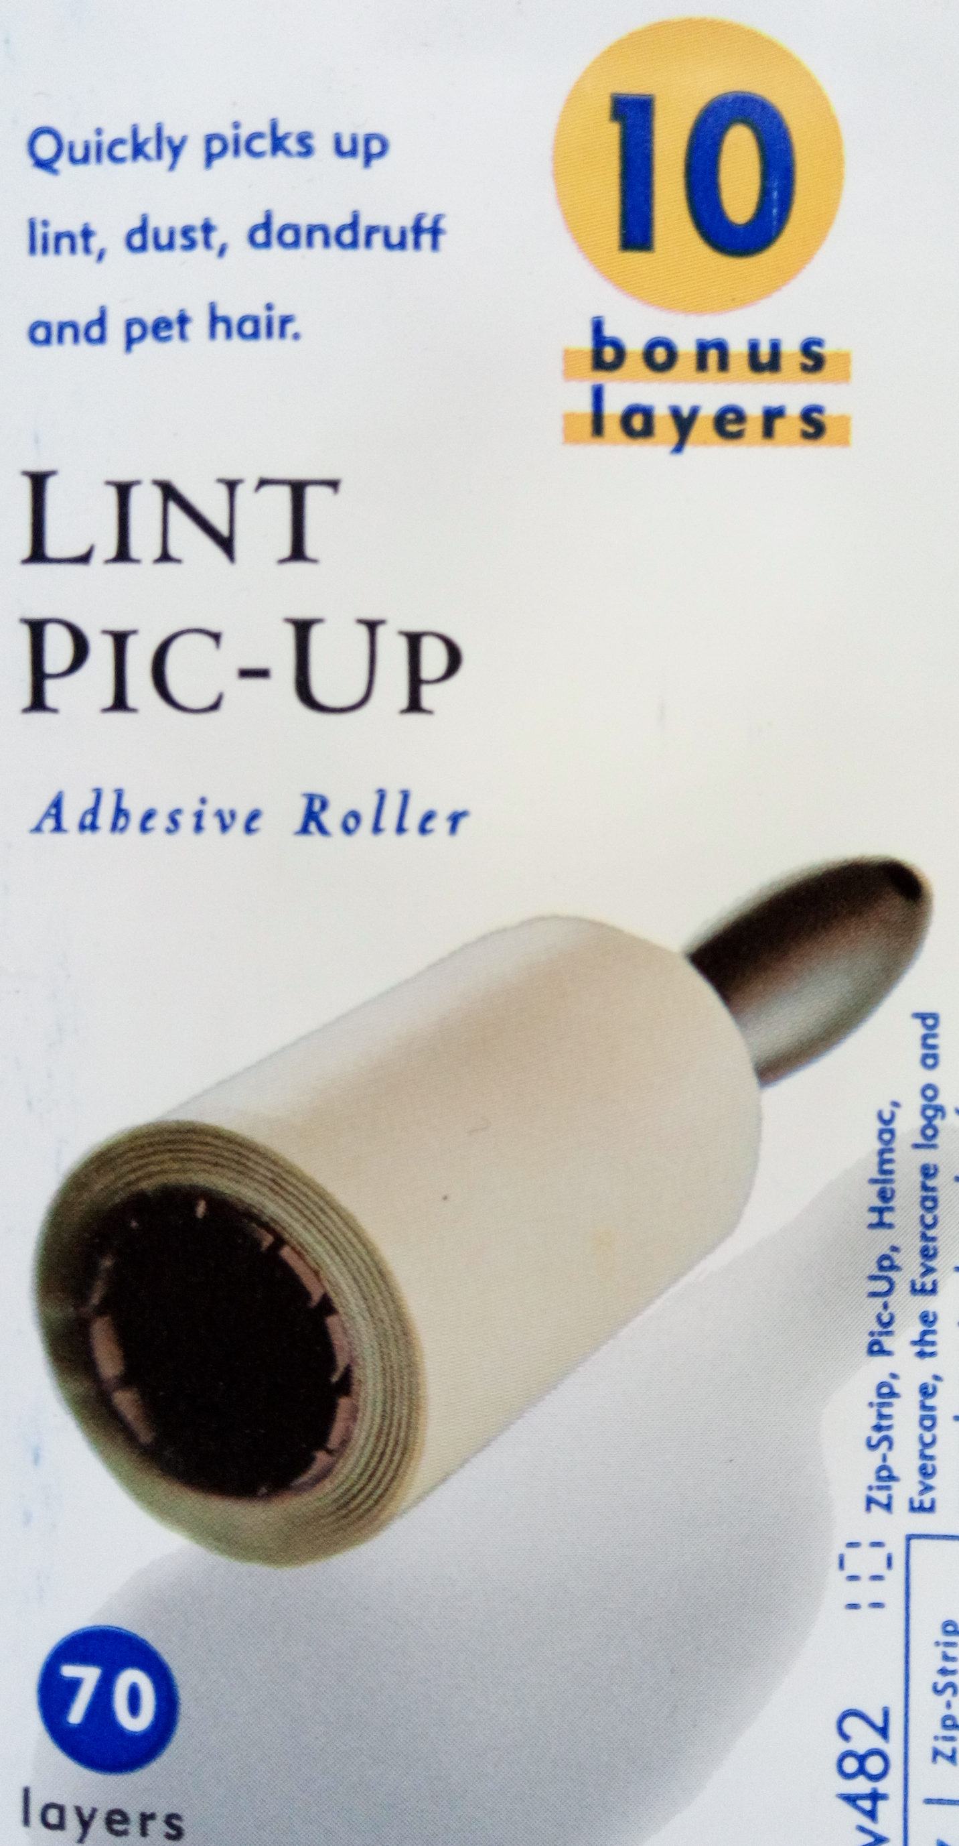
What is clippy?
A linter
A static analysis tool
Very annoying
Very helpful

Slide 6
Static analysis
The process of obtaining information
about the runtime behaviour of your program
without acutally running your program
Aka error messages

Slide 7
That‘s great…
everything already exists…
So you may be asking yourself:
...why am I here?

Slide 8
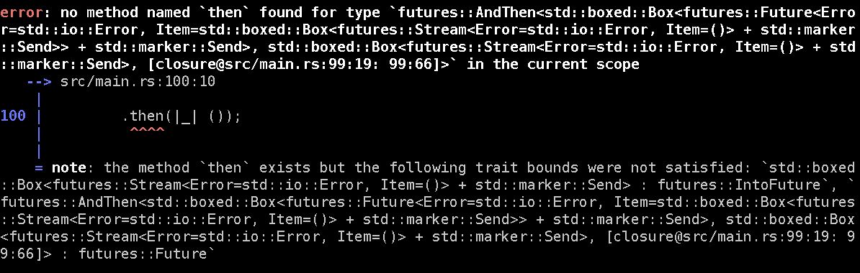
Project specific static analyses
Servo
  Garbage collection is hard
  Encoding it in the type system produces e.g.

Slide 9
How does it all work?
Step 1
  Create a new rustc binary that has more lints than the vanilla one
Step 2
  Use that rustc binary instead of the vanilla one by setting RUSTC_WRAPPER=my_awesome_rustc

Slide 10
Fin

Slide 11
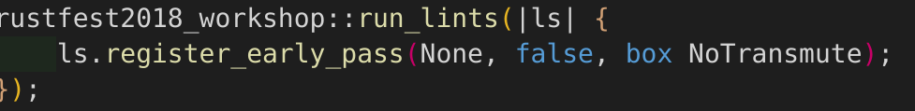
Just kidding – Let‘s do this
There are 150 lines of boilerplate
  (without code for even a single lint)
  I abstracted them away for you
Now it‘s three lines of code:

Slide 12
early_pass? What‘s going on?
Two kinds of lints (actually 3, but not today)
EarlyLintPass
  Syntactic lints, no types available
LateLintPass
  Lowered Datastructures (no for/while, just loop+if)
  Types!

Slide 13
Declaring a lint
declare_lint! macro
3 arguments:
  pub LINT_NAME
  Lint level (Allow, Warn, Deny, Forbid)
  A short description

Slide 14
Lint structure
pub struct HelperType;
impl LintPass for HelperType { … }
choose one:
  impl EarlyLintPass for HelperType { … }
  impl LateLintPass for HelperType { … }

Slide 15
LintPass Boilerplate
fn get_lints(&self) -> LintArray {
lint_array!(LINT_NAME)
}

Slide 16
Documentation
forge.rust-lang.org
„The rustc API docs are hosted here“
Search for „EarlyLintPass“
Big list of methods!
  Implement only those you want to run checks for

