Slide 1
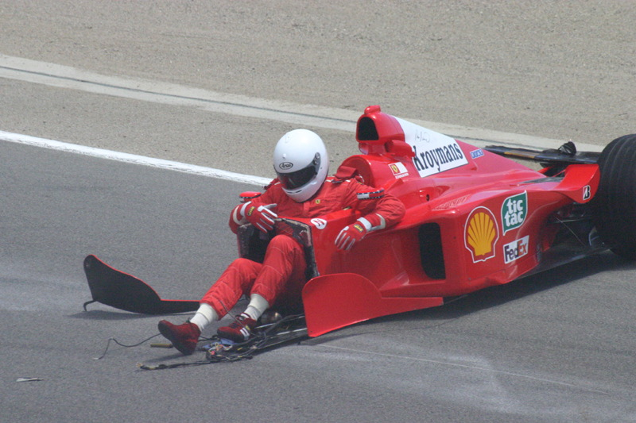
Driver Safety in Formula 1
Analysing the changes in driver safety in Formula 1 over time

Slide 2
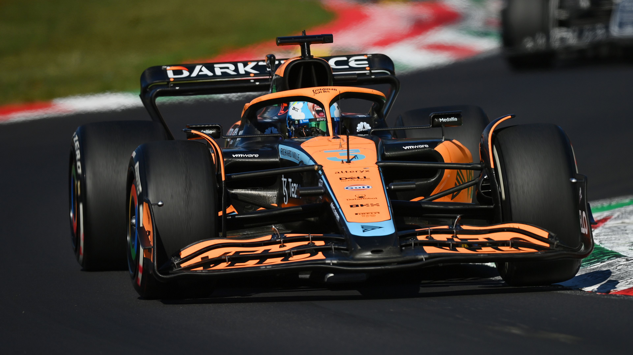
In recent decades, the sport of Formula 1 has prided itself on driver safety.

Slide 3
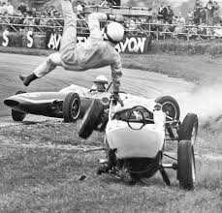
In the early decades of the sport (1950-1990) Formula One was extremely high risk for drivers.

Slide 4
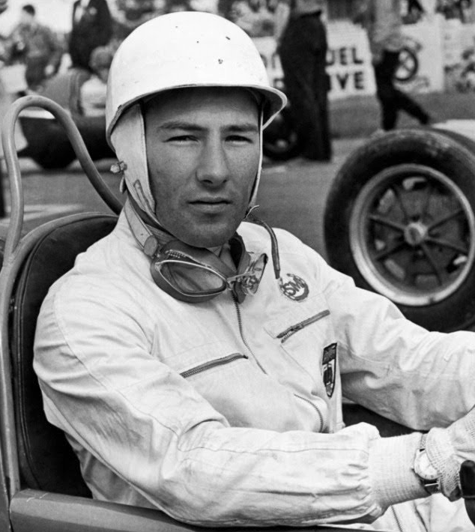
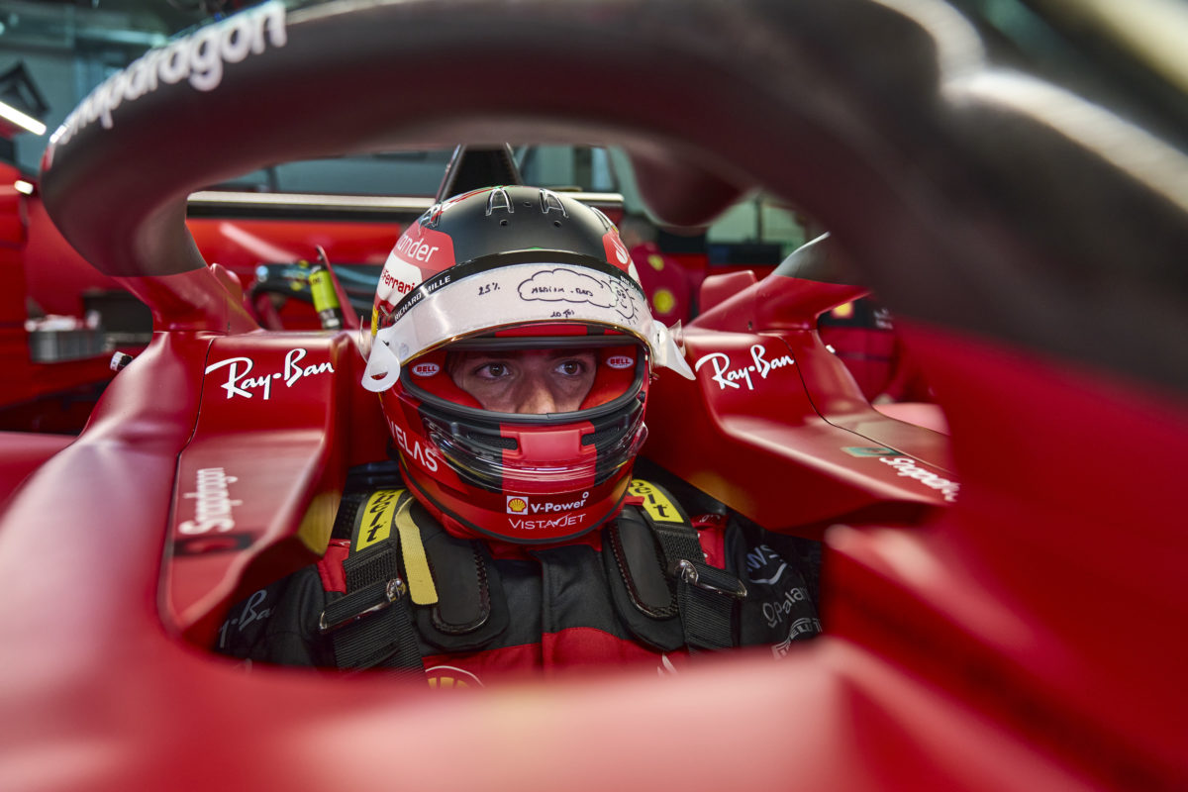
We decided to look at driver safety over the years by analysing driver fatalities and injuries.
1950’s
vs.
2020’s

