Slide 1
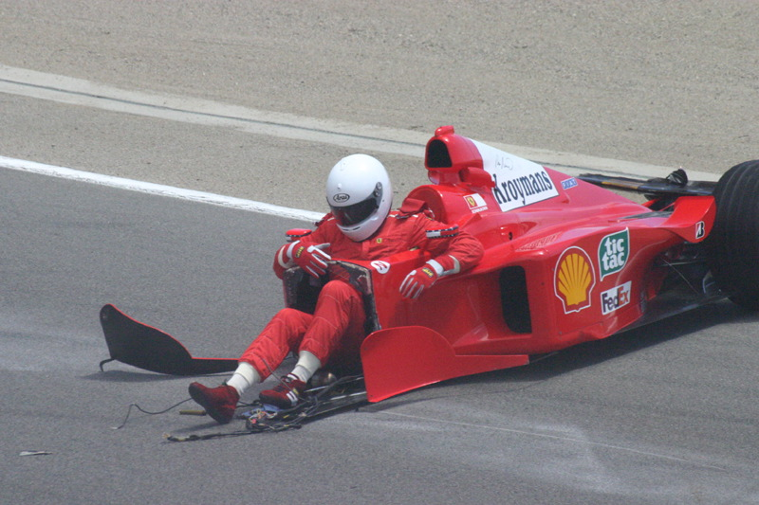
Driver Safety in Formula 1
Analysing the changes in driver safety in Formula 1 over time

Slide 2
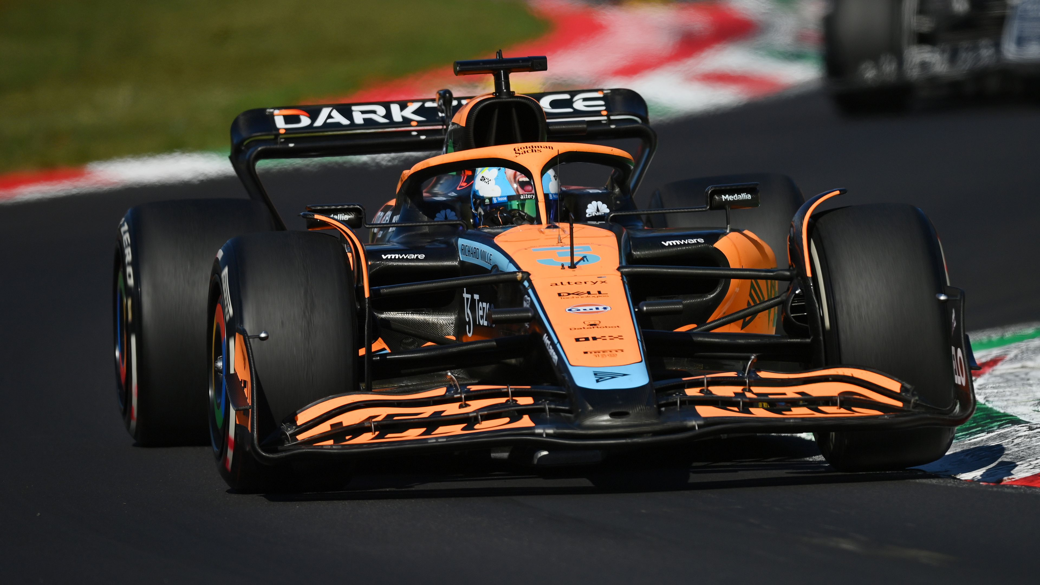
Formula 1 is the world’s premiere motor racing category.

Slide 3

In recent decades, the sport of Formula 1 has prided itself on driver safety.

Slide 4
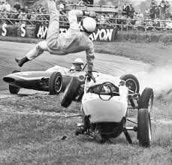
In the early decades of the sport (1950-1990) Formula 1 was extremely high risk for drivers.

Slide 5
Has the sport of Formula 1 become safer for competing drivers?

Slide 6
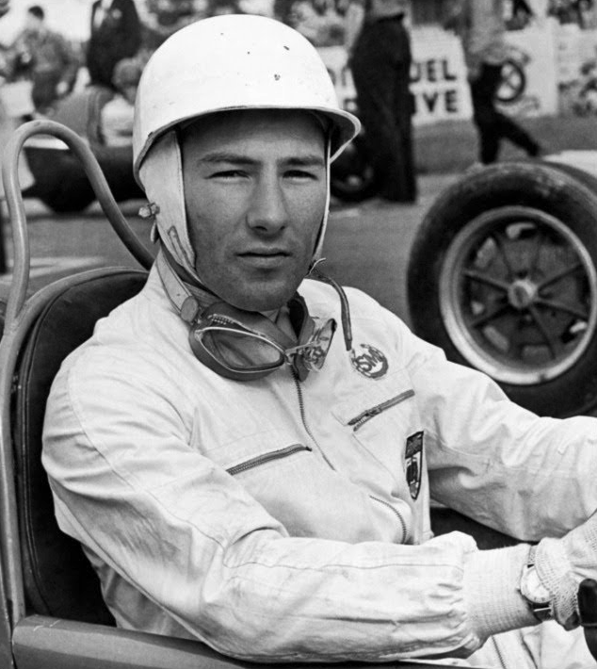
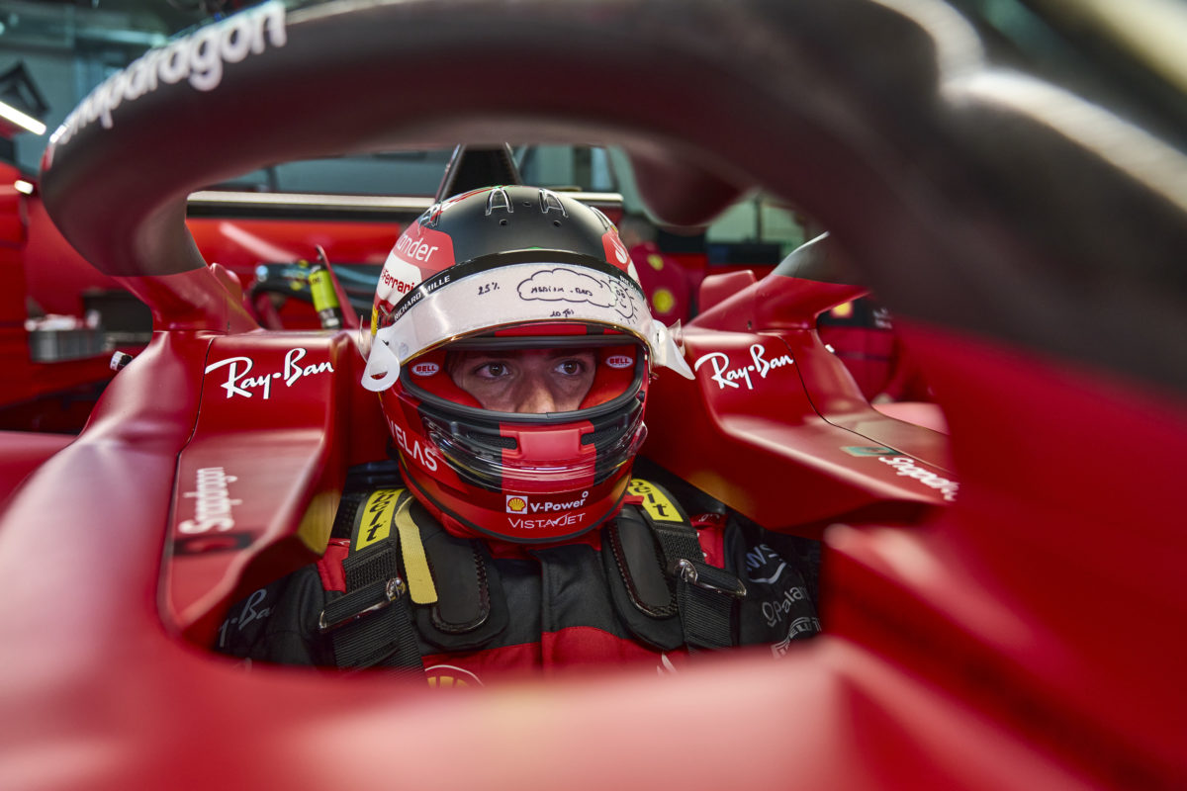
By analysing driver fatality and injury data, we seek to answer this question.

Slide 7
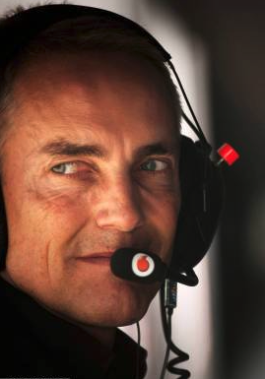
We Analysed:
Rate of Fatal Accidents
Rate of Injury due to Accidents
Fatalities at Different Types of Circuits

Slide 8
QUESTION 1
Has the rate of fatal accidents in Formula 1 events decreased over time?

Slide 9
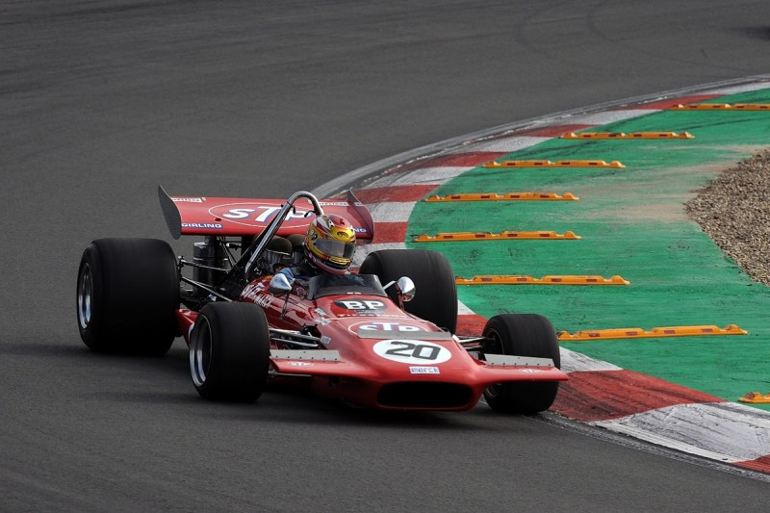
Fatalities in f1 Races
1950 to 2022 data
F1 Races only
Safety measures constantly under review
Significant changes to car requirements from 1990’s onward
David Ferrer at Zandvoort, 2017

Slide 10
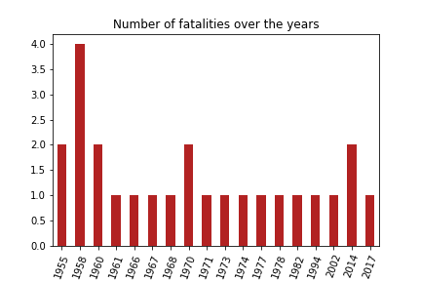
Fatalities over the years
Fatalities predominately happened in 50s to 70s
80s to 00s only had one fatality per decade
2014 saw two deaths
2017 was the most recent death in F1 racing

Slide 11
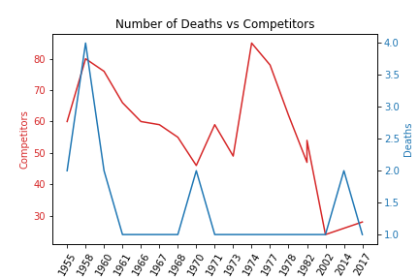
Fatalities vs number of drivers
Significant fluctuation
Changes in both numbers of drivers per race AND number of drivers involved in the F1 sport

Slide 12
QUESTION 2
Has the rate of injury due to accidents in Formula 1 events decreased over time?

Slide 13
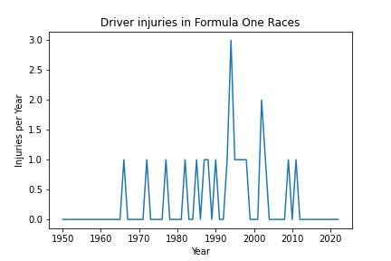
Injuries per Year
21 recorded injuries to drivers.
Maximum number of injuries in one season was 3 in 1994. There were two large periods of time where no injuries were recorded, 1950 - 1965 and 2012 to 2022.
This would show that Formula One has had a relatively safe record across the 73 seasons of competition.
This data does not include qualifying or practice sessions nor any test events.

Slide 14
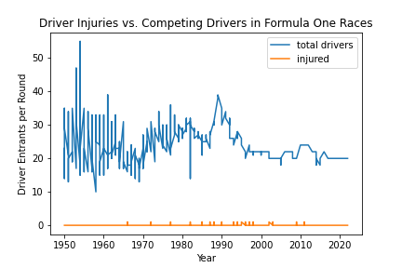
Driver injuries vs participants
In total there have been 25,840 entrants (total drivers) across 1,079 races and only 21 recorded injuries across the 73 seasons of Formula One.
Drivers entered into races varied from 13 -14 to a high of 55.
The number of drivers entered in races bares no correlation to the number of injuries to drivers over the 73 seasons of Formula One.
This data does not include qualifying or practice sessions nor any test events

Slide 15
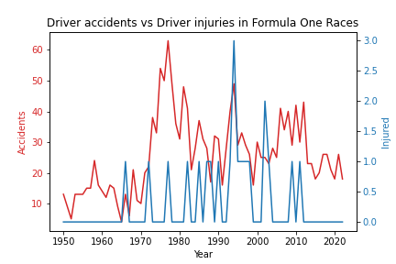
Driver accidents vs driver injuries
Accidents took a sharp up turn through the 1970s
No injuries have been recorded across the years of 1950 - 1965 and 2012 to 2022
latter part of 2000's showed accidents in the mid to high 30's per year compared to low to mid 20's per year in the last 10 years
This data does not include qualifying or practice sessions nor any test events

Slide 16
QUESTION 3
Have street or road circuits been less safe for drivers than dedicated race circuits?

Slide 17
Types of circuits
All Formula 1 circuits can be categorised into one of three categories:
Race Circuit
Road Circuit
Street Circuit

Slide 18
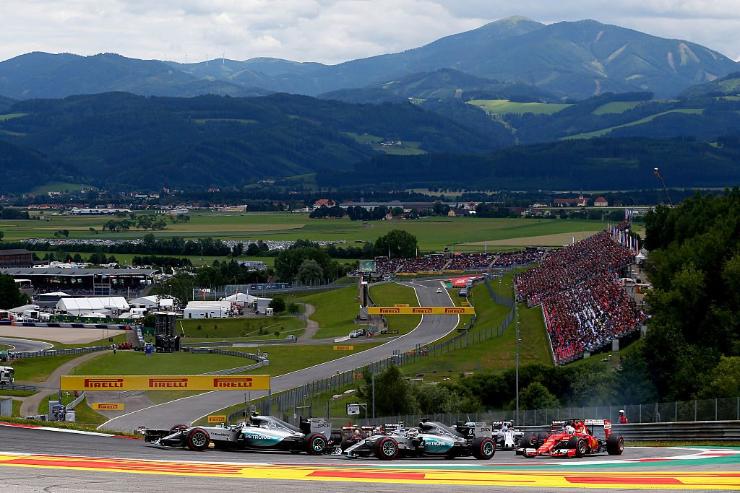
1. Race circuits

Slide 19
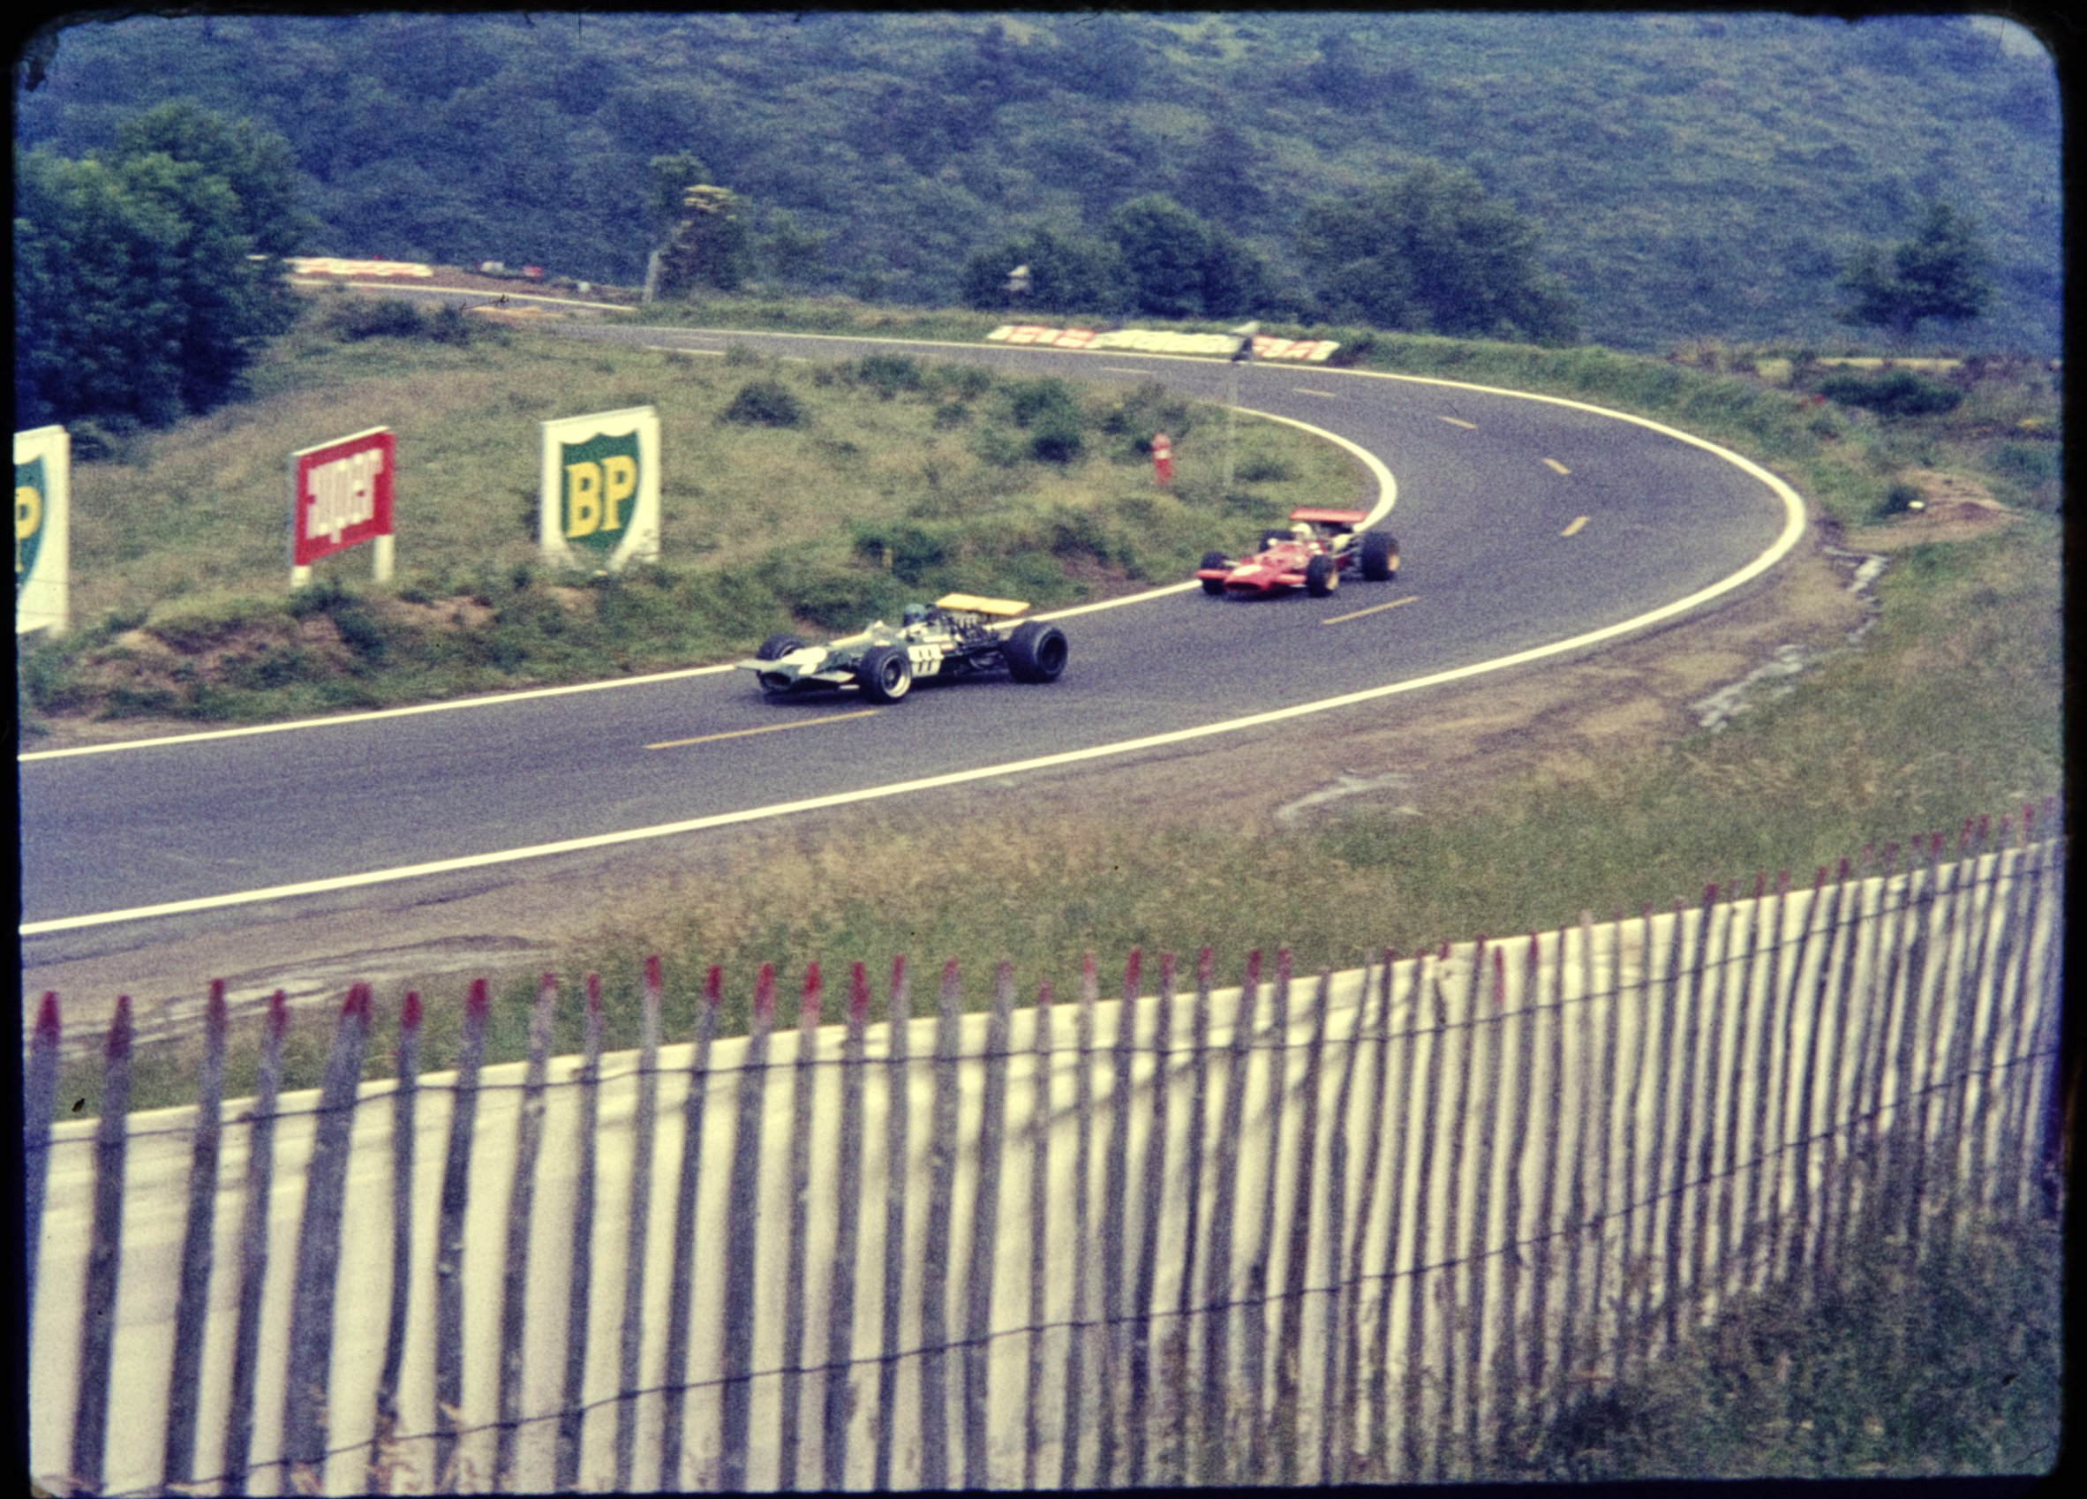
2. Road circuits

Slide 20
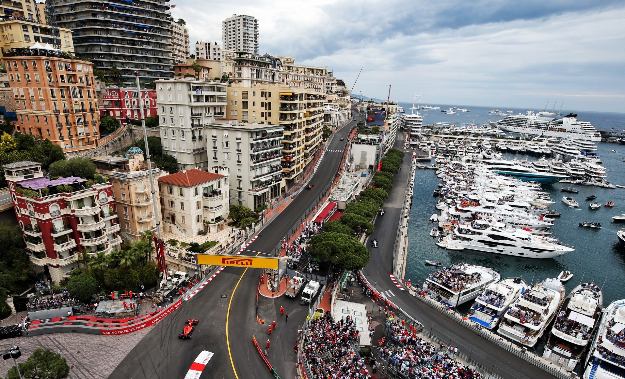
3. street circuits

Slide 21
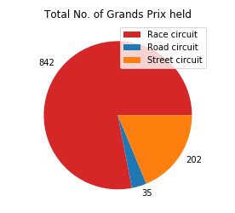
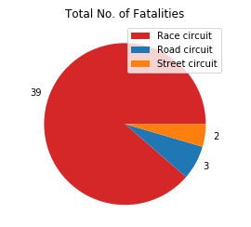
circuit type
Race circuits account for majority of Formula 1 events…
But also the majority of fatalities
Total = 1,079
Total = 44

Slide 22
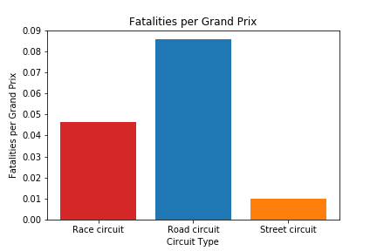
Fatalities per event
Road circuits have the highest incidence of fatalities
Street circuits have the lowest.

Slide 23
So has the sport of Formula 1 become safer for competing drivers?
Driver fatalities were higher in the 1950’s and 1960’s and progressively declined throughout the proceeding decades.
Driver injuries spiked in the 1990’s, but have since declined.
Road circuits (highest fatality rate) are not longer in existence. But dedicated race circuits are more dangerous than street circuits.

Slide 24
Thank you

