Slide 1
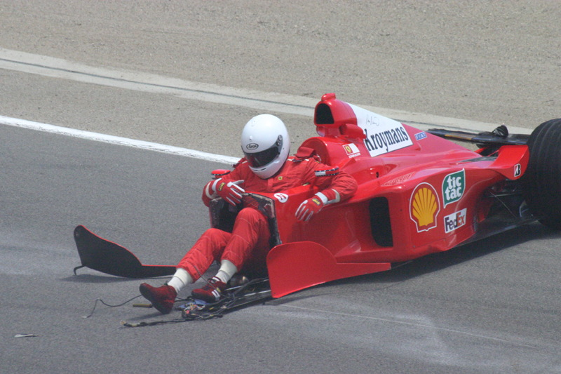
Driver Safety in Formula 1
Analysing the changes in driver safety in Formula 1 over time

Slide 2

In recent decades, the sport of Formula 1 has prided itself on driver safety.

Slide 3
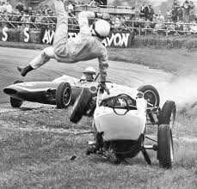
In the early decades of the sport (1950-1990) Formula 1 was extremely high risk for drivers.

Slide 4
Has the sport of Formula 1 become safer for competing drivers?

Slide 5
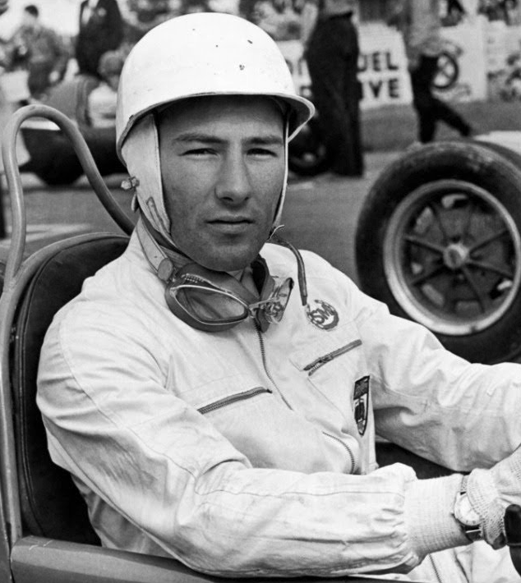

By analysing driver fatality and injury data, we seek to answer this question.

Slide 6
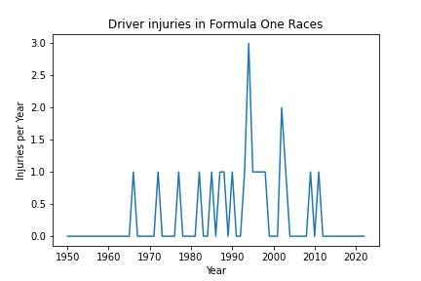
Injuries per Year
21 recorded injuries to drivers.
Maximum number of injuries in one season was 3 in 1994. There were two large periods of time where no injuries were recorded, 1950 - 1965 and 2012 to 2022.
This would show that Formula One has had a relatively safe record across the 73 seasons of competition.
This data does not include qualifying or practice sessions nor any test events.

Slide 7
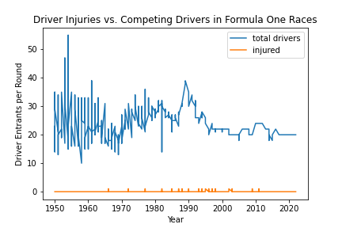
Driver injuries v participants
In total there have been 25,840 entrants (total drivers) across 1,079 races and only 21 recorded injuries across the 73 seasons of Formula One.
Drivers entered into races varied from 13 -14 to a high of 55.
The number of drivers entered in races bares no correlation to the number of injuries to drivers over the 73 seasons of Formula One.
This data does not include qualifying or practice sessions nor any test events

Slide 8
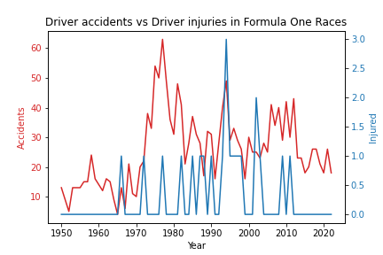
Driver accidents vs driver injuries
Accidents took a sharp up turn through the 1970s
No injuries have been recorded across the years of 1950 - 1965 and 2012 to 2022
latter part of 2000's showed accidents in the mid to high 30's per year compared to low to mid 20's per year in the last 10 years
This data does not include qualifying or practice sessions nor any test events

