Slide 1





CSE487: Cyber Security, Law, and Ethics

Slide 2
Welcome To Our Presentation
Presented By:
1.Samiha Masrura
2010-1-60-066
2.Afsana Hossain Esha
2010-1-60-075
3.Oli Ahmed
2019-3-60-073
Presented By:
Dr. Md. Hasanul Ferdaus
Assistant Professor
Department of Computer Science & Engineering

Slide 3



Introduction
An operating system (OS) is a collection of software that manages computer hardware resources and provides common services for computer programs. The operating system is the most important type of system software in a computer system.

Slide 4
What Is Burger Buddies Problem?
Suppose we have the following scenario: Cooks, Cashiers, and Customers are each modeled as a thread. Cashiers sleep until a customer is present. A Customer approaching a cashier can start the order process. A Customer cannot order until the cashier is ready. Once the order is placed, a cashier has to get a burger from the rack. If a burger is not available, a cashier must wait until one is made. The cook will always make burgers and place them on the rack. The cook will wait if the rack is full. There are no synchronization constraints for a cashier presenting food to the customer.

Slide 5
Focus Main Part
1.Process
2.Thread
3.Semaphore

Slide 6
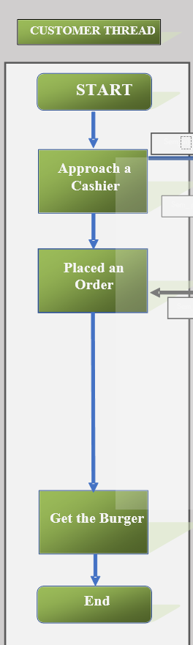
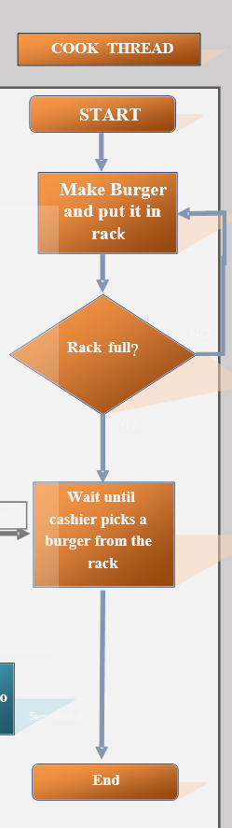
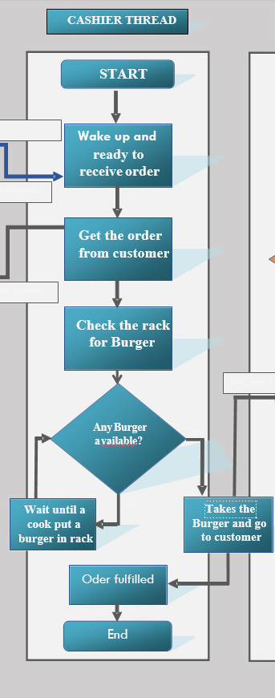
Customer Thread
Cashier Thread
Cook Thread
Flow Chart
In this flow chart there are 3 Threads
Customer Thread
Cashier Thread
Cook Thread

Slide 7
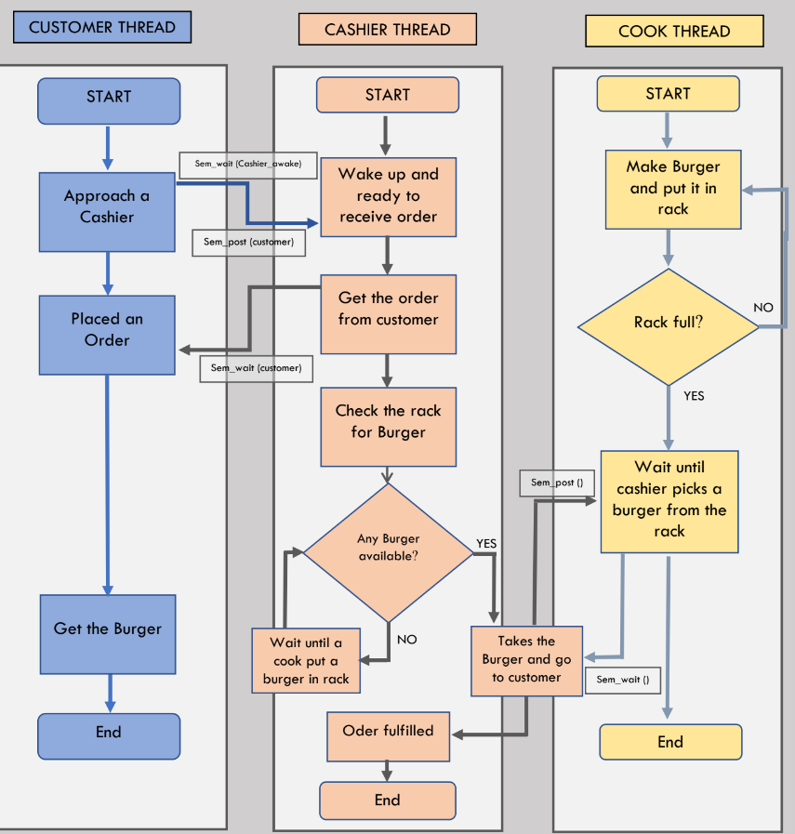
Customer Cashier Cook
Customer Thread depends on Cashier Thread
Cashier Thread depends on Cook Thread

Slide 8
CUSTOMER THREAD
Approach a Cashier
Place an order to the Cashier Thread
COOK THREAD
Cook thread continuously make burger until the rack is full
When the rack will full the Cook Thread will stop making burger
CASHIER THREAD
Get order from the Customer
Check rack for the burger
If no burger available, wait until a cook put a burger in rack
If burger available in rack, takes the burger and go to the Customer

Slide 9
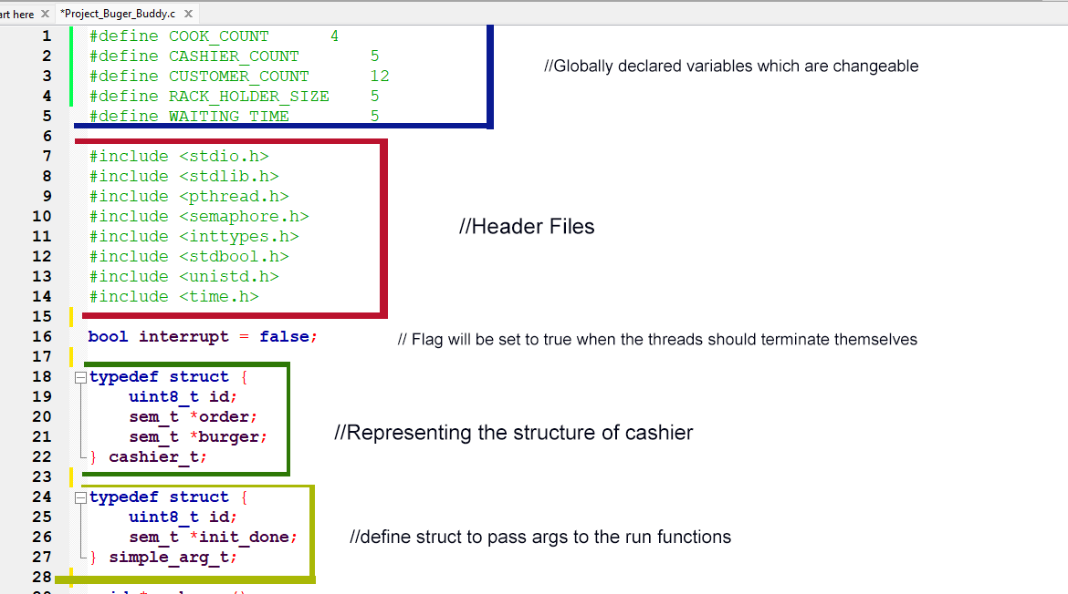

Slide 10
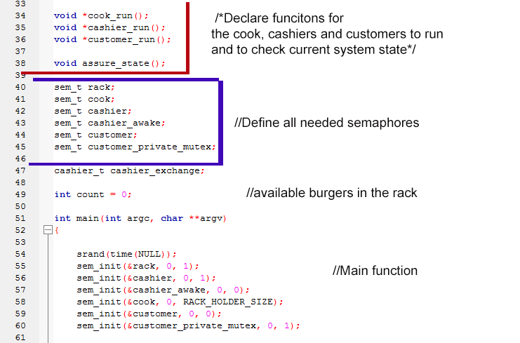

Slide 11
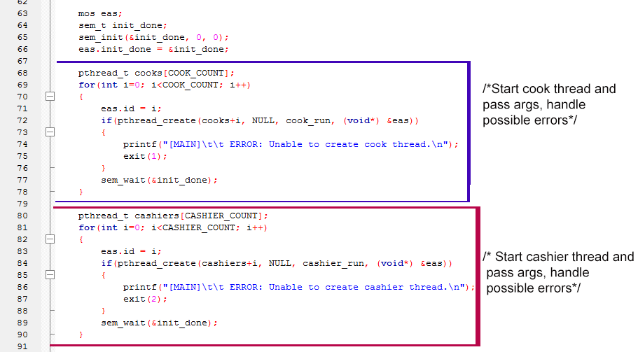

Slide 12
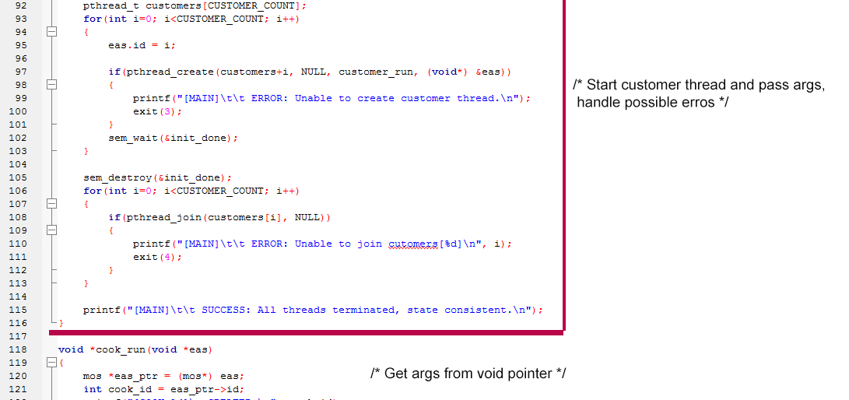

Slide 13
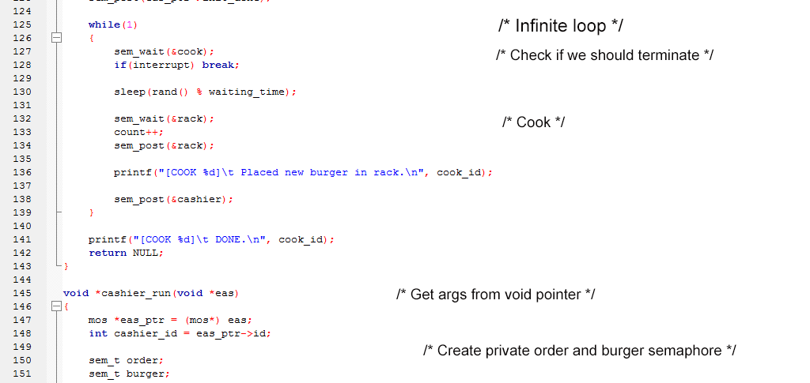

Slide 14
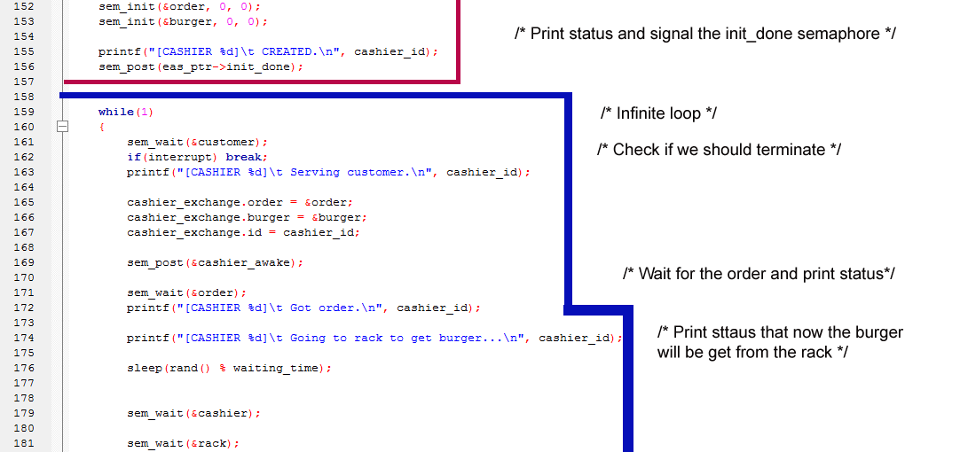

Slide 15
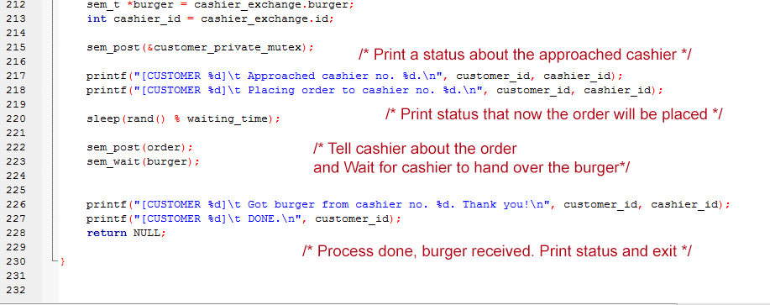

Slide 16
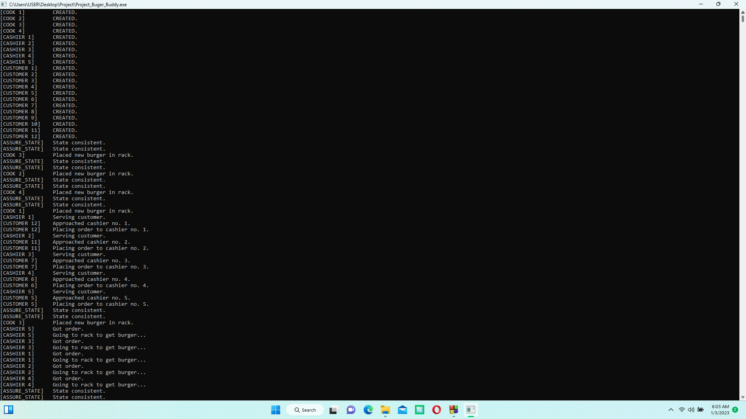

Slide 17
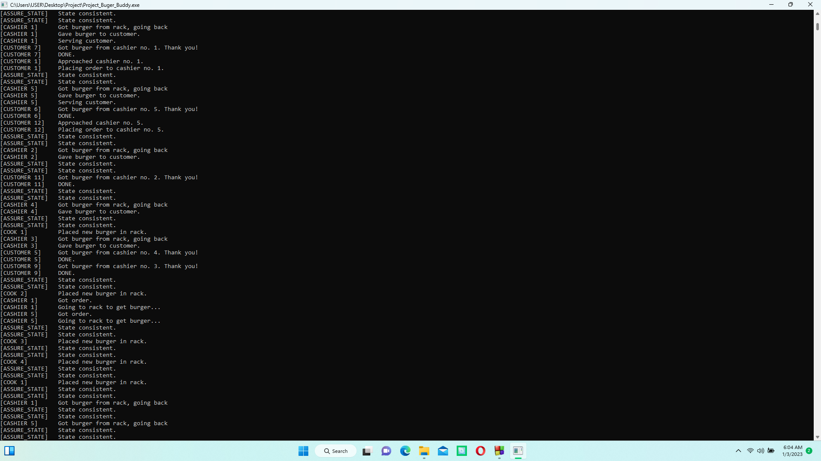

Slide 18
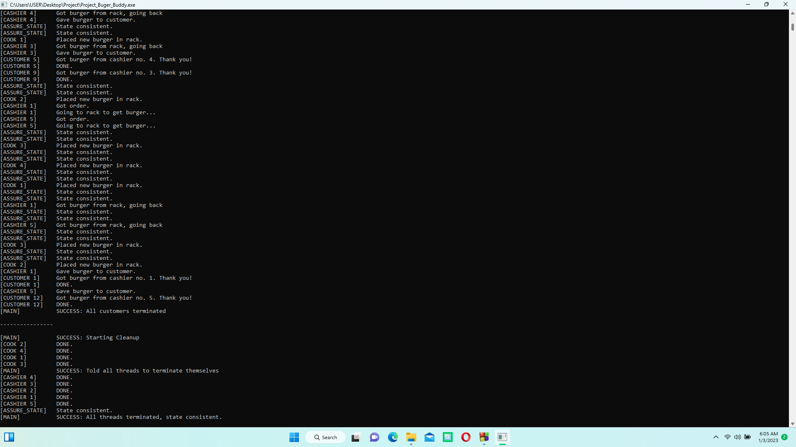

Slide 19

Thank You Everyone

