Slide 1
Assessing blood samples for malaria
Olumide Fadahunsi

Slide 2
Literature Review
Malaria is listed by the World Health Organisation (WHO) as a life-threatening disease
5 Plasmodium Parasites cause malaria, P. falciparum, P. vivax, P. ovale, and P. malariae, P. Knowles
Parasite identification is mainly done by a medical expert examining typically giemsa stain blood smears under a microscope
A lot of work done to use computer Vision in the medical field – AlexNet
Specific to malaria – Work to identifiy P. Vivax and P.Falciparum , Detect Malaria with an accuracy of 93.4%
African region is disproportionately dealing with malaria , 90% of the deaths in Africa
Africa also skipped the landline infrastructure and now the mobile phone is of massively important to the continent
There are to my knowledge 2 Mobile apps , both on android that do exactly what I plan to do, 1 snot publicly available, another is

Slide 3
My App
MVP –
App, that has the CNN on it and can analyse images
Requirements
Android 4.0 or higher
Camera with a minimum 5 mp
Start screen , Image acquisition page, Result Visualisation screen, Slide info entry, data upload page, Be able to share results
Have developed CNN loaded to it
CNN is given by Adrian Clark

Slide 4
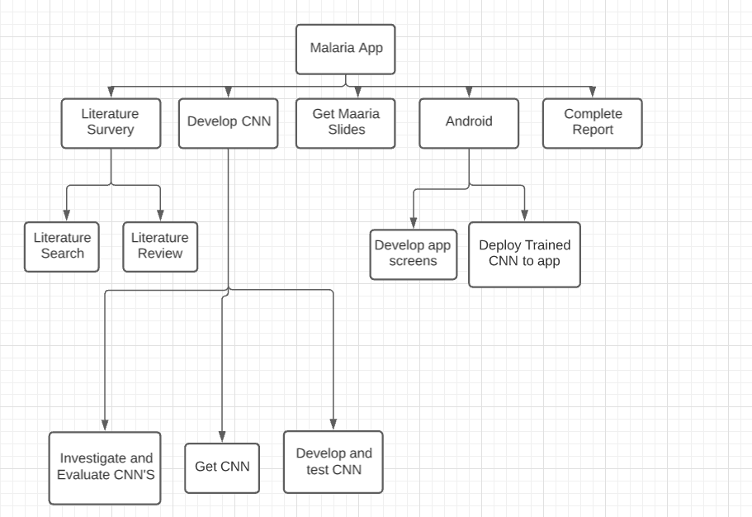
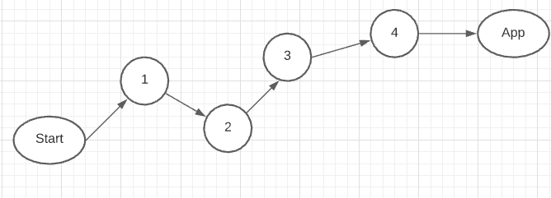
Activity | Estimate Duration
Literature Search | 4 weeks
Literature review | 2 weeks
Investigate and evaluate CNN’s | 1 weeks
Get CNN’s | 2 days
Develop and test CNN’s | 8 weeks
Get malaria Slides | 2 days
Develop App screens | 4 weeks
Deploy trained CNN to app | 2 weeks
Complete Report | 3 weeks
Total Effort | 26 weeks (approx. 7 months)

