Slide 1

Come eat!
Oliver Hliddal, Jan Weber, Stéphanie Wismer, Shijie Jiang, Nino Scherrer, Clive Charles Javara, Chen-Yen Kao

Slide 2
Target user(s) & stakeholders
Main target group:
Business people and college students that want to have a quality lunch but don’t have a lot of time to wait for their food
Primary stakeholders: End-users who want to get their food quickly
Secondary stakeholders: Restaurant owners, cooks, service staff,...
Tertiary stakeholders: potential investors whos porfit depends on the success/failure of the app

Slide 3
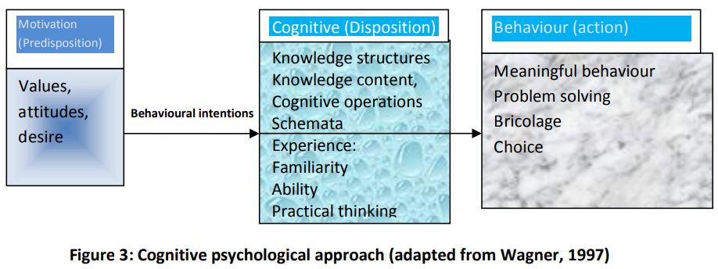
Status quo
Informations extracted from our interviews:
Spontaneous decisions to visit restaurants
Preference: already known restaurants (familiarity → cognitive psychological approach)
Problems: Time issue
App features: Google Map alike feature like suggestions about restaurants in near surrounding, rating tool, arrival possibility, and most importantly being able to define criterias which the restaurant needs to fulfil.
Challenges: e.g. customers who cancel their table (rules and tool needed for that case)

Slide 4
Their problems or needs
suitable for people with short lunch break e.g. office employees, no time wasted in the restaurant waiting for their meals.
Better planning possible for restaurant employees (organise meals for big groups)
People can rate the varied restaurants; writing and seeing the reviews afterwards
Have an easy and clear overview of the food which the different restaurants offer (vegan, vegetarian etc.).

