Slide 1
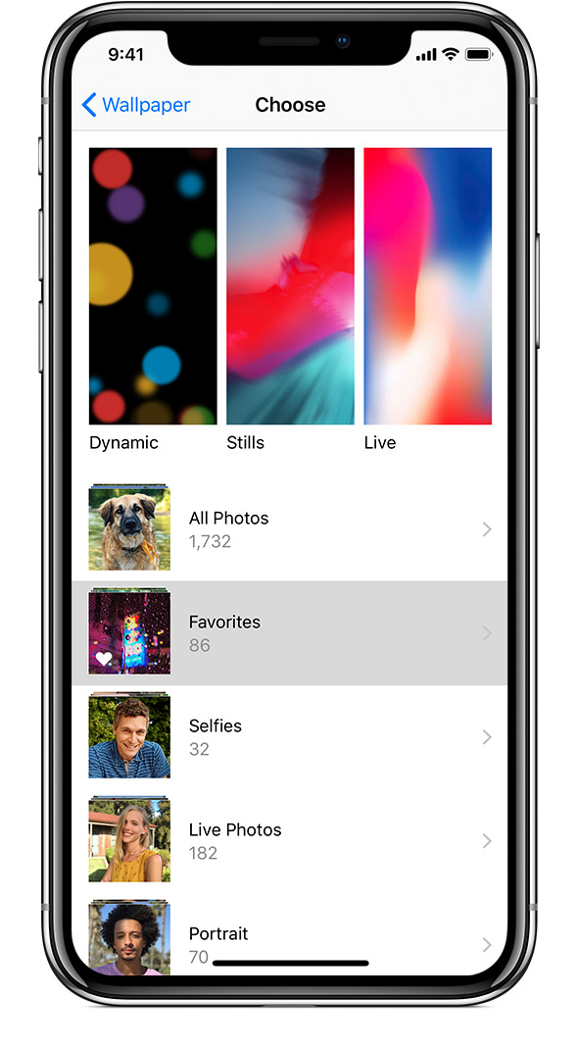

Slide 2
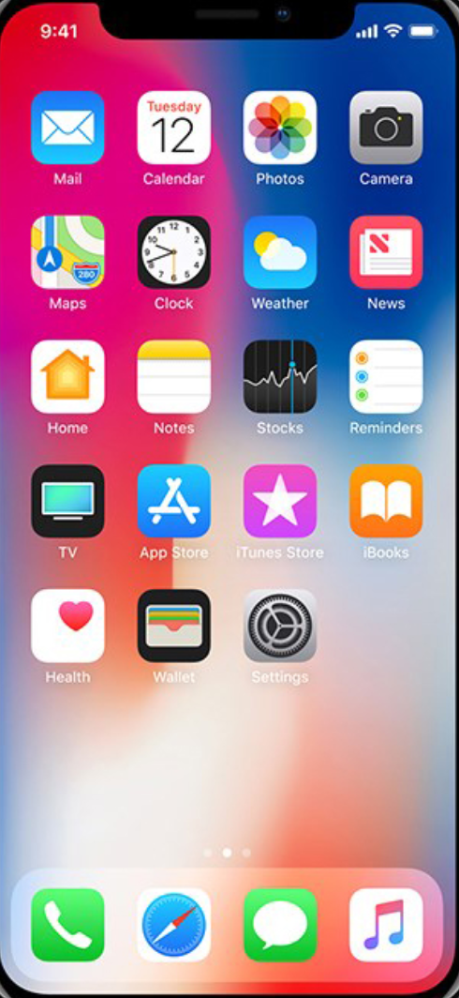

Come eat

Slide 3

Come Eat!

Slide 4
Log in
Username:
Password:
Log in
Register

Slide 5
Log in
Hans
Username:
Muster
Password:
Log in
Register

Slide 6
Log in

Slide 7

Register
Prename*:
Name*:
Password*:
Password*:
Email:
* mandatory fields
Register

Slide 8
Register
Hans
Prename*:
Muster
Name*:
Password*:
° ° ° ° ° ° ° ° ° ° ° °
Password*:
° ° ° ° ° ° ° ° ° ° ° °
Email:
hans@mail.com
* mandatory fields
Register

Slide 9
Register
Prename*:
Name*:
Password*:
Min. 8 letters
1 special character
1 capital letter
Password*:
Email:
* mandatory fields
Register

Slide 10
Register
Prename*:
Name*:
Password*:
Password*:
Email:
* mandatory fields
Please fill in the blanks!
Register

Slide 11

Main page
Where/What do you want to eat?
Filter
Welcome to Come eat!
________________________________
Using the App requires the location access
Allow
Exit App

Slide 12
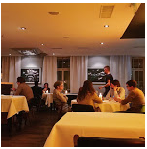
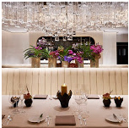


Main page
Where/What do you want to eat?
Filter

Slide 13
Hans Muster
Home
Map
Recently viewed
Your bookings
Group
Settings
Help

Slide 14
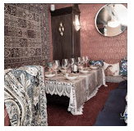
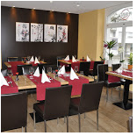


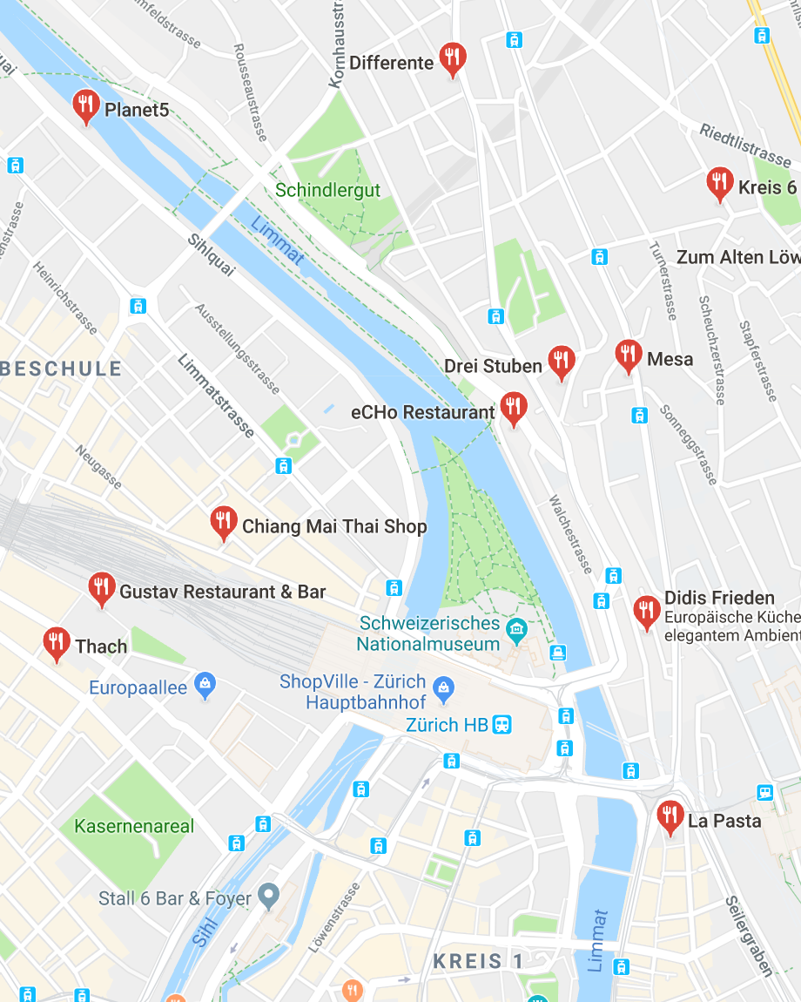
Map
Where/What do you want to eat?
Filter
Best ratings:

Slide 15
Map
Zürich, Pizza
Filter

Slide 16
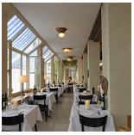
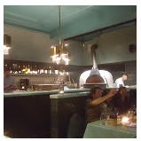


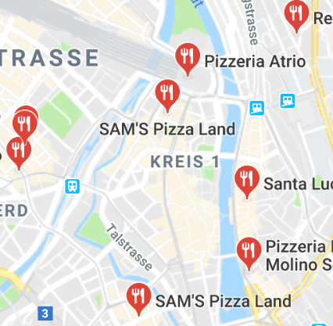
Map
Zürich, Pizza
Filter

Slide 17

Open
Google Maps
Klick to go back!

Slide 18
Filter
Cuisine
Price
Food type
Allergies
Search

Slide 19
Filter
Cuisine
x Italien
Price
Food type
Allergies
Search

Slide 20
Filter
Cuisine
x Italien
Price
x 10 – 40 CHF
Food type
Allergies
Search

Slide 21
Filter
Cuisine
x Italien
Price
x 10 – 40 CHF
Food type
x Pizza
Allergies
Search

Slide 22
Cuisine
All
American
Asian
Chinese
French
Greek
Indian
Italien
Japanese
Mexican
Swiss
Thai
Turkish
ü
Confirm

Slide 23
Price
Min
Max
Confirm

Slide 24
Price
10.-
40.-
Confirm

Slide 25
Food type
All
Pizza
Burrito
Curry
Fish
Kebab
Pizza
Pasta
Salad
Sushi
ü
Confirm

Slide 26
Allergies
All
Vegetarian
Vegan
Confirm

Slide 27
Search
Where/What do you want to eat?
x Italien
x 10 – 40 CHF
x Pizza
Filter

Slide 28
Restaurant
Menu
Book table
Rating
Add to favorites
Cancel

Slide 29
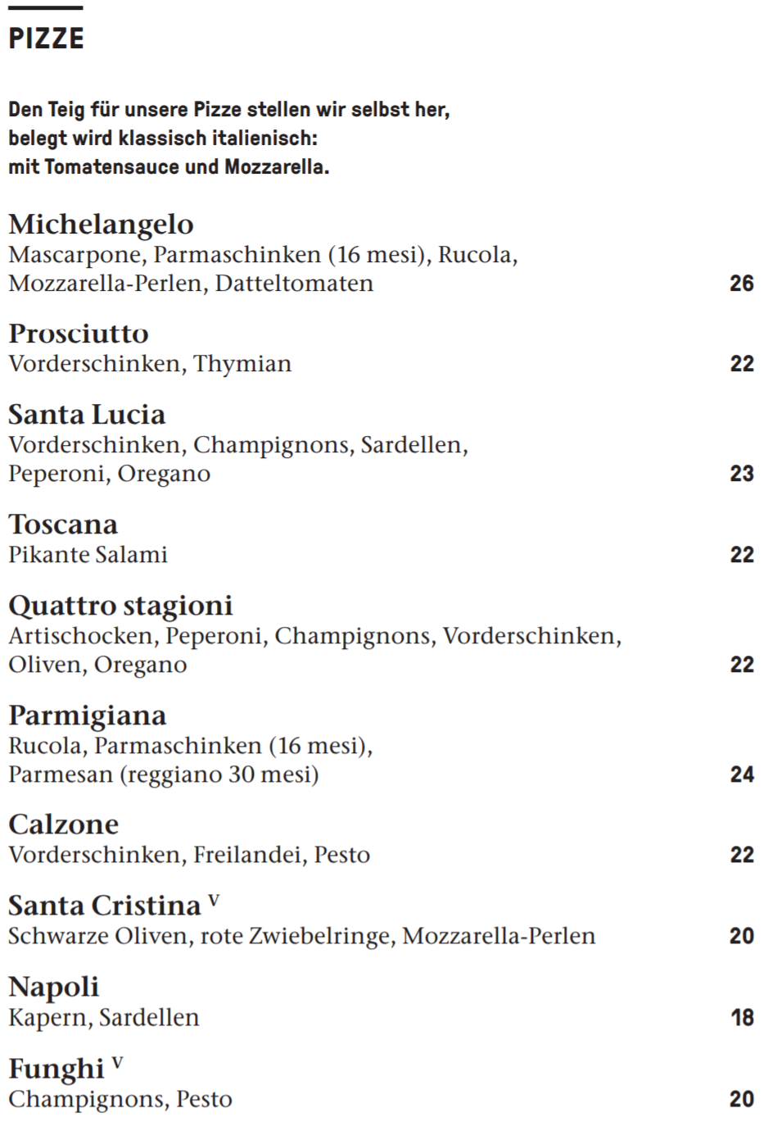
Menu
Cancel

Slide 30
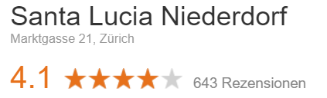
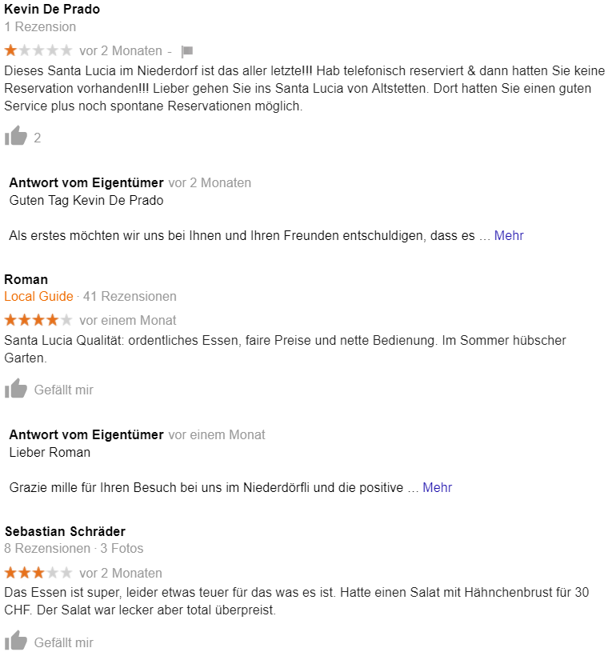
Recession
Cancel

Slide 31
Book a table
How many people?
When will you arrive?
hours
:
minutes
Date:
day
month
year
Preorder food
Cancel

Slide 32
Book a table
2
When will you arrive?
18
:
30
Date:
24
10
2018
Preorder food
Book
Cancel

Slide 33
Book a table
2
Preorder food
________________________________
Would you like to preorder food now?
When will you arrive?
18
:
30
Date:
Yes
24
10
2018
No
Preorder food
Book
Cancel

Slide 34
Book a table
2
When will you arrive?
18
:
30
Date:
24
10
2018
Preorder food
Book
Cancel

Slide 35
Menu
ü
ü
Book
Cancel

Slide 36
Menu
Payment
________________________________
Would you like to pay now?
ü
ü
Yes
No
Book
Cancel

Slide 37
Menu
Confirmation
________________________________
Please confirm your booking
ü
ü
Confirm
No
Book
Cancel

Slide 38
Menu
Confirmation
________________________________
Please confirm your booking
ü
ü
Confirm
No
Book
Cancel

Slide 39
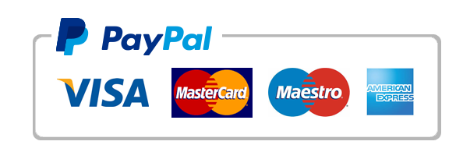
Payment
Name:
Max Mustermann
0000 1111 2222 3333
Date:
Month
Year
ZIP Code:
999
___________________________
45.- CHF
Order and Pay
Cancel

Slide 40
Payment
Name:
Hans Muster
5500 1234 5678 2341
Date:
01
21
ZIP Code:
123
___________________________
45.- CHF
Order and Pay
Cancel

Slide 41
Payment
Your payment is getting verified!

Slide 42
Payment
ü
Your payment is verified! Your booking was successfull.
We are looking forward for your visit!
Back

Slide 43
Book a table
Your booking was successfull.
We are looking forward for your visit!
Back

Slide 44
Main page
Where/What do you want to eat?
Filter

Slide 45
Settings
Notifications
Language: English
Location access: Allowed
Cancel

Slide 46
Settings
Notifications
Language: English
Location access: Allowed
Cancel

Slide 47
Help
Help articles
Legal
Come eat prototype version 1.0
© 2018 Come eat!
Cancel

Slide 48
Recently viewed
no more
Cancel

Slide 49
Your bookings
Today
Table & Food
2 people
18:30
24.10.2018
no more
Cancel

