Slide 1
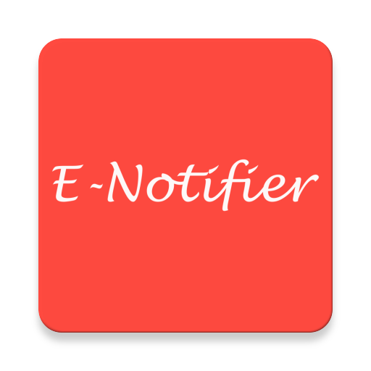
Final Presentation and Demo
Vaibhav Ingle
CYBR-8480

Slide 2
Introduction
What is E-Notifier ?
Project Goals
  Develop an android application which can integrate with the MetaWear device
  Develop a simple and intuitive user interface
  Verify that MetaWear device and android app maintain connectivity
  Test the application to ensure the functionality and security
Project Merits
  Open Source, easy to use, and portable

Slide 3
User Stories
Primary User Story
As a person in need, I want to send a predefined message to my emergency contact(s) so I can get help.
  On the push of a button, the user should be able to send an emergency text message
  On the shake of a wearable, the user should be able to send an emergency text message
Other User Stories
As a social networking user, I want to get notifications on the wearable device so I can stay connected with my contacts.
As a person in need, I want to call my emergency contact(s) so I can quickly get help.

Slide 4
Final Milestone - Completed Work
Added shake message functionality
Successfully able to send alerts to the saved contacts on the shake of a MetaWear device
App Polishing
  Updated Menu, GUI
  Added Help Button – included steps for users to setup and use the app
  Added App Icon

Slide 5
Application Requirements
Hardware/Software Requirements
  Android 4.4+ (API Level 19 +) with Bluetooth LE capable smart phone or tablet
  MetaWear device
  Android Studio
  Java Development Kit
Installation Steps
  By Cloning GitHub Repo and using Android Studio
  Or by directly downloading the APK

Slide 6
Future Work
User should be able to save the Settings
Adding GPS co-ordinates to emergency message
Adding a notification feature so that LED's on the MetaWear device should blink on getting SMS, call, and social media notifications
Adding the application on Google Play Store

Slide 7
Demo

