Slide 1
Bike COACH
Olivier Avande
CYBR 8080

Slide 2
INTRODUCTION
What is Bike Coach?
Project Goals
Explore android application development and the IoT: Create an app integrated with BLE enabled device
Record sensor data from MetaWear Board and process
Simple interface displaying workout metrics
Send feedback to user
Test application to ensure functionality

Slide 3
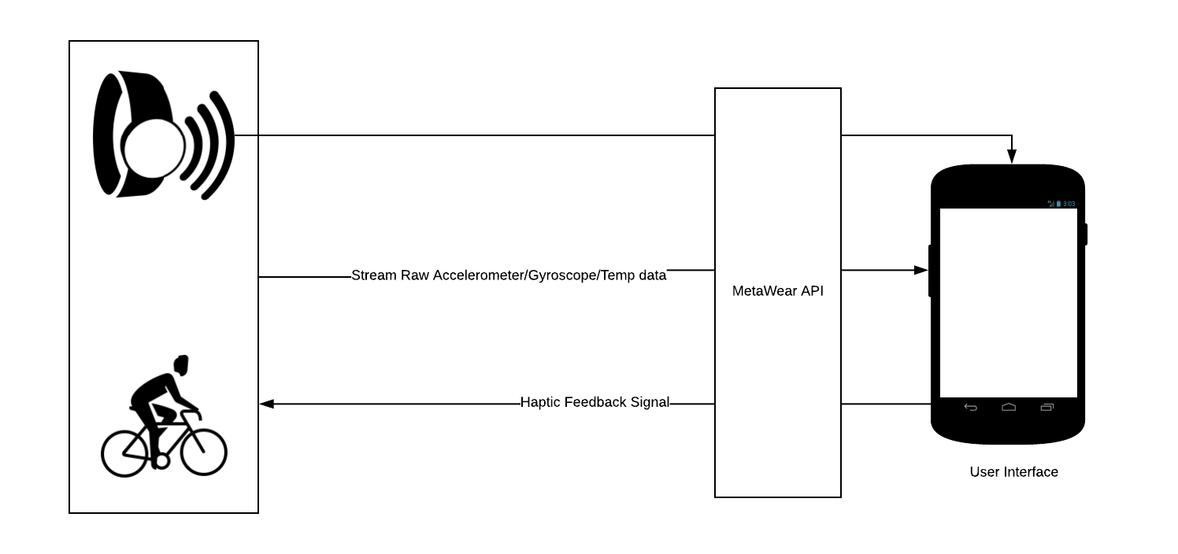
COMPONENT ARCHITECTURE
Board: MetaMotionR
Phone:
-android
-minSdk: 23
-targetSdk: 26

Slide 4
USER STORIES
User Story 1: As a cyclist, I want to monitor my cycling performance so I can analyze and improve on my fitness
Acceptance Criteria: A user will be able to view current speed, average speed, distance time and current temperature
User Story 2: As a cyclist, I want to set a desired speed so I can maintain that speed on my workout
Acceptance Criteria: a user will be able to input a speed that will constitute the threshold speed he has to keep up with
User Story 3: As a cyclist, I want to receive haptic feedback so I can increase my current speed over the the specified threshold
Acceptance Criteria: The Coin Vibe Motor of the MetaWear Board will vibrate every time the current speed is below the threshold speed

Slide 5
USER STORIES REALISATION
User Story 1:
Get linear acceleration from accelerometer + gyroscope values
Offset value to calibrate acceleration value
V(k+1) = Vk + Ak * Δt
For each axis, find v and the total velocity equal sqrt(vx^2+vy^2+vz^2)
Movement end check: If next 25 samples equals 0 then you stopped
Request temperature data every 3 s from board
Used device gps to find distance (inaccurate)
User Story 2
Simple input box to enter speed
User Story 3
If threshold > current vel then vibrate

Slide 6
DEMO
AirDroid Web (http://web.airdroid.com/) > Screenshot

Slide 7
FUTURE WORK
Bug Fix
Algorithms Improvement
Add more metrics (maybe?)
Pause button

Slide 8
Question
?

