Slide 1
Bike COACH
Olivier Avande
CYBR 8080

Slide 2
INTRODUCTION
What is Bike Coach?
Project Goals
Explore android application development and the IoT: Create an app integrated with BLE enabled device
Record sensor data from MetaWear Board
Simple interface displaying workout metrics
Send feedback to user
Test application to ensure functionality

Slide 3
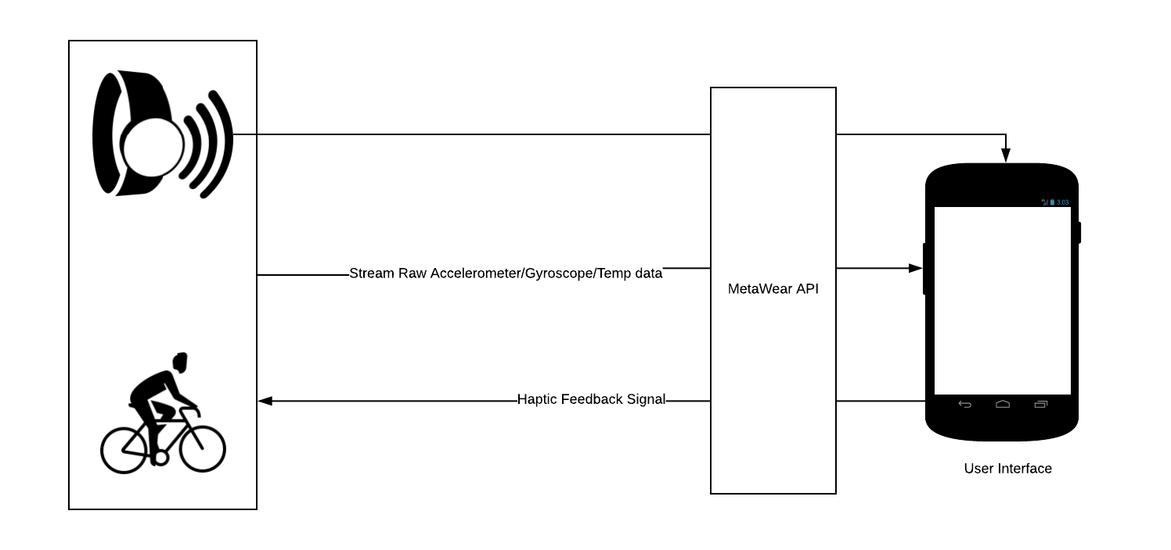
COMPONENT ARCHITECTURE
Board: MetaMotionR
Phone:
-android
-minSdk: 23
-targetSdk: 26

Slide 4
USER STORIES
User Story 1: As a cyclist, I want to monitor my cycling performance so I can analyze and improve on my fitness
Acceptance Criteria: A user will be able to view current speed, average speed, distance and time
User Story 2: As a cyclist, I want to set a desired speed so I can maintain that speed on my workout
Acceptance Criteria: a user will be able to input a speed that will constitute the threshold speed he has to keep up with
User Story 3: As a cyclist, I want to receive haptic feedback so I can increase my current speed over the the specified threshold
Acceptance Criteria: The Coin Vibe Motor of the MetaWear Board will vibrate every time the current speed is below the threshold speed

Slide 5
CODE EXPLORATION
ANDROID STUDIO
Two Activities, 1 Fragment, 1 Service
MainActivity : Handle Connection with MetaWear
DisplayActivity: Maintain Connection with MetaWear, Handles Unexpected Disconnect
DisplayActivityFragment1: Stream data from board, Handle user input, process data, display meaningful values to user
GPS_Service: Return travelled distance

Slide 6
DEMO
AirDroid Web (http://web.airdroid.com/) > Screenshot

Slide 7
FUTURE WORK
Bug Fix
Algorithms Improvement

