Slide 1
Modular Norm Models A Lightweight Approach for Modeling and Reasoning about Legal Compliance
https://github.com/robinagandhi/modularnorms

Slide 2
Example Legal Text
ELT 4.0: To reproduce and distribute the Work you must retain, in the Source form of any Derivative Works that you distribute, all copyright, patent, trademark, and attribution notices from the Source form of the Work
Notes:
Here is an example extracted from the Affero General Public License. From this particular text, we identify several rights and we have several pre-conditions.
This shows an example of how a single legal paragraph can have varied meaning in different contexts, can have references to other parts of the text and give rise to a complex scenario making it difficult to check the compliance of this statement individually.

Slide 3
Example Legal Text
ELT 4.0: To reproduce and distribute the Work you must retain, in the Source form of any Derivative Works that you distribute, all copyright, patent, trademark, and attribution notices from the Source form of the Work
Notes:
Here is an example extracted from the Affero General Public License. From this particular text, we identify several rights and we have several pre-conditions.
This shows an example of how a single legal paragraph can have varied meaning in different contexts, can have references to other parts of the text and give rise to a complex scenario making it difficult to check the compliance of this statement individually.

Slide 4
Modular Norm Model
ELT 4.0
You must retain, in the Source form…
Holder: User
Beneficiary: Copyright Holder
[You intend to] Reproduce and Distribute Copies
activates
Duty
satisfies
[You retained] in Source form… copyright, patent, trademark, and attribution notices
Notes:
The natural language analysis that you saw from the previous slide can be represented systematically in a Norm model. We have adopted the Nomos metamodel that expresses the elements of a norm using a modeling notation. Based on these metamodel, a norm has 5 elements. The previous example can be represented in the semantic frame of the norm.

Slide 5
Compliance Values - Duty
ST: Satisfied
SF: Not Satisfied
SU: Satisfiability Undefined
Notes:
Compliance – The norm instance applies (i.e. AT) and is satisfied (i.e. ST)
Non-compliance – The norm instance applies (i.e. AT), but is no satisfied (i.e. SF)
Tolerated – The norm instance des not apply (i.e. AF) and hence there is no need to satisfy it (i.e. SU/SF)
Inconclusive – It is not known if the norm instance applies (i.e. AU), and if it does, it is not known if it is satisfied (i.e. SU/SF)

Slide 6
Modular Norm Model
ELT 4.0
You must retain, in the Source form…
Holder: User
Beneficiary: Copyright Holder
Duty
[You intend to] Reproduce and Distribute Copies
activates
Duty | COM
satisfies
[You retained] in Source form… copyright, patent, trademark, and attribution notices
Notes:
The natural language analysis that you saw from the previous slide can be represented systematically in a Norm model. We have adopted the Nomos metamodel that expresses the elements of a norm using a modeling notation. Based on these metamodel, a norm has 5 elements. The previous example can be represented in the semantic frame of the norm.

Slide 7
Propagation to Containing Super Situation
Norm | Super Situation
Compliant (Com) | ST
Tolerated (Tol) | ST
Violated (Vio) | SF
Inconclusive (Inc) | SU

Slide 8
Modular Norm Model
ELT 4.0
You must retain, in the Source form…
Holder: User
Beneficiary: Copyright Holder
Duty
[You intend to] Reproduce and Distribute Copies
activates
Duty | COM
satisfies
[You retained] in Source form… copyright, patent, trademark, and attribution notices
Scenario: Compliant!
Notes:
The natural language analysis that you saw from the previous slide can be represented systematically in a Norm model. We have adopted the Nomos metamodel that expresses the elements of a norm using a modeling notation. Based on these metamodel, a norm has 5 elements. The previous example can be represented in the semantic frame of the norm.

Slide 9
Modular Norm Model
ELT 4.0
You must retain, in the Source form…
Holder: User
Beneficiary: Copyright Holder
Duty
[You intend to] Reproduce and Distribute Copies
activates
Duty | TOL
satisfies
[You retained] in Source form… copyright, patent, trademark, and attribution notices
Scenario: Compliant!
Notes:
The natural language analysis that you saw from the previous slide can be represented systematically in a Norm model. We have adopted the Nomos metamodel that expresses the elements of a norm using a modeling notation. Based on these metamodel, a norm has 5 elements. The previous example can be represented in the semantic frame of the norm.

Slide 10
Modular Norm Model
ELT 4.0
You must retain, in the Source form…
Holder: User
Beneficiary: Copyright Holder
Duty
[You intend to] Reproduce and Distribute Copies
activates
Duty | VIO
satisfies
[You retained] in Source form… copyright, patent, trademark, and attribution notices
Scenario: Violated!
Notes:
The natural language analysis that you saw from the previous slide can be represented systematically in a Norm model. We have adopted the Nomos metamodel that expresses the elements of a norm using a modeling notation. Based on these metamodel, a norm has 5 elements. The previous example can be represented in the semantic frame of the norm.

Slide 11
Modular Norm Model
ELT 4.0
You must retain, in the Source form…
Holder: User
Beneficiary: Copyright Holder
Duty
[You intend to] Reproduce and Distribute Copies
activates
Duty | INC
satisfies
[You retained] in Source form… copyright, patent, trademark, and attribution notices
Scenario: Need more information!
Notes:
The natural language analysis that you saw from the previous slide can be represented systematically in a Norm model. We have adopted the Nomos metamodel that expresses the elements of a norm using a modeling notation. Based on these metamodel, a norm has 5 elements. The previous example can be represented in the semantic frame of the norm.

Slide 12
(yet another) Legal Statement
Your Public License (YPL) v1.0
You may reproduce and distribute copies of the Work or Derivative Works thereof in any medium, with or without modifications, and in Source or Object form, provided that You meet the following condition:
You must retain, in the Source form of any Derivative Works that You distribute, all copyright, patent, trademark, and attribution notices from the Source form of the Work

Slide 13
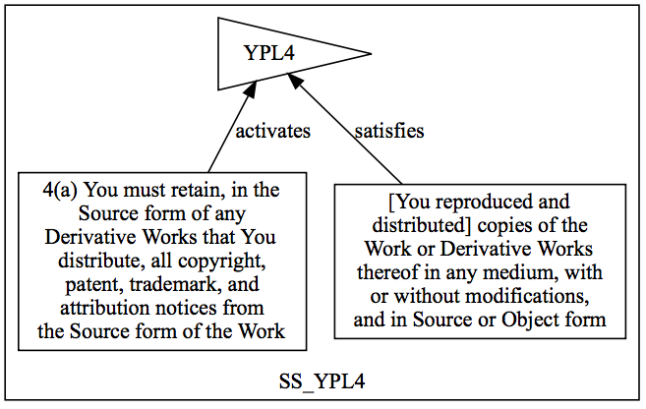
YPL 4 Norm Model

Slide 14
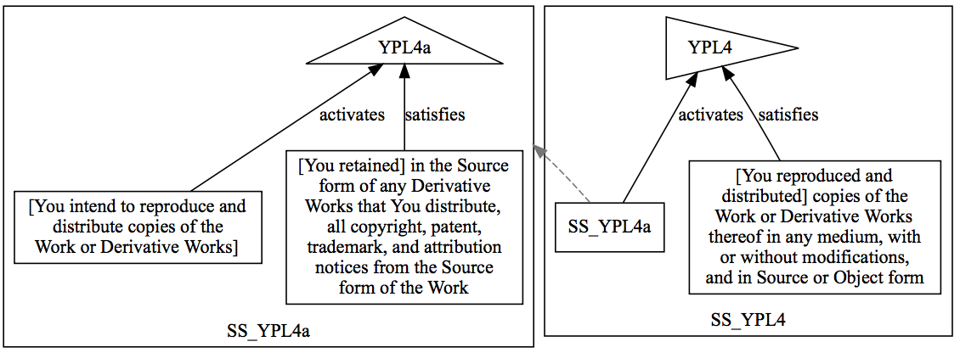
YPL 4 and YPL 4a

Slide 15
Compliance Values - Right
ST: Satisfied
SF: Not Satisfied
SU: Satisfiability Undefined

Slide 16
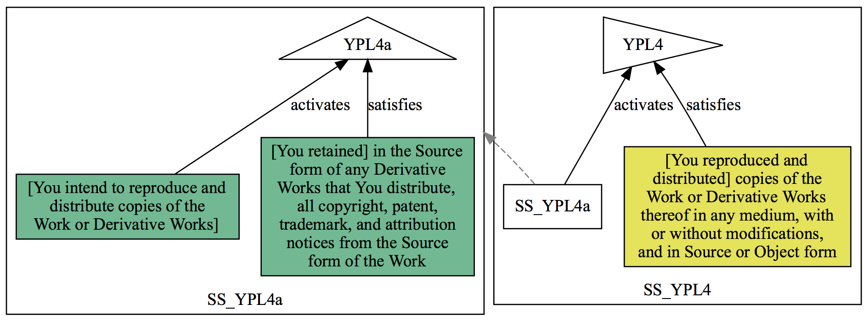
YPL 4 and YPL 4a

Slide 17
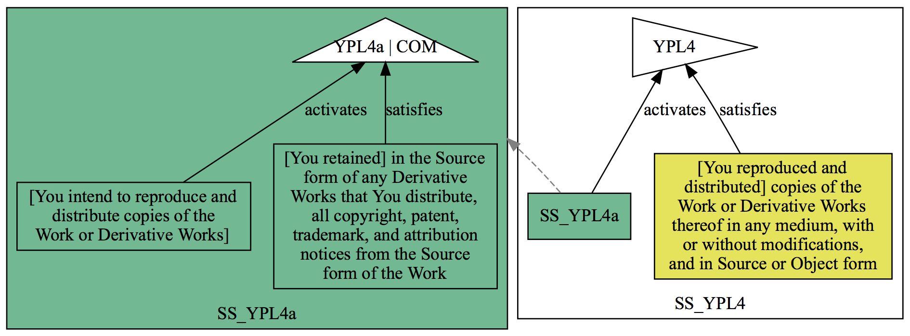
YPL 4 and YPL 4a

Slide 18
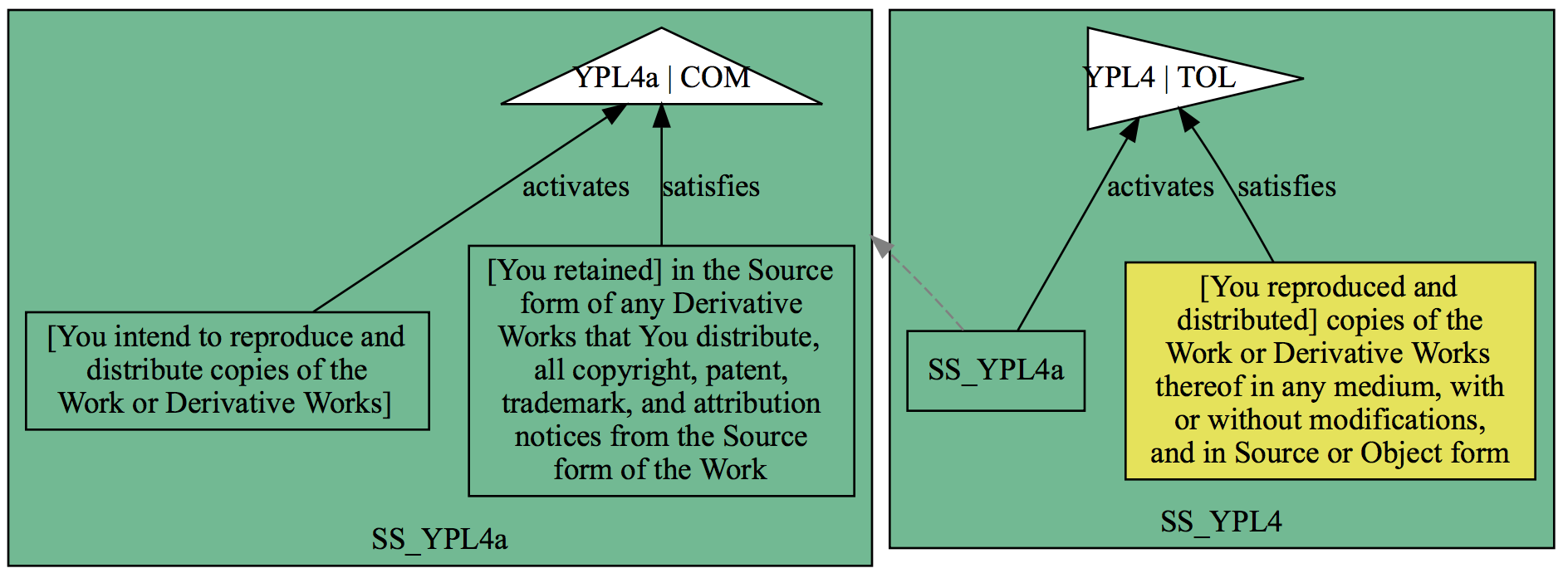
YPL 4 and YPL 4a

Slide 19
Exercise
Scenario
Sam is using a YourPublicLicense v1.0 licensed codebase in his organization. He wants to modify the codebase and distribute it to his customers. The original codebase has several copyright, patent, trademark, and attribution notices.

Slide 20
Question 1
In his modified copy, Sam excluded trademark notices from the original source code. Is Sam compliant with YPL v1.0?
Yes, Sam is compliant with YPL v1.0
No, Sam in not compliant with YPL v1.0
Need more information

Slide 21
Steps to Follow
Visit this link: https://goo.gl/ejhjp9
Determine the most relevant norm
Hover over Duties and Rights to read relevant text
Trace activating situations for the norm in Step 1
Follow links to other norms and situations
Assign truth values of situations with respect to the scenario and the question
Trace satisfying situations for the norm in Step 1
Assign truth values of situations with respect to the scenario and the question
Hit the SOLVE button.
Note the color of the situation containing the norm in Step 1.

Slide 22
Question 2
Sam includes all previous notices (from the original codebase) in to the modified codebase. Sam now distributed the modified source code. Is Sam compliant YPL v1.0?
Yes, Sam is compliant with YPL v1.0
No, Sam is not compliant with YPL v1.0
Need more information

Slide 23
Enough with Toy Examples!

Slide 24
New Scenario for AGPL Analysis
Bob is an avid user of StarWidget. StarWidget is an open source package whose source code is publicly available for download from Github over HTTP. StarWidget is licensed under AGPLv1.0. Bob has made some custom modifications to his forked copy of StarWidget to improve his productivity, calling it GalaxyWidget.
Bob has kept intact all licenses and associated warranties from StarWidget inside the GalaxyWidget codebase. Also when GalaxyWidget runs, it displays notices that includes ‘copyright’, ‘no warranty’, ‘trademark’, ‘patent’ and other attributions during user interactions.
Later Bob made GalaxyWidget github repository private. However, not all of the source code of GalaxyWidget is available for download. Bob also did not provide any provisions for downloading the complete modified code for GalaxyWidget over the web (over HTTP).

Slide 25
Sub-scenario (1)
Suppose another company 'Universal Gadgets' takes an interest in GalaxyWidget. Bob agrees to license GalaxyWidget to 'Universal gadgets' for a one-time fee.
Is Bob compliant with the AGPL license terms by charging a one-time fee?
Yes
No
Need more information

Slide 26
Sub-scenario (2)
Bob now wants to create a start-up company, 'Widget Groups' to distribute GalaxyWidget for commercial purposes. He included a copy of the AGPL v1.0 License with his distribution.
Bob distributed GalaxyWidget to his customers. Is Bob compliant with AGPL v1.0?
Yes
No
Need more information

