Slide 1

Impact of Heat Waves on Electricity Consumption
Diana Rodenberger
Manuel Moreno Cabrera
Olivier Zimmer

Slide 2



Overview of the problem
PROBLEM
Weather is the major cause of power outage accounting for 62% of power interruptions in the U.S. High demands of electricity during periods of extreme temperatures exacerbate the problem. Energy companies are facing the challenge of meeting the demands of energy during hot weather while minimizing outages and ensuring a reliable electric service.
GOAL
Probabilistic assessment and prediction of consumption and prices based on weather.
PLAN
Assess the impact of heat waves on electricity consumption and on power outages.
Define the characteristics above which high temperatures are likely to be harmful to the electrical grid.
Define relations between temperate and the price of power across different sectors.
Notes:
Manuel

Slide 3


Technical challenges
DATA
Original idea on hospital heatwave data - but N/A for this case
Format of data (weather & electricity) required heavy wrangling
Open Refine was primarily used to clean the data.
Different levels of granularity among the datasets. Aggregations at the state level were required for the weather data to merge datasets.
TECHNOLOGY
Cloud platform that can be shared amongst multiple users
Python and Google’s Cloud client
Notes:
Manuel

Slide 4


Acquisition and organization of information
Electricity Data
Consumption, Generation and Price data
Acquired using the Energy Information Administration’s Open Data API.
Structured-data, small size, low latency.
Outage data
Using Inside Energy’s grid disruption dataset is a compilation of annual power outage data from the Department of Energy.
Different levels of geographical granularity due to unstandardized reporting requirements
Heavy data cleaning required for all fields of interest.
Weather data
Downloaded from the Global Historical Climatology Network (GHCN)
Compiled 1218 fixed-length, format specific files from multiple weather stations. Each file converted into a .csv file prior to loading the data into our system
Data wrangling to get relevant variables using metadata file provided by source
Structured-data, medium size, low latency. Light data cleaning required.
Real-time Weather forecast Data
Data “supposedly” collected from a forecasting organization. Simulated data processed in mini-batches.
Notes:
Diana

Slide 5
Big Data Architecture
Similar to Lambda architecture
Google cloud
All data
BigQuery
ETL
R, python, open refine, BigQuery
Batch Layer
Precompute views
BigQuery
QD1: Correlation temp and price Tableau
QD2:Correlation temp and outage Tableau
QD3: Prediction temp/consumption
Python
New electricity and weather data
Serving Layer
(Tableau)
Merge
Real time views in Postgres
QD1
QD2
QD3
Real time increment
Storm
Speed Layer
Process real time forecasts
Update views
Predict cons.
Notes:
Olivier

Slide 6

Technologies used
Google BigQuery and Cloud storage (data lake)
Dremel infrastructure - see the dremel paper
Data lake: consistent, large scale storage (64 TB per disk)
Low cost, Archiving and disaster recovery, Seamless scalability
Available also with data streaming
Python
Extraction of data - to compile through API
Linear regression for prediction
R
Extraction of data - to compile weather data
Open Refine
Cleaning Outage data
Tableau
Processing data (correlation) and data visualization
Tableau public and Google Bigquery integration
Notes:
Olivier

Slide 7
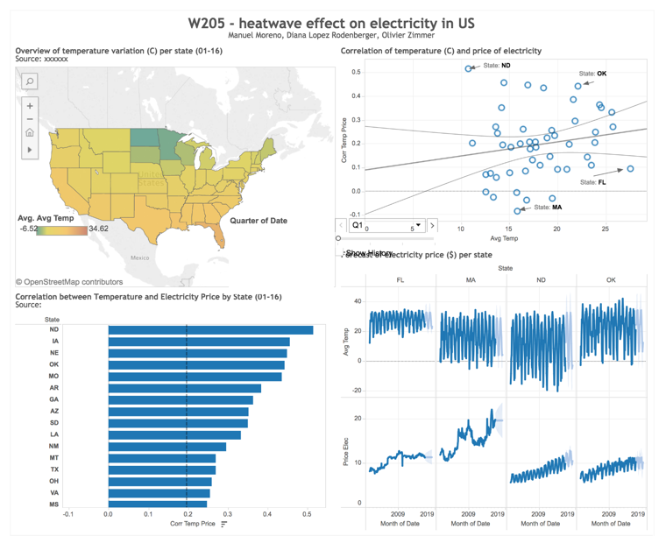
Results of the project
Interactive dashboard
Current data viz hosted on Tableau public - here
Some state (eg. FL or MA) have a low correlation due to low seasonality in the electricity price
Shows “high risk” state highly where prices are highly correlated with temperature
Show map of predicted power sales
No correlation with electricity generation
Notes:
Olivier
Difficult to assess a real strong correlation with outage (big outage event are happening in a very infrequent way)
More looking at relationship with price and sales
FL or MA (Florida or Massachusetts)

Slide 8
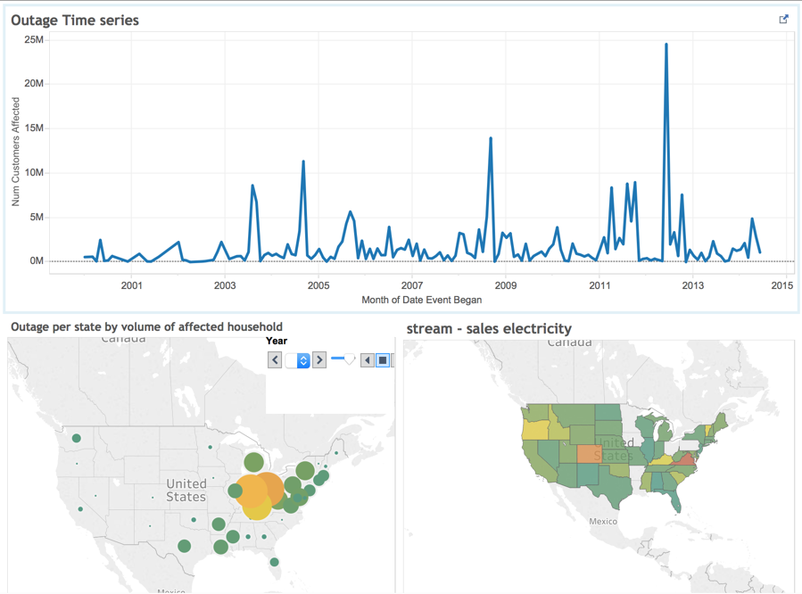
Results of the project
Interactive dashboard
Current data viz hosted on Tableau public - here
Some state (eg. FL or MA) have a low correlation due to low seasonality in the electricity price
Shows “high risk” state highly where prices are highly correlated with temperature
Show map of predicted power sales
No correlation with electricity generation
Notes:
Olivier
Difficult to assess a real strong correlation with outage (big outage event are happening in a very infrequent way)
More looking at relationship with price and sales
FL or MA (Florida or Massachusetts)

Slide 9

Limitations
Because this project will be using publicly-available datasets, it suffers limitations inherent with the sources. These include:
Lack of spatial and temporal granularity for power data sets
Inaccurate/Ambiguous geographical descriptions for outage data set, limited data set
Rough prediction model based on monthly average diminishes the impact of individual temperature extremes
Possible gaps in the outage data set
Outdated outage data
Future iterations of this project should strive to gather this type of data from the energy suppliers themselves as a way of mitigating these issues.
Notes:
Manuel

Slide 10

Thank you

Slide 11
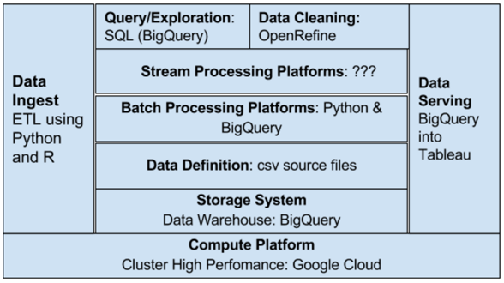
Layer architecture

