Slide 1
Fat-Tree QRAM: a high-bandwidth shared quantum memory architecture
Alex Newsham (amn57), Oliver Fogelin (of284)

Slide 2

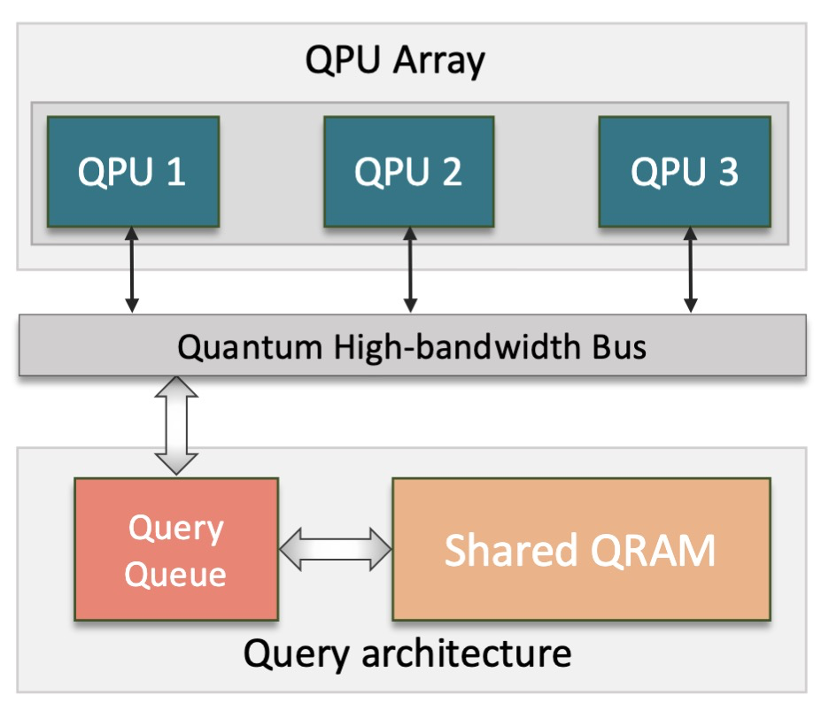
QRAM

Slide 3
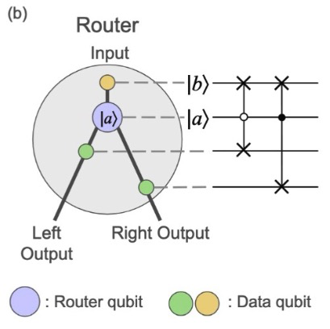
BB QRAM: Quantum Router

Slide 4
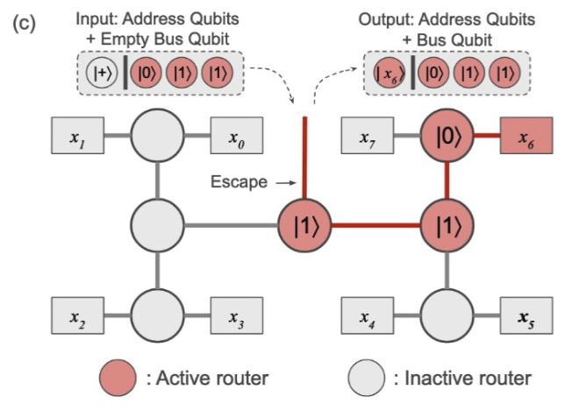

Slide 5
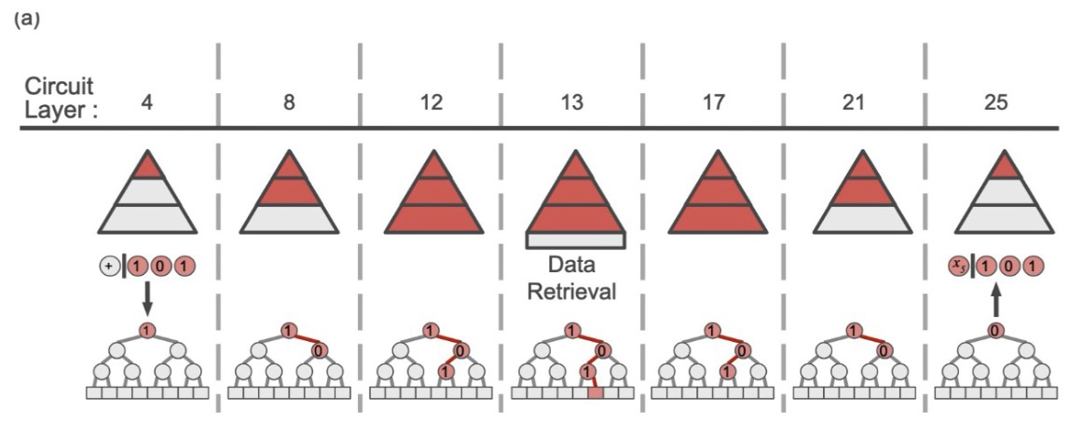
Query path

Slide 6
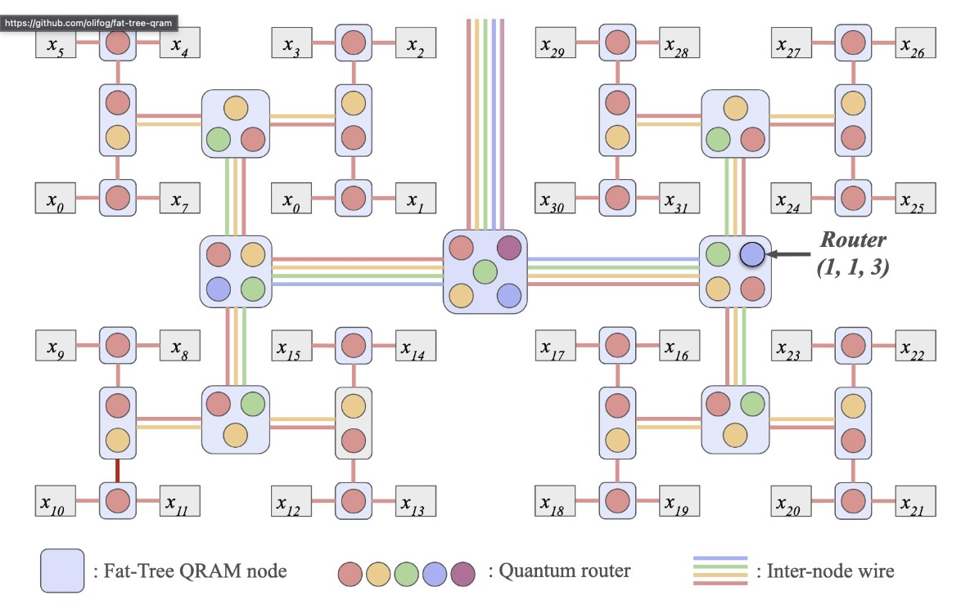
Fat-Tree construction

Slide 7
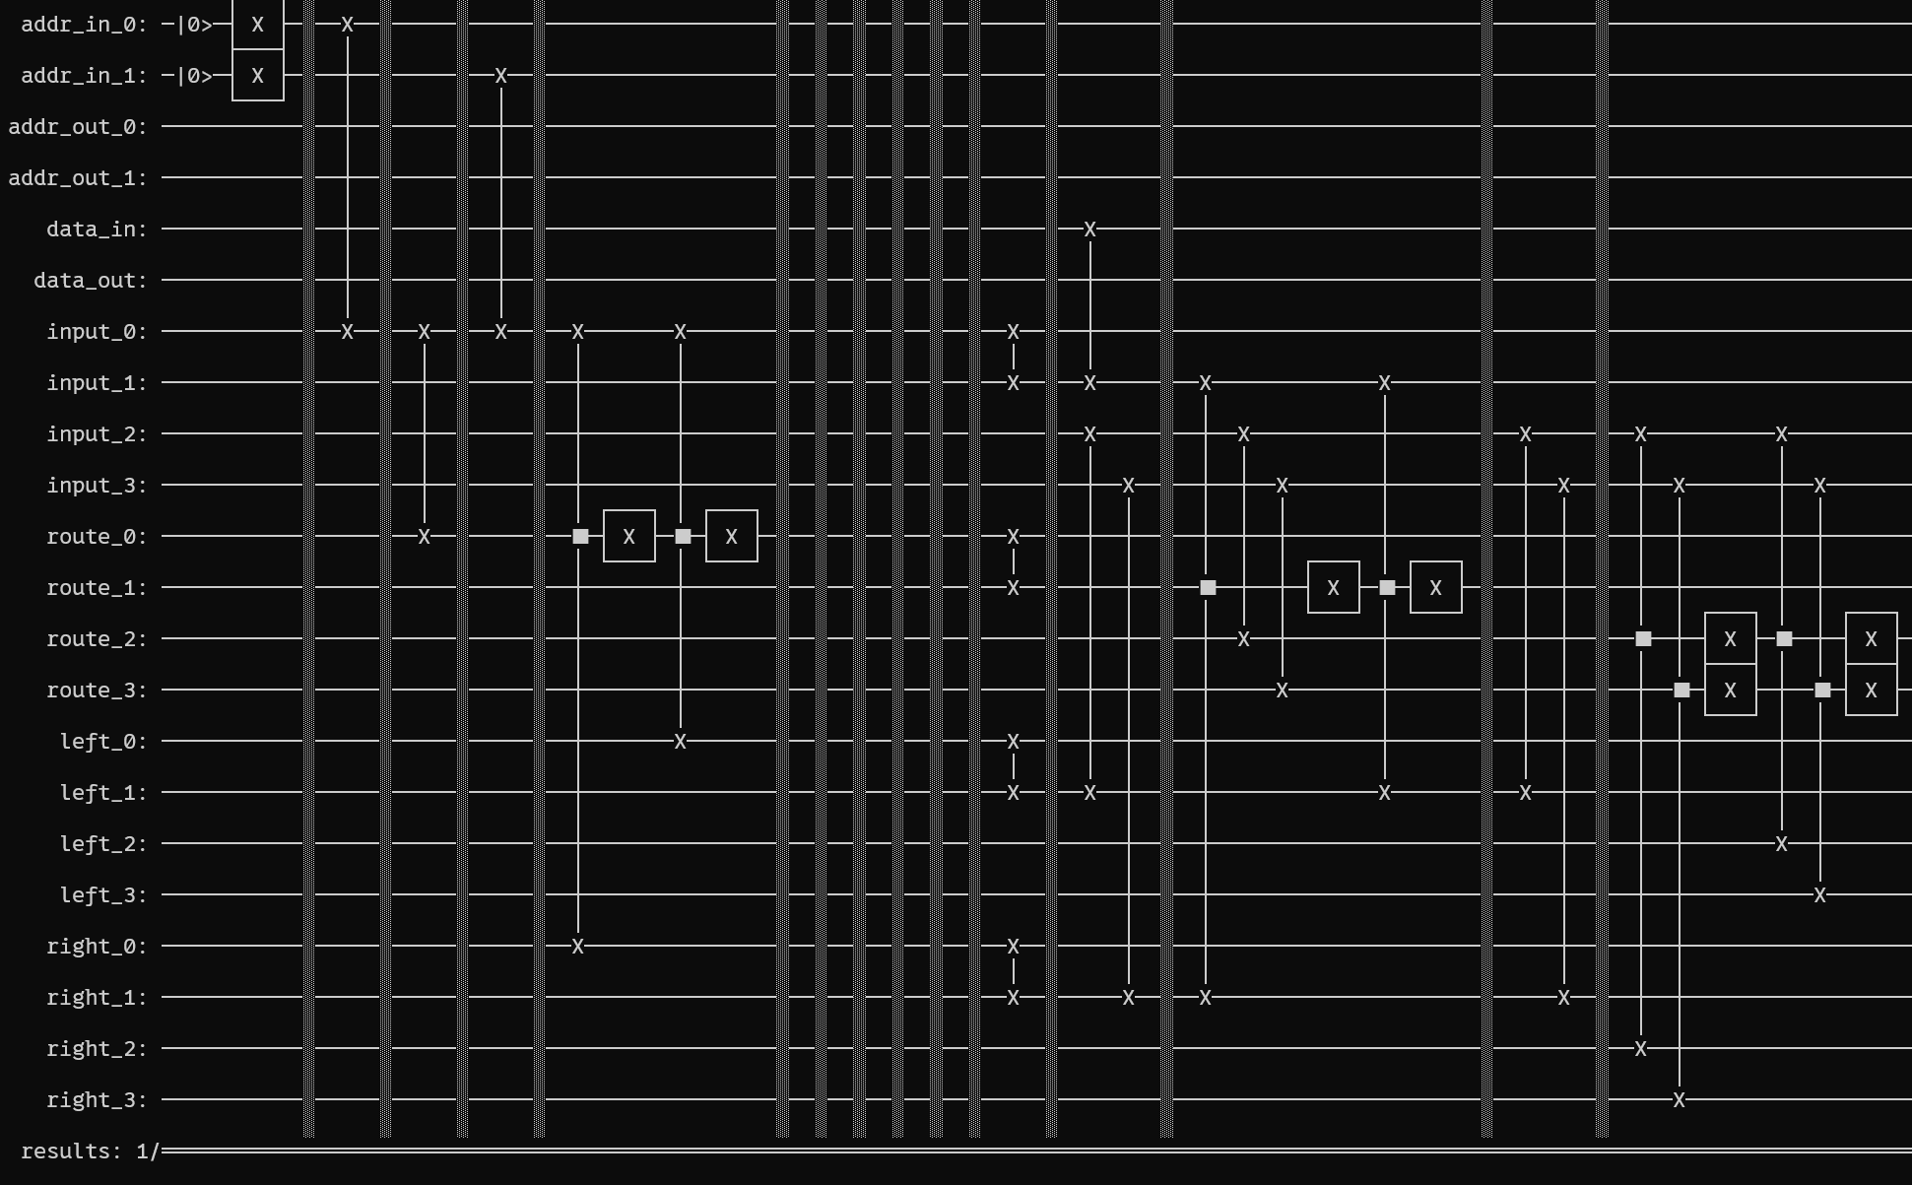
Qiskit Generated Circuits

Slide 8
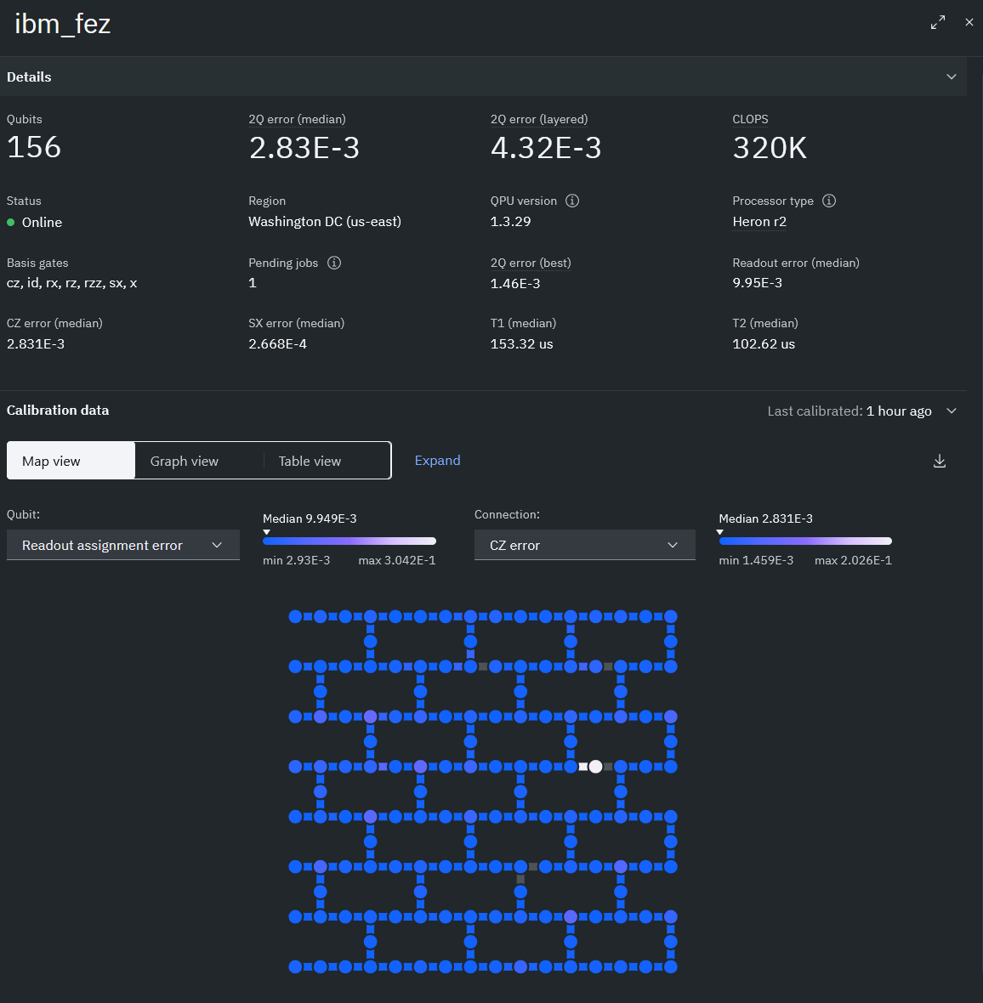
IBM Quantum Suite

Slide 9
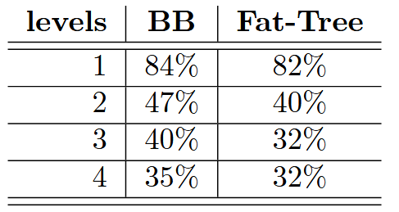
Implementation

Slide 10


Number of Qubits for n-size QRAM
BB QRAM:
Fat-Tree QRAM:

Slide 11



Increase in number of swaps
BB QRAM Gate count:
Additional SWAPS:
Increase:

Slide 12
Thank you for listening!!!

