Slide 1



Group 03
Sitorus Godang Elementary School Information System

Slide 2









Member
Ricky B Samosir
11321036
Frayogi Sitorus
11321050
Claudia Panjaitan
11321026
Olyvia Siahaan
11321062

Slide 3

Outline
1. Introduction
6. Usecase Diagram & Usecase Scenario
2. Website Development Goals
7. ER - Diagram, CDM & PDM
3. Current System
8. Class Diagram
4. Target System
9. Sequence Diagram
5. Main Function
10. Test Script & Result

Slide 4



Introduction
Public Elementary School 175807 Sitorus Godang is one of the educational institutions located in Sitorus Godang, Sigodang Tua, Silaen sub district, Toba district, North Sumatra, with the postal code 22382. During this time the process of submitting school information is still done manually without using any technology so that many are missed in its delivery. So of course it can slow down the process of making school administration by staff and the teaching and learning process and up to the delivery of announcements. The reports needed are reports on student and teacher data, subjects, classes, class schedules, students raport and delivery of announcements. Judging from the above problems, a school information system was built that can help the process of making reports and several other features in detail and efficiently. The application used is the PHP programming language with the Laravel Framework with a MySql database that can facilitate principals, teachers, or staff in managing school data. With the construction of this system, it is hoped that all the obstacles faced can be resolved and can improve the quality of education to the community.

Slide 5
Website Development Goals
The system built is expected to facilitate and help students, teachers, and principals in providing or receiving information. Information system of Sitorus Godang Elementary School information system is present to simplify all matters of school data management, for example: Report Card that contain grades and attendance are made using a website, so they can be printed and saved as .pdf so they are detailed and neat. Then the schedule that is made on the home page is more organized and can be accessed at any time. After that, the material to be explained by the teacher who will teach can upload in the material section so students can access it at any time and In addition to the books available to students, they can also be material from the teacher and can be downloaded. the same as the syllabus can be downloaded by each student. For the announcement section, it will make it easier to deliver in detail. Promotion of the school will also be known with a scope so that it can increase the number of students and can easily receive assistance easily from the head of education

Slide 6

Current System
Currently SD N 175807 Sitorus Godang still conducts the student data collection process manually. manually, for example: Lesson schedules that are written manually by each student. Then the material as student learning material, in addition to material from student books, many teachers have handbooks so that students have no material left behind other than their own notes. the process of delivering announcements from teachers to parents still occurs orally and in writing, announcements are distributed verbally and explicitly to students. However, sometimes it does not reach parents for reasons of forgetting or the delivery is not in detail conveyed to the destination.

Slide 7
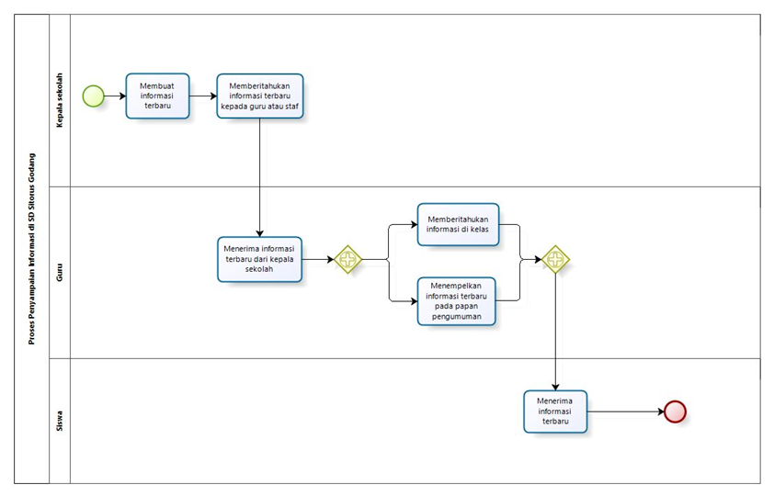
Current System - BPMN

Slide 8
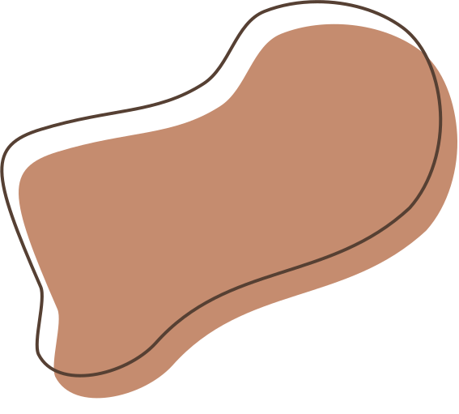
Target System
The system that will be built by the developer team is the Sitorus Godang Elementary School Information System. The system is expected to facilitate and help students, teachers, and principals in providing or receiving information. The SD Sitorus Godang information system is here to simplify all matters of school data management, for example: Student report cards containing grades and attendance are made using a website, so they can be printed and saved .pdf so that they are detailed and neat. Then the schedule is made on the home page so it is neater and can be accessed at any time. after that, the material that will be explained by the teacher who will teach can upload in the material section so students can access it at any time and in addition to the books in their students can also be material from the teacher and can be downloaded as well as the syllabus can be downloaded by each student. For the announcement section, it will be easier to deliver in detail. Promotion of the school will also be known with a wide scope so that it can increase the number of students and can easily receive assistance easily from the head of education.

Slide 9
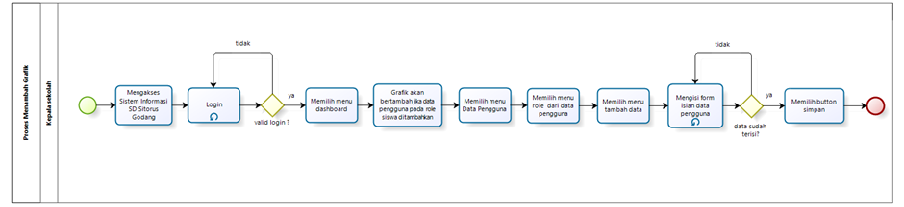
Target System - BPMN
BPMN is a graphical notation standard used to describe business processes in the form
of diagrams. The total number of existing BPMN is 45 BPMN

Slide 10
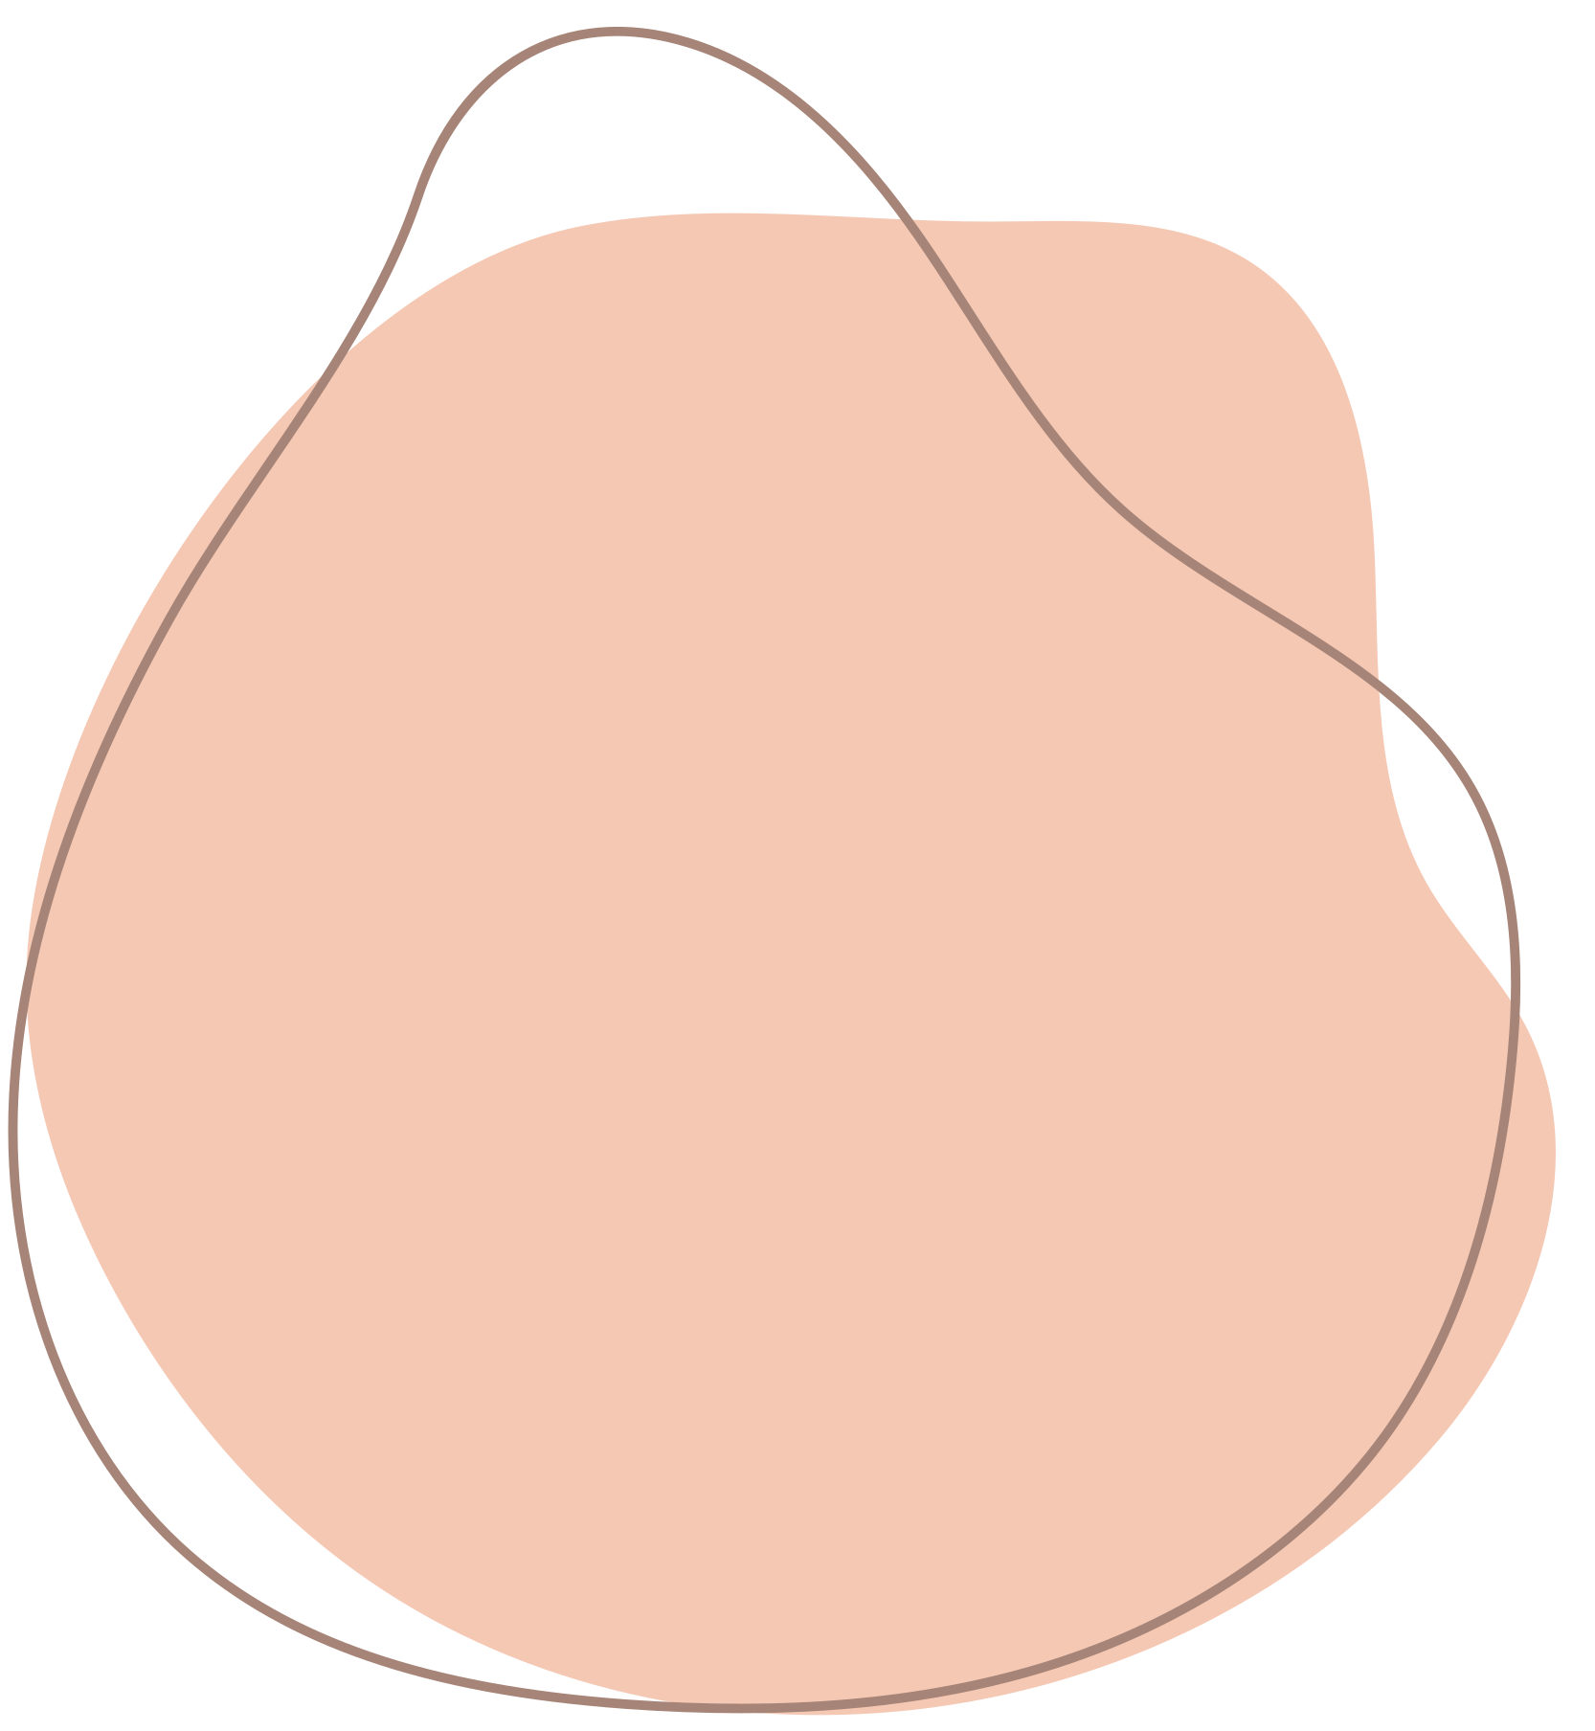

Main Function
1. Login function
2. Function to change password
3. Function to manage school information
4. Function of managing schedule management
5. The function of managing user data
6. The function of managing subjects
7. Function of managing syllabus
8. The function of managing class schedules
9. Function to manage graphs
10. Function to manage announcements
11. Function to manage student report cards
12. Profile editing function
13. Logout function

Slide 11
Use Case Diagram & Use Case Scenario
Use Case Diagram
Use case diagrams are graphical representations of the interactions between actors (users) and software systems
Use Case Scenario
Use case scenario is a narrative description of the steps taken by actors and the system in accomplishing a particular task or usage scenario

Slide 12
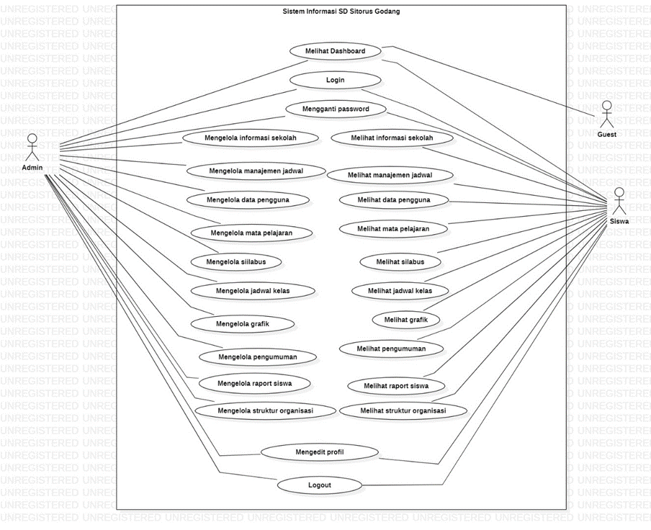
Use Case Diagram
The use case diagram will explain the functional description based on each actor in the Sitorus Godang Elementary School Information System

Slide 13
Use Case Scenario
The use case scenario will explain the system flow or steps and the role of each actor in the Sitorus Godang Elementary School Information System.
Each use case scenario will explain how the user can use each existing function, so that the user gets an idea before trying it directly on the system.
The total number of use case scenarios on this system is 53.

Slide 14


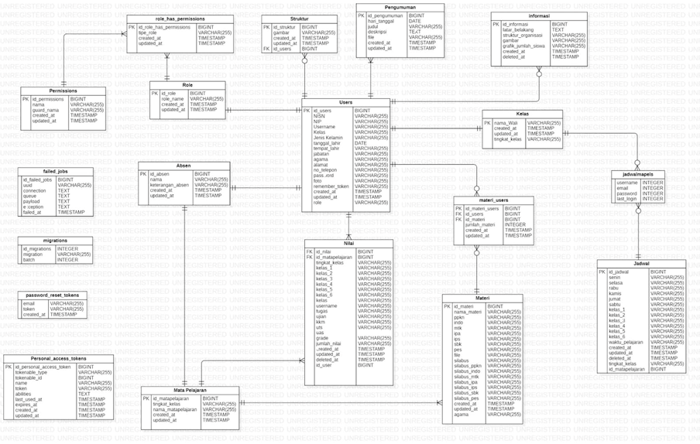
ER - Diagram, CDM & PDM
ER - Diagram
An ER diagram is a graphical representation of interconnected entities (objects) and the attributes associated with those entities. This ER-Diagram have 19 entities.
12 main entities as the storage of the data needed, and 4 built-in entities from the framework used by Laravel.

Slide 15
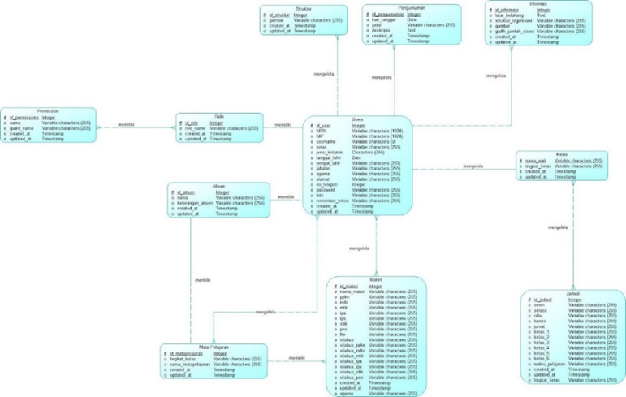
ER - Diagram, CDM & PDM
Conceptual Data Model
CDM is a high-level representation of the data structure that describes business entities, their associated attributes, and the relationships between entities in the database. This CDM have 11 entities with one to many and many to many relationship

Slide 16
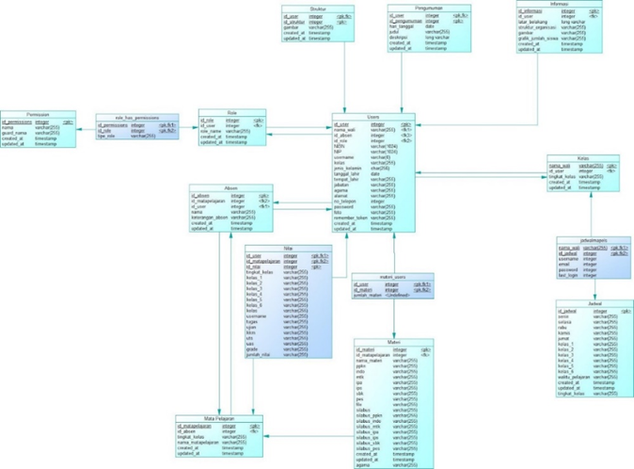
ER - Diagram, CDM & PDM
Physical Data Model
PDM is a technical implementation representation of the data structure that focuses on the physical and technical aspects (describing tables, columns, indexes, and dependencies between tables) of the database.
PDM have 11 main entities after generate from many to many relationship so 15 entities

Slide 17
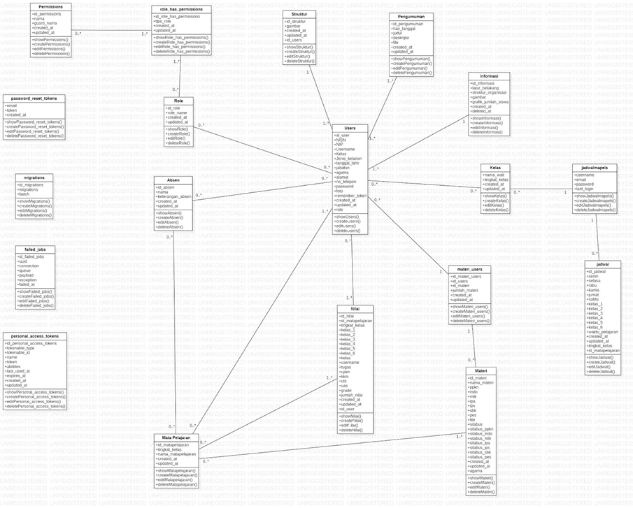
Class
Diagram
Class diagram is a type of diagram used in software modeling to describe the structure of classes in a system and the relationship between these classes.
class diagram have 19 class with zero or one to many relationship with Mandatory: Indicates that an object must have a relationship with another object. For example, every user must be registered in one class level.

Slide 18
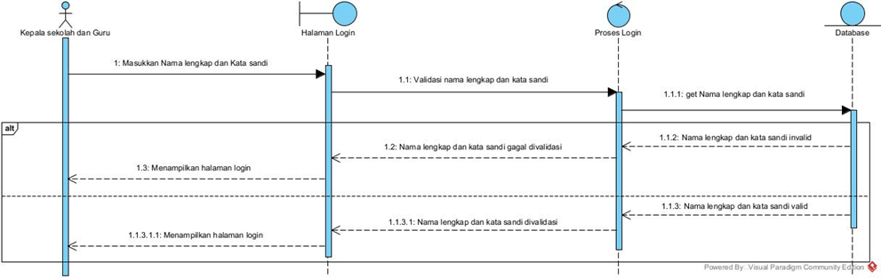
Sequence Diagram
Sequence diagram is a type of diagram used to describe the interactions between objects in the system in a certain order. The total number of sequence diagrams in this system is 35.
Sequence Diagram Login

Slide 19

Test scripts are used during the testing phase of each function that has been built. A test script is a set of instructions or procedures that describe how a particular test case should be implemented to provide a brief overview of the test case and its purpose.
Test Script
&
Result
The result in question is the result of each test item that determines whether the function being tested is running properly, so that the conclusion will be obtained that the function is acceptable.

Slide 20
Demo

Slide 21

Thank You
for your attention

