Slide 1


Institut Teknologi Del
Mata Kuliah 10S2201- Aljabar Linear
Systems of Linear Equations and Matrices
Presented by: Junita Amalia

Slide 2
Institut Teknologi Del
1.1 Introduction to Systems of Linear Equations 1.2 Gaussian Elimination 1.3 Matrices and Matrix Operations 1.4 Inverses; Algebraic Properties of Matrices 1.5 Elementary Matrices and a Method for Finding invers Matrices 1.6 More on Linear Systems and Invertible Matrices 1.7 Diagonal, Triangular, and Symmetric Matrices 1.8 Matrix Transformations 1.9 Applications of Linear Systems: Polynomial Interpolation
Outlines

Slide 3

Elementary Matrices
DEFINITION 1 Matrices A and B are said to be row equivalent if either (hence each) can be obtained from the other by a sequence of elementary row operations.

Slide 4
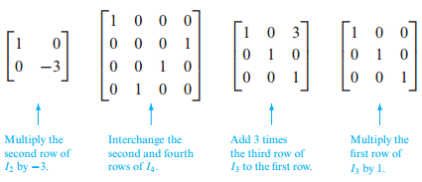
Elementary Matrices
DEFINITION 2 A matrix E is called an elementary matrix if it can be obtained from an identity matrix by performing a single elementary row operation.
Example elementary matrices and the operations that produce them:

Slide 5
Row Operations by Matrix Multiplication
THEOREM Row Operations by Matrix Multiplication
If the elementary matrix E results from performing a certain row operation on Im and if A is an m × n matrix, then the product EA is the matrix that results when this same row operation is performed on A.

Slide 6
Row Operations by Matrix Multiplication
THEOREM Every elementary matrix is invertible, and the inverse is also an elementary matrix.
THEOREM 1.5.3 Equivalent Statements If A is an n × n matrix, then the following statements are equivalent, that is, all true or all false. (a) A is invertible. (b) Ax = 0 has only the trivial solution. (c) The reduced row echelon form of A is In. (d) A is expressible as a product of elementary matrices.

Slide 7

A Method for Inverting Matrices
Inversion Algorithm To find the inverse of an invertible matrix A, find a sequence of elementary row operations that reduces A to the identity and then perform that same sequence of operations on In to obtain $A^{−1}$.

Slide 8



Using Row Operations to Find $A^{−1}$
Example: Find the inverse of
Clue:

Slide 9
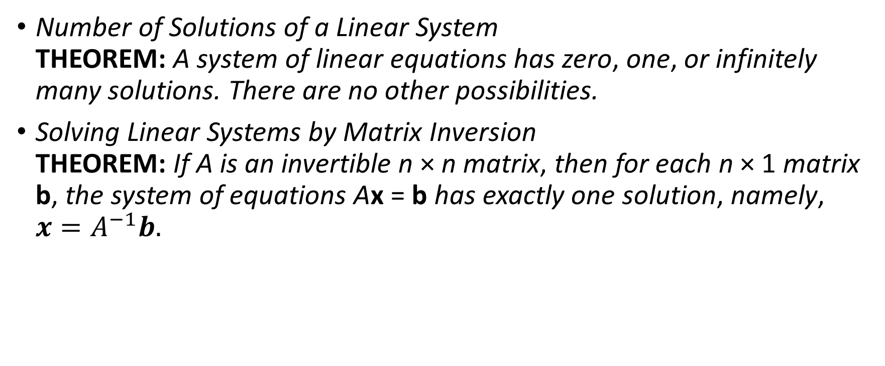
More on Linear Systems and Invertible Matrices
Number of Solutions of a Linear System THEOREM: A system of linear equations has zero, one, or infinitely many solutions. There are no other possibilities.
Solving Linear Systems by Matrix Inversion THEOREM: If A is an invertible n × n matrix, then for each n × 1 matrix b, the system of equations Ax = b has exactly one solution, namely, $x=A^{−1}b.$

Slide 10



Solution of a Linear System Using $A^{−1}$
Consider the system of linear equations
Find value of unknown!
In matrix for m this system can be written as Ax = b, where

Slide 11


We showed that A is invertible
The solution of the system is
So

Slide 12




Solving Two Linear Systems at Once
Solve the systems
Solution: The two systems have the same coefficient matrix

Slide 13

Properties of Invertible Matrices
THEOREM Let A be a square matrix.

Slide 14
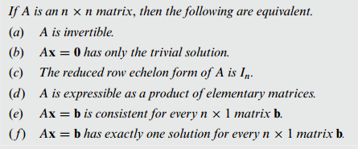
Equivalence Theorem
Theorem: Let A and B be square matrices of the same size. If AB is invertible, then A and B must also be invertible.

Slide 15

A Fundamental Problem
Let A be a fixed m × n matrix. Find all m × 1 matrices b such that the system of equations Ax = b is consistent.
Example: What conditions must b1, b2, and b3 satisfy in order for the system of equations
to be consistent?

Slide 17
Referensi
Howard Anton and Chris Rorres, Elementary Linear Algebra, 11-th edition, John Wiley, 2014.

Slide 18

Thank you!
Feel free to approach us if you have any questions.

