Slide 1
Introduction to Database System
Slide by : Humasak Simanjuntak
Presented by : Hernawati Samosir

Slide 2
Overview
Introduction to DBS environment
  DBMS Architecture
  Storage Structure
Introduction to SQL Server Environment
HTS_Week1_DatabaseSystemEnvironment

Slide 3
What is a DBMS
To be able to carry out operations like insertion, deletion and retrieval, the database needs to be managed by a substantial package of software is usually called a Database Management System (DBMS)
A DBMS is usually a very large software package that carries out many different tasks including the provision of facilities to enable the user to access and modify information in the database
Data Description Languages (DDL) and Data Manipulation Languages (DML) are needed for manipulating and retrieving data stored in the DBMS.
HTS_Week1_DatabaseSystemEnvironment

Slide 4
DBMS Architecture
A DBMS is a complex piece of software that usually consists of a number of modules.
The DBMS may be considered as an agent that allows communication between the various types of users.
The information (data) about the data in a database is called the metadata
A DBMS provides facilities for:
  describing the database, when a database is being set up
  authorization specification and checking
  access path selection
  concurrency control
  logging and recovery
HTS_Week1_DatabaseSystemEnvironment

Slide 5
DBMS Architecture
The main components of the DBMS are:
  A Query Language and a Data Description Language (DDL) to provide users the access to the database.
  A translator for users' instructions in the query language and the DDL including query optimization.
  A Database manager
  A file manager
  The physical database
  The metadata
The above listing of DBMS components does not include some very important components e.g. concurrency controller and recovery manager.
HTS_Week1_DatabaseSystemEnvironment

Slide 6

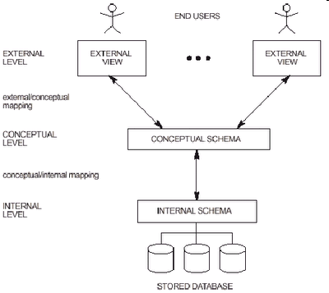
DBMS Architecture
A commonly used views of data approach is the three-level architecture suggested by ANSI/SPARC (American National Standards Institute/Standards Planning and Requirements Committee). ANSI/SPARC produced an interim report in 1972 followed by a final report in 1977
The three levels of the architecture are three different views of the data:
  External - individual user view
  Conceptual - community user view
  Internal - physical or storage view
HTS_Week1_DatabaseSystemEnvironment

Slide 7
DBMS Architecture
Unsophisticated users (customers, travel agents, etc)
Sophisticated users, application
Programmers, DB administrators
Web Forms
Application Front Ends
SQL Interface
SQL COMMANDS
shows command flow
Plan Executor
Parser
shows interaction
Query
Evaluation
Engine
Operator Evaluator
Optimizer
Transaction Manager
Files and Access Methods
Recovery Manager
Buffer Manager
Lock Manager
Disk Space Manager
Concurrency Control
DBMS
Index Files
shows references
System Catalog
Architecture of a DBMS
Data Files
DATABASES
HTS_Week1_DatabaseSystemEnvironment

Slide 8
Overall System Architecture
A DBMS is typically run as a back-end server in a (local or global) network, offering services to clients directly or to application servers.
Users/
Clients
Application
Server
Data
Server
Request Reply
Application Program 1
Application Program 1
Request Reply
Encapsulated data
Exposed data
Objects
Stored Data (Pages)
Generally, we call this
the “3-tier” reference architecture
HTS_Week1_DatabaseSystemEnvironment

Slide 9
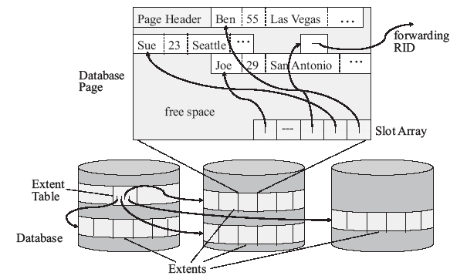
Storage Structure
Whether the DBMS offers relational, object-relational, or other data structures at the user interface, internally they have to be mapped into fixed-length blocks that serve as the basic I/O-unit of transfer between main and secondary memory.
HTS_Week1_DatabaseSystemEnvironment

Slide 10
Introduction to SQL Server environment
HTS_Week1_DatabaseSystemEnvironment

Slide 11
Introduction to SQL Server environment
SQL Server : RDBMS that uses Transact-SQL to send request between a client computer and a SQL Server computer.
Results
Transact-SQL
Application
Client
SQL Server
Relational Database
Management System
HTS_Week1_DatabaseSystemEnvironment

Slide 12
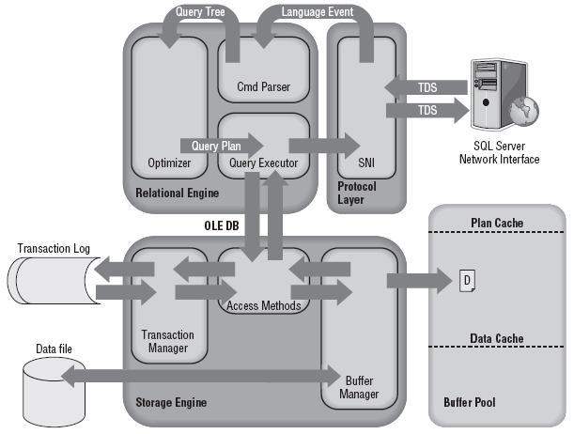
Introduction to SQL Server environment
The major components of the SQL Server architecture.
HTS_Week1_DatabaseSystemEnvironment

Slide 13
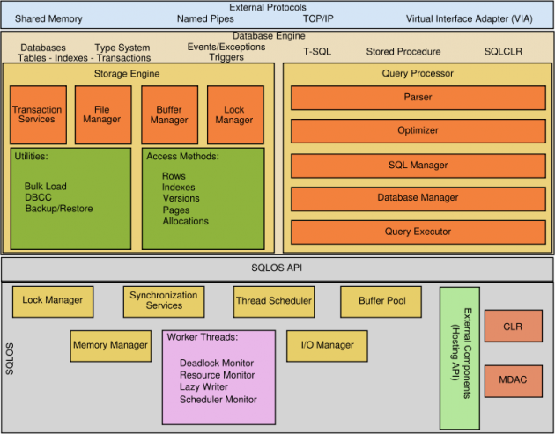
Introduction to SQL Server environment
The major components of the SQL Server architecture.
HTS_Week1_DatabaseSystemEnvironment

Slide 14
Introduction to SQL Server environment
SQL Server Software
  SQL Server Enterprise Manager Snap-in for Microsoft Management Console (MMC).
  SQL Server Administration Tools and Wizards.
  SQL Server Command Prompt Management Tools.
  SQL Server Help and SQL Server Books Online.
  Microsoft SQL Server OLAP Services.
  Microsoft English Query Support.
  SQL Server Analysis Service
  SQL Server Integration Service
  SQL Server Reporting Service, etc
HTS_Week1_DatabaseSystemEnvironment

Slide 15
Introduction to SQL Server environment
Type of Databases
System Databases
master
model
tempdb
msdb
Resource
pubs
northwind
user1
User Databases
HTS_Week1_DatabaseSystemEnvironment
Notes:
SQL Server System Databases
Master
Purpose - Core system database to manage the SQL Server instance. In SQL Server 2005, the Master database is the logical repository for the system objects residing in the sys schema. In SQL Server 2000 and previous editions of SQL Server, the Master database physically stored all of the system objects.
Prominent Functionality
Per instance configurations
Databases residing on the instance
Files for each database
Logins
Linked\Remote servers
Endpoints
Additional Information
The first database in the SQL Server startup process
In SQL Server 2005, needs to reside in the same directory as the Resource database
Sources for Database Information - SQL Server 2000 to 2005 Crosswalk
SQL 2000 to 2005 Crosswalk - Startup Parameters
Resource
Purpose - The Resource database is responsible for physically storing all of the SQL Server 2005 system objects. This database has been created to improve the upgrade and rollback of SQL Server system objects with the ability to overwrite only this database.
Prominent Functionality
System object definition
Additional Information
Introduced in SQL Server 2005 to help manage the upgrade and rollback of system objects
Prior to SQL Server 2005 the system related data was stored in the master database
Read-only database that is not accessible via the SQL Server 2005 tool set
The database ID for the Resource database is 32767
The Resource database does not have an entry in master.sys.databases
TempDB
Purpose - Temporary database to store temporary tables (#temptable or ##temptale), table variables, cursors, work tables, row versioning, create or rebuild indexes sorted in TempDB, etc. Each time the SQL Server instance is restarted all objects in this database are destroyed, so permanent objects cannot be created in this database.
Prominent Functionality
Manage temporary objects listed in the purpose above
Additional Information
Properly Sizing the TempDB Database
Each time a SQL Server instance is rebooted, the TempDB database is reset to its original state
Model
Purpose - Template database for all user defined databases
Prominent Functionality
Objects
Columns
Users
Additional Information
User defined tables, stored procedures, user defined data types, etc can be created in the Model database and will exist in all future user defined databases
The database configurations such as the recovery model for the Model database are applied to future user defined databases
MSDB
Purpose - Primary database to manage the SQL Server Agent configurations
Prominent Functionality
SQL Server Agent Jobs, Operators and Alerts
DTS Package storage in SQL Server 7.0 and 2000
SSIS Package storage in SQL Server 2005
Additional Information
Provides some of the configurations for the SQL Server Agent service
For the SQL Server 2005 Express edition installations, even though the SQL Server Agent service does not exist, the instance still has the MSDB database
Missing SQL Server Agent History
MSSQLTips Category - SQL Server Agent
Distribution
Purpose - Primary data to support SQL Server replication
Prominent Functionality
Database responsible for the replication meta data
Supports the data for transaction replication between the publisher and subscriber(s)
Additional Information
MSSQLTips Category - Replication
ReportServer
Purpose - Primary database for Reporting Services to store the meta data and object definitions
Prominent Functionality
Reports security
Job schedules and running jobs
Report notifications
Report execution history
Additional Information
MSSQLTips Category - Reporting Services
ReportServerTempDB
Purpose - Temporary storage for Reporting Services
Prominent Functionality
Session information
Cache
Additional Information
MSSQLTips Category - Reporting Services

Slide 16
Introduction to SQL Server environment
System Databases
master Records all the system level information for an instance of SQL Server (instance-wide metadata such as logon accounts, endpoints, linked servers, Files for each database, and system configuration settings)
model Provides a template or prototype for new user databases (The entire contents of the model database, including database options, are copied to the new database)
tempdb Provides a storage area for temporary tables and other temporary working storage needs (Temporary user objects that are explicitly created)
HTS_Week1_DatabaseSystemEnvironment

Slide 17
Introduction to SQL Server environment
System Databases
msdb Supports SQL Server Agent and provides a storage area for scheduling information and job history (SQL Server Management Studio, Service Broker and Database Mail)
Resource contains all the system objects that are included with SQL Server (sys.objects, are physically persisted in the Resource database, but they logically appear in the sys schema of every database, does not contain user data or user metadata)
HTS_Week1_DatabaseSystemEnvironment

Slide 18
SQL Server 2008
SQL Server 2008 extends the performance, reliability, availability, programmability, and ease-of-use of SQL Server 2000 and 2005
SQL Server 2008 includes several new features that make it an excellent database platform for large-scale online transactional processing (OLTP), data warehousing, and e-commerce applications.
HTS_Week1_DatabaseSystemEnvironment

Slide 19
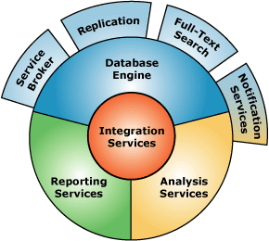
SQL Server 2008, 2010, 2012
Component SQL Server 2008:
  Database Engine
  Analysis Service
  Integration Services
  Replication
  Reporting Services
  Notification Services
  Full-Text Search
  Service Broker
HTS_Week1_DatabaseSystemEnvironment

Slide 20
SQL Server 2008, 2010, 2012
Database Engine : The Database Engine is the core service for storing, processing, and securing data
Analysis Service : Analysis Services delivers online analytical processing (OLAP) and data mining functionality for business intelligence applications
Integration Services : enterprise data transformation and data integration solution that you can use to extract, transform, and consolidate data from disparate sources and move it to single or multiple destinations
Replication : Replication is a set of technologies for copying and distributing data and database objects from one database to another and then synchronizing between databases to maintain consistency
Reporting Service : new server-based reporting platform that you can use to create and manage tabular, matrix, graphical, and free-form reports that contain data from relational and multidimensional data sources
Notification Services : platform for developing and deploying applications that generate and send notifications.
Full-Text Search : functionality you need to issue full-text queries against plain character-based data in SQL Server tables
Service Broker : technology for building reliable, scalable, and secure database applications
HTS_Week1_DatabaseSystemEnvironment

Slide 21
Task:
Install SQL Server
Trying the SQL Server Environment
HTS_Week1_DatabaseSystemEnvironment

Slide 22
Thank You ☺
HTS_Week1_DatabaseSystemEnvironment

