Slide 1

Chapter 9. Numerical Methods
Del Institute of Technology Indonesia

Slide 2
9.1 LU-Decompositions

Slide 3
Up to now, we have focused on two methods for solving linear systems, Gaussian elimination (reduction to row echelon form) and Gauss–Jordan elimination (reduction to reduced row echelon form).
While these methods are fine for the small-scale problems in this text, they are not suitable for large-scale problems in which computer roundoff error, memory usage, and speed are concerns. In this section we will discuss a method for solving a linear system of n equations in n unknowns that is based on factoring its coefficient matrix into a product of lower and upper triangular matrices.
This method, called “LU-decomposition,” is the basis for many computer algorithms in common use.

Slide 4
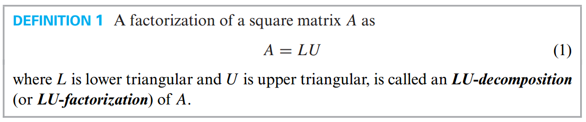
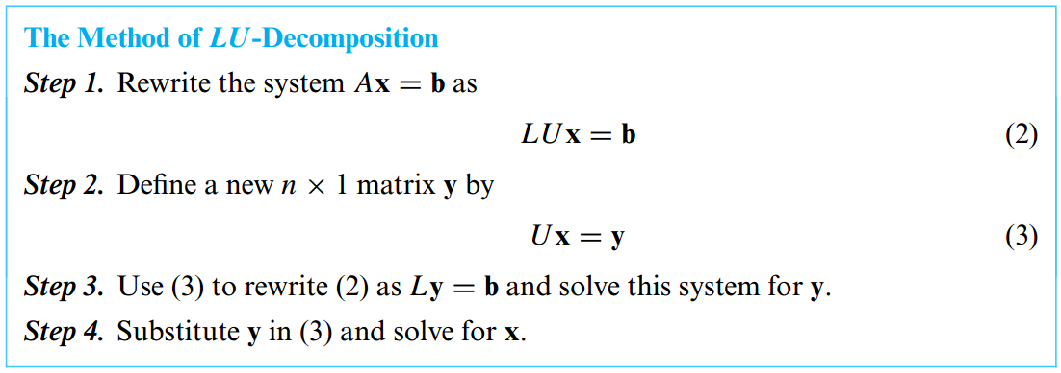
Solving Linear Systems by Factoring

Slide 5
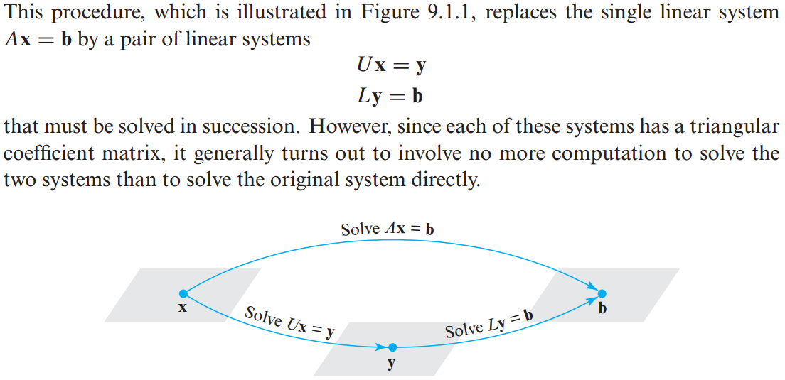

Slide 6
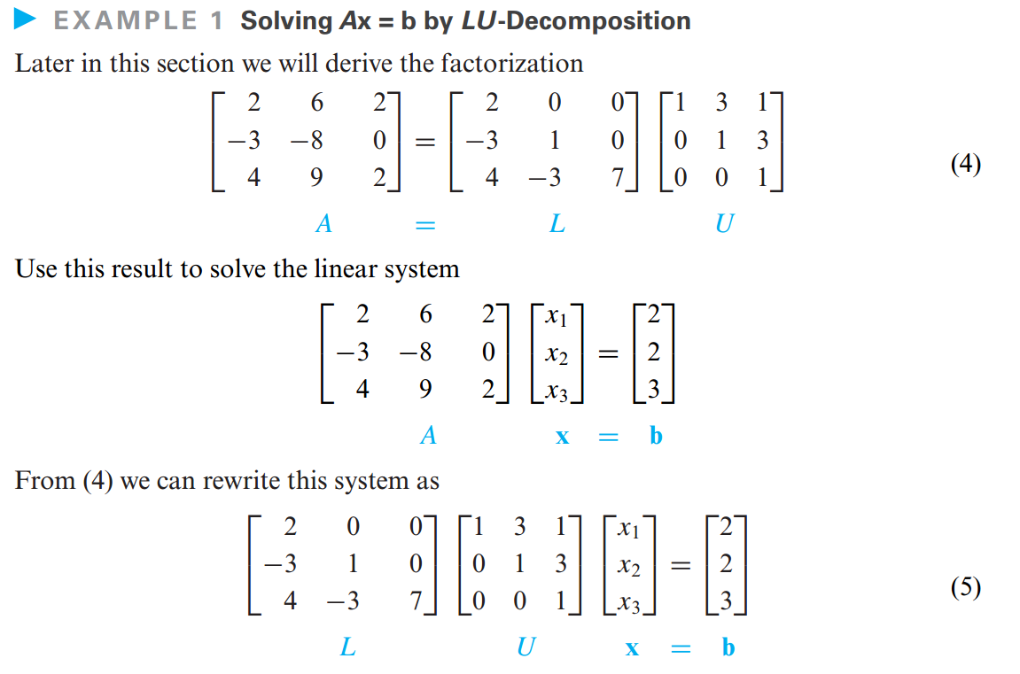

Slide 7
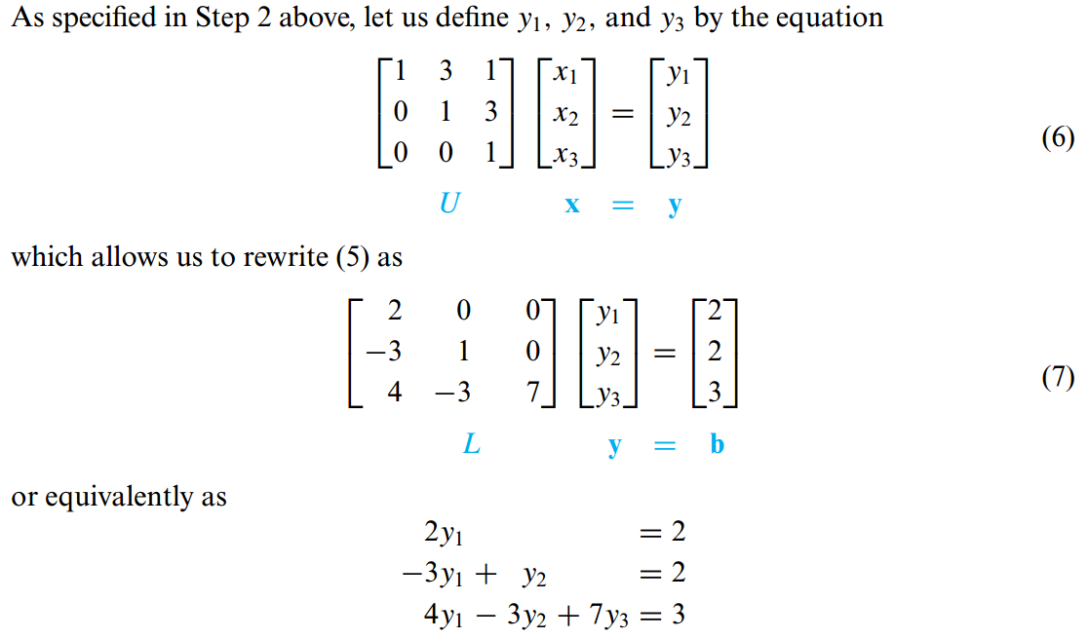

Slide 8
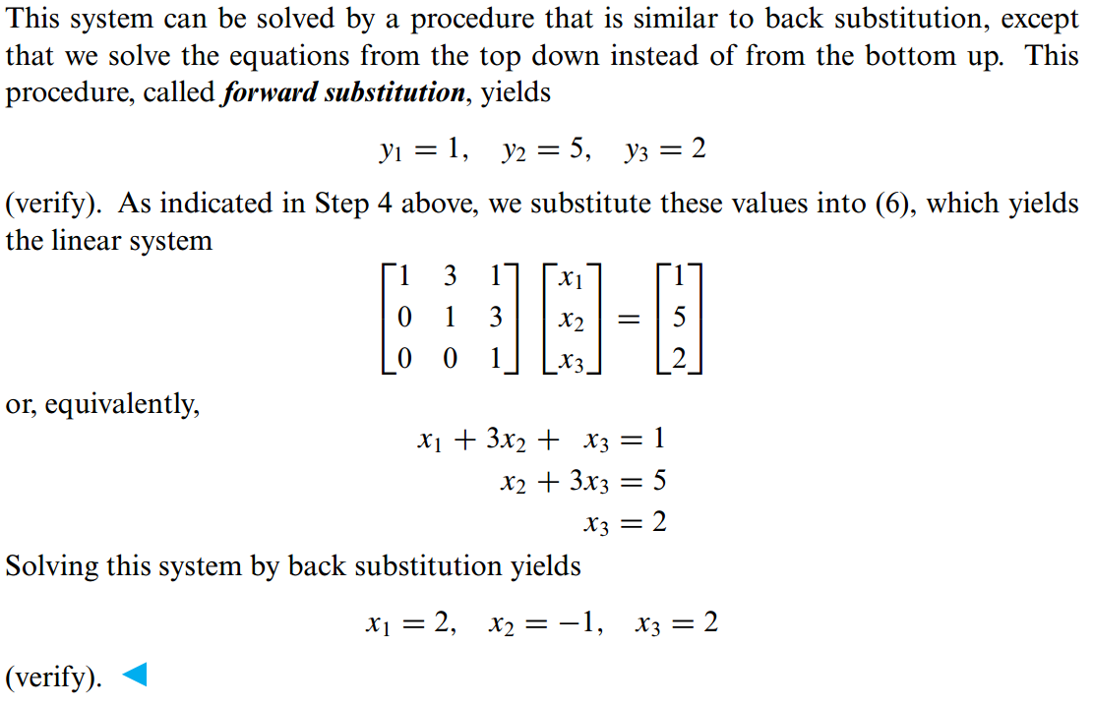

Slide 9
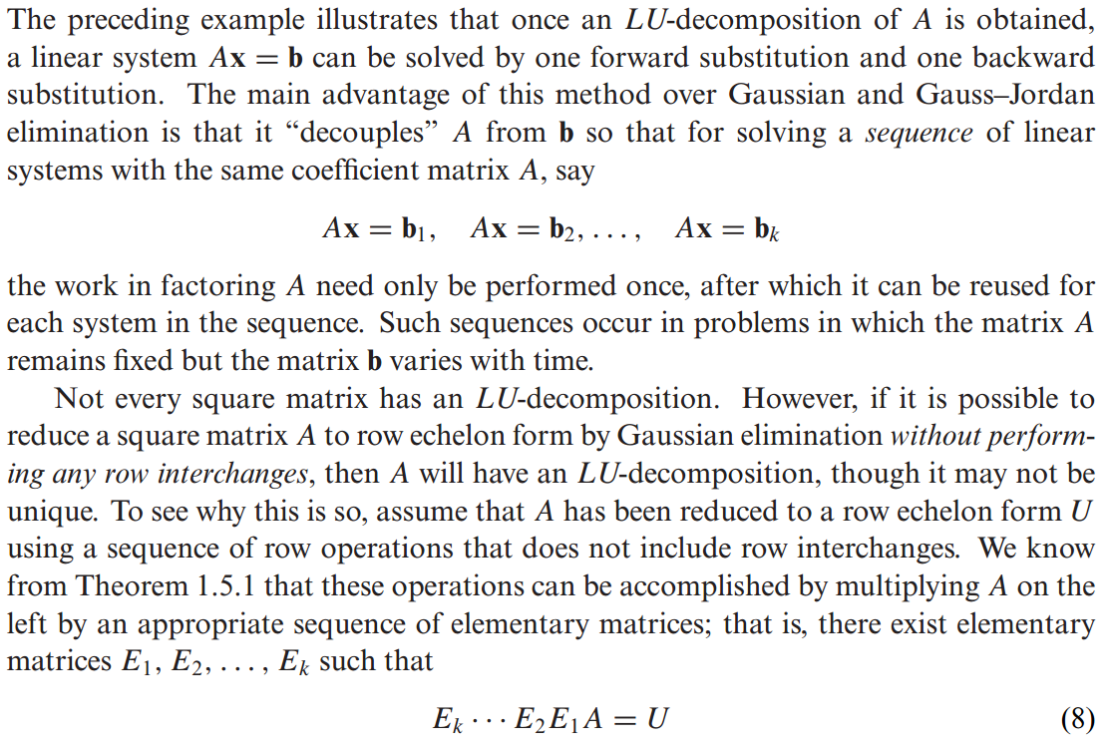
Finding LU-Decompositions

Slide 10
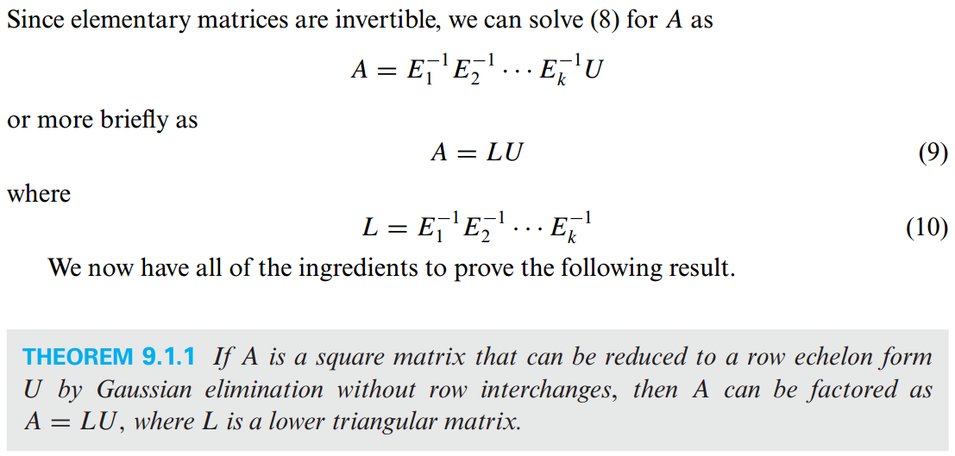

Slide 11
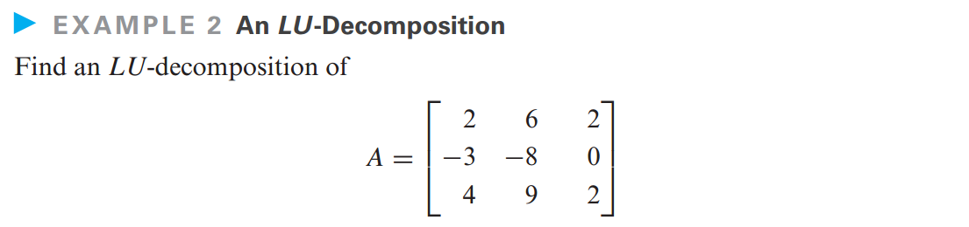
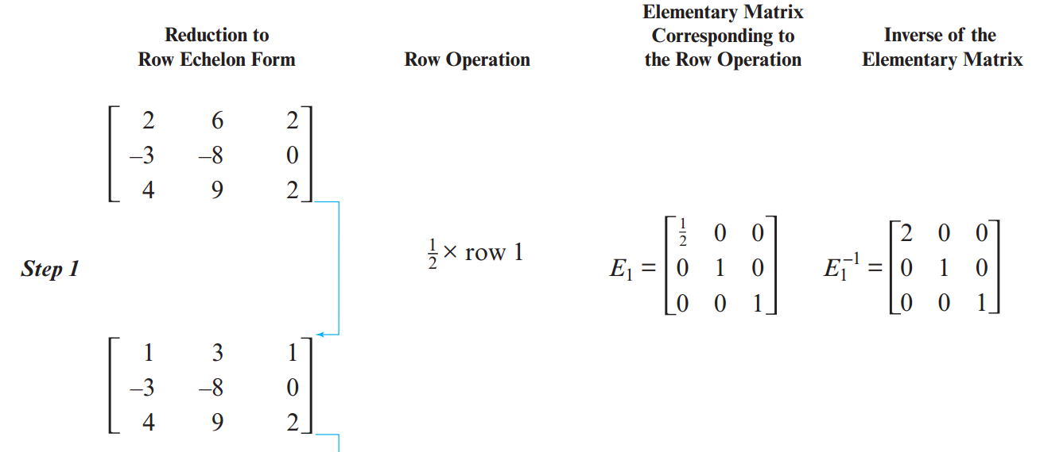

Slide 12
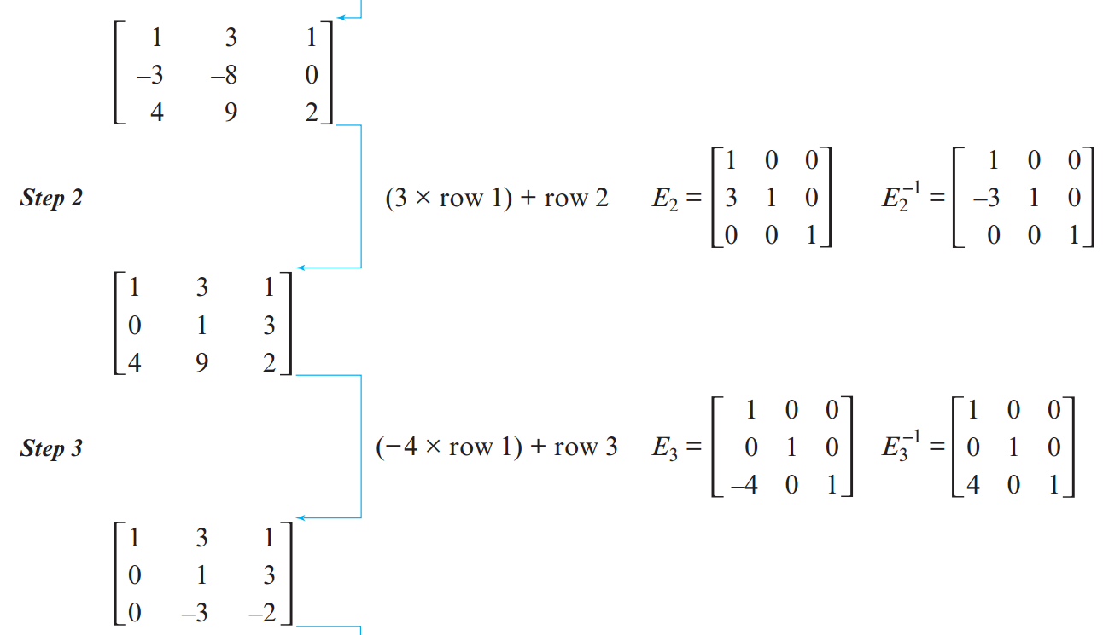

Slide 13
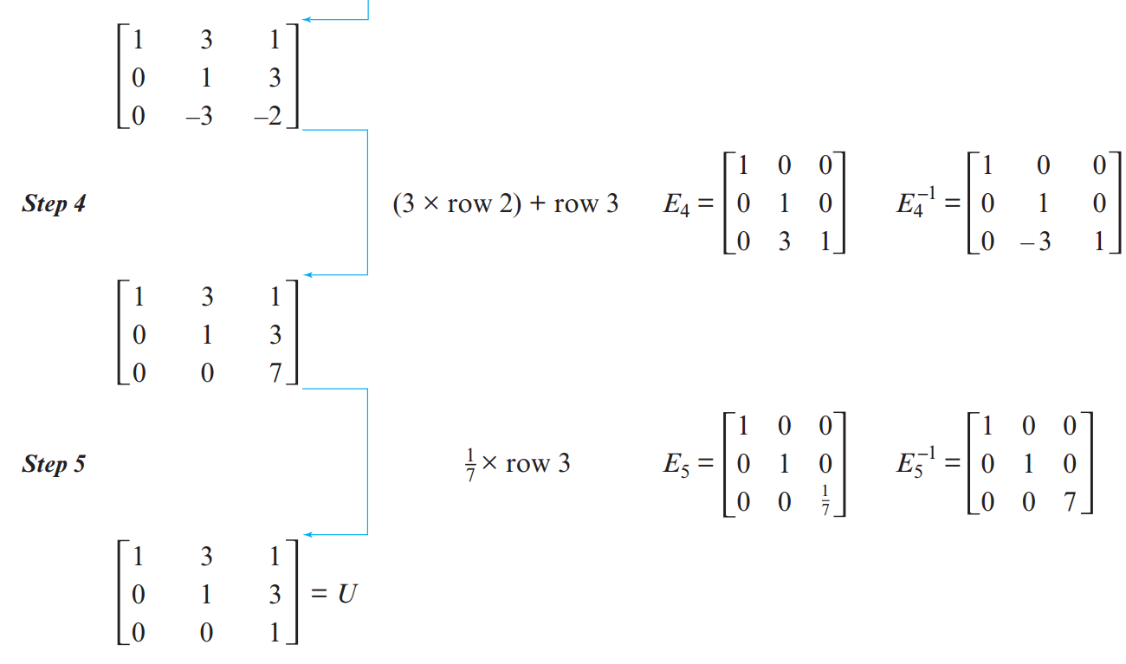

Slide 14
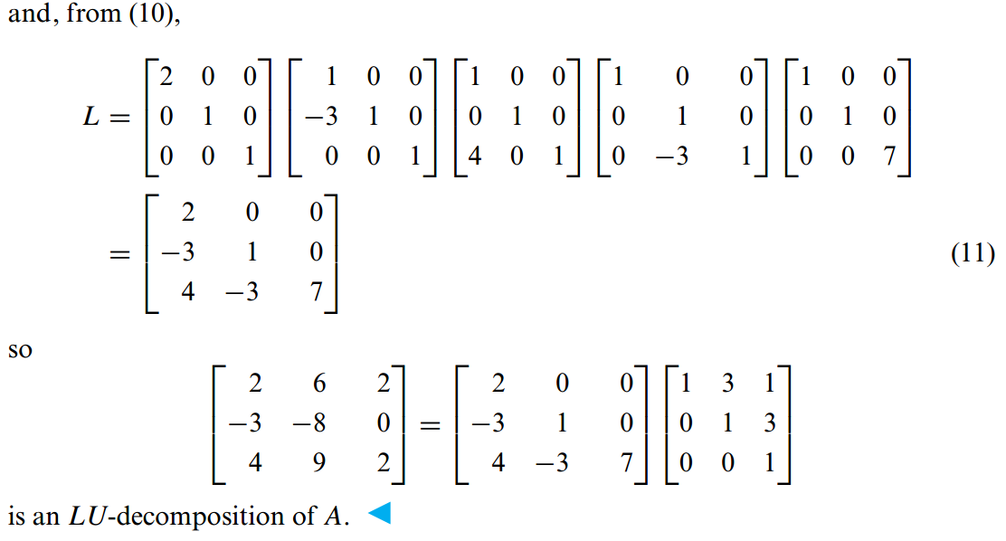

Slide 15
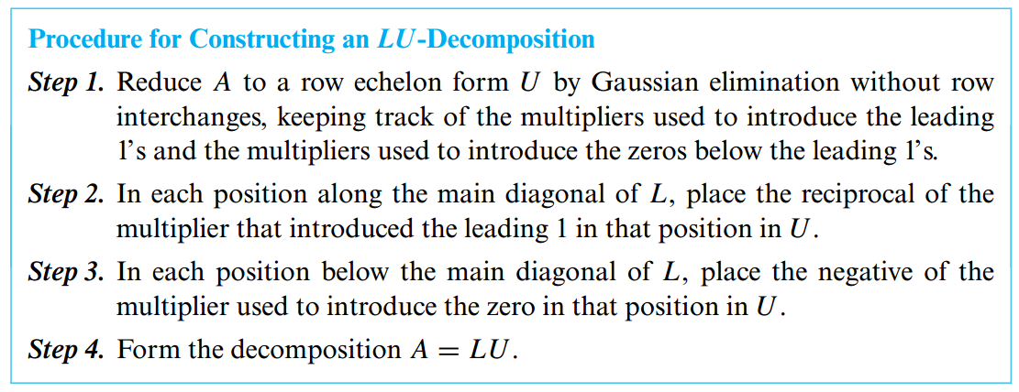

Slide 16
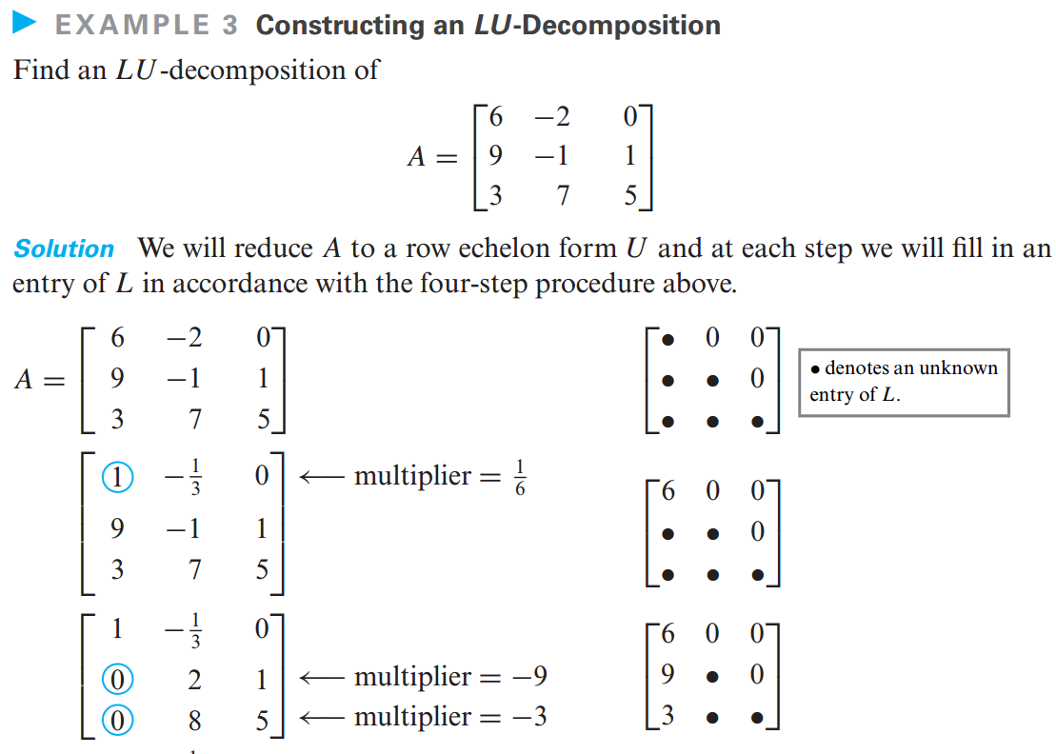

Slide 17
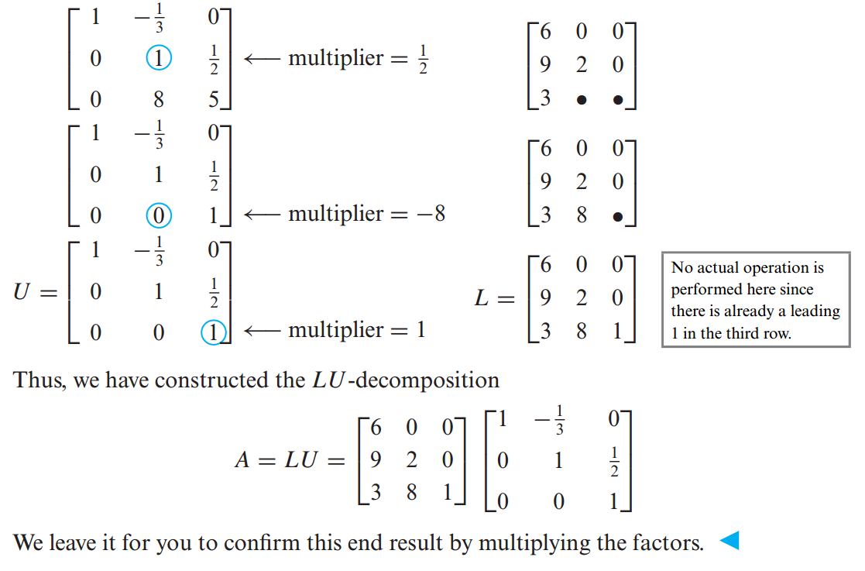

Slide 18
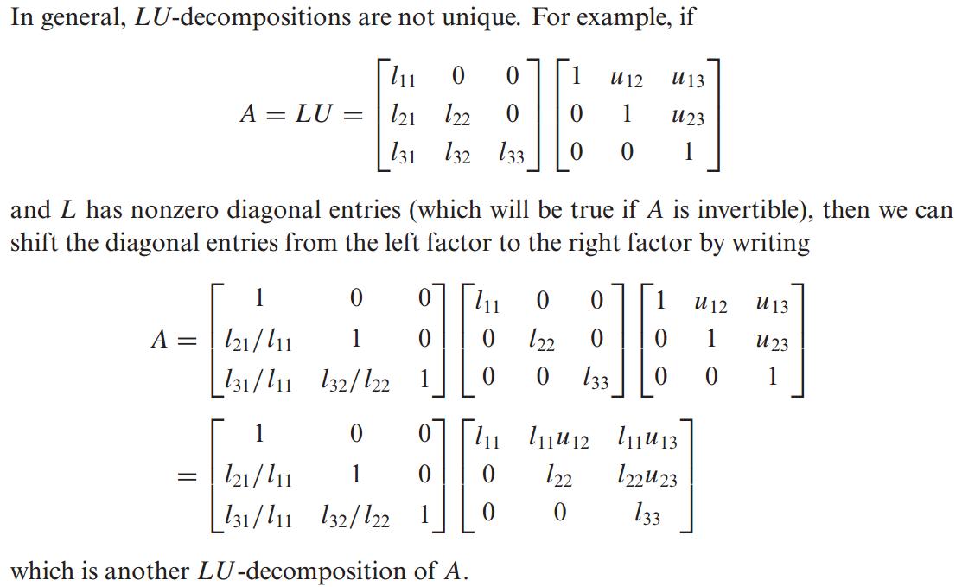
LU-Decompositions Are Not Unique

Slide 19
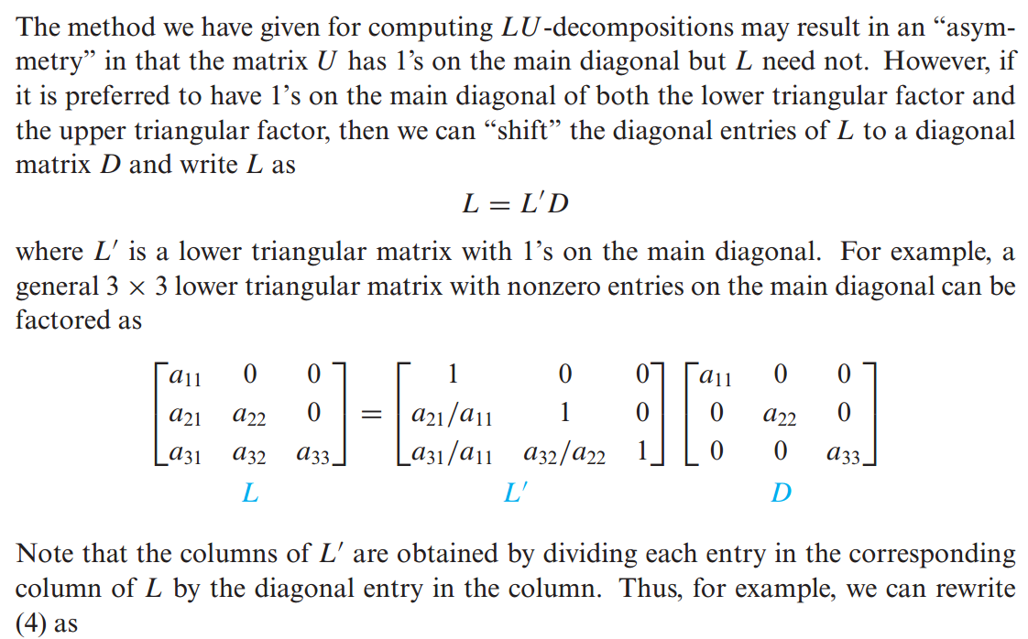
LDU-Decompositions

Slide 20
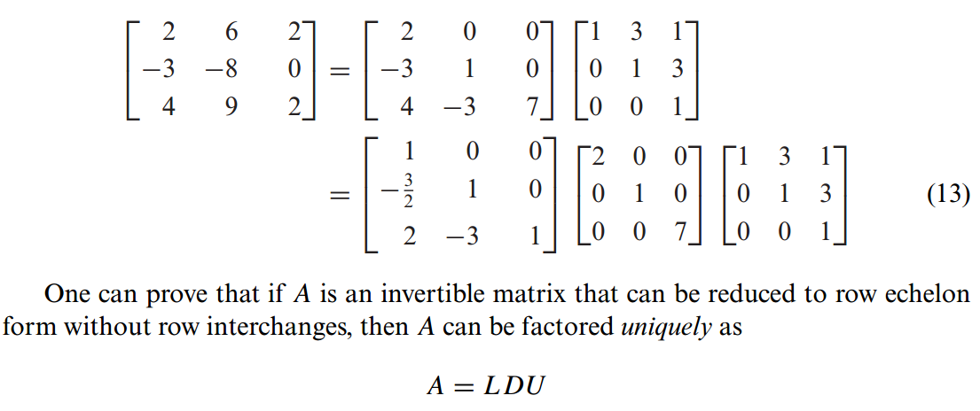

Slide 21
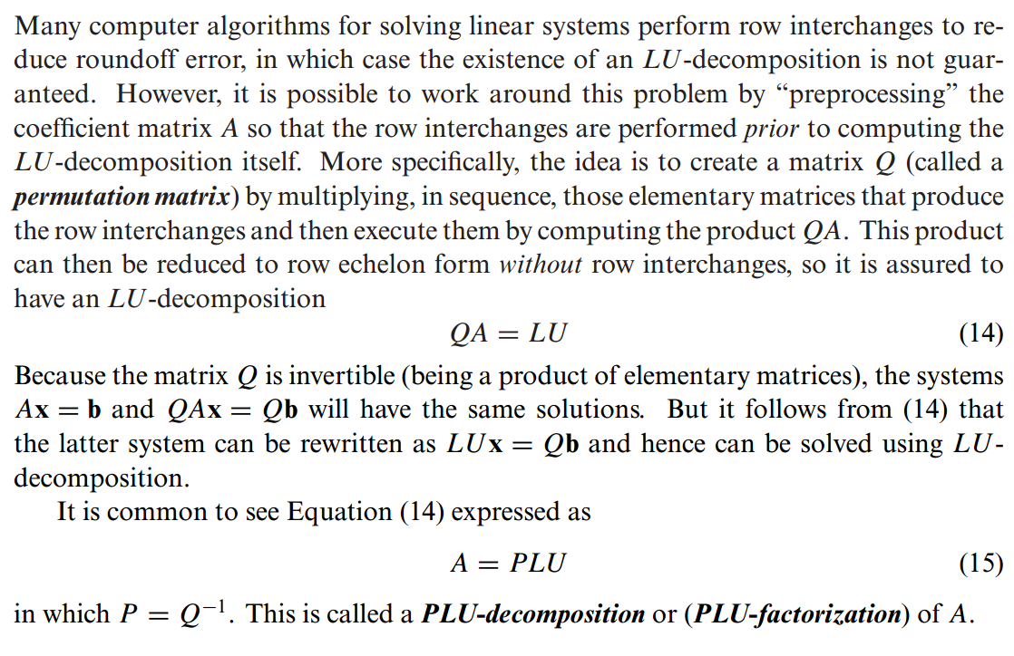
PLU-Decompositions

