Slide 1

Medical Software Development
Presentation
Exercise 10 Aleksandra Iskrzynska

Slide 2
Scientific Question
The data ‘squats_03.json’ contains the recording of performing squat exercise
The question arises if through the analysis we are able to: Detect how many squats were done
The answer to the following question could be used in the context of rehabilitation or healthy training.

Slide 3
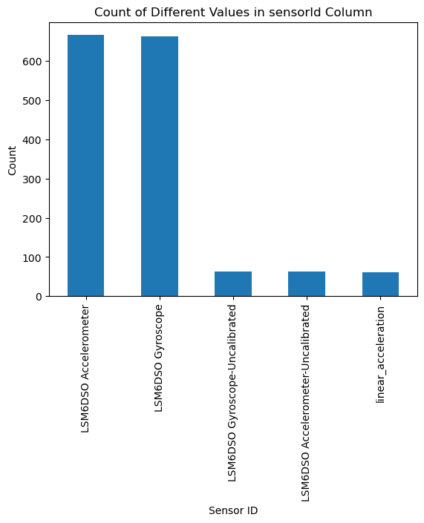
Sensors used to collect the data
Taking the amount of data LSM6DSO sensor was used for data analysis

Slide 4
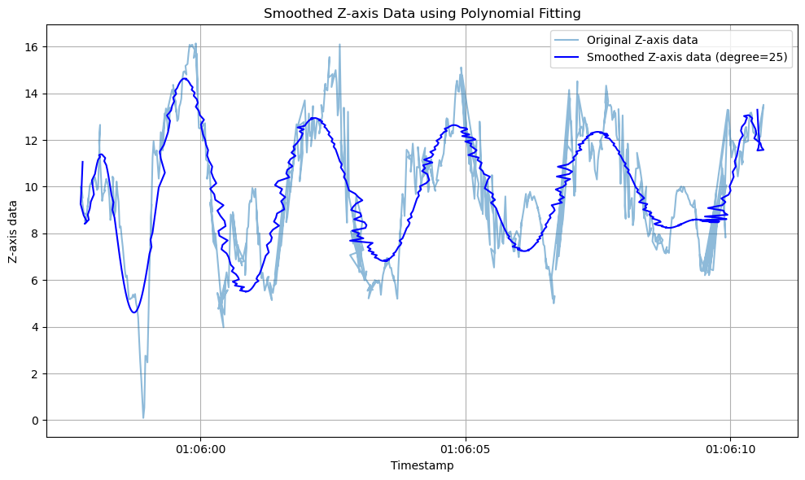
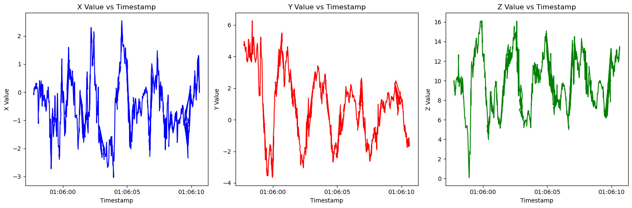
Analytics Part
For a squad we should expect ‘rabbit ears’ looking like signal in accelerometer
We could see from Z axis that at least 8 squats were performed, but during the recording 10 were made

Slide 5
Analytics Part
With polynomial fitting we could have some overview of the number of squats but still more improvements are needed
Additionaly the acceleration could be further analyzed to know if the squads were done at correct speed

