Slide 1
Enhancing Marketing Precision:
Predicting Term Deposit Subscriptions in Banking
Contributors - Adarsh Prajapat, Himani Tyagi, Olimpia Borgohain, Shailoz Kumar Singh

Slide 2
Bank Marketing - Portuguese Banking Institution
Problem Statement :
The focus of this project is the analysis of direct marketing campaigns conducted by a Portuguese banking institution, where phone calls were utilized to engage potential clients
Multiple contacts were established with the same clients to maximize effectiveness in determining their inclination towards subscribing to a term deposit ("yes") or not ("no")
The primary goal is to develop a predictive model that can accurately forecast whether a client will subscribe to a term deposit or not based on the given dataset

Slide 3
Motivation :
Practical Implications from the insights (for banking/insurance institution's marketing strategies)
Utilizing predictive models - enhance client outreach approach
Improvements in campaign design and execution
Financial benefits for the institution
Invaluable in the context of investment planning - follow personalized approach & offer tailored investment options

Slide 4

Dataset :
Source - UC Irvine Machine Learning Repository : https://archive.ics.uci.edu/dataset/222/bank+marketing
Pertains to direct marketing campaigns (phone calls)
Numerical (Age, Duration, Campaign, etc.)
Categorial (Job, Marital, Loan, Housing, etc.)
Target Variable - y - Values: “yes” or “no”
Columns : 21 - Rows : 41188

Slide 5
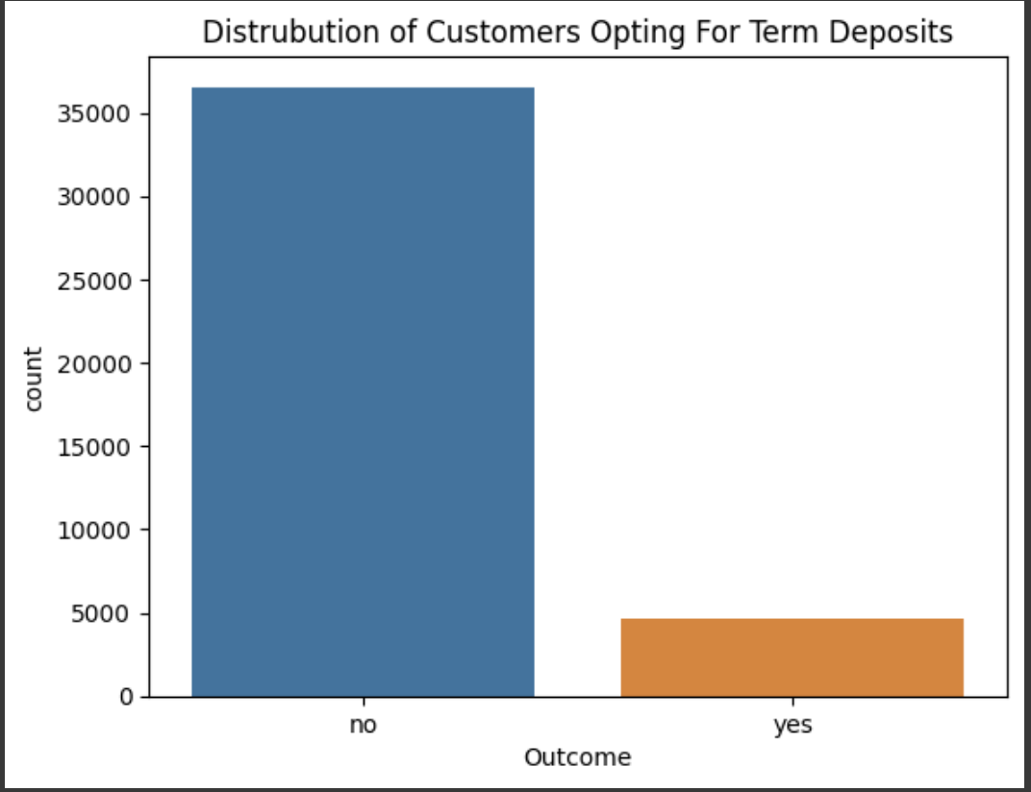
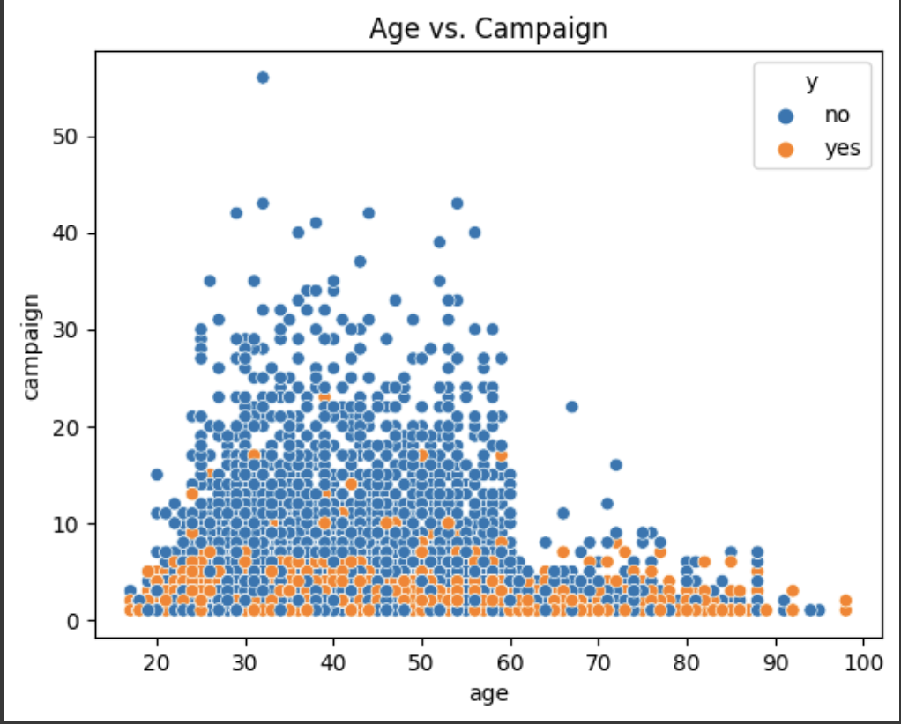
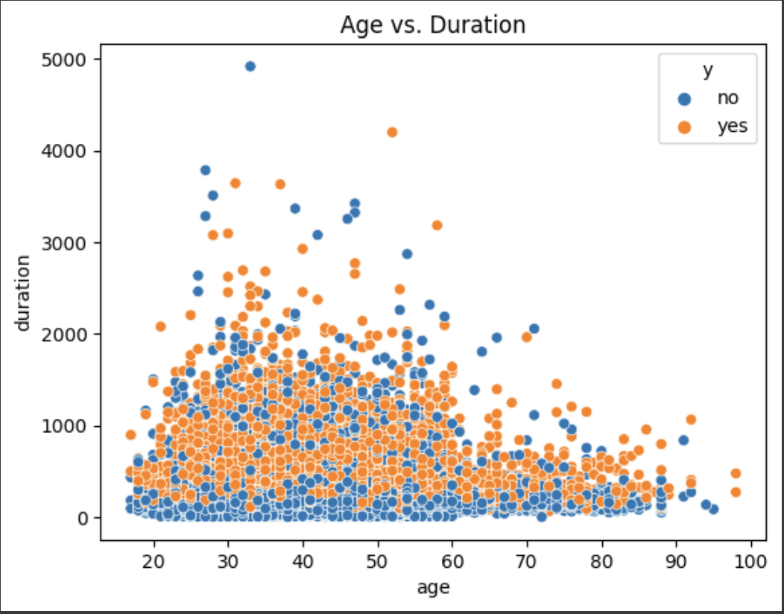
There is no relationship between age of a customer and them subscribing to a term deposit with respect to the number of contacts in the current campaign by analyzing the image.
Customer Distribution - Majority have not opted for the term deposit
The scatter plot of age vs. call duration shows a weak negative correlation between the two variables.
Some Interesting Plots
Notes:
he scatter plot of age vs. call duration shows a weak negative correlation between the two variables. This means that as people get older, they tend to have shorter call durations. However, the correlation is very weak, and there is a lot of variation in call duration within each age group.

Slide 6
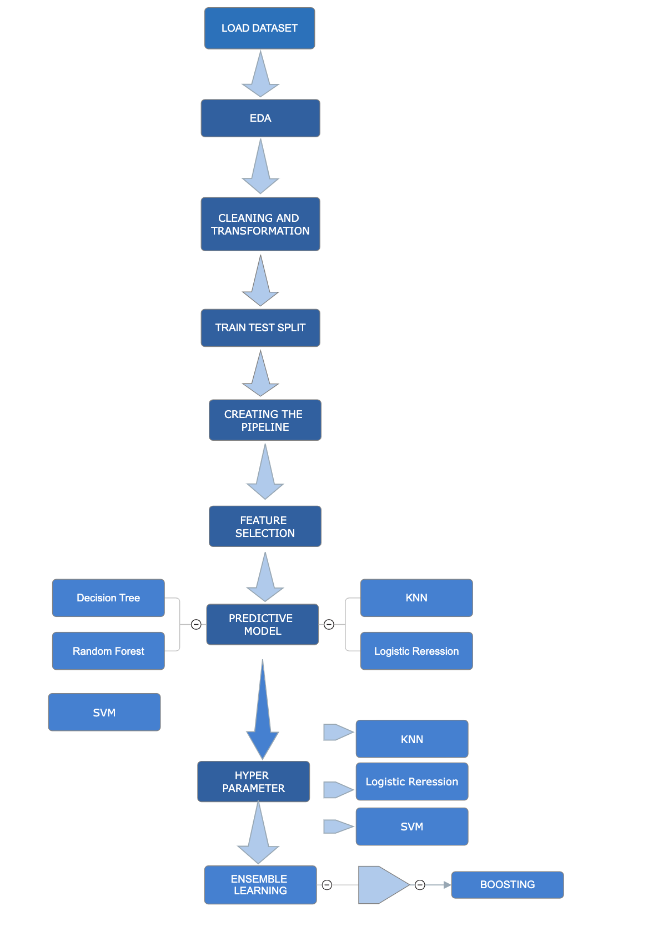
Flow Chart

Slide 7
Major Challenges :
Dataset selection - Many were over used (eg: Kaggle)
Feature Selection for the Model
Support Vector Machines - Hyperparameter Tuning and Balancing strategies took the most amount of time for execution (approximately an hour plus)

Slide 8
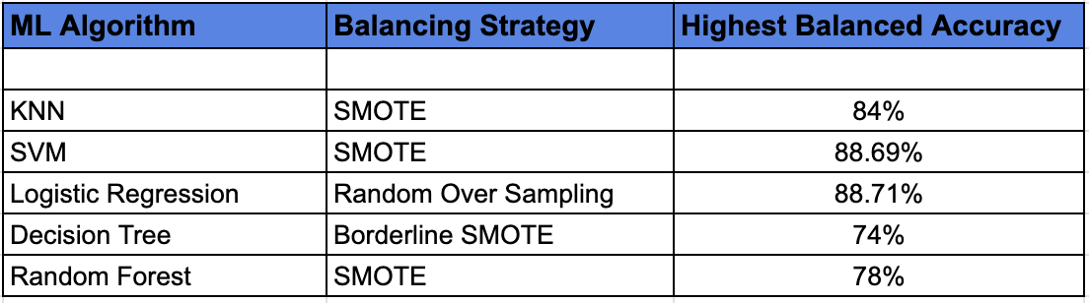
Conclusion :
Out of the 5 used ML Algorithms i.e. Random Forest, Decision Tree, KNN, SVM, Logistic Regression - SVM, KNN and Logistic Regression gave the best predictions/results
Performance of all the classification algorithms w.r.t. the best balancing strategies

Slide 9
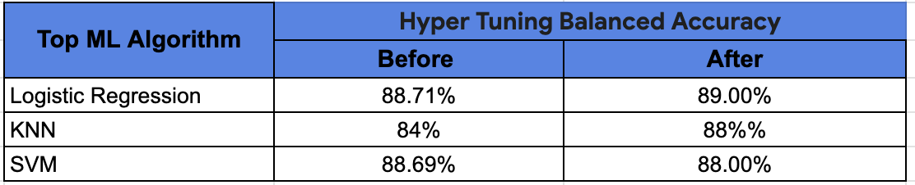
Conclusion :
Performance of the Top ML Algorithms before and after Hyper Tuning Balanced Accuracy

Slide 10
Thank You

Slide 11
Link : https://colab.research.google.com/drive/16TCp-7MEtFoXNVjT0h43I5qOH3wApM5Q?usp=sharing

