Slide 1
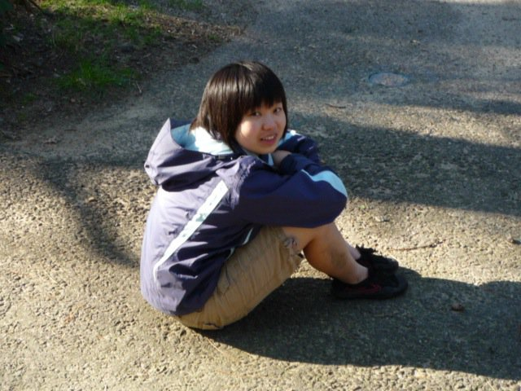

Meet Jialiya…

Slide 2
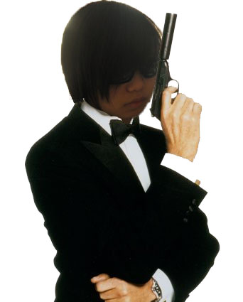
…secret agent!

Slide 3

Mobile Espionage action for the 21st century
Jialiya Huang, Charlie Offenbacher, Andrew Heine, Luis Gutierrez
Skyhook Sprint – 3.10.11

Slide 4
Mission: Get the files!
Team up against other players for fast paced, location based gameplay. Race against time to collect the most files and meet all the checkpoints before the other team!
Carrier Agent
Pick up files from a series of Checkpoints
Use ScoutView to spot file locations & other players – THROUGH WALLS!!!
Guardian Agent
Defend your Carrier with EMP Blasts
Steal files from the enemy Carrier and bring them back to your team to WIN BIG!!!

Slide 5
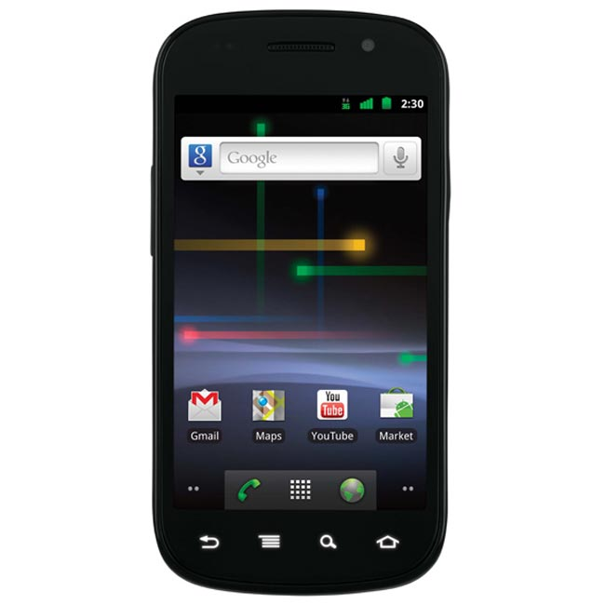

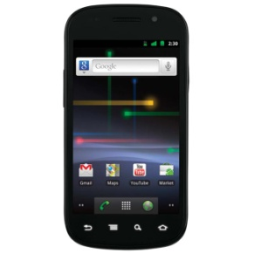


Tools & Tactics
ScoutView: Locate files, enemies and teammates with augmented reality
EMP Blast: Lock down nearby enemies to halt their progress to give your teammates tactical advantage
DataSyphon: Get in close range of an enemy Carrier to deduct their score and add it to your team
!
!
!
!
EMP
INITIATED
LOCKED
FILES
GAINED!
+273
101001010110011010101001010100101010010101010101
FILES
STOLEN!
- 273

Slide 6

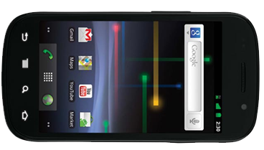
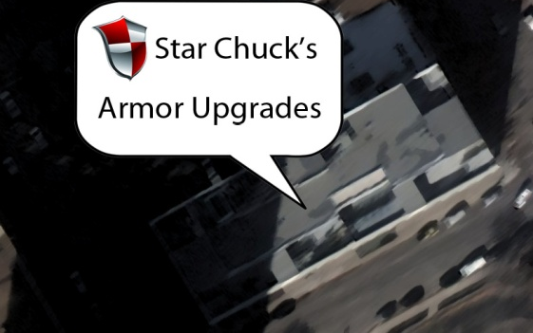
The competitive edge
Visit real world stores to access virtual equipment shops.
Stock up on upgrades and new gadgets to make your team more effective and dominate the competition
Points to spend: 2380

