Slide 1


Slide 2

Need no experience
Visual composition
User control
Educational
Write your own lyrics
Share with your friends!

Slide 3
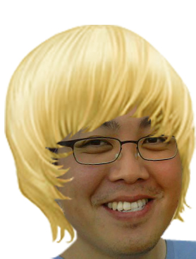
Now You too can become a Pop Star!

