Slide 1
Enabling citizens to keep Boston safe
Notes:
Allows city to track which areas need urban development
By getting feedback from citizens as to which parts of the city don’t feel safe to them

Slide 2
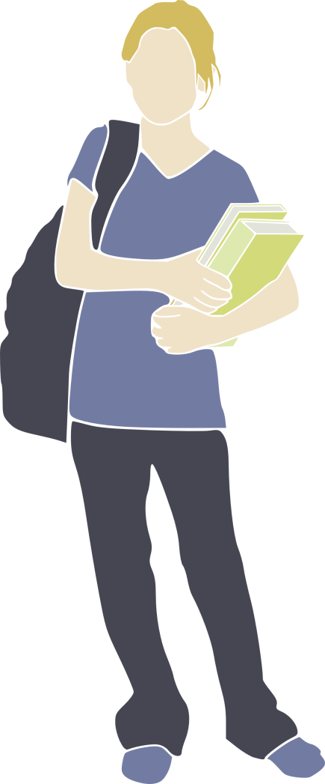
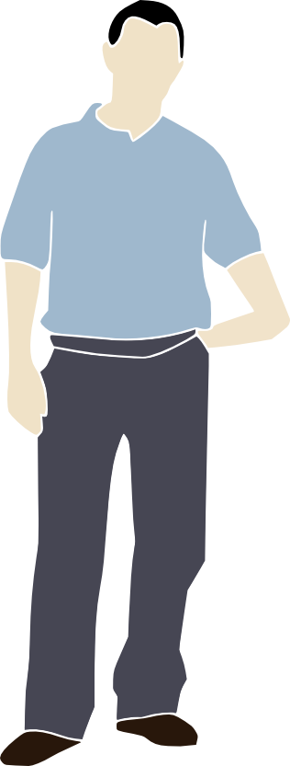
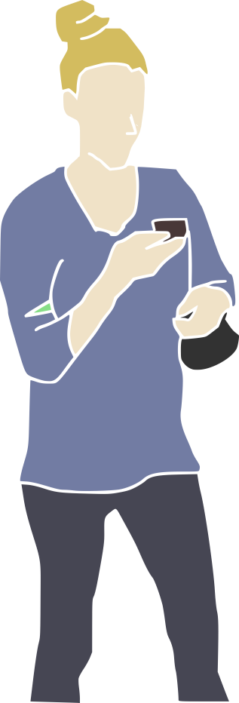

Citizen identifies unsafe area.
Reports it with CitySafe mobile.
City address concern.
!
!
Notes:
Sally walking back to her appartment after a long day of classes notices some really big icicles hanging from the freeway over pass.. If they fall down, they could really hurt somebody. Reports it to

Slide 3
Demo

Slide 4
