Slide 1
Black Ops 2008:
It’s The End Of The Cache As We Know It
Or: “64K Should Be Good Enough For Anyone”
Dan Kaminsky
Director of Penetration Testing
IOActive, Inc.
copyright IOActive, Inc. 2006, all rights reserved.

Slide 2
Introduction
Hi! I’m Dan Kaminsky
  This is my 9th talk here at Black Hat
  I look for interesting design elements – new ways to manipulate old systems,
  old ways to manipulate new systems
  Career thus far spent in Fortune 500
    Consulting now
  I found a really bad bug a while ago.
    You might have heard about it.
    There was a rather coordinated patching effort.
    I went out on a very shaky limb, to try to keep the details quiet
      Asked people not to publicly speculate
        Totally unreasonable request
        Had to try.
      Said they’d be congratulated here

Slide 3
Thanks to the community
First finder: Pieter de Boer
  51 hours later
Best Paper
  Bernard Mueller, sec-consult.com
  Five days later, but had full info/repro
Interesting thinking (got close, kept off lists)
  Andre Ludwig
  Nicholas Weaver
  “Max”/@skst (got really really close)
  Zeev Rabinovich
  Michael Gersten
  Mike Christian
Left the lists
  Paul Schmehl
  Troy XYZ
  Others ☺
Thanks
  Jen Grannick (she contacted me)
  DNSStuff (they taught me LDNS, and reimplemented my code better)
  Everyone else (people know who they are, and know I owe them a beer).

Slide 4
Obviously thanks to the Summit Members
Paul Vixie
David Dagon
  Georgia Tech – thanks for the net/compute nodes
Florian Weimer
Wouter Wijngaards
Andreas Gustaffon
Microsoft
Nominum
OpenDNS
ISC
Neustar
CERT
People have really been incredible with this.
What did we accomplish?

Slide 5
There are numbers and are there are numbers
120,000,000
  The number of users protected by Nominum’s carrier patching operation
  They’re not the Internet’s most popular server!
    That’s BIND, and we saw LOTS of BIND patching
  They’re not the only server that got lots of updates
    Microsoft’s Automatic Updates swept through lots and lots of users
    Do not underestimate MSDNS behind the firewall. Just because you can’t scan for it doesn’t mean it’s not out there.
  One hundred and twenty million – that, alone, is 42% of broadband subscribers. That’s cool.
That was a lot of work. The IT guys stepped up.
  Lets watch ‘em!

Slide 6
What about the Fortune 500?
Doing OK!
  From significant sample of Fortune 500:
    70% have tested and patched mail servers
    15% patched, but suffer from NATs
      This has been a real problem
    15% unpatched
  Non-mail servers doing almost as well
    61% patched
    21.75% patched, but suffer from NATs
    17.25% unpatched
Thank you, Mike Ryan, Jacob Carlson, Charles
Henderson of Trustwave R&D, Application Testing
  They do PCI testing, and were well positioned to encourage testing and validation for this flaw
  Certainly an unusual and awesome use of security through compliance
    Unprecedented – probably a better hack than the original bug ☺

Slide 7
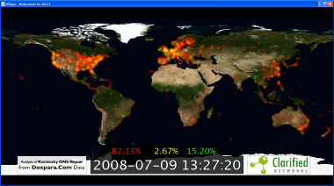
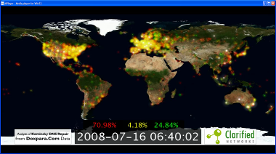
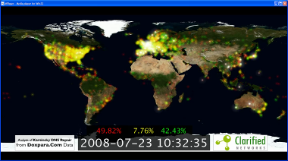
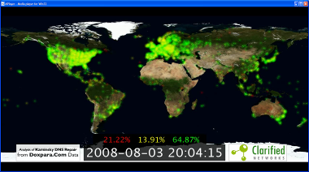
Can we watch the patching in action? (Thank you, Joachim Viide et al, Clarified Networks)

Slide 8
But why all this work?
Good question

Slide 9
Intro to DNS
System on Internet which maps names (that humans understand) to numbers/ “IP Addresses” (that the Internet can deal with)
  Just like 411 information, or the White Pages
  Numbers change so frequently on the Net, that it’s easier to just keep looking them up
  Almost everything on the Internet depends on DNS returning the right number for the right request
    More than you’d think
      Foreshadowing!

Slide 10
DNS is distributed
Three possible answers to any question
  “Here’s your answer”
  “Go away”
  “I don’t know, ask that guy over there”
    This is delegation. You start with a request, and then get bounced around all over the place.
    13 root servers: “www.foo.com? I don’t know, go ask the com server, it’s at 1.2.3.4”
    Com server: “www.foo.com? I don’t know, go ask the foo.com server, it’s at 2.3.4.5”
    Foo.com server: “www.foo.com? Yeah, that’s at 3.4.5.6.”
Dealing with “ask that guy” (“Delegation”) a lot of work, so DNS infrastructure divided into Servers (that run around) and Clients, or “Stub Resolvers”, that either do or don’t get an answer
  BIND = Name Server
  Your Desktop = Stub Resolver

Slide 11
What about bad guys?
If everything depends on receiving the right number for the right name, wouldn’t a bad guy want his number returned instead?
  Yup
So when the name server asks ns1.foo.com for www.foo.com, couldn’t the bad guy reply first, with his own number?
  Yup
What’s supposed to prevent this?
  Transaction ID – “random” number between 0 and 65535. The real name server knows the number, because it was contained in the request. The bad guy doesn’t know – at best, he can guess

Slide 12
The Guessing Game
Good guy – the real name server – has a 65,536 to 1 advantage over the bad guy
  Those are long odds for the bad guy
When the good guy gets his reply in – “wins the race” – he can say how long until the next “race”, via something called the TTL, or “Time To Live”
  1 minute
  1 hour
  1 day
  This is how long a given number is “valid” for a particular name.
1 day * 65,536 races / 2 = 84.5 years for 50% chance
  Good luck on that.

Slide 13
And thus, Forgery Resilience
Document being assembled by Bert Hubert, author of PowerDNS
  Was soon to be an Internet RFC
Basic concept: Long TTL = High Security, Low TTL = Low Security
  65,535 minutes / 2 = 22 days for 50% chance
The basic concept is wrong, very very wrong
  Quote from my Black Hat 2007 talk: “TTL’s are not a security feature”
  The concept implies its opposite, i.e. that the bug I found must exist, because there’s no way something not intended to be a security feature would ever stand up to attack
    So Bert delayed his RFC while we fixed the bug
However, I had no idea this was under development when I found the flaw
  So what’s the bug?
    There are three issues – first two were kind of known, the last is what’s new

Slide 14
First: If it’s a race, between who can reply with the correct TXID first, the bad guy has the starter pistol
Bad guy can force the name server to go run to the good guy and look something up
  It takes time to get the real request (with random number) to the good guy
  It takes more time to get the real response back from the good guy
  It takes no time for the bad guy to immediately follow up a request with a fake response
    Might have the wrong random number, but it’ll definitely arrive first

Slide 15
Second, who said the bad guy can only reply once
Winner of the race is the first person to show up with the correct random number
Nowhere does it say the bad guy can’t try lots of random numbers
  He has time – he doesn’t need to wait for anything to reach him, because nothing ever will
If the bad guy can reply 100 times before the good guy returns, that 65536 to 1 advantage drops to 655 to 1.
  Alas…still long odds. And when he loses, he has to wait the TTL. That could be 655 days – almost 2 years!
  Or maybe not.

Slide 16
Finally, the bad guy doesn’t actually need to wait to try again.
If the bad guy asks the name server to look up www.foo.com ten times, there will only be one race with the good guy
  The first race will be lost (most likely), and then the other nine will be suppressed by the TTL
    No new races on this name for one more day! Here, use the answer from a while ago
    So, can we race on other names?
If the bad guy asks the name server to look up 1.foo.com, 2.foo.com, 3.foo.com, and so on, for ten names, there will be 10 races with the good guy
  TTL only stops repeated races for the same name!
Eventually, the bad guy will guess the right TXID before the good guy shows up with it
  And now…the bad guy is the proud spoofer of … 83.foo.com
  So? He didn’t want to poison 83.foo.com. He wanted www.foo.com

Slide 17
Bait and Switch
Is it possible for a bad guy, who has won the race for 83.foo.com, to end up stealing www.foo.com as well?
  He has three possible replies that can be associated with correctly guessed TXID
  1) “Here’s your answer for 83.foo.com – it’s 6.6.6.6”
  2) “I don’t know the answer for 83.foo.com.”
  3) “83.foo.com? I don’t know, go ask the www.foo.com server, it’s at 6.6.6.6”
    This has to work – it’s just another delegation
      13 root servers: “83.foo.com? I don’t know, go ask the com server, it’s at 1.2.3.4”
      Com server: “83.foo.com? I don’t know, go ask the foo.com server, it’s at 2.3.4.5”
      Foo.com server: “83.foo.com? I don’t know, go ask the www.foo.com server, it’s at 6.6.6.6”

Slide 18
Enter The DNSRake
Named after a common method for lockpicking
1) Send a query to a nameserver, for $RANDOM.foo.com
  The bad guy has the starter pistol
2) Send 200 fake replies to that nameserver, with TXID 0-200
  The bad guy can reply multiple times
3) Send replies containing nameserver redirections to www.foo.com
  $RANDOMwww.foo.com IN NS www.foo.com
  www.foo.com IN A 6.6.6.6
  If this works, it works
  If it fails, return to step 1

Slide 19
What’s it look like?
1 0.000000 1.2.3.4-> 66.240.226.139 DNS Standard query ANY 2465786792ask-dan-at-foo-com.foo.com
2 0.000669 1.2.3.4-> 66.240.226.139 DNS Standard query response NS ask-dan-at-foo-com.foo.com A 6.6.6.6
3 0.001008 1.2.3.4-> 66.240.226.139 DNS Standard query response NS ask-dan-at-foo-com.foo.com A 6.6.6.6
4 0.001304 1.2.3.4-> 66.240.226.139 DNS Standard query response NS ask-dan-at-foo-com.foo.com A 6.6.6.6
  5-201 are like 4
  202 repeats back to 1

Slide 20
Running the attack…
dnsrake 66.240.226.139 1.2.3.4 ask-dan-at-foo-com.foo.com 63752 6.6.6.6 200
  1) IP of my name server, mail.doxpara.com (BIND9, but it'll work against anyone)
  2) IP of ns*.foo.com
    Repeat command for each ns*
  3) Name I'd like to pollute
  4) Fixed source port of my server, leaked by having it look up something off one of my own domains
  5) IP I want to force people to use
  6) Ratio of random requests to spoofed responses

Slide 21
Validating the attack
# dig @mail.doxpara.com
ask-dan-at-foo-com.foo.com
; <<>> DiG 9.2.5 <<>> @mail.doxpara.com
ask-dan-at-foo-com.foo.com
; (1 server found)
;; global options: printcmd
;; Got answer:
;; ->>HEADER<<- opcode: QUERY, status: NOERROR, id: 59212;; flags: qr rd ra; QUERY: 1, ANSWER: 1, AUTHORITY: 5, ADDITIONAL: 5
;; QUESTION SECTION:
;ask-dan-at-foo-com.foo.com. IN A
;; ANSWER SECTION:
ask-dan-at-foo-com.foo.com. 86279 IN A 6.6.6.6

Slide 22
Extending The Attacks
So that works against pretty much everything in wide deployment
  BIND8/9
  MSDNS
  Nominum (with some tweaks)
  Doesn’t work against DJBDNS, PowerDNS, MaraDNS
Most commonly offered defense: “Our DNS servers don’t accept queries from the outside world. They must be safe!”
  Can someone ask them to look up www.doxpara.com, will they return 157.22.245.20?
  If so, don’t be so sure

Slide 23
On Bailiwicks
1.foo.com is able to return a reply for www.foo.com for a reason
  “In bailiwick”
  The root servers can return any record
  The com servers can return any record…for com
  The foo.com servers can return any record for foo.com
  It wasn’t always this way, but then Eugene Kashpureff wanted his own TLD (com, net, etc)
    He just added additional records in every reply for foo.com, declaring his own TLD existed
    Everyone accepted it
  So the bailiwick system was invented to prevent foo.com from declaring anything about com, or some other new TLD
  (This was 1997, the last time we had a bug this bad.)
    2002, Vagner Sacramento’s Birthday Attacks, couldn’t override cache
    2007, Amit Klein’s TXID prediction, couldn’t override cache

Slide 24
Out Of Bailiwick Referrals, or How To Attack Name Servers Behind Firewalls
DNS doesn’t stop working when you get a referral into another bailiwick
  If foo.com says “Ask that guy over there, here’s his address”, and that guy is bar.com, the name server goes back to the root and asks: “Heh, where’s bar.com?”
This means any lookup can spawn any other arbitrary lookup, on demand
  1. Force a lookup to 1.badguy.com
  2. Reply with a referral (NS or CNAME) to 1.foo.com
    This immediately causes a request to be sent to the foo.com name server
  3. Follow the reply with an immediate stream of fake replies from the foo.com name server
There are many many ways to do #1

Slide 25
The Many Starter Pistols Of Mr. Bad Guy
Web Browsers will look up what the bad guy wants
  Any link, any image, any ad, anything can cause a DNS lookup
  No Javascript required, though h0h0h0 it helps
Mail Servers will look up what the bad guy wants
  On first greeting: HELO
  On first learning who they’re talking to: MAIL FROM
  On SPAM check
    Get worried now.
  When trying to deliver a bounce
  When trying to deliver a newsletter (Lyris, ahem, plz patch)
  When trying to deliver an actual response from an actual employee

Slide 26
GetHostByName() Considered Harmful
Web log resolution
  Reverse DNS – given a connection from 6.6.6.6, PTR lookup to www.badguy.com
  Return a CNAME (alias) with a 0 TTL, to anyone else’s name
  Each record will now repeatedly look up the attacker controlled name, even though the target aliased into has a longer lifespan
“Web Bugs” in documents
  File formats that “call home” to their authors upon reading
  They’re not just about privacy violation anymore
Lots and lots of things in Web 2.0
  URL attachments
  Keep getting more worried

Slide 27
GetHostByAddr() ain’t doing too well either
IDS/IPS
  Scan a large network, something will automatically try to figure out who you are
    Reverse DNS maps numbers to names, using PTR lookups
      Start trembling
    PTR can reply with a CNAME or NS too
    Technically you don’t even need to scan with your own IP address
      Heh, you know they’ll be looking, though maybe you don’t know exactly when.

Slide 28
Roy Arends’ Trick
The Microsoft nameserver, when it sent a query to the outside world, would accept queries back on that particular socket
  So, you answer a question with a question
  Roy found this, mentioned it to the dev, it was fixed in an unrelated codepath and the fix was absorbed with the overall update
  Nice find, Roy!

Slide 29
About Those Internal Only Name Servers: An amusing trick
Badguy wants to trigger a lookup on a nameserver at 100.1.2.3
Badguy spoofs source IP to be…100.1.1.3
This passes the router ACL, because it’s a nearby subnet
This passes the “internal-only” recursion rule, because it’s a nearby subnet
Badguy will never see the response to his query, because that’s going back to 100.1.1.3
But Badguy asked for 1.badguy.com.
  He’ll see the request for 1.badguy.com
  Which he can reply to with…1.badguy.com IN CNAME 1.foo.com, and follow up with a flood of fake replies for:
  1.foo.com IN NS www.foo.com, www.foo.com in A 6.6.6.6

Slide 30
The “Fix”, As Per DJB: Source Port Randomization
Before: 65536 to 1 odds
After: Between 163,840,000 to 1 and 2,147,483,648 to 1 odds
This is an improvement
  That’s a lot of traffic to go unnoticed
    Not necessarily too much
So why not go with something perfect?

Slide 31
THERE ARE MANY, MANY VARIANTS OF THIS ATTACK
As said in my Black Hat 2007 talk: TTL is not a security feature
  There are many, many ways around the TTL logic
Family 1: Alternate Referrers
  CN AME
  DNAME
  Extra Glue
Family 2: Request Polluters (Cause request to be ignored upstream)
  Unknown QTYPE
  Unknown QCLASS
  Nonexistent Names

Slide 32
Florian Weimer / Brian Dowling’s new PowerDNS attack
In short, PowerDNS does not respond to certain queries it considers malformed. This in itself is not a problem, and was even thought of as a security measure. Brian and Florian, independently I think, have discovered that not answering a query for an invalid DNS record within a valid domain allows for a larger spoofing window of the valid domain. Because of the Kaminsky-discovery, this has become bad. For a sophisticated attacker, this provides no benefit. However, such a long window allows unsophisticated hackers to achieve better results.
  Bert Hubert, PowerDNS
Basically, recursive resolvers would pass a query to PowerDNS, which it authoritatively would ignore. This meant that there was an infinite window – the other guy wasn’t even in the race

Slide 33
And Keep Going…
Other methods
  Anything that causes the cache to clear
  Abusing naturally low-TTL records
  Abusing IDS systems that block if they see an attack (2005 Black Ops)
  Just polluting a subdomain, because web browsers don’t like attacker controlled subdomains (2008 Toorcon talk, i.e. Rickrolling The Internet)
  AND MORE

Slide 34
The Choice
1) Point fixes, where we’re guaranteed to miss at least something
2) A generic, sledgehammer fix, that applies a minimum level of security to vulnerabilities we don’t know about yet
  Yes, I was even being sneaky about what I meant by Sledgehammer fix ☺
DJB WAS RIGHT
  NOT PERFECT – he has bugs too, as we’re seeing (and patching, don’t ask)
    For example, he didn’t implement birthday attack protection – he believed port randomization was enough
    There may be other issues
  Everyone should be better, even DJBDNS – we all need to get to work
  Thus begins a debate on alternative solutions
    Lets not have it with a backdrop of 10 second kills every time a gap is identified

Slide 35
The Caveat
Many solutions will be proffered
Unless it is compatible with the Root Servers and the TLD’s – either by backwards compatibility or by code modification to those particular authoritative servers, no other modification is helpful
  It doesn’t matter how you lock down foo.com if .com is broken
There’s a blog entry at http://www.doxpara.com going through all the other solutions, and how they’re all vaguely broken
  I’m here to talk about the present bugs

Slide 36
What of the client?
Hasn’t been the focus of the remediation efforts
  Has received two MSRC fixes in the last six months:
  1) TXID fix, for Amit Klein’s research
  2) Source Port fix, for my research
  Why?

Slide 37
On Amit’s Client TXID Research
A lot of people wondered why his TXID bug in Client got fixed
  Given TXID (Random #) TX1, and TX2, predict TX3
  That’s an important thing to be given!
So people were complaining that they couldn’t figure out how to execute Amit’s attack in the real world
  If you can sniff TX1, you don’t need to guess TX2, you can also sniff TX2
  Suppose you have a nameserver that forwards TX1, unmodified, from the client through itself to an upstream server. Either you can see TX1, in which case you can reply to it, or you can’t, but you can send your own TX2, and reply to it.
    “Hello lame forwarder. Please ask for www.foo.com with txid 100. By the way, here’s a reply for www.foo.com on txid 100. What a coincidence, that is the correct txid!”
Amit caught some flak. Too bad he was right ☺

Slide 38
Nothing Can Be Analyzed In Isolation
To understand how to attack Amit’s bug, you must realize that things happen before, and after a DNS reply
  Before: A HTTP request is sent to before.badguy.com
    Say, on port 10000
    This retrieves HTML, with an IMG, which asks for after.badguy.com
    DNS request goes out…on port 10001
      This was pre-MSRC ☺
  After: A HTTP request is sent to after.badguy.com
    When? Immediately
    Where? Wherever after.badguy.com claims to be
    Where and when are signals. They are low bandwidth signals…but we’re only trying to collect a 16 bit value!

Slide 39
The Chain
Client browses to a website controlled by badguy
Client looks up after.badguy.com against Local Name Server
Local Name Server goes to ns1.badguy.com, asking for after.badguy.com
ns1.badguy.com doesn’t reply to Local Name Server.
Local Name Server thus doesn’t reply to Client.
Client sits around twiddling its thumbs.
  Open port
  Open TXID
Ns1.badguy.com pretends to be Local Name Server, replying with all possible TXIDs
  Knows what port from the before.badguy.com connection
  Doesn’t know what TXID – but will, on average, guess every 32K packets
    If doesn’t guess in time, oh well, try again
  Will eventually guess correctly

Slide 40
Signals
When ns1.badguy.com guesses the TXID correctly:
  1) A connection will go to whatever address ns1.badguy.com declared for after.badguy.com
  2) This will happen immediately
Strategies
  1) Timing: When the HTTP connection arrives, see what we were sending a few milliseconds ago.
    100ms or so of accuracy, on a 3 second window, yields ~5 bits of data
    Can retry
  2) Direction (thank you Florian Weimer): The more addresses the bad guy has, the more information he can get via which address “wins”.
    If he has 1024 addresses, he gets 10 of 16 bits
    If he has 65536 addresses (a class B), he wins
    Without IPv6, that’s not happening..

Slide 41
Shared Signals
There are lots of hosts out there
Can an attacker borrow some of them?
  Return the IP addresses of other hosts, then find out which one was “visited”?
Alternate approaches:
  1) Idle Scanning
    Find 64K boxes that don’t have any traffic
    Forge replies across all TXIDs, each with a different address destination
    Check all boxes for sudden traffic spikes
    Doesn’t really work anymore, too many people scanning the Internet ☺

Slide 42
Another Path
  2) PTR pollution
    Find 64K networks that reverse lookup everything, and put it into a publicly visible name server
    Forge replies, then see what’s in the name server cache
    Too noisy, can’t be run multiple times in short succession

Slide 43
Nobody ever expects
The Billy Hoffman Option
3) Return 64K different web servers, then read via the DOM which one you actually hit
  Whoever it is, is going to be a host in your own domain
  DNS rebinding to discover DNS TXID
    Huzzah!
  Can also find 64K sites with different cookies, and then analyze document.cookie to see which one was hit

Slide 44
Of course, much easier with my attack
Don’t try to guess next TXID, just force repeated lookups for a name and then fill in whatever answer you want
  * - Initiate sequence to trigger a dns lookup by the adns resolver. Send * the same range of spoofed DNS ids in a constant flood spoofed as the * primary DNS server for the host. Even a local DNS request will take * long enough to allow some amount of the spoofed DNS responses through * before the primary DNS responds. Since the resolver does not cache * results, the dns lookups can be triggered until the DNS id is * incremented within the DNS id range being spoofed.
    h0dns_spoof.c - zmda - saik0pod@yahoo.com
“Sniper Rifle” vs. a Nuke
  Attack one host? Or many?

Slide 45
So, is that all?
No. That’s HOW to attack DNS. More interesting question: WHY to attack DNS.

Slide 46
We Start With The TLDs
It is indeed possible to pollute com, net, org, etc.
  Directly: com NS
  Indirectly: A.GTLD-SERVERS.NET, B.GTLD-SERVERS.NET., C.GTLD-SERVERS.NET…
When the bad guy poisons com, he gets all requests
  Even requests he didn’t know in advance he wanted!
  He gets to decide:
    What he’ll poison forever (response, long TTL)
    What he never wants to see again (delegation, real NS)
    What he’ll check out for a little while (response, short TTL)

Slide 47
MX Intercept: It’s Not Just For the NSA Anymore
“Remember how pissed you were when you found out the NSA had rooms where they could read everything? That’s every kid right now.” –Brad Hill
Mail is special – has its own type of record
  MX – Mail Exchange
Attacker who owns com, can see who’s sending mails to who, and can pick off any he likes
  Can silently intercept, then let the mail run off to its correct destination
    Give himself top priority, fail to fully accept a message, then let the message fall through to the next server

Slide 48
Message Pollution
1/3rd of attacks come from direct user action
  Loading a document
  Downloading and installing malware
Attacker can also accept a message, infect attachments with malware, and forward it along
  DOC -> Infected Doc
  EXE -> Infected Exe
  ZIP with Password containing EXE -> ZIP with Password containing Infected EXE
    Attacker can read ☺
  Link to EXE -> Link to infected EXE
    Attacker can either change link, or poison link in destination

Slide 49
Shouldn’t The SPAM Filter Stop This?
SPF should notice the wrong IP
  SPF comes from DNS
  All SPAM filtering comes from DNS
  Can actually hijack SPAM filters – attacker ends up controlling mail reception entirely

Slide 50
Not going there, but…
SIP ain’t looking too great either
  SRV records are easily detectable
  SIP INVITE/REGISTER messages look like they can contain DNS names – triggering a lookup in target networks
    If you have an environment that explictly uses DNS name contacts, you might even be able to choose your intercepts
Thanks to Zane Lackey

Slide 51
Spidey Sense
Obviously the entire web is affected, for a client behind a corrupted DNS server
  Can directly poison via com corruption
    Requires rebinding to read actual site contents
  Can indirectly poison a single site via its subdomain library dependencies
    Prototype.js
    CSS scripts
  Can indirectly poison the entire web via google-analytics.com, ad.doubleclick.net, sitemeter, or any other codebase commonly loaded via an external <script src> tag.
  Hope you’re not downloading any executables from the web…
(But SSL will save us!)

Slide 52
The Internet is more than the Web; HTTP is more than the Browser
Welcome to the third age of hacking
  1st age: Servers
    FTP, Telnet, Mail, Web, Time
    These were the things that consumed bytes from a bad guy
    These are the things that got locked down
  2nd Age: Browsers
    Javascript, ActiveX, Java, Image Formats, DOMs
    These are the things that are getting locked down
      Slowly
      Incompletely (ActiveX Sitelock to http:// doesn’t work too well right now)
  3rd Age: EVERYTHING ELSE
    Check out this desktop from an Internet Cafe

Slide 53
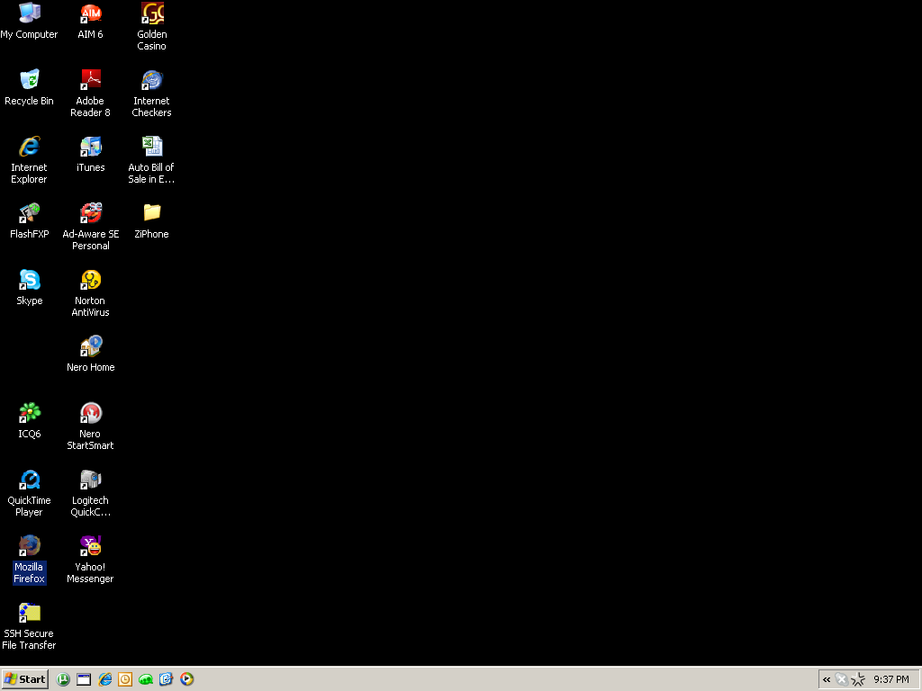

Slide 54
We’re no longer in browserland anymore…

Slide 55
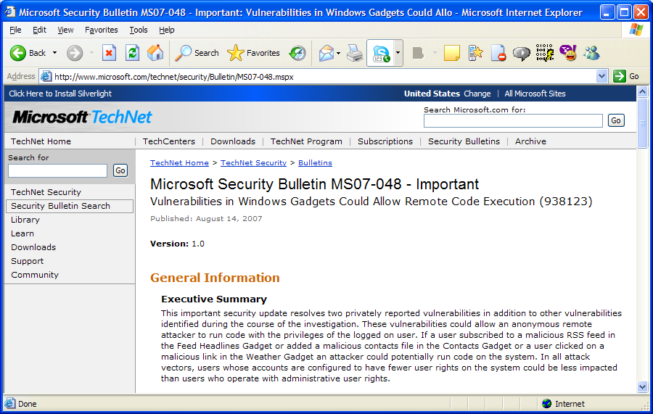
Remember Sidebar from Last Year?

Slide 56
This is not an exception
Browsers are really really good client code
  Relatively ☺
  They’re so much more complex than anything we ever put on the server
  We’ve been trying to secure them for far longer
What do you think happens when you fuzz weak clients?

Slide 57
Ilja van Sprundel, dumb fuzzing IRC with ircfuzz.c
* ircfuzz v 0.3 by Ilja van Sprundel. * so far this broke: - BitchX (1.1-final) * - mIRC (6.16) * - xchat (2.4.1) * - kvirc (3.2.0) * - ircii (ircii-20040820) * - eggdrop (1.6.17) * - epic-4 (2.2) * - ninja (1.5.9pre12) * - emech (2.8.5.1) * - Virc (2.0 rc5) * - TurboIRC (6) * - leafchat (1.761) * - iRC (0.16) * - conversation (2.14) * - colloquy (2.0 (2D16)) * - snak (5.0.2) * - ircle (3.1.2) * - ircat (2.0.3) * - darkbot (7f3) * - bersirc (2.2.13) * - Scrollz (1.9.5) * - IM2 * - pirch98 * - trillian (3.1) * - microsoft comic chat (2.5) * - icechat (5.50) * - centericq (4.20.0) * - uirc (1.3) * - weechat (0.1.3) * - rhapsody (0.25b) * - kmyirc (0.2.9) * - bnirc (0.2.9) * - bobot++ (2.1.8) * - kwirc (0.1.0) * - nwirc (0.7.8) * - kopete (0.9.2)
Things are a little better now
  Not much
  You really really don’t want to be talking to a malicious IRC server
    Lets not even talk about netsplits

Slide 58
Lets not forget about the biggest, most extensive clients out there
Games
  Gaming - The Next Overlooked Security Hole
    Ferdinand Schober,
    Security Researcher
  We're now seeing those unifying technologies the web, and monolithic engines making their way in to these games. Automatic updates, electronic publishing systems, in-game advertisements, pay-for-item MMORPG systems all of these represent structural weaknesses that more and more people should be exploiting. Given the expectation of today's gamers a far as graphics, physics, and other frivolous crap, smaller developers have to purchase someone else's engine to get started and all of the bugs that come with it.

Slide 59
How do you know what to attack?
You know where it’s going
  It tells you via DNS
  That often tells you who it is
But if you need more, and it’s speaking HTTP…
  Host header
  User-Agent
  Extra Headers

Slide 60
Who needs an exploit? Lured by design, upgraded by design
Francisco Amato’s EvilGrade
  Implemented modules: ------------------- - Java plugin - Winzip - Winamp - MacOS - OpenOffices - iTunes - Linkedin Toolbar - DAP [Download Accelerator] - notepad++ - speedbit
  Bigger companies than I thought. But otherwise, yeah, we knew this was going to be a problem
  Actually warned LinkedIn in advance

Slide 61
Autoupgrade Is Hard
To succeed, your update package must be:
  Signed.
  Signed by you.
  Signed by you, using the right EKU (Extended Key Usage)
  Signed from an unrevoked signature
  Be the same product
  Be a new version
Or you could use SSL, but ZOMG PERFORMANCE
Translation: Must be Windows Update, or you’re hosed ☺
  Maybe Adobe. MAYBE.
  See also: “Secure Software Updates: Disappointments and New Challenges”, Bellissimo, Burgess, Fu

Slide 62
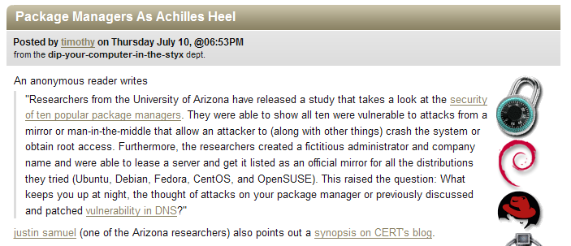
*facepalm*
What is this “OR” you speak of?
What, I can only use one bug at a time?
DNS provides the Man-In-The-Middle that breaks Package Managers!
But SSL! SSL WILL SAVE US!

Slide 63
Make no mistake
This is the first big test of SSL
Has it stood up because of the strength of its crypto?
Or has it stood up because nobody had the opportunity to play MiTM?

Slide 64
Lets talk about SSL.
First, you have to actually use it
  How many executables will you download insecurely this week?
    Attackers can pick and choose what domains to snipe, remember?
  Who here still uses FTP? I do.
Second, you must never downgrade.
  http://www.foo.com 302’ing to https://www.foo.com – an attacker injected in the middle via DNS can replace the 302 with a 200. Will you notice?
    Will your users?

Slide 65
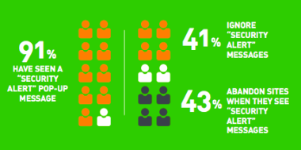
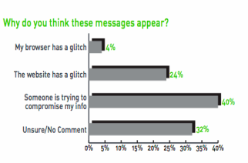
More SSL
Can’t ignore the errors!
  Data on top right is self-reported
    Source: Consumer Reports
  Actual data: When a major online bank in New Zealand had its cert expire, 99.5% of users still entered their credentials.
    DNS-based attacker has a remarkably high success rate

Slide 66
Must Actually Care About Certificate Chain
327,467 SSL certificates were scanned
  140,355 SSL certificates were self-signed – 42%!
  That’s not even saying the other 58% are signed by a trusted CA!
The browsers care about certificates
  They worry about SSL meaning something
  People who write applications – well, they might…

Slide 67
Who Says Applications Always (ever) Care About Cert Chains?
Mike Zusman on SSL VPN’s:
  Yes, you will see many SSL VPN servers on the Internet serving invalid certificates.
  Cert validation varies product to product. One particular SSL VPN client I've worked with is hardcoded to only accept valid, trusted certs. If it is not signed by a trusted CA, the cert needs to be added to the local trust store. Another one allows you to turn validation on and off.
  None of the clients I've seen do any caching/white listing (like an SSH client). This way once you have the SSL VPN client installed, you can connect to ANY server you need to seamlessly. Great for re-purposing attacks.
In other news, go read Mike Zusman’s notes on SSL VPN’s. He is doing some very important work.

Slide 68
Even if actually a web app, must handle secure cookies correctly
Secure cookies: For SSL only
But, check it out – anyone can write a secure cookie!
  The specific use case that Adam Barth and I are working on is defining a new HTTP header that indicates cookie integrity. The Set-Cookie header provides confidentiality using the Secure flag, but the Cookie header provides no corresponding mechanism for indicating integrity; thus the server cannot distinguish cookies that were set over HTTP from those that were set over HTTPS.
    Collin Jackson
    http://markmail.org/message/fvbw24nd7egokdlx
So even if the SSL site secures its cookies, it’s still potentially vulnerable to an attacker who partially overwrites with his own cookies
  With DNS poisoning, it’s now possible to inject cookies via the HTTP “version” of any HTTPS site

Slide 69
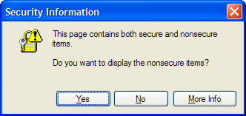
Must not mix Secure and Insecure
About the only thing you can safely import is an invisible image
Everything else ends up able to mess with you
  Full DOM access: <script> loaders, such as ad scripts and trackers
  Partial Page Access: <iframe> to foreign domain
Don’t worry, Firefox is making it harder to notice this every day
  Average website – 10-20 domains – very hard to convert everything to SSL, people want to do this incrementally

Slide 70
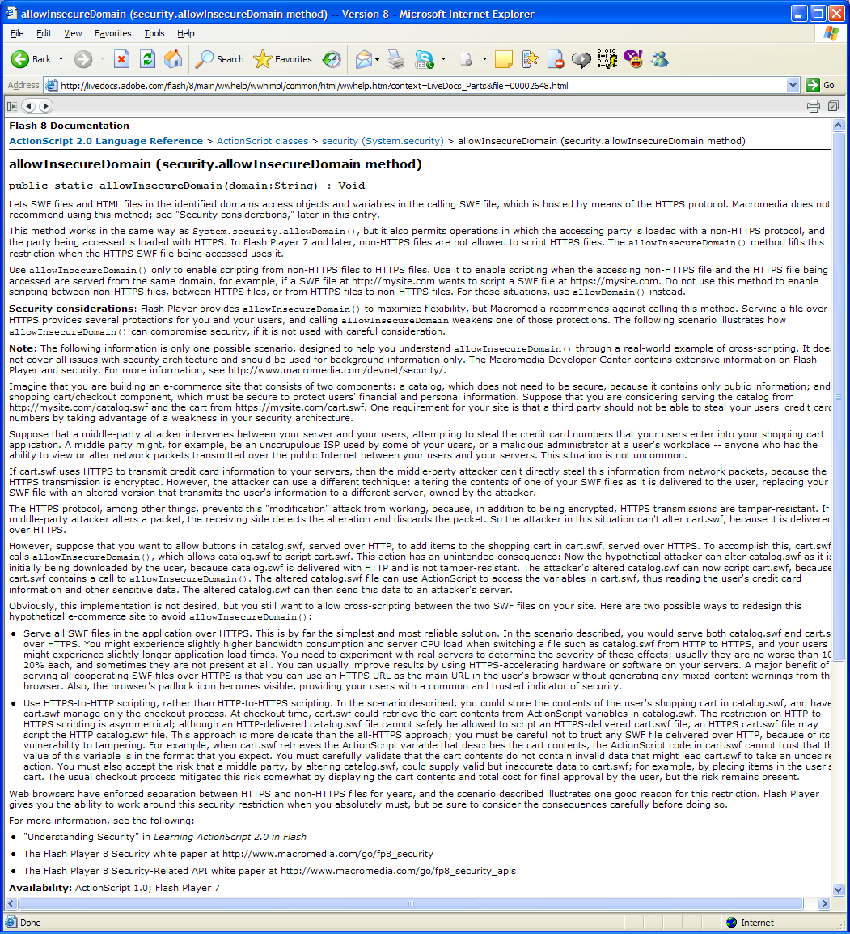
Woe To The Poor Flash Security Guy Who Had To Document AllowInsecureDomain()
http://tinyurl.com/6dv58r
Yes, the call is about as bad as it sounds
The author of this document hates the call more than I do
The author of this document was right – AllowInsecureDomain() + DNS hijack = useless SSL
…and of course…

Slide 71
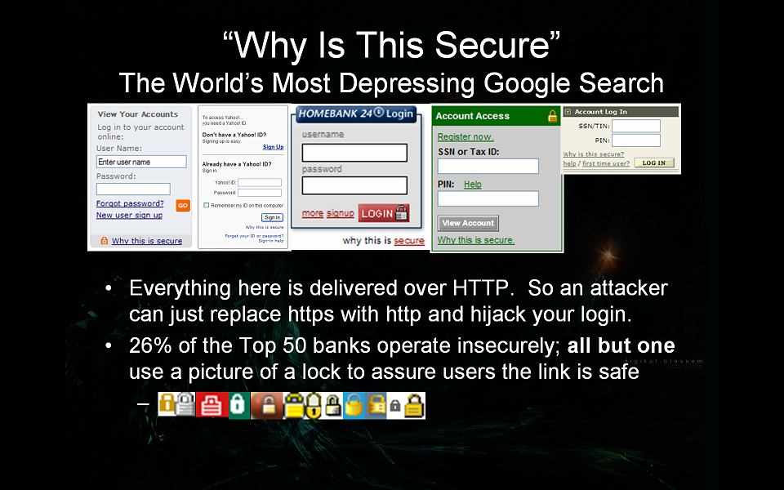

Slide 72
We Live In The Future
Gone from 26% in 2006 to ~5% maybe
  Financial sites are improving, if not perfect
    See: "Analyzing Web Sites For User-Visible Security Design Flaws“, Atul Prakash, Laura Falk, Kevin Borders
    (Things are a little better than they were back when this data was collected)
  Everyone else still kinda sucks
Still, lots of sites are trying the “we’ll protect credentials by logging in via SSL, then switching back to HTTP game”
  Graham and Maynor’s Sidejacking works fine now
  So does just stripping the SSL, or injecting Javascript to read the typed credentials from the DOM
  Only now, you’re not on the LAN – you’re wherever
Security is quantized, but people keep trying to make it incremental.
  But wait! At least the crypto is good!

Slide 73
Cert should not use MD5
Oh wait, it’s 2008, we’re still pretending this hashing algorithm works
  Pay no attention to its 12 year old death row status
  Or its government decertification a decade ago
  Or the generation of collisions 3 years ago
  Or the second preimage (“cloning”) attacks against MD4 2 years ago
  Etc. etc. etc.

Slide 74
Cert Must Never Have Been Generated By Debian
People are comparing “Kaminsky DNS” to “Debian NRNG”
  Since when was there a competition?
  These bugs combine catastrophically!
    1) Almost all Debian-generated and CA signed certificates are still valid
      Revocation is a myth, only expiration works
    2) Whoever collected all those public certificates when the bug broke, can still impersonate anyone with the cert
      Up to five years!
    3) DNS flaw provides MiTM access such that Debian NRNG may be exploited
      Why did everyone compute Debian NRNG OpenSSH keys, but not grab OpenSSL certs?
      No obvious exploit path, until now

Slide 75
So?
We’ve known all those things about SSL.
  This is all old stuff.
  Bla bla bla, show me something new, bla bla bla
OK. Fine.
  Why do you think SSL certificates are valuable?
    Anyone can buy one
    Anyone can generate bits
    What prevents anyone in the audience from getting a cert for www.microsoft.com?

Slide 76
Into The Lions Den
CA’s sell bits
  But there’s some meaning applied to those bits – an assertion that an identity has been validated, at least to some level
  How are identities validated by most CA’s?

Slide 77
Say Hello To My Little Friend
Domain Validation: How SSL Certificate Authorities use DNS to determine whether you get a certificate
  Look up the domain in WHOIS
    DNS address lookup
  Send an email to the mail address on file
    DNS MX record lookup
  Visit the web page and look for a file
    DNS A record lookup
Guess how secure that is in the face of a DNS attack?

Slide 78
Hello My Little Friend
Actually, we’re doing OK
  For some reason, every CA scrambled during the month of July to make sure that they were patched
    Thank you, Tom Albertson, Kelvin Yiu, Zot O’Connor of Microsoft ☺
    Thank you Verisign, Comodo, Digicert, Trustwave, everyone who kept this matter secret
www.SSLShopper.com figured it out…but they think the answer is to buy EV certs. Unfortunately…

Slide 79
And what about EV?
EV is a display mechanism, not a code security mechanism
  Extended Validation. The browser’s scripting policy does not distinguish between HTTPS connections that use an Extended Validation (EV) certificates from those that use non-EV certificates. For example, PayPal serves https://www.paypal.com/ using an EV certificate, but a principal who has a non-EV certificate for www.paypal.com can inject script into the PayPal login page without disrupting the browser’s Extended Validation security indicators; see Figure 2.
    “Beware of Finer Grained Origins”, Collin Jackson, Adam Barth
So, no. EV does nothing in the face of also-extant Domain-Validated Certificate

Slide 80
What Else Is Interesting?
CA’s have web interfaces to manage previously issues certs…
  …web interfaces you have to sign into.

Slide 81
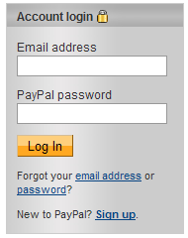
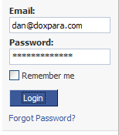
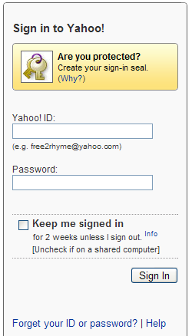
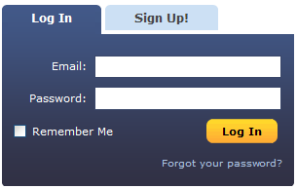
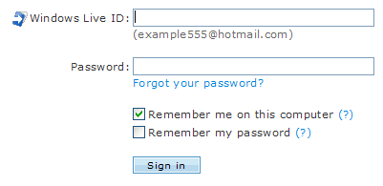
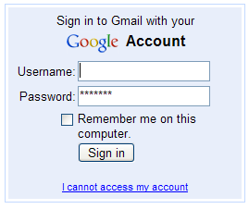
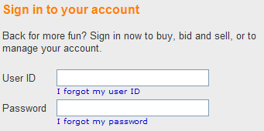
When I said The Web was broken, I wasn’t talking about just its clients.
(confused?)

Slide 82
Welcome to the Skeleton Key.
It’s By Design.

Slide 83
Forgot My Password Modes
This is a generic lost credential technique
  Generally, a fully automated way to get into an account without the password
    Near-universally deployed
  Three modes seen in the field
    1) Password Leak: Just mails you your password. Somewhat uncommon.
    2) Reset Password: Mails you a link that resets your password. Guarantees detection of attack. Most common.
    3) Reset w/ Additional Protections: Mails you a link, and makes you jump through hoops. Somewhat common on high-value sites.
  #1 and #2 are trivial to pop (though #2 has side effects).

Slide 84
Attacking Forgot My Password systems
It’s just an email, meaning, it forces a lookup to an attacker controlled name
  What did we need, to pollute com?
  This means any lookup can spawn any other arbitrary lookup, on demand
    1. Force a lookup to 1.badguy.com
    2. Reply with a referral (NS or CNAME) to 1.foo.com
    3. Follow the reply with an immediate stream of fake replies from the foo.com name server
Not complicated. After poisoning, request password for arbitrary account
  It will do an MX lookup
  You will see the MX lookup
  Game over ☹

Slide 85
News
Fixed (beyond just the CA’s)
  Google
  Live
  Yahoo
  Paypal
  eBay
  MySpace
  Facebook
  LinkedIn
  Bebo
  Craigslist
  LiveJournal
  Hi5
  Citrix (GoToMyPC)
This is very, very cool. Thank you to all the companies who worked with me on this!
  Ow my cell phone bill ☺

Slide 86
Reality Check
No way we got everyone
But we did ok.

Slide 87

Would OpenID have helped?

Slide 88

How did Stikis find the “friend”?
Hint: DNS

Slide 89
What of OpenID with HTTPS?
Should be fine…
  Alas: Ben Laurie found that a couple major OpenID providers were using HTTPS…
    But with a Debian misgenerated certificate
    DNS + OpenID + Debian NRNG = WIN
*glorious*

Slide 90
So Right About Now You’re Probably Thinking…
OK. Clients are hosed. Web 2.0 is hosed. But my intrawebs are safe!
  Are they? Are they really?

Slide 91
Let Us Discuss The Inconvenient Matter Of Reverse DNS
You know, we also own in-addr.arpa
  This is the space that, when you look up 1.2.3.4, returns “a.b.c.d.com”
What can you do with this?
  Obvious: Spoof log entries in Apache
    Apache Double-Reverse Lookup Log Entry Spoofing Vulnerability
      Martin Kraemer, 2002
    Apache will log the name that reverse DNS provides, if that name resolves back to the same IP
      Well, we control both forward and reverse DNS, so heh
    May even be able to fake numeric TLDs…
      6.6.6.6 IN PTR 1.2.3.4
      1.2.3.4 IN A 6.6.6.6
      Possibly (probably) stopped by client side APIs
        Never assume an API is every smarter than it had to be to ship

Slide 92
More Reverse DNS
SQL/Script Injection via Client-Targeted Reverse DNS
  Reverse DNS is often put into a DB
  Input may not be sanitized, because server may sanitize for the client
  What if the client doesn’t sanitize as much as the server?
    This is probably pretty painful to execute

Slide 93
Lets Party Like It’s 2007
Black Ops 2007: Possible to use browser plugins to connect to internal resources
  You browse to my site, I get TCP, maybe UDP, to your site
    Flash
    Java
  Flash secured this with crossdomain.xml, per IP address
  Java secured this with…reverse DNS
    Which we own.
    I can has 1.0.0.10.in-addr.arpa!
    Full TCP and UDP from any browser in your org, to any host behind the firewall, if you don’t patch DNS
      And have Java
      Bonus: IPsec!
    Note: You don’t get 127.0.0.1, because 1.0.0.127.in-addr.arpa has an authoritative record on most servers.
      MAY get per-interface bind though…
    To get 127.0.0.1 out of Java, see John Heasman’s talk

Slide 94
Spreading The Phun
If you have arbitrary socket access…
…then you can spew packets on Port 53…
…then you can scan for more name servers behind the corporate firewall.
☹

Slide 95
Also…SNMPv3
If you can spoof arbitrary UDP packets, behind the firewall, you can spoof arbitrary SNMPv3 packets too
  Have you patched against the SNMPv3 bug?

Slide 96
Enough with the client bugs?
What about servers? Are they vulnerable?

Slide 97
Which would you rather own? BGP? Or DNS?
BGP controls the flow of packets already destined for the Internet
  Two boxes on the same LAN can not be attacked with BGP – packets won’t even route
  No specificity – can’t select sessions opened at time A, but not time B
  Lots of visibility – people see, and log, BGP announces
DNS controls where packets are destined for in the first place
  Two boxes on the same LAN will trust DNS to determine if they should talk directly to eachother – packets will be made to route
  Some specificity – can select traffic on a per name, per query basis
  Very low visibility – distributed, minimal logs

Slide 98
So DNS > BGP, right?
DNS > BGP
  Or is it?
  Who says attacks compete?
  Use BGP to hijack DNS traffic!
  Stealing The Internet – No Really – 4PM, Track 4, Kapela/Pilosov
    Only works if you have BGP connectivity, but do you trust everyone with BGP connectivity?
      Pakistan 1, YouTube 0

Slide 99
Difficulty: Cannot poison authoritative on servers…
…with DNSRake, anyway.
Can still poison authoritative with client attacks
Not everyone is talking directly to primaries/secondaries
  Isolated Split Brain is very safe
    No external DNS to desktop + fake roots = attacker never sees any internal traffic
  AD is heavy on primaries – also safe
    No cache to corrupt
  Split brain environments are heavy on forwarders – somewhat safe
    Attacker may not be able to spoof destination of forwarder
  If internal servers are talking to a normal name server, that’s recursing both to the Internet and to internal names: Game On

Slide 100

When Internal DNS Goes Bad
So much bad behavior behind the firewall, all directed via DNS!
  Telnet
  SNMP – queries and traps
  Auth servers (RADIUS/TACACS)
  Backup/Restore
  SOA architectures
    Resolve back to names, DNS determines addresses
  Backend Databases

Slide 101
Even if internal DNS is hard to hit, external dependencies are fair game
So many connections between companies
  DNS controls how the servers find each other
  The link might be secured
    If SSL is used – is anyone actually checking the certificates?
      Are you sure?
    If IPsec is used – is it tied to destination subnet?
      DNS changes destination subnet, therefore DNS can change IPsec rules.

Slide 102
The ultimate external dependencies
Payment processing / Offsite backup
  Now is not a good time to have an insecure link to your offsite stores
  I’m not saying anyone does. But if there’s a scintilla of a chance, patch patch patch
SNMP against the Internet
  If you are using SNMP to log into machines on the Internet, you’re probably using DNS to find them
    Interesting interactions with SNMPv3 bugs?
Search Engine Population
  There’s Search Engine Optimization, and there’s this
CDN.

Slide 103
Content Distribution Network Corruption
How do you think you populate a CDN?
  Provide the CDN a URL
    Uses DNS, pulls data
  Treat the CDN as a proxy
    Uses DNS, pulls data
  It would be really, really bad if Akamai etc. DNS went bad

Slide 104
Summary
DNS servers had a core bug, that allows arbitrary cache poisoning
  The bug works even when the host is behind a firewall
  There are enough variants of the bug that we needed a stopgap before working on something more complete
Industry rallied pretty ridiculously to do something about this, with hundreds of milllions protected
DNS clients are at risk, in certain circumstances
We are entering (or, perhaps, holding back a little longer) a third age of security research, where all networked apps are “fair game”
  Autoupdate in particular is a mess, broken by design (except for Microsoft)
SSL is not the panacea it would seem to be
  In fact, SSL certs are themselves dependent on DNS
DNS bugs ended up creating something of a “skeleton key” across almost all major websites, despite independent implementations
Internal networks are not at all safe, both from the effects of Java, and from the fact that internal routing could be influenced by external activity
  The whole concept of the fully internal network may be broken – there are just so many business relationships – and, between IPsec not triggering and SSL not being cert-validated, these relationships may not be secure
  We’re not even populating CDN’s securely!

Slide 105
Hype
So I hear there are people who don’t think breaking DNS is a big deal ☺
  I hear them pretty loudly.
    So did the Pwnie judges – apparently the overwhelming majority of Most Overhyped noms were for DNS bugs (mine and Petka’s)
  I do believe they called me out.
  I humbly nominate them for Most Overhyped Bug.
    They said there was a bug in my talk – that it was old.
    Halvar did not call me out. He is very much not nominated.

Slide 106
Lessons Learned
We have to get better at fixing infrastructure.
  We got lucky with this bug.
  The next one will not be so “smooth”
  Disaster recovery planning needs to include how to handle the discovery in a flaw in any mission critical code anywhere
    Servicability needs to start becoming a more important purchasing metric.
    Servicability is, ultimately, the measure of software flaw survivability.
Cooperation across competitors, and researchers, can indeed be very productive
  120M users from just one infrastructure provider
A lot of people just do not realize the degree to which security best practices have been ignored for years
  DNS should not have been capable of this much damage.
  It was. Why?

Slide 107
Bottom Line
We are doing a lot of things insecurely.
  Even with DNS fixed, there are other scenarios in which unencrypted IP traffic is lost to an attacker
  That attacker is capable of way more than he should be.
    More than I’ve even said here.

