Slide 1
Web-based email case study - gmail
2013 Spring CS470B Final Project
By Zhang Ying SID: 10167
Co-work with Gao Huaxin (SID: 10161)

Slide 2
Index
Section 1. Guideline for the final project – from prof. Liu
Section 2. Analysis on the full header of one sample received mail
Section 3. Go deep into the log-in process of gmail.com
Getting started with DNS query
Connection setup : 2-times redirection and 3-times hand-shakes
User authentication under SSL/TLS
About Cookies
Section 4. Details about the web-based mail functionalities:
Technologies involved 1/2
Technologies involved 2/2
Section 5. TCP/IP layer view of the received sample mail

Slide 3
Guidelines 1:
Methodology:
Review topics covered in lecture hours, from textbook, reference books plus online research, to conduct a comprehensive study about web-based email implementation in gmail. Optionally, you may use sniffer like wire-shark or your choice to analyze the communication traffic: you are required to back up your findings with supporting evidence.
Submission:
Write a project report to present your findings, including support evidences (such as highlighted contents of packets captured, screen shots, diagrams and charts); along with plain English description; summarize with some conclusions in answering the above questions accordingly.

Slide 4
Guidelines 2:
1. Review full headers of a sample email message you received in your gmail account (create one if you don't have one already): starting upward from the line right on top of the email message body, identify all components, from the sender's info, hop-by-hop, to your inbox (the destination);
2. Outline the process when you enter an URL in your web browser to connect to http://gmail.com, which including but not limited to, how DNS works in the background to get you to the destination; how the HTTP URL is directed to HTTPs prior to authentication taking place; how the 3-way handshake process played out in this case; OPTIONAL: roles of digit certificate(s) & cookies; security and privacy issues involved;
3. What happened immediately in the background after you enter your credentials; what info is encrypted; OPTIONAL: what authentication mechanism is behind gmail's sign-in process;
4. Based upon your understanding of the responsibilities of each layer in OSI model, give a high level description about, in the above received sample email message, what happened at both the sender and you as recipient ends, from layer to layer.
5. Roles of SMTP, IMAP, FTP(s), MIME, ENCODING or other technologies involved in composing, sending and receiving an email message, uploading or downloading an attachment; OPTIONAL: how antivirus works prior to downloading your attachment;

Slide 5
Full header of one sample email
Delivered-To: olina.zhang5046@gmail.com
Received: by 10.49.58.234 with SMTP id u10csp169853qeq;
Mon, 15 Apr 2013 09:45:08 -0700 (PDT)
X-Received: by 10.52.89.68 with SMTP id bm4mr14162722vdb.123.1366044308388;
Mon, 15 Apr 2013 09:45:08 -0700 (PDT)
Return-Path: <Sephora@shop.sephora.com>
Received: from mh.sephora.m0.net (mh.sephora.m0.net. [209.11.164.144])
by mx.google.com with ESMTP id da5si13511858vdc.115.2013.04.15.09.45.07;
Mon, 15 Apr 2013 09:45:08 -0700 (PDT)
Received-SPF: pass (google.com: domain of Sephora@shop.sephora.com designates 209.11.164.144 as permitted sender) client-ip=209.11.164.144;
Authentication-Results: mx.google.com;
spf=pass (google.com: domain of Sephora@shop.sephora.com designates 209.11.164.144 as permitted sender) smtp.mail=Sephora@shop.sephora.com;
dkim=pass header.i=@shop.sephora.com
Return-Path: <Sephora@shop.sephora.com>
DomainKey-Signature: q=dns; a=rsa-sha1; c=nofws;
s=v1; d=shop.sephora.com;
h=DKIM-Signature:Received:Date:From:Reply-to:To:Message-ID:Subject:Errors-to:MIME-Version:Content-Type:Content-Transfer-Encoding:X-eid:X-pid:X-AcxSID:List-Unsubscribe;
b=bV8weXwAQRMlDcDW/Vq+OICHoSyTaEQfj5LQb9pY0ieFN1Qox54gHyovr6jkxjLA
OF1Q5GvgJFvqe6dAV/IzHasGOzSy8nbXSap2eX1PeD55MOidoPBYxBz/9heWBBG2
RIBvI5dmGbrxekNEGe3nIHSJrZjyEzpN6vJnN3jLTGM=
DKIM-Signature: v=1; a=rsa-sha1; d=shop.sephora.com; s=v1; c=simple/simple;
q=dns/txt; i=@shop.sephora.com; t=1366044051;
h=From:Subject:Date:To:MIME-Version:Content-Type;
bh=ER+QqLNKofvwqR5yqSanV/lYucw=;
b=lti9OAA7WApOQuJh5lK6ct/KI37tjW6X1qZZAfY/UQQGbnYy0mBGzvEdLcv58UCX
rTKHH0A2Erv3bILiEG3Su8J+JCGGL9YfDTyOCw5fxSzSkeCvf3qIVk66B/izUJXY
S4Wq72di3X+D9NYeGQ8j9CqJ0l+7kJVfo/9T4CGoTAg=;
Received: from [192.168.138.174] ([192.168.138.174:45469] helo=fcvm25a3.dc1.prod)
by oms15.dc1.prod (envelope-from <Sephora@shop.sephora.com>)
(ecelerity 3.3.2.44647 r(44647)) with ESMTP
id A9/EE-13190-39D2C615; Mon, 15 Apr 2013 09:40:51 -0700
Date: Mon, 15 Apr 2013 09:40:49 -0700 (PDT)
From: Sephora Beauty Insider <Sephora@shop.sephora.com>
Reply-to: Sephora@shop.sephora.com
To: olina.zhang5046@gmail.com
Message-ID: <24294552894.1366044051348@dc1.prod>
Subject: Top tools + 15% off!
Errors-to: Sephora@shop.sephora.com
MIME-Version: 1.0
Content-Type: text/html; charset="ISO-8859-1"
Content-Transfer-Encoding: quoted-printable
X-eid: 2.5.3JG.2Un.17yK7k.Me4NK_..H..21eK.CQAKEPY0
X-pid: 530964
X-AcxSID: 13520.530964
List-Unsubscribe: <mailto:Sephora@shop.sephora.com?subject=unsubscribe%20xeid:2.5.3JG.2Un.17yK7k.Me4NK_..H..21eK.CQAKEPY0>

Slide 6
Full header: bottom-up analysis
Part 1 (in blue):
All the mail information from sender part with all information about the original mail, e. g. date, from, to, reply-to, etc.
Part 2 (in red):
Mail received by sender’s mail server.
Part 3 (in green):
Mail passed from sender’s mail server to recipient's mail server. Authentication made at this point, refer to the “Authentication-Results” field in this part.
Part 4 (in orange):
Mail delivered from recipient's mail server to the recipient mail box.

Slide 7
The log-in process of web-based email - phase 1: getting started with DNS query
Refer to textbook <<Computer Networking: A Top-Down Approach 5th edition>>,
chapter 5.9 A Day in the Life of a Web Page Request, page 505
User enters the URL http://gmail.com in his/her web-browser, which will raise a HTTP GET message from the top application layer. But before the HTTP GET message could be sent out, following steps are needed:
An DNS query based on UDP is sent out to the local DNS server in order to get the destination IP address of gmail.com. In order to envelop the DNS query message into link layer frame, ARP is involved to get the MAC address of the user’s gateway router. Then the DNS query message will be encapsulated into frame and sent to the user’s gateway router and then by the router to the local DNS server.
Assume the gmail.com is already cached in the local DNS server, the local DNS server could reply directly with the IP address to the user process in a DNS reply message.
After getting the DNS response, the user process extract the data and get the IP address of gmail.com. The user’s web browser can now communicate with gmail.com.

Slide 8
The log-in process of web-based email - phase 2: connection setup (2-times redirection & 3-times hand-shake)
Refer to textbook <<Computer Networking: A Top-Down Approach 5th edition>>,
chapter 8.5 Secure TCP Connections: SSL, page 727
Before transferring the actual HTTP GET data, call-setup MUST be performed between user process and the destination processes.
In this case actually 3 times hand-shake is performed since the initial HTTP GET message is redirected twice.
Note: each time when the user process gets redirected to somewhere-else, a DNS query will be raised to get the destination IP address before the user process could continue to communication with that new destination.
After get the destination IP address, certain kind of hand-shake communication is always needed before the real data could be transferred between 2 parties.
Refer to the following 4 wire-shark screenshots on the next 4 slides for the details about the 2-times redirection and 3 times hand-shakes.
Notice that the 2nd redirection change the protocol from HTTP into HTTPs meaning that a secure connection is requested later on. Therefore the 3rd hand-shake gets more complicated than normal TCP 3-way hand-shake, for details refer to slide.

Slide 9
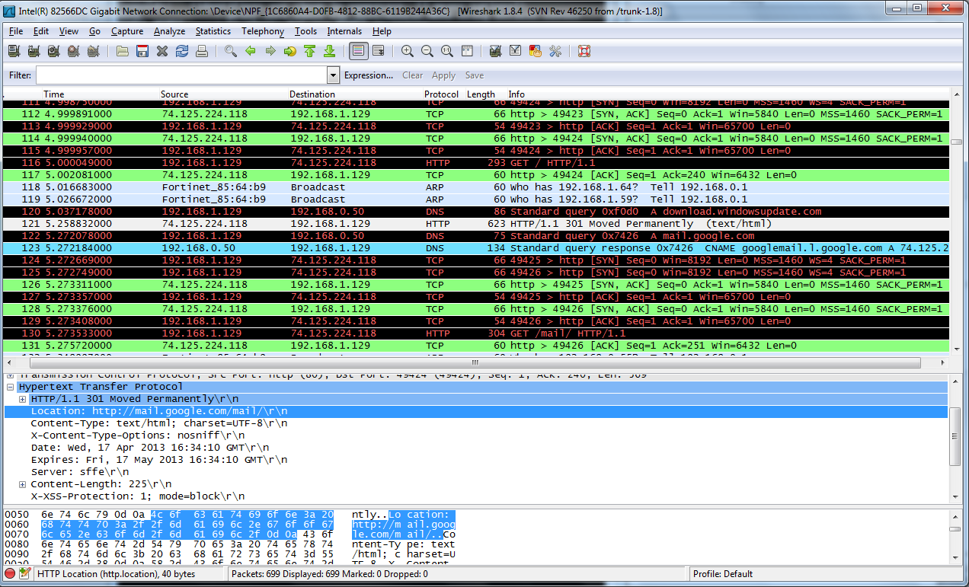
Figure 1: 1st redirection
1st time redirection
Happens when user send HTTP GET to gmail.com, the HTTP response is: 301 Moved Permanently
Redirect to the location: http://mail.google.com/mail

Slide 10
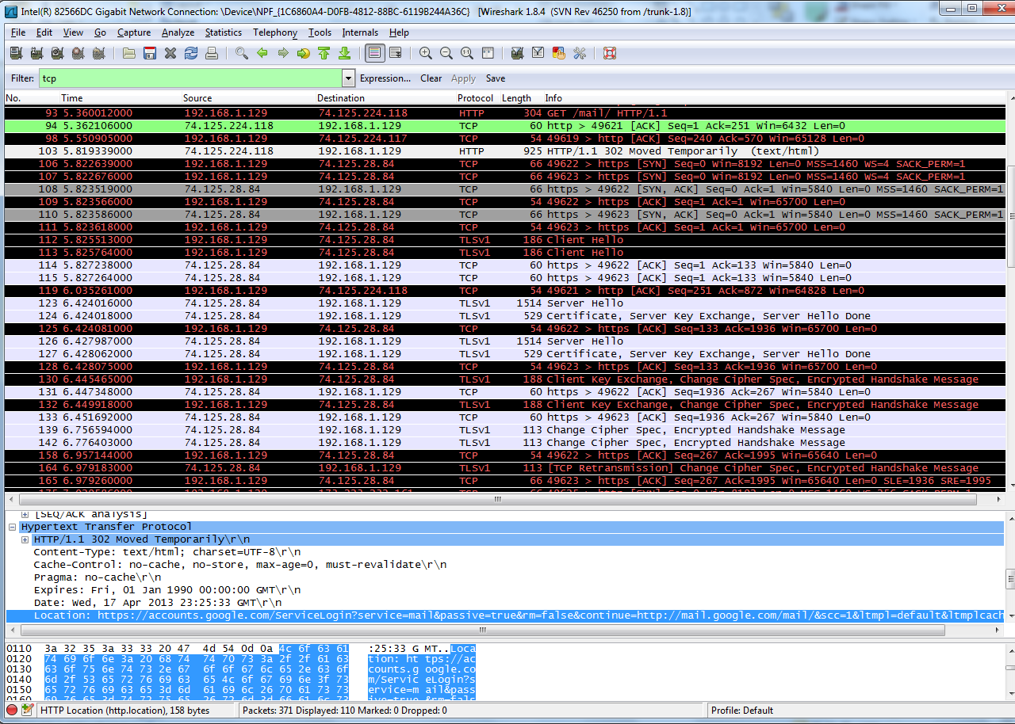
Figure 2: 2nd redirection
2nd time redirection:
Happens when user send HTTP GET to mail.google.com, HTTP response: 302 Moved Temporarily
Redirect to the location https://accounts.google.com/ServiceLogin?service-mail&passive-true…

Slide 11
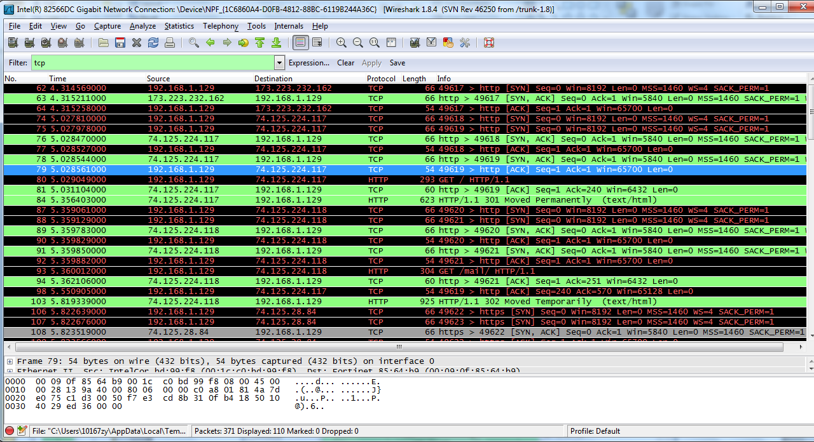
Figure 3: 3-times hand-shake
Above wire-shark screenshot shows:
3 times hand-shake were made to get the user finally to the log-in page
The flow-graph on next slide will show the 3-times hand-shake more clearly

Slide 12
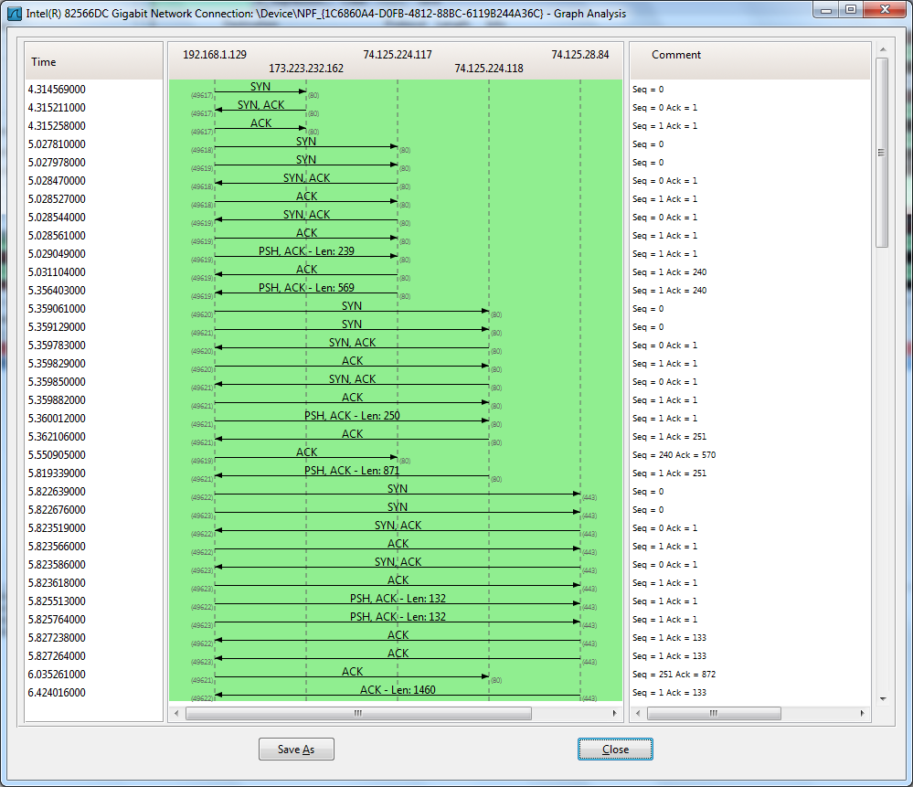
Figure 4: flow graph of 3-times hand-shake
No. 1 HS
No. 2 HS
No. 3 HS

Slide 13
The log-in process of web-based email - phase 2: connection setup (SSL/TLS hand-shake)
Refer to textbook <<Computer Networking: A Top-Down Approach 5th edition>>,
chapter 8.5 Secure TCP Connections: SSL, page 727
After the normal 3-way TCP hand-shake, a SSL/TLS hand-shake is additionally performed at the No. 3 hand-shake procedure in this case with following steps (hand-shake packets after 2nd redirection on Figure 2):
The client sends a list of cryptographic algorithms it supports, along with a client nonce. (client hello)
From the list, the server chooses a symmetric algorithm (for example, AES), a public key algorithm (for example, RSA with a specific key length), and a MAC algorithm. It sends back to the client its choices, as well as a certificate and a server nonce. (server hello)
The client verifies the certificate, extracts the server’s public key, generates a Pre-Master Secret (PMS), encrypts the PMS with the server’s public key, and sends the encrypted PMS to the server.
Using the same key derivation function (as specified by the SSL standard), the client and server independently compute the Master Secret (MS) from the PMS and nonces. The PMS is then sliced up to generate the two encryption and two MAC keys. Furthermore, when the chosen symmetric cipher employs CBC (such as 3DES or AES), then two Initialization Vectors (IVs)—one for each side of the connection—are also obtained from the PMS. Henceforth, all messages sent between client and server are encrypted and authenticated (with the MAC).
The client sends a MAC of all the handshake messages.
The server sends a MAC of all the handshake messages.

Slide 14
The log-in process of web-based email – phase 3: user authentication under SSL/TLS
Refer to textbook <<Computer Networking: A Top-Down Approach 5th edition>>,
chapter 8.5 Secure TCP Connections: SSL, page 727
After SSL/TLS hand-shake completed, the TCP connection based on SSL/TLS established successfully. Then the user’s web browser creates a HTTP GET message containing the URL to get fetched. The HTTP GET message then becomes the payload of a TCP segment, and then placed into a datagram, and then frame to be sent to gmail.com eventually.
Upon receiving the HTTP GET message from user, the server side will reply with HTTP response message containing the redirected URL.
The web browser of user side will display the returned web page accordingly, on that page user’s mail address and password is requested. The web browser will encapsulate the mail address and password entered by user into a encrypted message (TLSv1 application data) and sent to server side.
The message from user web browser is encrypted with the server public key. So only the server could decrypt it with its private key. Certain validation is performed on server side to verify the user information, and then server will authorize the user by providing HTTP response with the web mail box access if validation succeeds.

Slide 15
The log-in process of web-based email – phase 4: about cookies
Refer to textbook <<Computer Networking: A Top-Down Approach 5th edition>>,
chapter 2.2.4 User-Server Interaction: Cookies, page 110
Why Cookies?
HTTP server is stateless. However it is often desirable for a web site to identify users either to restrict user access or to serve customized contents to different users. Therefore Cookies.
What is Cookies?
Cookies, defined in RFC 2965, allow sites to keep track of users with following 4 components:
1) a cookie header line in the HTTP response message;
2) a cookie header line in the HTTP request message;
3) a cookie file kept on the user’s end system and managed by the user’s browser;
4) a back-end database at the Web site.

Slide 16
Web-based mail functions - technologies involved 1/2
Refer to textbook <<Computer Networking: A Top-Down Approach 5th edition>>,
chapter 2.4 Electronic Mail in the internet, page 120
SMTP: The user’s mail server still sends messages to other mail servers using SMTP.
IMAP: IMAP is the protocol used to sync. contents between user’s mailbox and the web-browser
HTTP: The user agent is an ordinary Web browser, and the user communicates with its remote mailbox via HTTP. While sending a mail via web-based method, the message is sent from user’s browser to his/her mail server over HTTP instead of SMTP.

Slide 17
Web-based mail functions - technologies involved 2/2
Refer to textbook <<Computer Networking: A Top-Down Approach 5th edition>>,
chapter 2.4 Electronic Mail in the internet, page 120
ENCODING: traditionally SMTP supports 7-bit ASCII encoding only, which is not enough in nowadays communication world. Therefore MIME is introduced.
MIME: Multipurpose Internet Mail Extensions
refer to RFC2045 (http://tools.ietf.org/html/rfc2045)
MIME is an Internet standard that extends the format of email to support:
textual message bodies in character sets other than US-ASCII
an extensible set of different formats for non-textual message bodies
multi-part message bodies
textual header information in character sets other than US-ASCII.
FTP: When the user uploads/downloads attachments FTP is used to transfer the file from local to/from the user’s mailbox on the server.

Slide 18
Web-based email - OSI layer view
sender
recipient
L7: application
App. Protocols: HTTP/HTTPs, SMTP, IMAP, FTP etc.
L4: transport
Application messages is enveloped into TCP segments
L3: network
Segments from L4 is encapsulated into datagrams
L1: physical
L2: link
Datagrams from L3 is encapsulated into frames
Binary bits transferred on the physical layer
L6: presentation
L5: session
Data exchange including encoding, MIME
User log-in and log-out management
L7: application
App. Protocols: HTTP/HTTPs, SMTP, IMAP, FTP etc.
L4: transport
Datagrams from L4 is extracted into TCP segments
L3: network
Frames from L3 is extracted into datagrams
L1: physical
L2: link
Bits from physical layer is extracted into frames
Binary bits transferred on the physical layer
L6: presentation
L5: session
Data exchange including encoding, MIME
User log-in and log-out management
network

Slide 19

THANK YOU!
By presenting this final project report at the end of the semester, I would like to say thank you to Prof. Liu who guided us into the wonderful network world with his wonderful lectures all the way.
I would also present my thanks to my classmate Huaxin together with whom I finally complete this project.

