Slide 1
CS570 Final Project
Clustering Analysis
on Movie Reviews Dataset
- Group Focus: Infinit.e

Slide 2
Group Members
Name | Email
Olina Zhang(lead) | olina.zhang5046@gmail.com
Ocean Gao | ocean.gao398@gmail.com
YanChun Tao | erin.taotao@gmail.com
Peter Sun | psun888@gmail.com
Srinath | sridharan10432@mail.npu.edu
Rahul | rahul.pardeshi2400@gmail.com

Slide 3
Schedules
Phase I: env. setup @wk11
Phase II: Hands-on with Infinit.e @wk12-13
Phase III: Wrap-up and Final Report @wk14

Slide 4
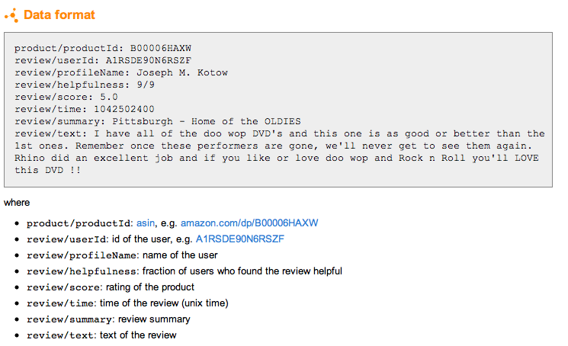
Input Dataset: movie reviews
https://snap.stanford.edu/data/web-Movies.html

Slide 5
Phase I: Install IKANOW infinit.e - Offline
Insights of the offline installation packages from: http://www.ikanow.com/downloads/
1) infinit.e-preinstall-offline-bundle contains:
#1 infinit.e-platform.prerequisites.offline-v0.2-70.75.noarch
#2 elasticsearch-0.19.11-3.noarch
#3 infinit.e-hadoop-installer.offline-v0.2-70.75.noarch
install-infinite-offline.sh
example configurations folder
2) infinit.e-install-bundle contains:
#1 infinit.e-config-v0.2-805.81.noarch
#2 infinit.e-index-engine-v0.2-805.81.noarch
#3 infinit.e-db-instance-v0.2-805.81.noarch
#4 infinit.e-processing-engine-v0.2-805.81.noarch
#5 infinit.e-interface-engine-v0.2-805.81.noarch
Phase I: Env. Setup

Slide 6
Phase I: Install IKANOW infinit.e - Online
Quick Install:
http://www.ikanow.com/downloads/
Quick install – online
Right click the "Download" button for the online "enterprise linux" install package and select “Copy Link”
On a linux console type "curl -L -o install.rpm '<PASTE HERE>'"
Then run (sudo) rpm -i install.rpm and follow the instructions
Phase I: Env. Setup

Slide 7
Phase I: Firewall Config.: Open port 8080
Step1: [root@CentOS64x64 ~]# vi /etc/sysconfig/iptables
add following line to open port 8080:
-A INPUT -p tcp -m state --state NEW -m tcp --dport 8080 -j ACCEPT
Step2: [root@CentOS64x64 ~]# service iptables restart
Hint: You can temporarily stop the firewall to test whether it’s the root cause of connection-failure by command: service iptables stop
Phase I: Env. Setup

Slide 8
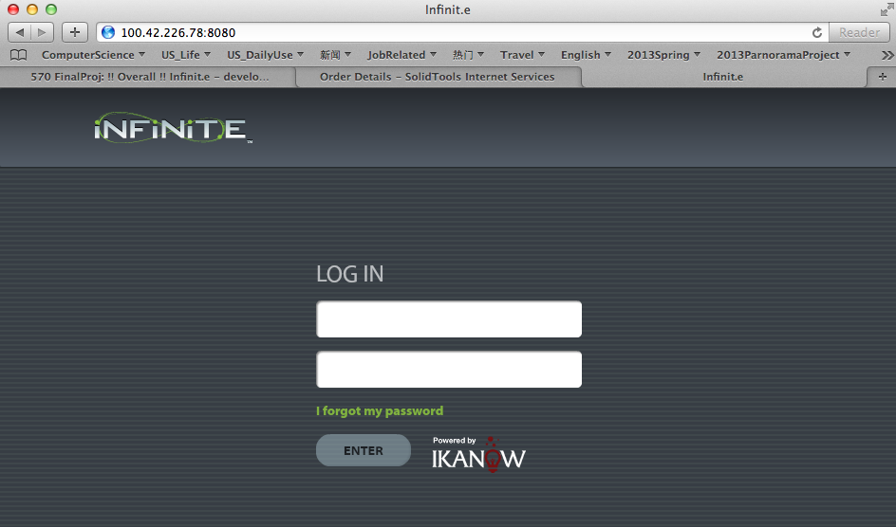
Phase I: Start Infinit.e from your local machine
You will get the login GUI with URL:
http://your_server_IP_addr:8080
If you are using sample configuration during the installation
User:
infinite_default@ikanow.com
Password:
infinit.e!2013
Phase I: Env. Setup

Slide 9
Phase I: Hadoop Installation
As mentioned during the installation
Note standalone Hadoop not installed, to do so run /opt/hadoop-infinite/install.sh (not necessary for single node installations)
By running /opt/hadoop-infinite/install.sh it installs Cloudera free Hadoop distribution
Phase I: Env. Setup

Slide 10
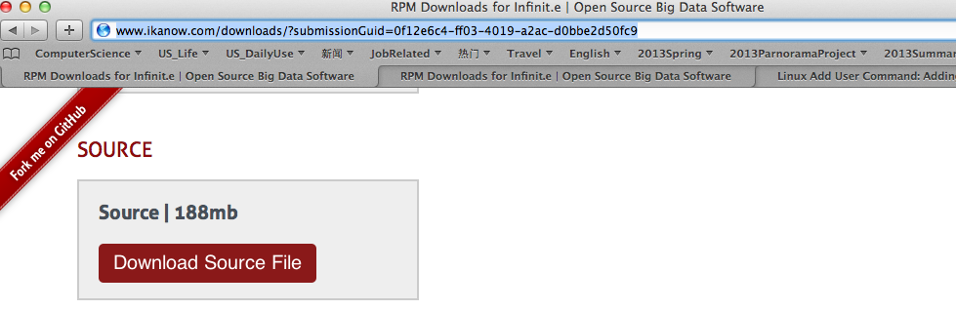
Phase II: Hands-on with Infinit.e
Source Code Package (Infinit.e-master.zip) available at: http://www.ikanow.com/downloads/
Phase II: Hands-on with Infinit.e

Slide 11
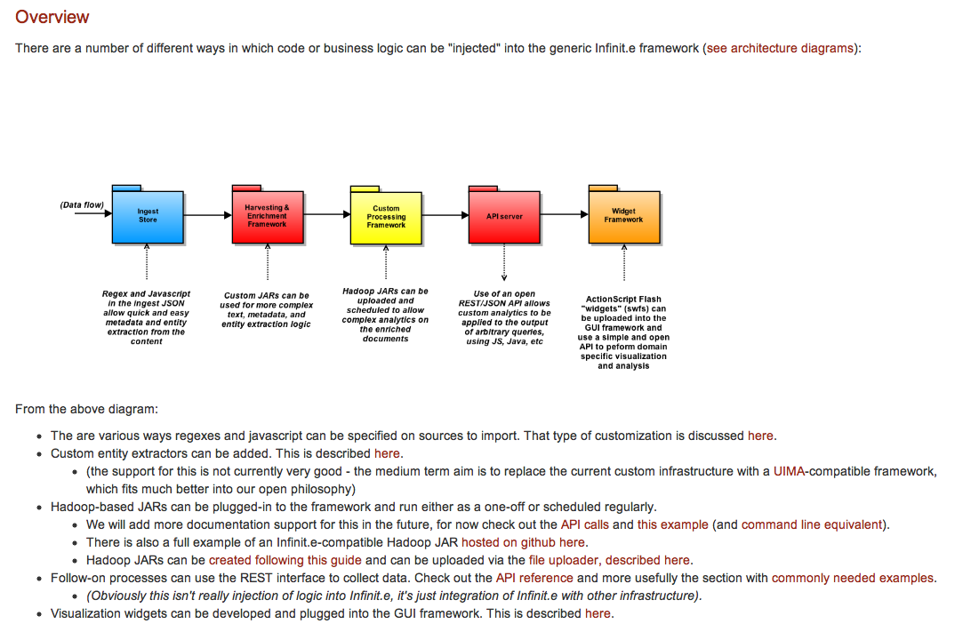
Infinit.e - developing visualizations and plugins
Phase II: Hands-on with Infinit.e
https://ikanow.jira.com/wiki/display/INFOSS/Infinit.e+-+developing+visualizations+and+plugins

Slide 12
Phase II: Hands-on Scope
2 major parts are concerned:
Source import (process the input data file)
Extract data
Enrich data (structure/non-structure analysis)
Hadoop plugin
Dev. Hadoop .jar (compatible with infinit.e)
Submit hadoop job to infinit.e
Track the job status and results
Phase II: Hands-on with Infinit.e

Slide 13
Part 1: import source data
The whole picture about configuring a source
Ref: https://ikanow.jira.com/wiki/display/INFAPI/Config+-+Source
Luckily, user-friendly GUI available to do the job in some simple steps:
1) add source
2) test source
3) publish source
Phase II: Hands-on with Infinit.e

Slide 14
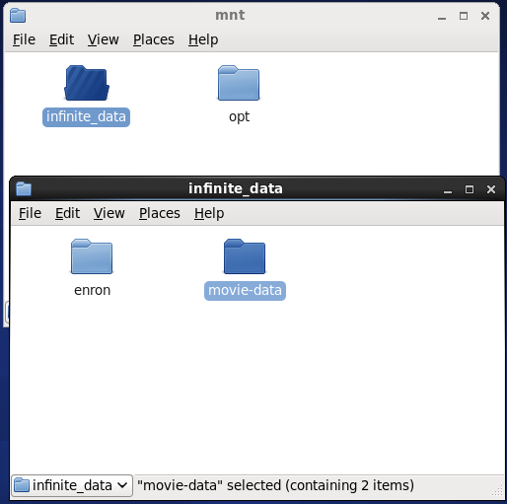
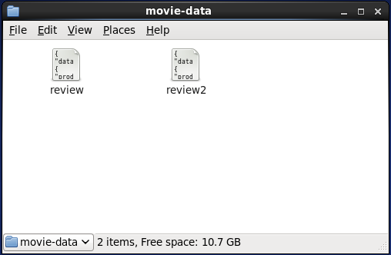
Phase II: Prepare Data
1.Create a movie review data directory "movie-data"
2. Create two files for movie review data
Phase II: Hands-on with Infinit.e

Slide 15
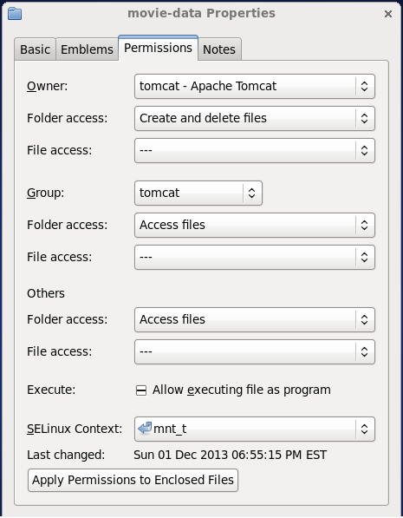
Phase II: Prepare Data
3. Content of review data
4. Set the "movie-data" permission of properties.
Phase II: Hands-on with Infinit.e

Slide 16
Phase II: Manager Home
GUI avaliable http://100.42.226.78:8080/manager
Phase II: Hands-on with Infinit.e

Slide 17
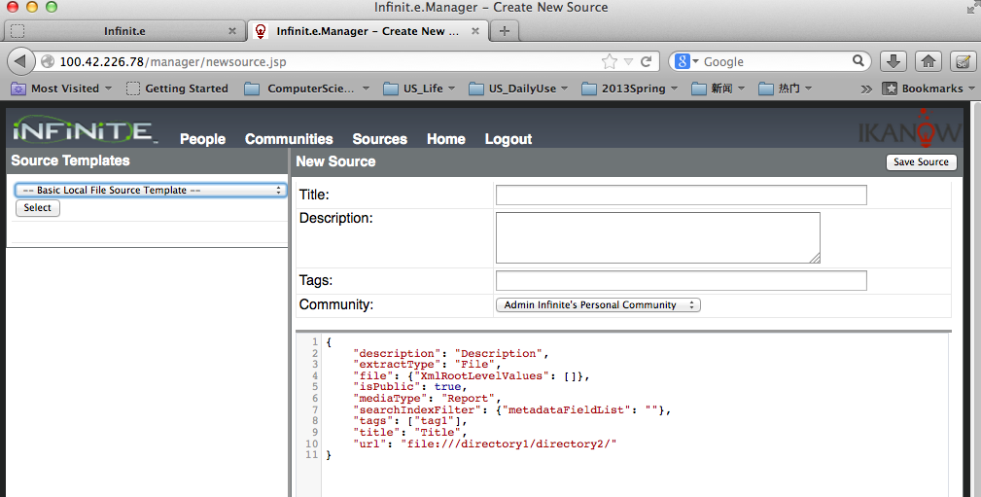
Phase II: Add Source
GUI avaliable@ http://100.42.226.78:8080/manager/newsource.jsp
Basic local file template:
{
"description": "Description",
"extractType": "File",
"file": ""
"isPublic": "true",
"mediaType": "Report",
"tags": ["tag1"],
"title": "Title",
"searchIndexFilter": {"metadataFieldList": ""},
"url": "file:///directory1/directory2/"
}
Phase II: Hands-on with Infinit.e

Slide 18
Phase II: Movie Review Source
Phase II: Hands-on with Infinit.e

Slide 19
Phase II: Test Source
After the new source added and saved successfully, you can test the source
Phase II: Hands-on with Infinit.e

Slide 20
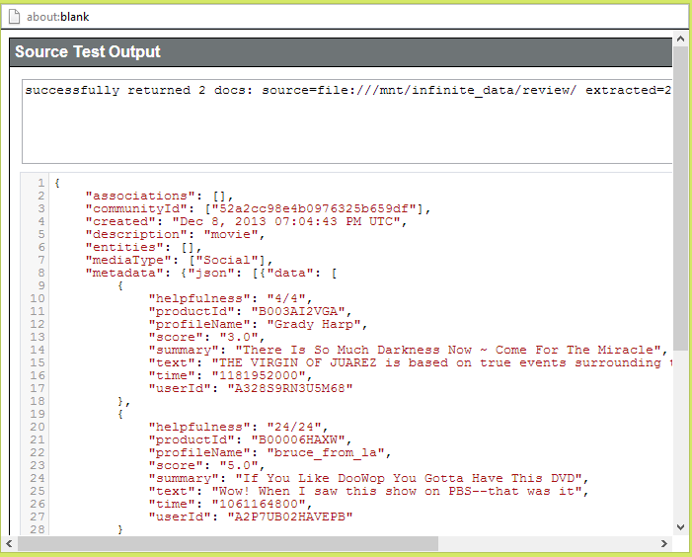
Phase II: Test Source: result
Note: pop-up should be enabled to view the test results.
Phase II: Hands-on with Infinit.e

Slide 21
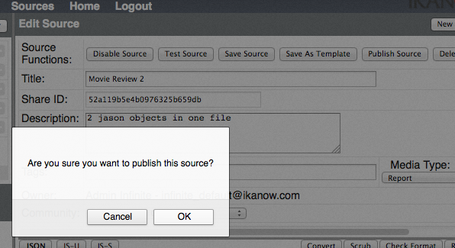
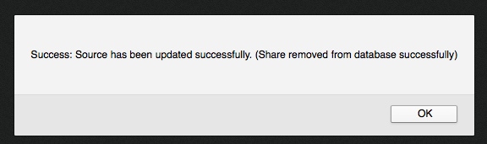
Phase II: Publish Source
Once your source tested you can publish it
Phase II: Hands-on with Infinit.e

Slide 22
Phase II: Search Source
After pulished the source, go back to infinit.e home to "Refresh" sources.
You will see the new source in sources list, then you can search from this source.
Phase II: Hands-on with Infinit.e

Slide 23
Part 2: hadoop plugin
Step 1: hadoop jar dev.
Infinit.e compatibleHadoop JARs can be created following this guide:
https://ikanow.jira.com/wiki/display/INFOSS/Hadoop+Plugin+Guide
Phase II: Hands-on with Infinit.e

Slide 24
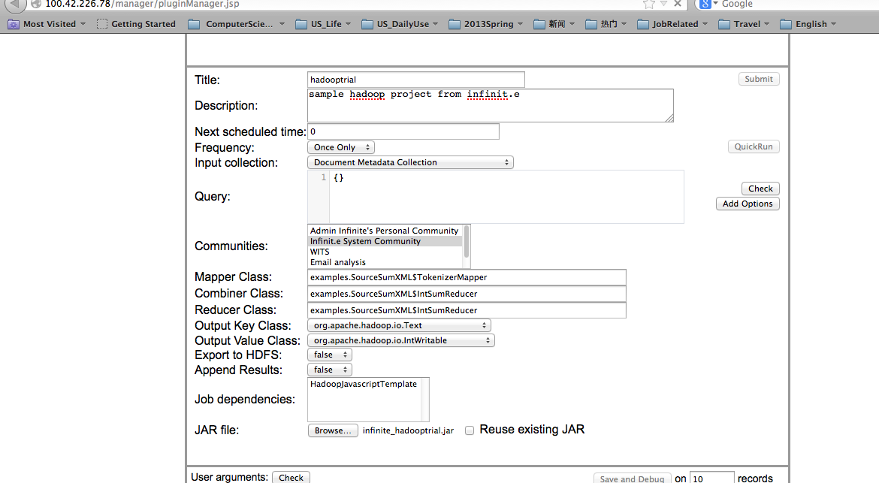
Phase II: Upload/Schedule hadoop plugin
Step 2: upload/submit hadoop jar
ref: https://ikanow.jira.com/wiki/display/INFAPI/GUI+utilities+-+uploading+files
Phase II: Hands-on with Infinit.e

Slide 25
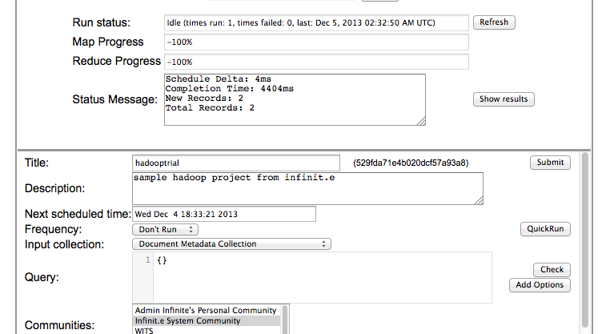
Phase II: “Save and Debug” operation
Phase II: Hands-on with Infinit.e

Slide 26
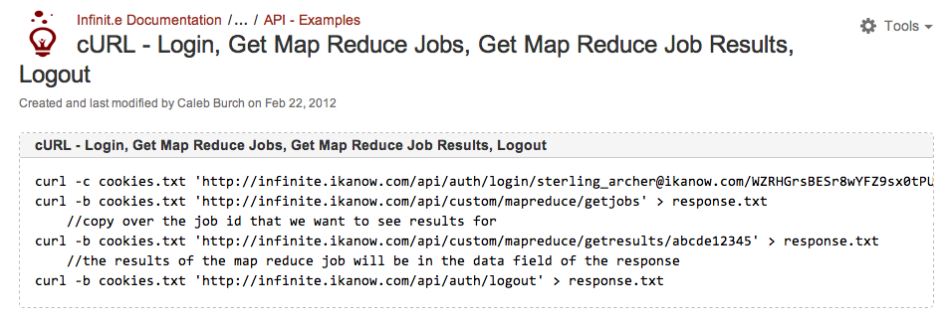
Phase II: APIs: login, GetJobs,GetResults,logout
Step 3: Check job status & results
Ref: https://ikanow.jira.com/wiki/display/INFAPI/cURL+-+Login%2C+Get+Map+Reduce+Jobs%2C+Get+Map+Reduce+Job+Results%2C+Logout
Phase II: Hands-on with Infinit.e

Slide 27
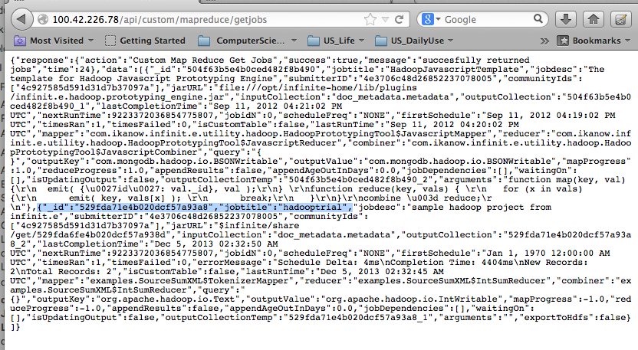
Phase II: Check Jobs via Infinit.e API
Phase II: Hands-on with Infinit.e

Slide 28
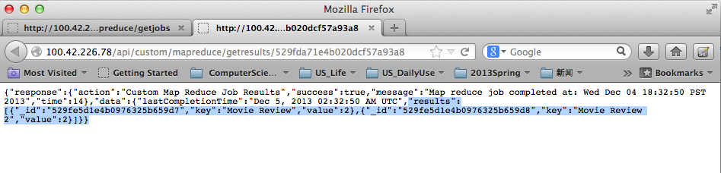
Phase II: Get Job Results via API
Phase II: Hands-on with Infinit.e

Slide 29
Phase III: Wrap-up and Report
Contribution from everyone in the team:
YanChun
Ocean
Peter
Srinath
Rahul
Olina

Slide 30
Thank You!

