Slide 1

SoftDes Midterm Project Spotify Hit Songs
Sparsh Gupta and Sohum Kothavade
Team Blueberries

Slide 2
Introduction
Research Question: How non-musical factors make a song successful?
Music industry has become extremely competitive.
Identifying factors which can make artists successful by creating ‘hit’ songs is important.
Spotify has become the world’s largest music provider having 433 million total users as of 2022 in 184 markets/regions across the world.
How do we define a ‘hit’ song?
Spotify’s data includes a parameter for every music/song track called the ‘popularity’.
A value between 0 and 100, with 100 being the most popular.
Based on algorithm which uses total number of plays of the track & how recent they are.

Slide 3
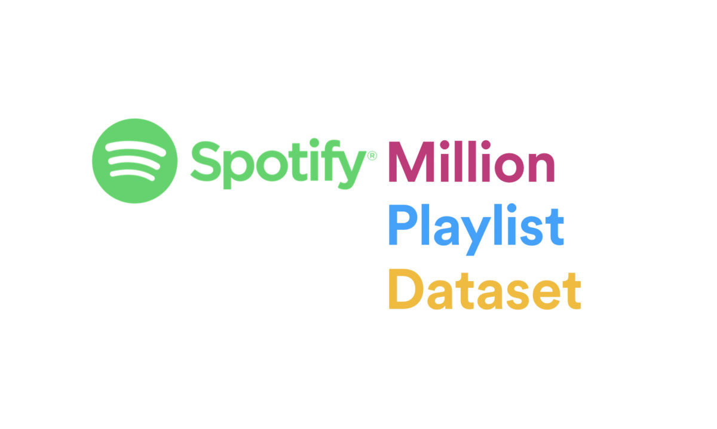
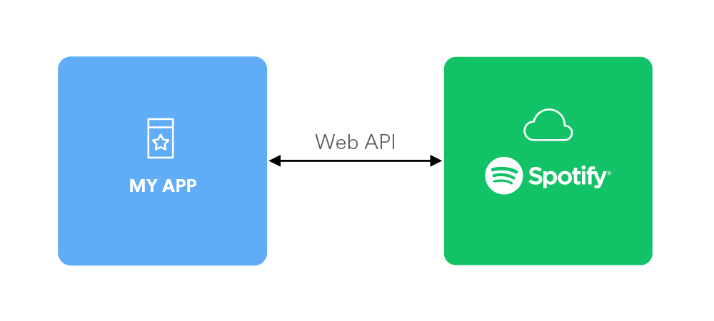
Methodology
We collected our data from Spotify's 'The Million Playlist' dataset, which contains over a hundred million songs across a million playlists.
To access this data, we utilized Spotify's Web API through standard HTTPS requests from Python, and authorized our access using valid API tokens.
We also used the SpotiPy package to extract data from unique song identifiers.
We use a function which authenticates our API token and reads the data into a list, which includes statistics for several non-musical factors of interest.

Slide 4
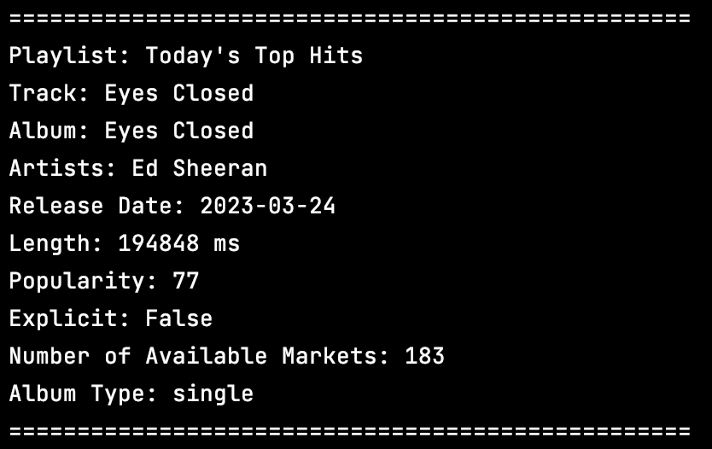
Methodology (contd.)
We use SpotiPy to get 50 playlists and obtain around 3833 song tracks data from Spotify's dataset.
We export this data to a csv file including ten data columns, such as track popularity and non-musical factors.
We import Pandas and Matplotlib for data processing and plotting.
We then generate visualizations such as histograms, scatter plots, line charts, and bar charts based on this data.
Sample of Extracted Data

Slide 5
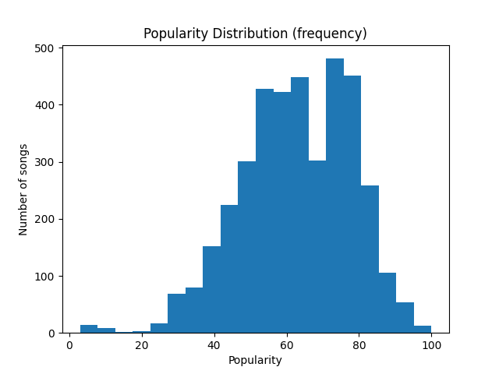
Results – Data Sample
We plotted a histogram to check the bias in our dataset and concluded that this dataset sample reflects and actual real-world music data.
Notes:
We observe that the most frequency of songs in the data lie between the ‘popularity’ of 70-80 which lets us know that most songs in this dataset are more popular than average. We also interpret that very low number of tracks lie in the ‘popularity’ range of 0-20 and therefore, not many songs are highly unpopular or unsuccessful. Also, songs which are extremely successful (popularity: 90-100) have low frequency of occurrence in the dataset.

Slide 6
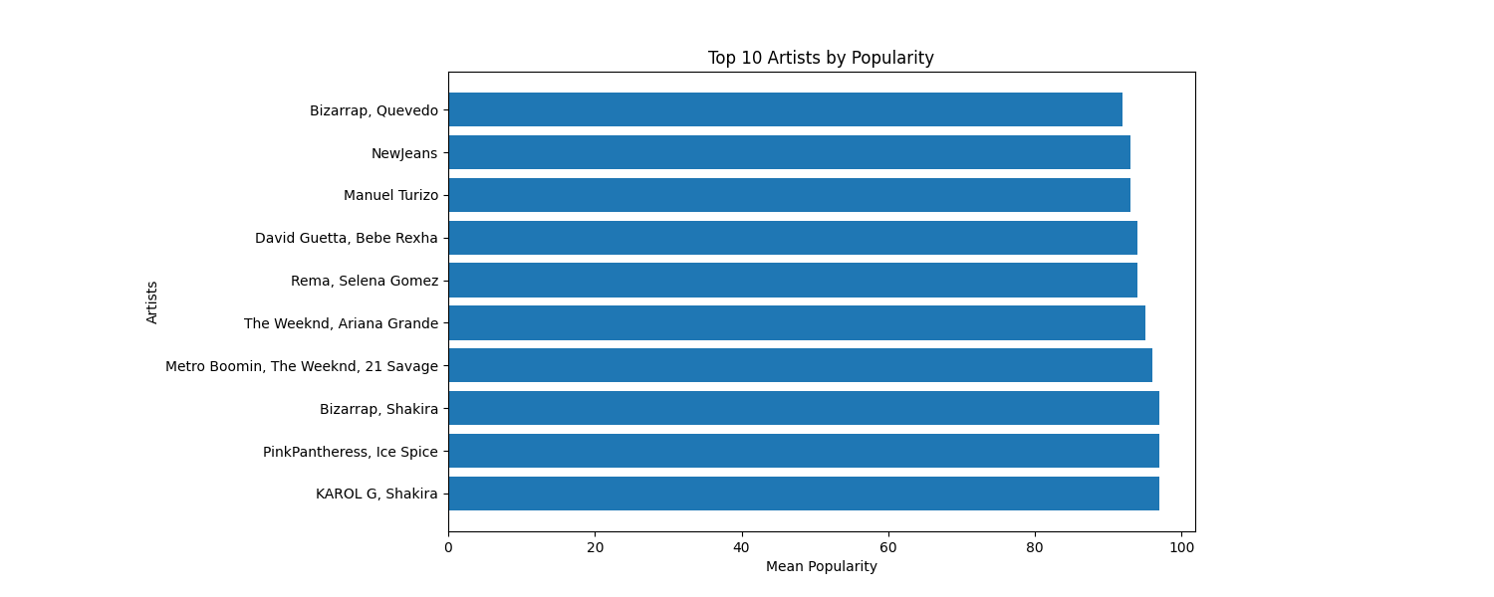
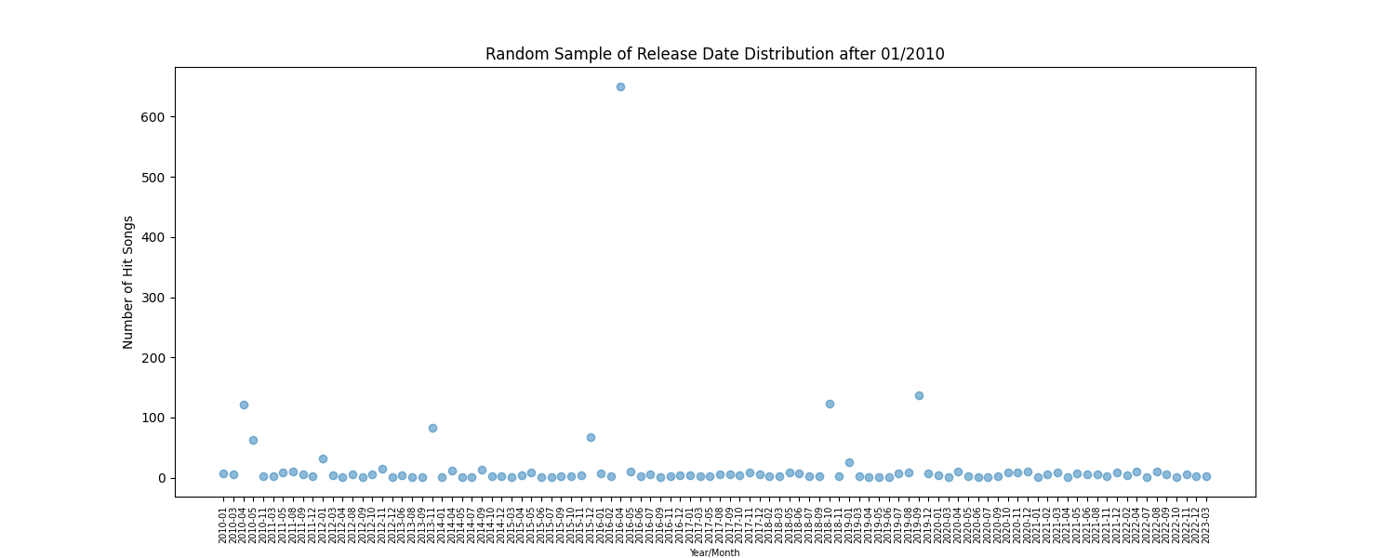
Results - Factors affecting Popularity
The top 10 artists on Spotify have a higher chance of producing hit songs.
We can interpret that songs released around start of the summer months and end of the year are more likely to become 'hit'.

Slide 7
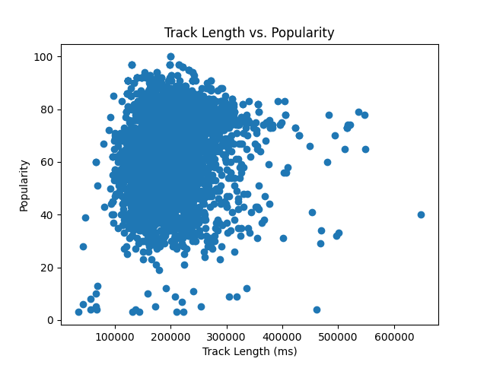
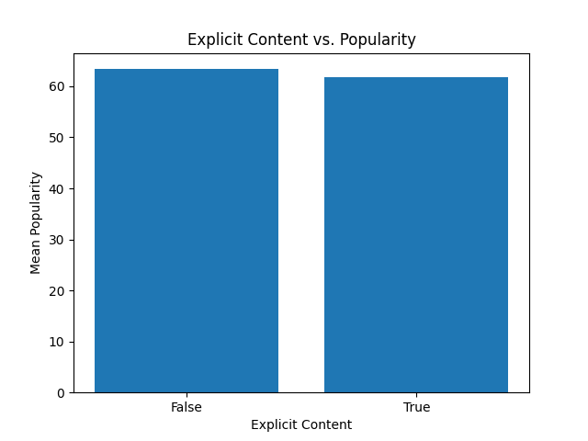
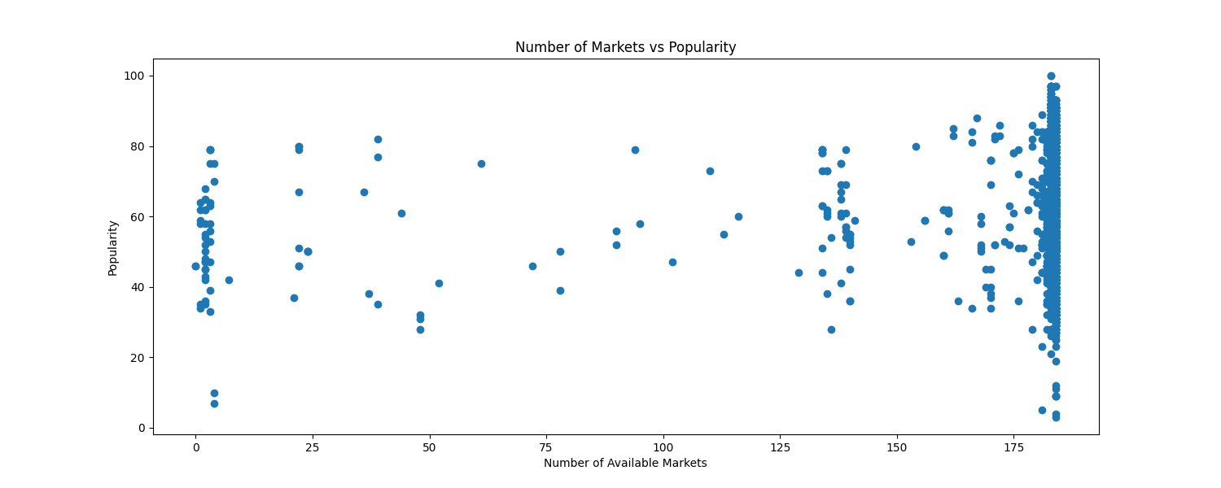
Results – Factors not directly affecting Popularity
We analyzed the length of songs and found that it does not affect a song's success unless it's too short.
Explicit content in lyrics does not affect a song's popularity much.
The number of markets a song is released in does not guarantee its success, but songs released in fewer markets are less likely to become super hits.

Slide 8
Conclusion
Some non-musical factors can contribute significantly to the popularity of a song.
Spotify’s popularity metric is a useful tool for analyzing the success of a song.
Data analysis can provide valuable insights for decision-making in the music industry.
Notes:
Some non-musical factors can contribute significantly to the popularity of a song: This project highlights how factors like release date of songs, song artists, etc. play a role in determining the success of a song. However, we also found out that factors like track length, explicit lyrics, etc. actually have no major effect on the popularity/success of a song.
Spotify's popularity metric is a useful tool for analyzing the success of a song: Spotify's popularity metric is based on a combination of factors, including the total number of plays and how recent those plays are. By using this metric, we can classify songs as "hits" or "non-hits" and analyze the factors that contribute to their success.
Data analysis can provide valuable insights for decision-making in the music industry: By analyzing data from Spotify and other sources, we can gain valuable insights into what makes a song successful. These insights can be used by music producers, record labels, and artists to adjust their strategies and increase the likelihood of creating a hit song.

