Slide 1
OWL Jan-24-14
How Websites Work

Slide 2

“The Internet” vs. “The Web”?

Slide 3
The Internet
A network of computer networks linked with a broad array of technology, which facilitate the transmission of data and exchange.
Information travels via protocols (digital rules)

Slide 4
The Web
The way of accessing all this information via the Internet using HTTP (Hypertext Transfer Protocol) protocol and tools such as browsers
Hence “hyperlinks”
Notes:
<a href=“…”> </a>

Slide 5
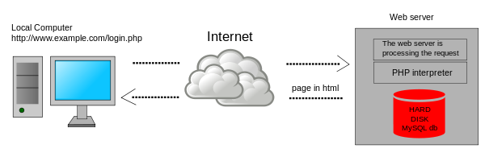
Client Side vs. Server Side
Front End vs. Back End

Slide 6
Front End Client Side
Very DesignE
What the user sees and interacts with in the browser
Runs “The Client Side”
Aka, displays things
Application that runs on a user’s computer (the client being a browser, but not always)
Front End == Client Side

Slide 7
Back End Server Side
Crunching Data
Runs in the “back end” (unseen by the user) on either the computer or on the server.
Runs on a Server
Explicitly does not run on the users computer (so somewhere else)
Back End == Server Side

Slide 8
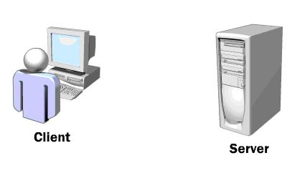
So, Quick Review:

Slide 9
The DOM (Document Object Model)
Programming interface for HTML and XML
Defines structure of document
Defines how document can be manipulated
Document == Web page
Web page =>> DOM

Slide 10
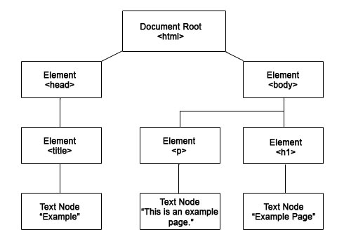

Slide 11

Browsers

Slide 12
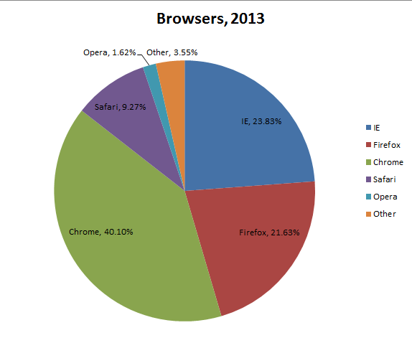

Slide 13
Browsers
Each browser renders differently
Browser Compatibility is important!
You will also hate it.

Slide 14
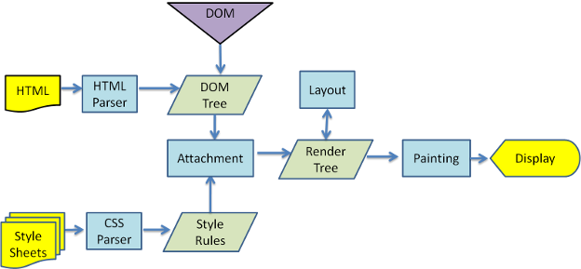
Webkit (Chrome & Safari)

Slide 15
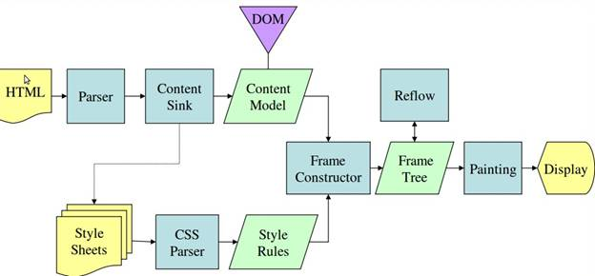
Gecko (Firefox)

Slide 16
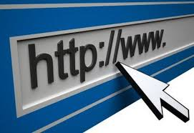
How URLs Work
The style of this header terrifies me…

Slide 17

Enter in a URL
Browser looks up IP Address for Domain Name
(IP = Internet Protocol address)
(DNS = Domain Name System)
Will also reference cache/stored data

Slide 18

Enter in a URL
Browser sends HTTP request to server
Also contains cookies browser has for domain

Slide 19

Enter in a URL
Server Handles/GETs the request

Slide 20

Enter in a URL
Server sends back an HTTP response

Slide 21
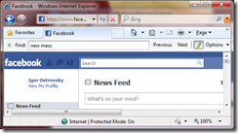
Enter in a URL
Browser begins rendering HTML

Slide 22

Enter in a URL
Browser sends requests for objects embedded in HTML

Slide 23
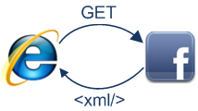
Enter in a URL
Browser sends further asynchronous (AJAX) requests

Slide 24
And Done!
(ish)

