Slide 1
CSS to Know
And this is just the beginning

Slide 2
What to What?
Tags = regular HTML
Ids = #id, only one hashtag per page
Class = .class, many as you want
Priorities?
Child priority over parent
Ids/classes priority over tags

Slide 3
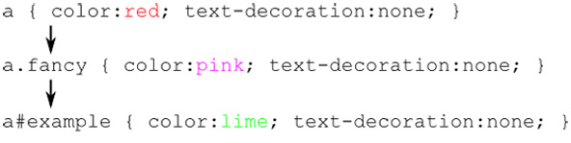
Tags, Classes, IDs

Slide 4
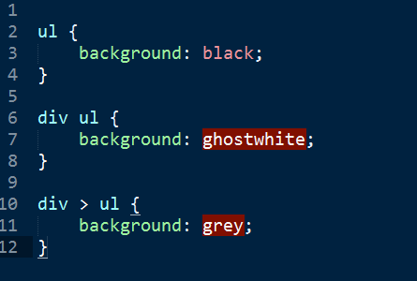
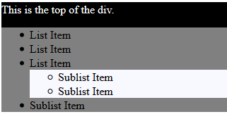
Parents & Children

Slide 5
Display
Display: block;
Display: inline;
Display: inline-block;
Display: none;
Display: inline-table;

Slide 6
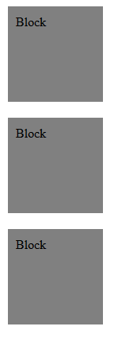
display: block;
One element per “line”
Default blocks
paragraphs
H-tags (eg. <h1>)
Lists
Can apply (almost) any style
Cannot easily align

Slide 7
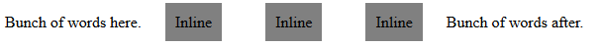
display: inline;
Runs on in one line
Default inline
<span>
<a>
Cannot alter
Top/bottom padding
Top/bottom margin

Slide 8
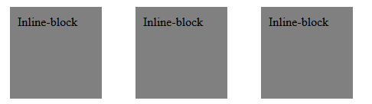
display: inline-block;
Combines block and inline properties
Default inline-block? None
Can apply any style, except alignment
Also reference “float”

Slide 9
display: none;
Do not display anything
Commonly used to hide elements while keeping them on the page

Slide 10
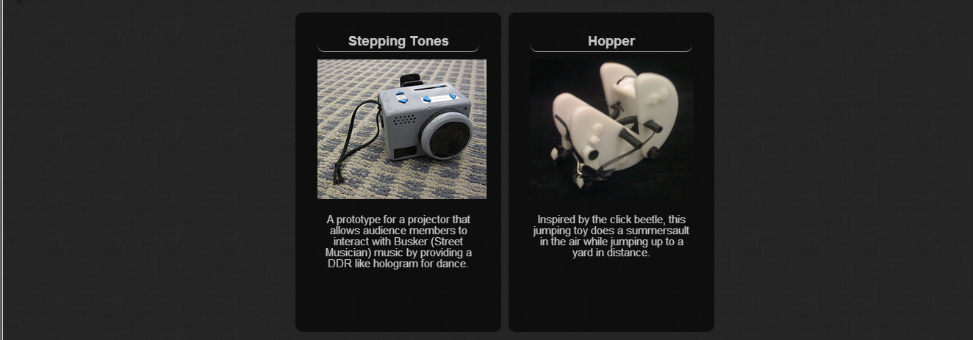
display: table/inline-table;
The greatest thing ever
Treats block/inline block elements like regular inline/table elements
(solves alignment issues)

Slide 11
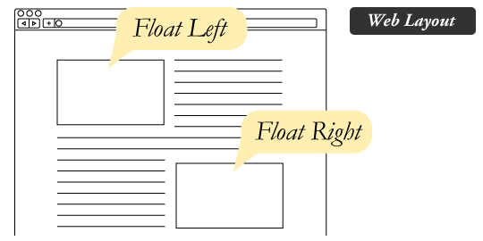
Floats

Slide 12
Position
position: static;
position: absolute;
position: relative;
position: fixed;
position: inherit;
top
left
right
bottom
z-index

Slide 13
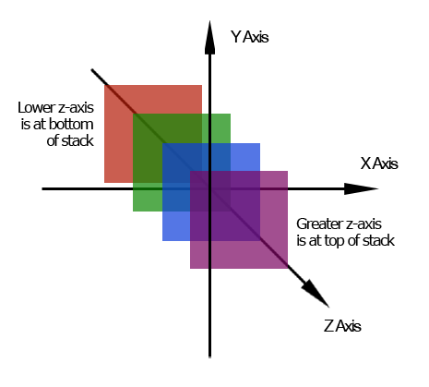
z-index
Determines what is on top of what
Default, later elements stacked on top

Slide 14
position: static;
Occurs in the order it appears in the doc
Default for everything
You’ll probably never use it (just saying)
Has “mass”
(aka, affects the position of the rest of the elements in the doc which also “have mass” on the same z-index)

Slide 15
position: relative;
Set position based on where it occurs in the doc
Original location maintains mass
Where ever you move it will not
Aka, you get a giant empty space if you move it

Slide 16
position: absolute;
Absolute position based on whatever parent is not static
Position with: top/left/right/bottom
Has no mass
Pushed to a higher z-index, but does not necessarily influence by other elements in that index

Slide 17
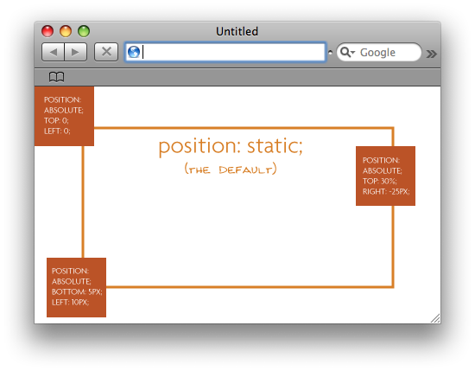

Slide 18
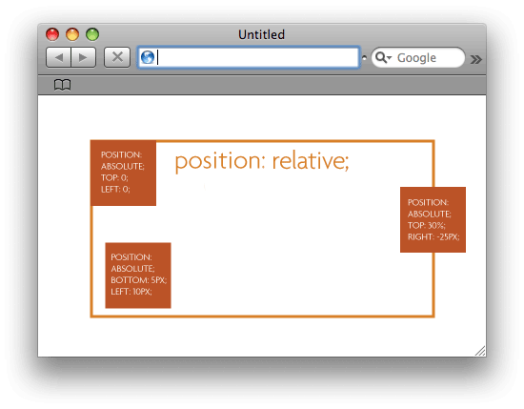

Slide 19

position: fixed;
A set, unchanging location based on the screen.
Location does not change with scrolling
Has “no mass”

Slide 20
Alignment
Inline alignment
Block alignment
text-align: right;
text-align: left;
text-align: center;
margin: 0 auto;
vertical-align: top;
vertical-align: middle;
vertical-align: bottom;
vertical-align: baseline;
(and more)
Center blocks,

Slide 21
Backgrounds
Regular (background: #ffffff;)
Gradient
Patterns
Images at specific coordinates
Opacity (transparent) backgrounds?

Slide 22
Gradient background
Need a webkit
Also, it is okay to use a generator like this:
http://www.colorzilla.com/gradient-editor/

Slide 23
Patterns & Images
Patterns:
repeat-x
repeat-y
repeat
no-repeat
Full Images:
Vertical-alignment
Horizontal-alignment
Does it move with the doc?
Size

Slide 24
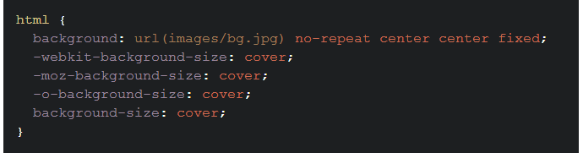

Slide 25
Opacity Backgrounds?
Method 1
Method 2
Make a wrapper around element
Set background & opacity of wrapper
Set element opacity: 1;
Make tiny pixel png
Set pattern background for the element

Slide 26
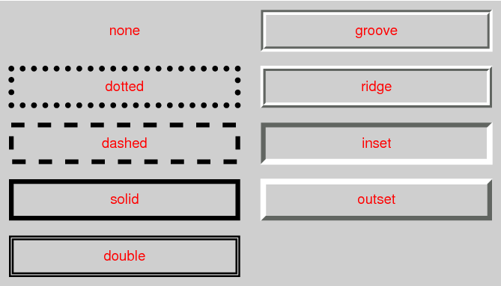
Borders
border: (thickness) (color) (type);
** border-radius, to round the corners

Slide 27
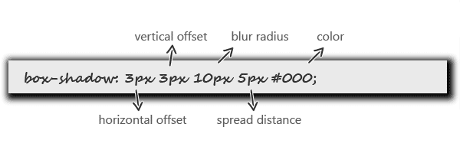
Text-shadow / Box-shadow
text-shadow, same but no spread distance
box-shadow also has inset option

Slide 28
Size & Scrolling
Pixel (px) *100px/inch
Percentage (%)
Computed font-size
(em)
overflow
overflow-x
overflow-y
width
max-width
min-width
height
max-height
min-height

Slide 29
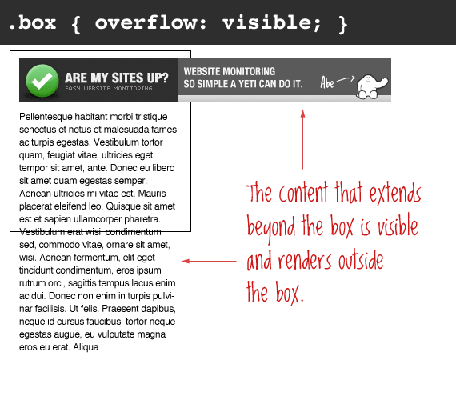

Slide 30
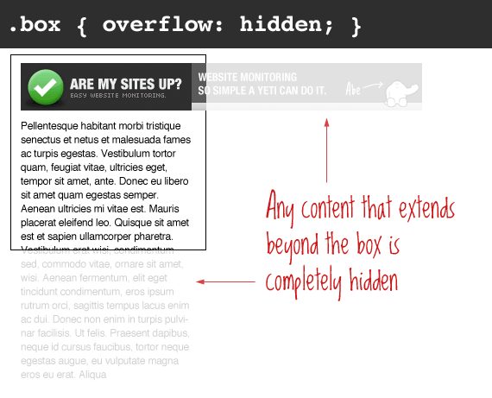

Slide 31
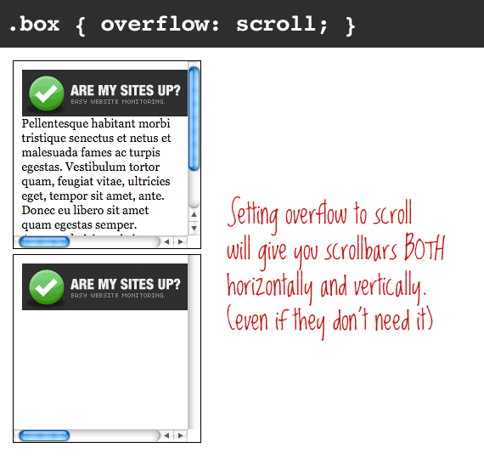

Slide 32
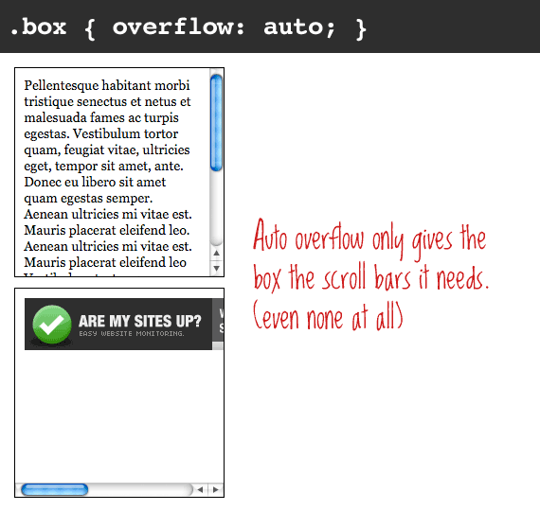

Slide 33
Anchor Tag
a = How link normally looks
** Default style overrides parent
a:hover = How looks when cursor over it
a:visited = How looks when clicked on and
back on original page
** If change a, do not need to set

Slide 34
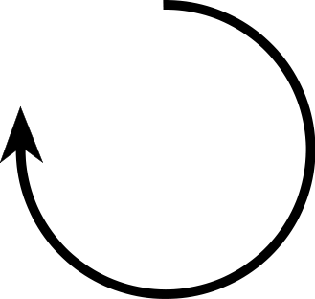
Other Things
padding: (top) (right) (bottom) (left);
Warning: padding adds to width/height
margin: (top) (right) (bottom) (left);
border-radius: (top-left) (top-right) (bottom-right) (bottom-left);
2nd-4th value is optional

Slide 35
Inline/text attributes
font-family
font-size
font-weight (think bold)
font-style (underline, italic)
etc.
line-spacing (think margin)
line-height (think padding)

Slide 36
CSS Tricks
http://css-tricks.com/snippets/
http://line25.com/

