Slide 1
Crash course to words
Because English sucks

Slide 2


Slide 3
Website vs. Web App
WEBAPP
WEBSITE
The “fine line” between them.
Content and Design heavy
Primarily informal
Code happy
Primary focus on user/function

Slide 4
Javascript: The Buzz
Universal language recognized by all browsers
Doing awesome things client side
Controls the Browser
Communicates asynchronously
Alter the DOM!
We are entering the ‘Javascript Age’
Pretty much everything web is made from Javascript
Or migrating to it
Because making things client side has become a thing
Like really

Slide 5
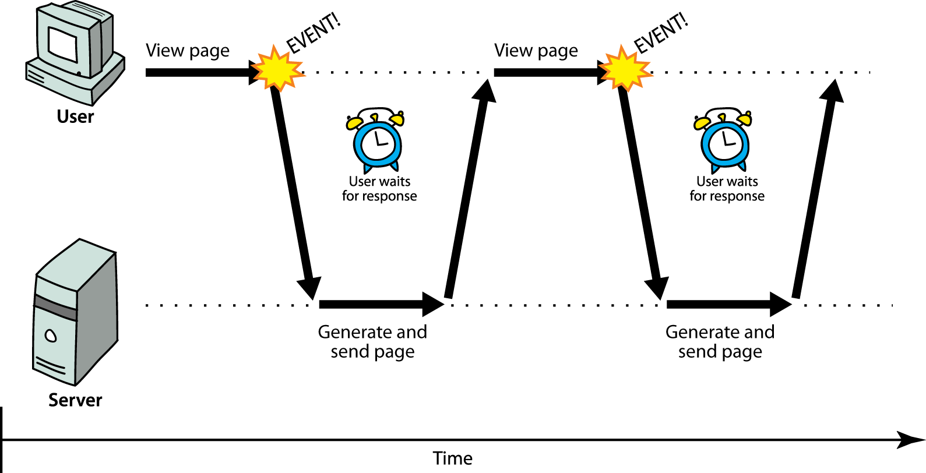
AJAX

Slide 6

Ha ha!
Waiting!

Slide 7
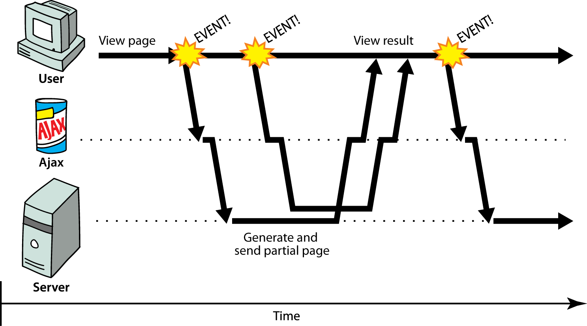
AJAX

Slide 8
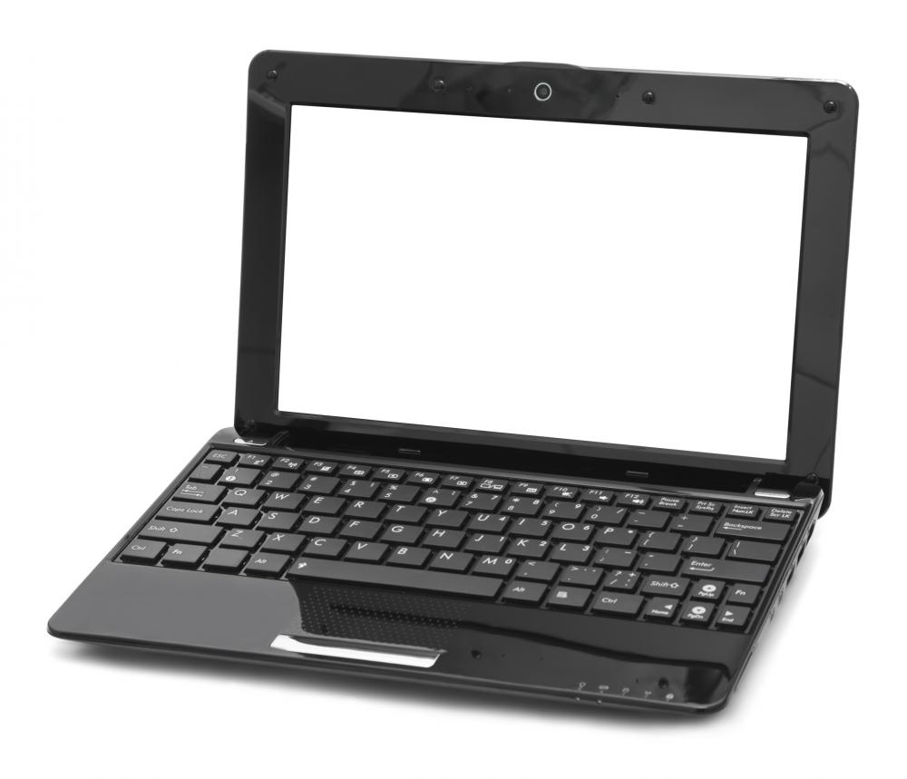

AJAX: Warning
Ha ha!
Waiting!

Slide 9
Libraries vs. Frameworks
Libraries
Toolkit to help you make the most out of your code
Someone wrote the hard stuff for you
Lots of neat stuff to work with
Frameworks
Code “Template”
Enforces structure to your code
Acts on your site as a whole with a specific goal
For the most part, a specialized type of library

Slide 10
Library Types
DOM Manipulation
GUI (graphic-user interface) / Widget
These often come with their own CSS
Graphic/Visual/Canvas related
Web application related
Just think frameworks
AJAX
Deals specifically with Ajax
Others

Slide 11



Example Libraries
Want more? http://jster.net/
http://www.javascriptplugins.com/

Slide 12
jQuery: The Debate
Why?
It’s a nice, straight forward library!
Handles DOM manipulation and AJAX
Cross browser compatibility
Why not?
“JQuery users don’t know Javascript”
It is not intended to be used as a framework for client side interaction
Monstrously messy really fast if misused

Slide 13



API’s
“Application Program Interface”
Short version:
Let’s communicate!
I like it.

Slide 14



Example Frameworks

Slide 15



Frameworks/Platforms
Kind of the same thing, just depends what you are talking about.
Think Server Side/Back End

Slide 16
Databases
Stores data
MySQL vs. NoSQL
Difference in how data is stored
Translation: Table vs. Not

Slide 17
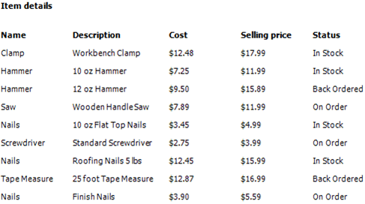
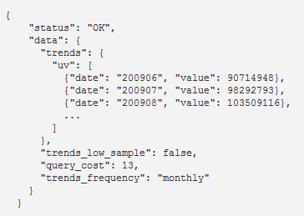
TABLE
JSON-BASED

Slide 18
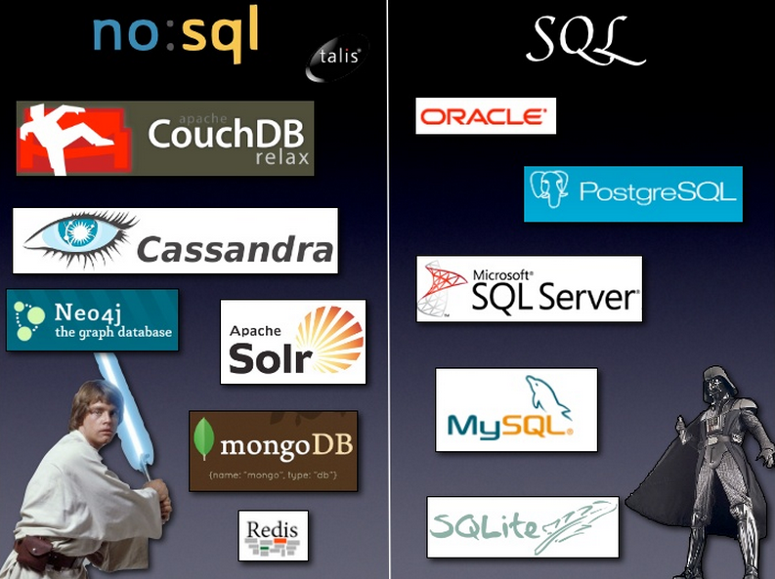

Slide 19


LAMP vs. MEAN Stack

Slide 20
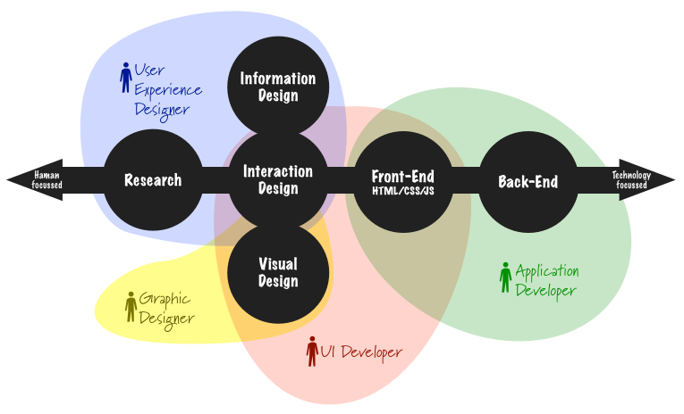
UI/UX Design

