Slide 1

welcome To our presentation

Slide 2

Represented By
Hasan Shakif Tushar
2014-1-60-094
Alinoor Hossain Olip
2014-3-60-008
Mamunur Rashid
ID # 2014-2-60-023
Aiswarja Saha Joye
ID# 2014-2-60-114

Slide 3
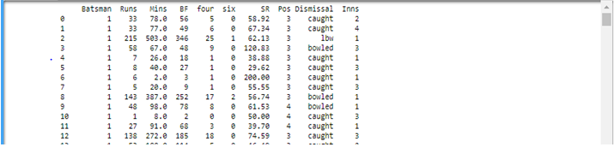
the screenshot of our data set after importing in jupyter notebook

Slide 4

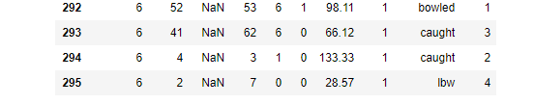
Problems in Dataset some missing attribute ☹
We solve this using dropna() function

Slide 5
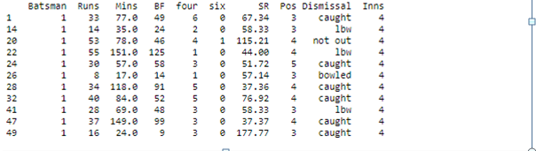
For Comparisons of Performances of players we need to do partitioned the dataset to get only 4th innings data.

Slide 6
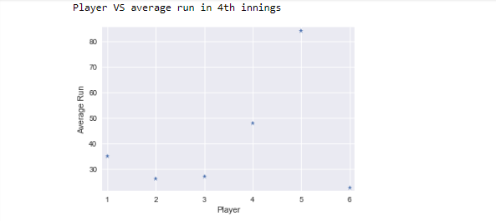
Players VS Average run in 4th innings
Interpretation: This graph shows that player 5 has the highest average among the batsman. That means for draw or win, batsman5 has the highest impact then player4, player1, player3, player2, player6 respectively.

Slide 7
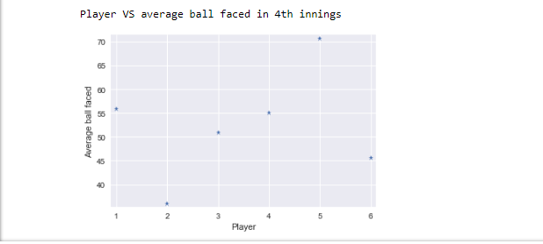
Players VS balls faced in 4th innings
Interpretation:. The result is almost same as above but player6 has surprisingly high value than player2 in terms of ball facing. The average of player2 is slightly better in 4th innings than player6. But player6 has survived in the pitch better playing over twice as much ball than player2.
So combining both player6 has the higher impact than player2 in 4th innings.
.

Slide 8
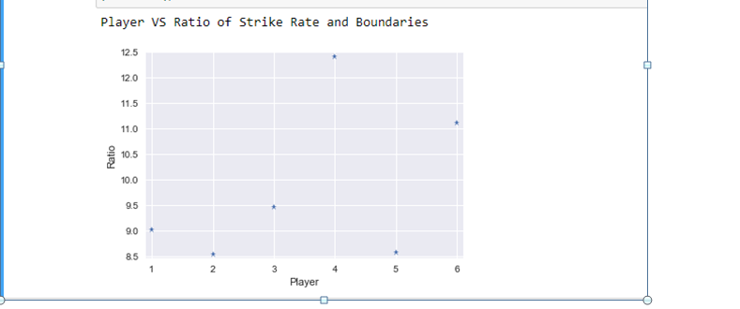
Players VS Ratio of Strike Rate and Boundaries
Interpretation: This graph shows that player4 has the highest ratio so this player is always busy to take runs in spite of scoring fewer boundaries.
.
.

Slide 9
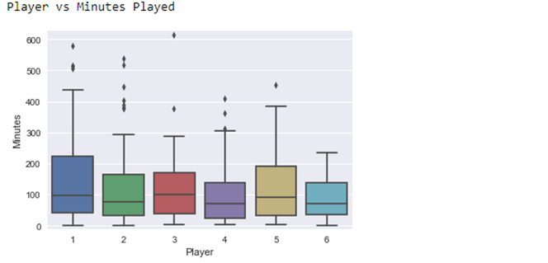
Players VS Minutes Played
Interpretation: from the graph we see the batsman_1 is the best performer for test match and also can make more runs in that particular test match.
.
.

Slide 10
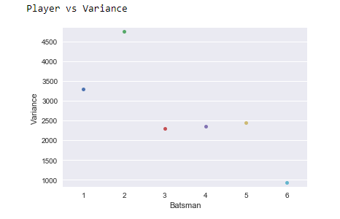
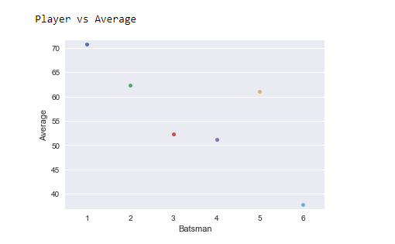
Finding which players are more Consistent player
Interpretation: From the graph of player vs average and player vs variance we can see batsman1 is best among them as it got the highest average as well as comparatively lower variance in respect to average. On the other hand batsman2 has the slightly higher average than batsman5 but the variance of batsman2 is much higher than batsman5 which makes batsman5 more consistent than batsman2.
.
.

Slide 11
.
Prediction of Players
Steven Smith
Virat Kohli
Joe Root
David Warner
Kane Williamson
Tamim Iqbal

Slide 12
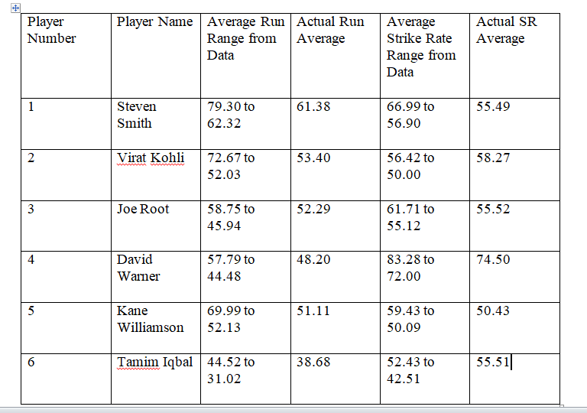

Slide 13

Any Question in your mind????

Slide 14


Thank you all for being with us…….☺

