Slide 1
Predictive Modelling using Different Algorithm of Data Mining

Slide 2
Participants
- Kazi Arafat Hossain 2014-1-60-046
- Sheikh Tahsin Shahriar 2014-3-60-002
- Alinur Hossain Alip 2014-3-60-

Slide 3
About Our Datasets
We use 3 datasets to for our work.
- We’ve applied Naïve Bayes and Decision tree algorithm to Blood datasets.
- We used SVM to muffin-cup cake datasets.
- We used Apriori algorithm to shoplist datasets.

Slide 4
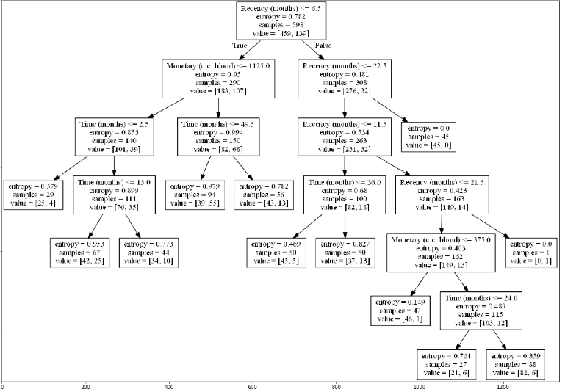
Decision Tree

Slide 5
Decision Tree Vs. Naïve Bayes

Slide 6
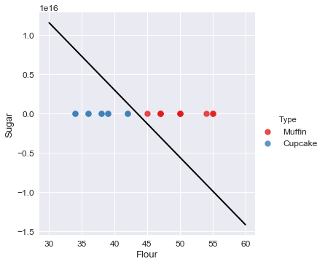
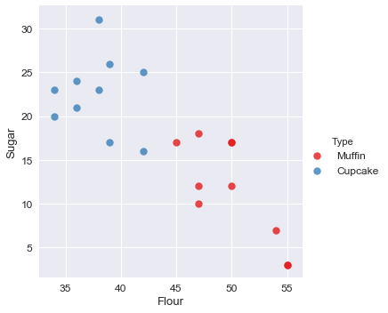
SVM

Slide 7
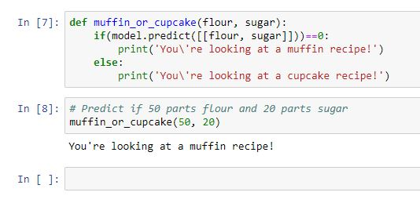
SVM Prediction

Slide 8
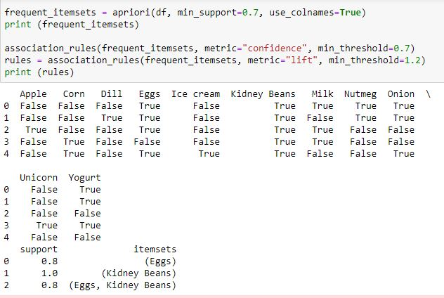
Apriori Algorithm

Slide 9
THANK YOU

