Slide 1


Slide 2

Bangladesh Army University Of Science And Technology, BAUST
HOME RENT PRICE
PREDICTION WEBSITE
Department | CSE
Course Code | CSE 4252
Course Title | Data Ware-housing and Data Mining Sessional
Course Credit | 3
Submitted By |  | Submitted To
Name | Id | Name of the Teacher: Md. Mamun Hossain
Fahim Adnan | 180101046
MD AL-FAYAD ADOR | 180101010 | Designation: Assistant Professor

Slide 3
TABLE OF CONTENT
Introduction.
Project Summary.
How It works?
Architecture Diagram.
Hardware & Software specification.
Pictures of the project’s practical demo.
Future Work.

Slide 4
INTRODUCTION
Problems faced during renting a house:
It’s a Stressfull thing.
Tenant are generally not aware of factors that influence the house rent.
Hence real estate agents are trusted with the communication between Tenant & Landlord , This just create a middle man and increases the cost.

Slide 5
Project Summary
Our project is a machine learning app, based on certain specifications of your home it will try to guess the most accurate price.
Feature such as Location, Bedroom Number, Bathroom Number, Land Size etc.

Slide 6
How It Works
Collecting Data: First step was to collect data. We collected data from
https://www.bproperty.com .
Then preprocess the collecting data.
After preprocessing the data we trained the model using machine learning algorithm which in this case is linear regression.
Based on the generated graphs we predict the cost of the house rent.

Slide 7
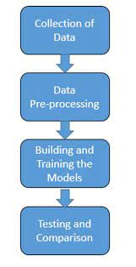
Architecture Diagram

Slide 8
Specification
Hardware | Software | Libraries
Laptop | Framework –Flask Design- Html, CSS | Numpy,Pandas,Seaborn,Matplotlib
Ram – Min 4 GB | Virtual Environment - Anaconda Navigator | BeautifulSoup,request,csv
HDD – Min 500 GB | Language – Python, Javascript | Scikit-learn
Internet – wifi, broadband | IDE - Spyder, Jupyter Notebook, VS Code | Pickle, Json

Slide 9

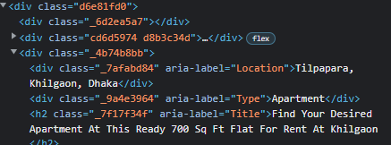
Collecting Data
URL: https://www.bproperty.com/en/dhaka/properties-for-rent
Save Those data in a datahouse.csv file in write mode.

Slide 10
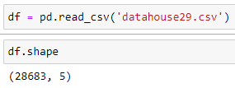
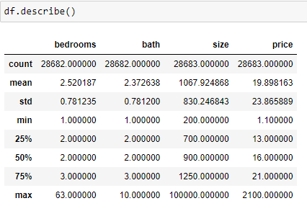
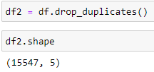
Data Preprocessing

Slide 11
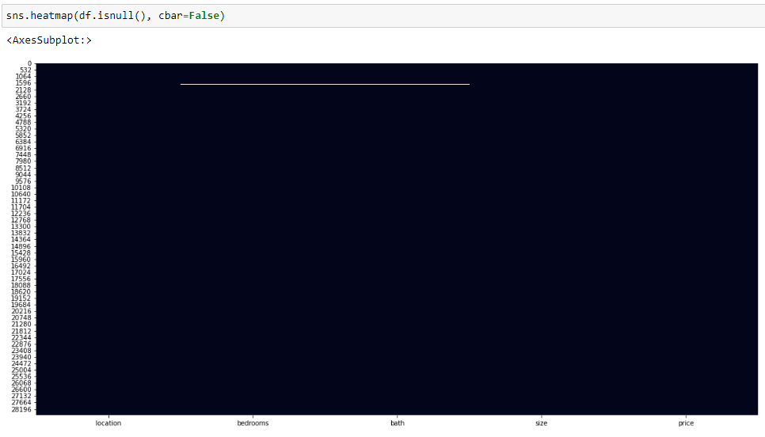
Null value In Dataset

Slide 12
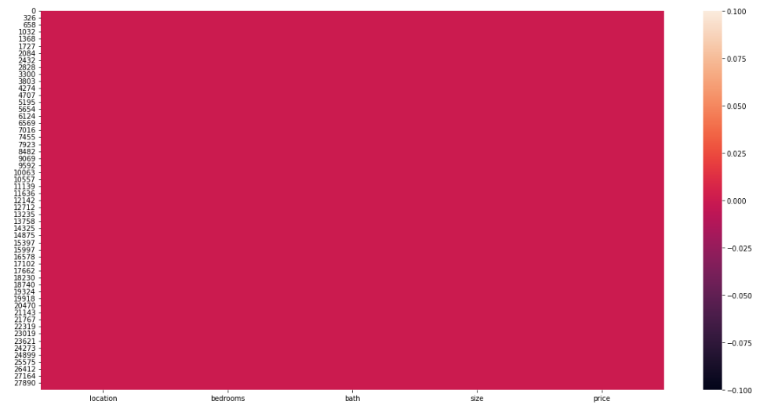
Heatmap

Slide 13
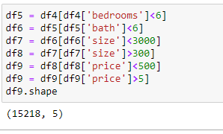
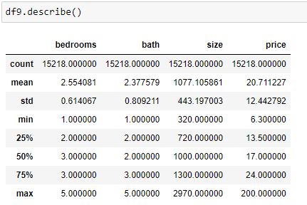
Data Cleaning & Describe

Slide 14
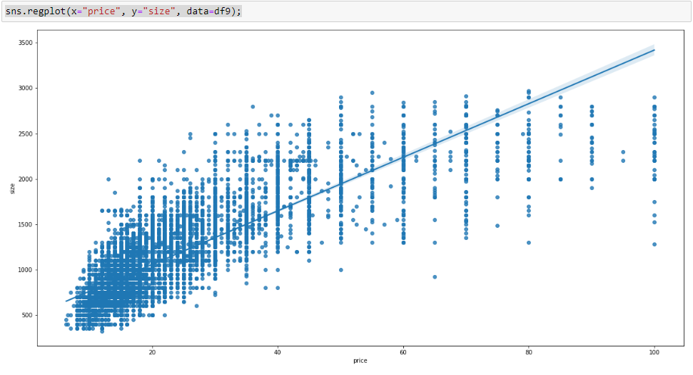
Dataset Regplot of size & price
This method is used to plot data and a linear regression model fit

Slide 15
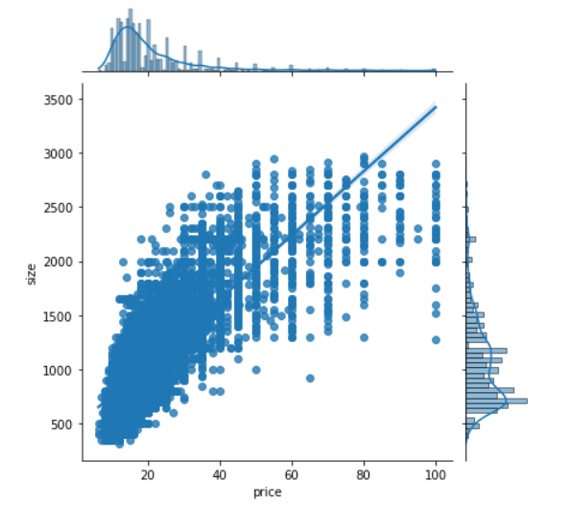
Dataset Jointplot of size & price
Jointplot displays a relationship between 2 variables (bivariate) as well as 1D profiles (univariate) in the margins.

Slide 16
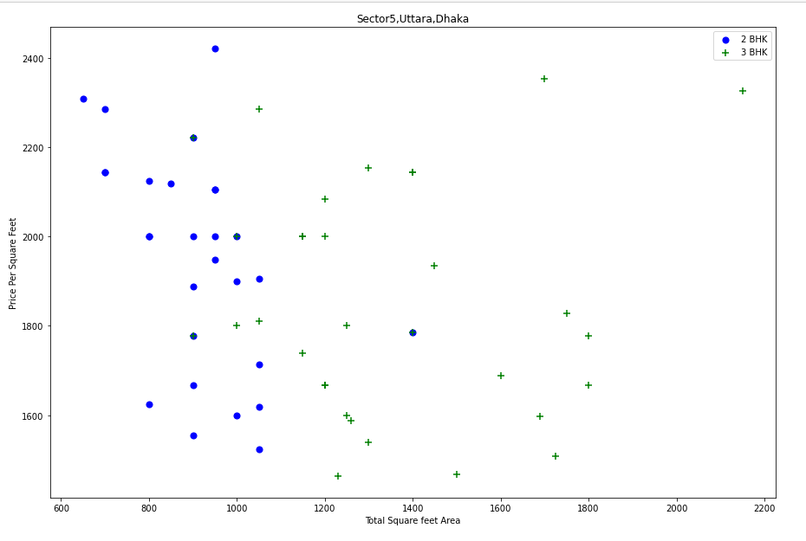
Outliers Detection & Remove

Slide 17
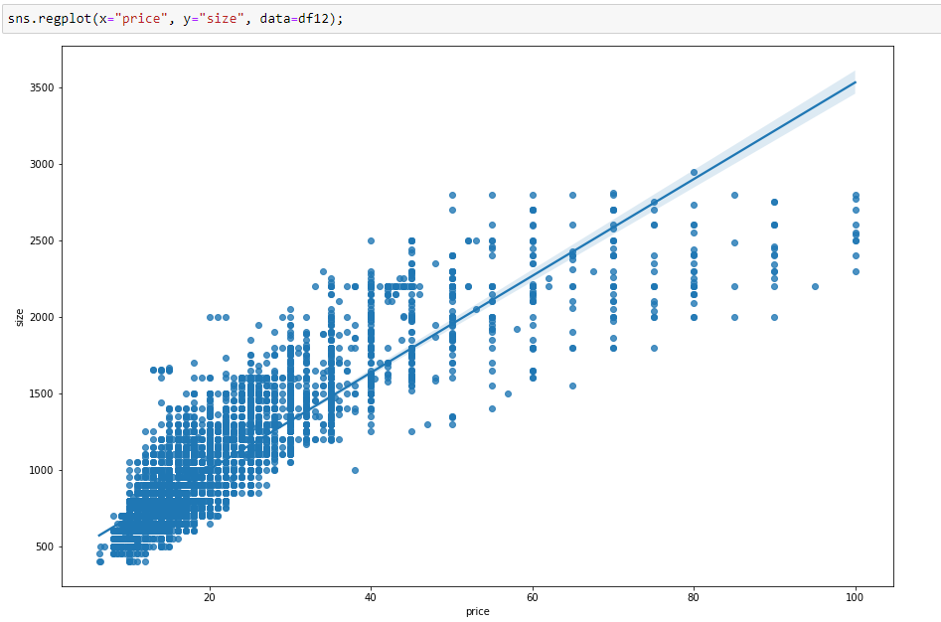
Preprocessed Dataset Regplot of size & price

Slide 18
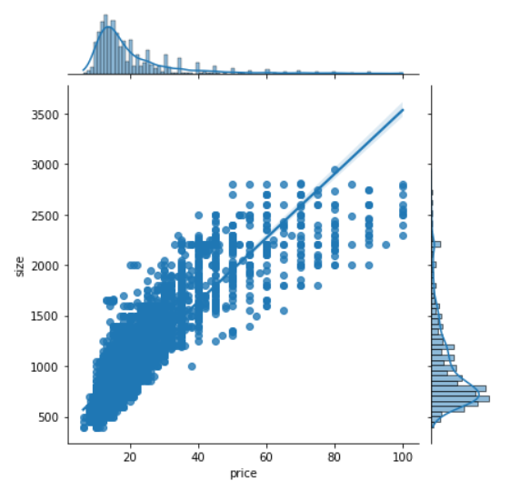
Dataset Jointplot of size & price

Slide 19
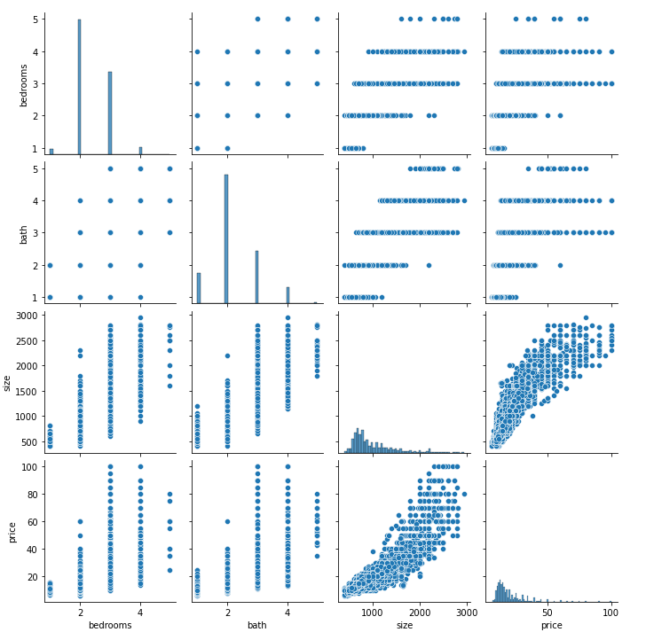
Preprocessed Dataset Pairplot

Slide 20
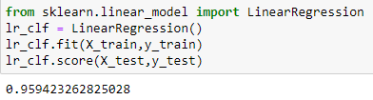

Machine Learning Models

Slide 21
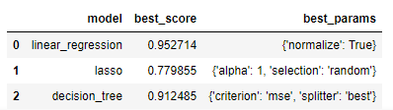
Find best model Using GridSearch
GridSearch is a tool that is used for hyperparameter tuning. As stated before, Machine Learning in practice comes down to comparing different models to each other and trying to find the best working model.
lasso (least absolute shrinkage and selection operator; also Lasso or LASSO) is a regression analysis method that performs both variable selection and regularization in order to enhance the prediction accuracy and interpretability of the resulting statistical model.

Slide 22
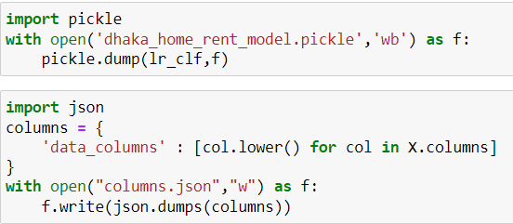
Pickle Model Build & Save Data in Json Format

Slide 23
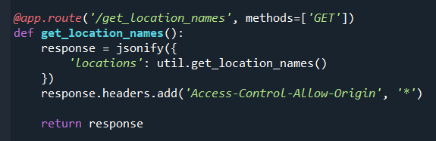
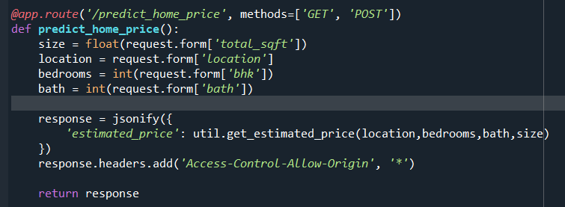
Get Location name & Predict Rent

Slide 24
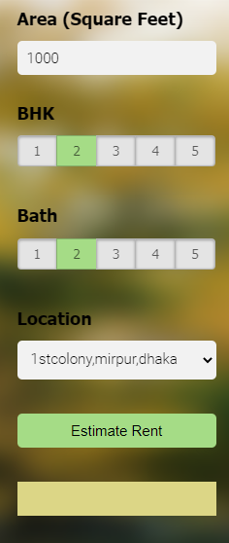
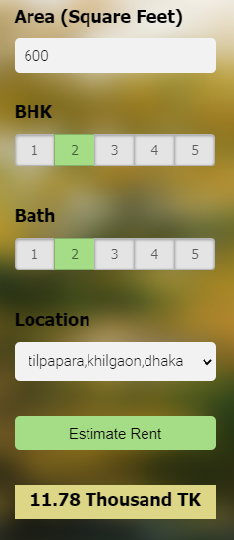
House Rent Prediction Page

Slide 25
Future Work
The future works of this project include the following:
We can add more feature in our dataset.
We can use other advanced regression techniques, like Random Forest and Bayesian Ridge Algorithm.
Since the data is highly correlated, we should try Elastic Net regression Technique.

Slide 26


