Slide 1
PRODUCTION QUALITY · THE PROBLEM
The Problem:
Identifying Production Risk Early
Large volumes of production observations meet limited inspection capacity. The difficult question is deciding which cases deserve attention before failure becomes visible.
PRODUCTION LINE QUALITY RISK ADVISOR
Notes:
Open with the operational tension: production creates many observations, but inspection time is limited. The project focuses on finding the high-risk cases early enough to support focused investigation.

Slide 2
OUR SOLUTION
Turn production data into a ranked inspection queue.
From raw observations to explainable candidates
Assess
Prioritize
Explain
Support
Estimate machine-failure risk from production variables.
Rank observations around available inspection capacity K.
Show the factors behind each risk assessment.
Give engineers a focused set of cases to investigate.
Production Line Quality Risk Advisor combines machine-learning risk assessment with decision support.
Notes:
The solution is not automatic machine control. It is a decision-support workflow that turns production observations into prioritized, explainable inspection candidates.

Slide 3
SYSTEM ARCHITECTURE & WORKFLOW
Two lanes connect model development to the engineer’s view
TRAINING & EVALUATION LANE
USER-FACING PREDICTION LANE
AI4I 2020
Preprocess
New observation
Prediction
10,000 synthetic observations
Clean and prepare variables
Current production conditions
Estimate failure risk
Analyze
Features
Prioritize
Explain
Explore patterns and failure modes
Prepare model inputs
Surface the highest-risk cases
SHAP and feature importance
Models
Evaluate
Dashboard
Compare multiple algorithms
Cross-validation, confusion matrix, precision-recall, Precision@K
Streamlit view for exploration
Risk policy
Connect scores to inspection capacity K
Notes:
Emphasize the separation. Training and evaluation establish model behavior. The user-facing lane applies the prepared workflow to observations, prioritizes cases, explains the result, and delivers it through Streamlit.

Slide 4
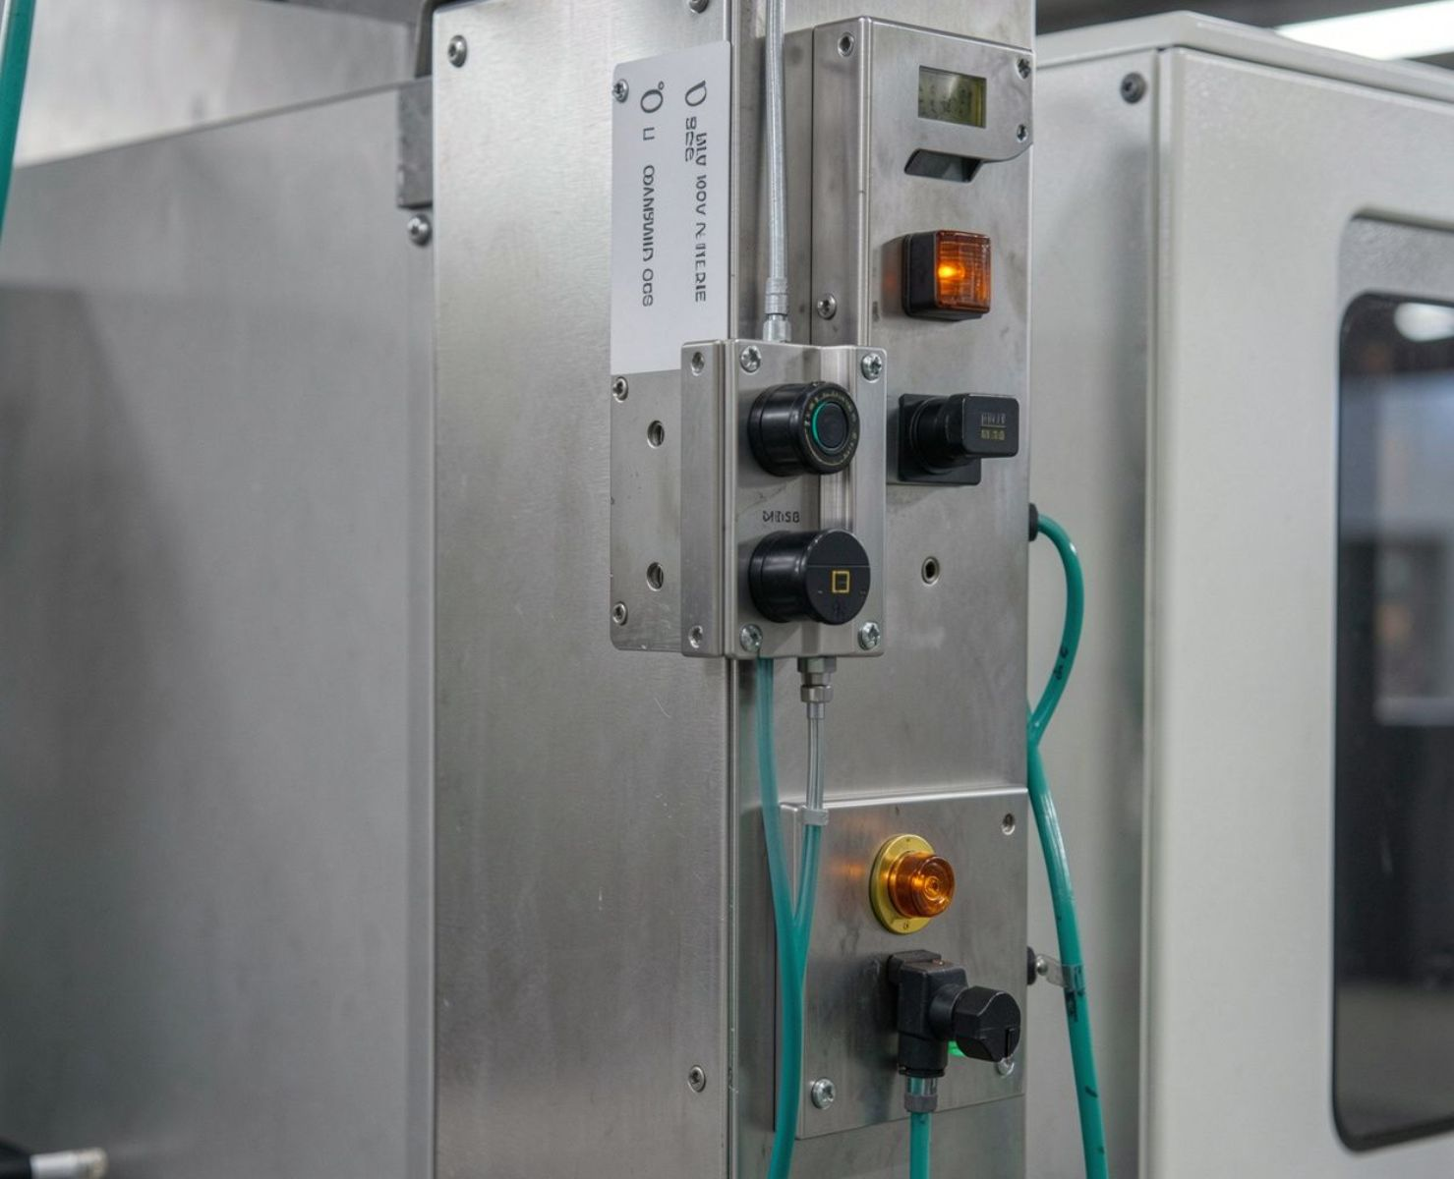
DATASET & TECHNOLOGY STACK
A focused dataset, a practical analytics stack
AI4I 2020 is synthetic, with 10,000 observations and a binary Machine Failure target.
Source: UCI Machine Learning Repository.
Production variables: Product type · air temperature · process temperature · rotational speed · torque · tool wear
Programming & machine learning
Processing, statistics & explainability
Visualization, dashboard & documentation
Python · Logistic Regression · Decision Tree · Random Forest / Bagging · AdaBoost · SVM
Preprocessing, analysis, cross-validation, confusion matrix, precision-recall · SHAP · feature importance
Interactive analytics · Streamlit · project documentation
Notes:
Introduce the dataset as a consistent project foundation, then connect each technology choice to the workflow: modeling, evaluation, explanation, visualization, dashboarding, and documentation.

Slide 5
THE DIFFERENCE
Prediction is the starting point. Inspection priority is the decision.
CONVENTIONAL PREDICTIVE MODEL
Optimize the prediction task
Predict a binary Machine Failure outcome.
Report model performance through standard metrics.
Focus on whether the prediction is correct.
Leave inspection selection outside the model view.
Which observations should we inspect first, and why?
PRODUCTION LINE QUALITY RISK ADVISOR
Connect risk to action
Prioritize cases around inspection capacity K.
Use Precision@K alongside cross-validation and precision-recall.
Include statistics, baselines, and model comparisons.
Use SHAP and feature importance to support explanation.
Enable interactive exploration through Streamlit.
Notes:
Be precise about the claim. The project does not claim universal accuracy gains. Its difference is that it evaluates and presents predictions in the context of limited inspection capacity, explanation, baselines, and interactive exploration.

Slide 6
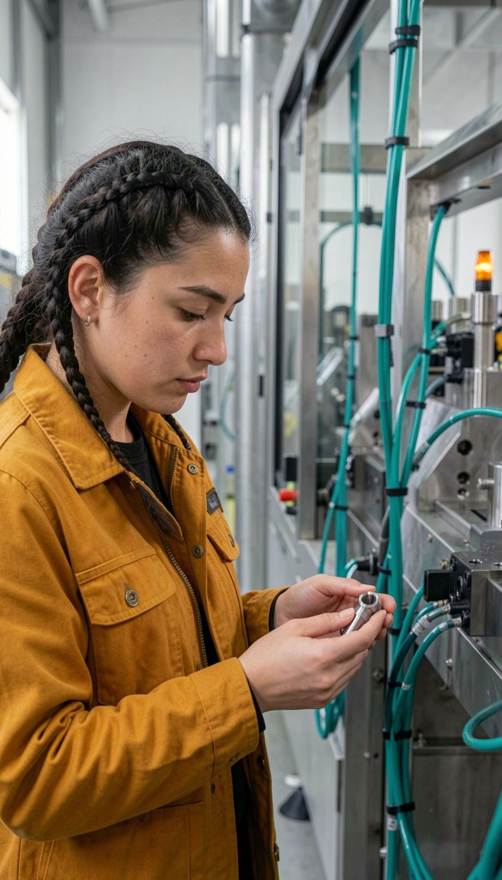
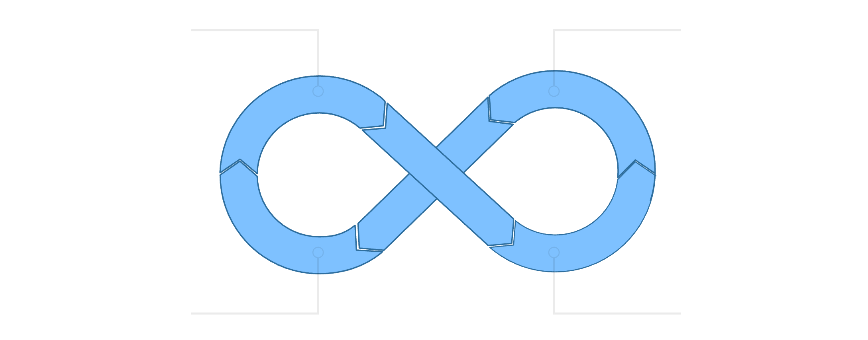

FROM PREDICTION TO ACTION
Risk becomes useful when an engineer can act on the explanation
Production Generates Observation
Model Estimates & Explains Risk
Engineer Investigates & Acts
Prioritize by Inspection Capacity
Production conditions: Observe air temperature, process temperature, speed, torque, tool wear, and product type. Risk explanation: Review the risk score and the factors highlighted by SHAP and feature importance. Focused quality action: Investigate prioritized observations within capacity K and guide the next quality decision.
Notes:
Close on the loop, not on automation. The advisor helps the engineer decide where to look first and understand why. The final action remains focused investigation and quality decision-making.

