Slide 1
DBMS
Lab 05

Slide 2
Users, Privileges, and Roles
Learn more about users
See how privileges are used to enable users to perform tasks in the database
Explore the two types of privileges: system privileges and object privileges
Learn how system privileges allow you to perform actions such as executing DDL statements
See how object privileges allow you to perform actions such as executing DML statements
Explore how to group privileges together into roles
Learn how to audit the execution of SQL statements

Slide 3
Creating a User
To create a user in the database, you use the CREATE USER statement. The simplified syntax for the CREATE USER statement is as follows:
CREATE USER user_name IDENTIFIED BY password
[DEFAULT TABLESPACE default_tablespace]
[TEMPORARY TABLESPACE temporary_tablespace];
where
user_name is the name of the database user.
password is the password for the database user.
default_tablespace is the default tablespace where database objects are stored. If you omit a default tablespace, the default SYSTEM tablespace, which always exists in a database, is used.

Slide 4
Con..
The following example connects as system and creates a user named jarir with a password of 1234:
CREATE USER jarir IDENTIFIED BY 1234;
creates a user named jarir and specifies a default and temporary tablespace:
CREATE USER jarir IDENTIFIED BY 1234 DEFAULT TABLESPACE users TEMPORARY TABLESPACE temp;
Notes:
SELECT tablespace_name FROM dba_tablespaces;

Slide 5
Changing a User’s Password
A newly created user cannot connect to the database until granted the CREATE SESSION system privilege.
GRANT CREATE SESSION TO jarir;
You can change a user’s password using the ALTER USER statement. For example, the following statement changes the password for jarir to iit123:
ALTER USER jarir IDENTIFIED BY iit123;

Slide 6
Con…
You can also change the password for the user you’re currently logged in as using the PASSWORD command.
CONNECT jarir/1234
PASSWORD
Changing password for JARIR
Old password: ******
New password: ******
Retype new password: ******
Password changed

Slide 7
Con..
You can see users list from the following command;
SQL> select * from all_users;
USERNAME USER_ID CREATED
------------------------------ ---------- ---------
IIT_USER 93 15-NOV-17
PHPHOL 92 30-SEP-17
OLI 91 10-AUG-17
BI 90 09-AUG-17
PM 89 09-AUG-17
SH 88 09-AUG-17
IX 87 09-AUG-17
OE 86 09-AUG-17
HR 85 09-AUG-17
SCOTT 84 30-MAR-10

Slide 8
Deleting a User
You delete a user using the DROP USER statement. The following example connects as system and uses DROP USER to delete jarir:
CONNECT system/password
DROP USER jarir;
Notes:
You must add the keyword CASCADE after the user’s name in the DROP
USER statement if that user’s schema contains objects such as tables.

Slide 9
System Privileges
A system privilege allows a user to perform certain actions within the database, such as executing DDL statements. For example, CREATE TABLE allows a user to create a table in their schema.

Slide 10
Granting System Privileges to a User
You use GRANT to grant a system privilege to a user. The following example grants some system privileges to jarir (assuming you’re still connected to the database as system):
GRANT CREATE SESSION, CREATE USER, CREATE TABLE TO jarir;

Slide 11
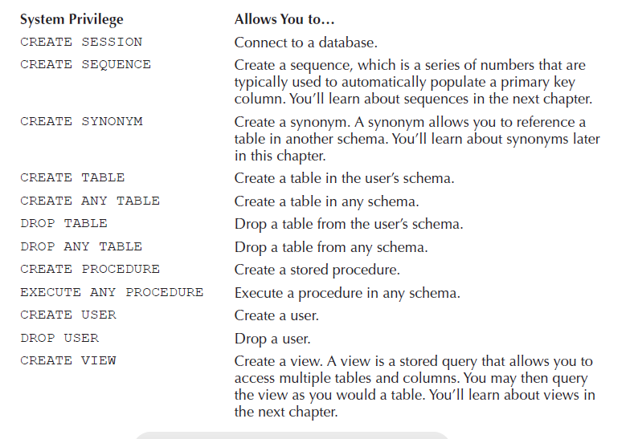
Con…

Slide 12
Checking System Privileges Granted to a User
You can check which system privileges a user has by querying user_sys_privs. describes some of the columns in user_sys_privs.
SELECT * FROM user_sys_privs ORDER BY privilege;
USERNAME PRIVILEGE ADM
------------------------------ ---------------------------------------- ---
STEVE CREATE SESSION NO
STEVE CREATE TABLE NO
STEVE CREATE USER NO
PUBLIC EXECUTE ANY PROCEDURE NO
STEVE EXECUTE ANY PROCEDURE YES

Slide 13
Making Use of System Privileges
Once a user has been granted a system privilege, they can use it to perform the specified task. For example, steve has the CREATE USER privilege, so he is able to create a user:
CONNECT steve/button
CREATE USER roy IDENTIFIED BY williams;

Slide 14
Con..
If steve were to attempt to use a system privilege he doesn’t have, the database will return the error ORA-01031: insufficient privileges. For example, steve doesn’t have the DROP USER privilege, and in the following example steve attempts to drop roy and fails:
SQL> DROP USER roy;
DROP USER roy
*
ERROR at line 1:
ORA-01031: insufficient privileges

Slide 15
Revoking System Privileges from a User
You revoke system privileges from a user using REVOKE. The following example connects as system and revokes the CREATE TABLE privilege from steve:
CONNECT system/manager
REVOKE CREATE TABLE FROM steve;

Slide 16
Object Privileges
An object privilege allows a user to perform certain actions on database objects, such as executing DML statements on tables.
Object Privilege Allows a User to…
SELECT Perform a select.
INSERT Perform an insert.
UPDATE Perform an update.
DELETE Perform a delete.
EXECUTE Execute a stored procedure.

Slide 17
Granting Object Privileges to a User
You use GRANT to grant an object privilege to a user. The following example connects as store
and grants the SELECT, INSERT, and UPDATE object privileges on the products table to steve along with the SELECT privilege on the employees table:
CONNECT store/store_password
GRANT SELECT, INSERT, UPDATE ON products TO steve;
GRANT SELECT ON employees TO steve;

Slide 18
Checking Object Privileges Made
The following example connects as store and queries user_tab_privs_made. Because there are so many rows, I’ll limit the retrieved rows to those where table_name is PRODUCTS:
CONNECT store/store_password
SELECT * FROM user_tab_privs_made
WHERE table_name = 'PRODUCTS';

