Slide 1
DBMS Lab-01
Khondokar Oliullah
JU,Bangladesh

Slide 2
What is a Database System?
Database System = Database + DBMS
A Database is
A large, integrated collection of data
Models a real-world enterprise.
Entities (e.g., students, courses)
Relationships (e.g., Mary takes CS123)
A Database Management System (DBMS) is a software package designed to store and manage databases easily and efficiently.

Slide 3
Why Use a DBMS?
Suppose we need to build a university information system. How do we
store the data? (use file structures…)
query the data? (write programs…)
Update data safely? (more programs…)
provide different views on the same data? (registrar versus students) (more prog…)
deal with crashes? (more prog…)

Slide 4
Constraints
NOT NULL
UNIQUE
DEFAULT
CHECK-used for specifying range of values for a particular column of a table.
Key Constraints – PRIMARY KEY, FOREIGN KEY
Domain constraints
Mapping constraints

Slide 5
Keys in DBMS
Primary Key – A primary is a column or set of columns in a table that uniquely identifies tuples (rows) in that table.
Super Key – A super key is a set of one of more columns (attributes) to uniquely identify rows in a table.
Candidate Key – A super key with no redundant attribute is known as candidate key
Alternate Key – Out of all candidate keys, only one gets selected as primary key, remaining keys are known as alternate or secondary keys.
Composite Key – A key that consists of more than one attribute to uniquely identify rows (also known as records & tuples) in a table is called composite key.
Foreign Key – Foreign keys are the columns of a table that points to the primary key of another table. They act as a cross-reference between tables.

Slide 6
Oracle Structured Query Language (SQL)
Structured Query Language (SQL) is the set of statements with which all programs and users access data in an Oracle database.
SQL provides statements for a variety of tasks, including:
Querying data
Inserting, updating, and deleting rows in a table
Creating, replacing, altering, and dropping objects
Controlling access to the database and its objects
Guaranteeing database consistency and integrity

Slide 7
MS Access vs MySql vs Oracle
 | MS Access | MySql | Oracle SQL
Description | Microsoft Access combines a backend RDBMS (JET / ACE Engine) with a GUI frontend for data manipulation and queries. | Widely used open source RDBMS | Widely used RDBMS
DB Engines Ranking | Score 126.13 | Score 1349.11 | Score 1374.88
Implementation Language | C++ | C & C++ | C & C++
Server operating systems | Windows | Linux OS X Windows etc | Linux OS X Windows etc
Replication Method | N0 | Yes | Yes

Slide 8
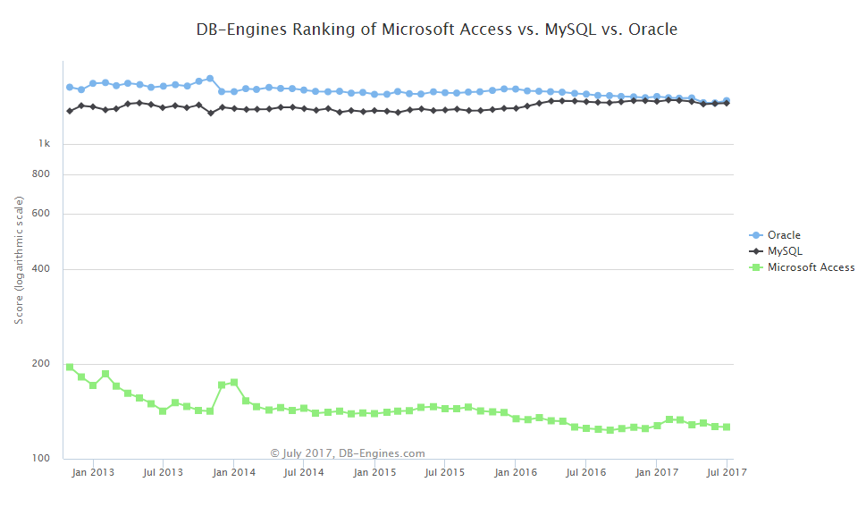
Continue

Slide 9
Database Language
Data Definition Language (DDL). Used to define & change database schemas.
Storage Definition Language (SDL). Specify the physical schema.
View Definition Language (VDL). Used to represent information to users.
Data Manipulation Language (DML). Used to query & update data.

Slide 10
DDL Commands
Create
Drop
Alter
Rename
Truncate

Slide 11
Data Type
CHARACTER [(length)] or CHAR [(length)]
VARCHAR (length)
BOOLEAN
SMALLINT
INTEGER or INT
DECIMAL [(p[,s])] or DEC [(p[,s])]
NUMERIC [(p[,s])]
REAL
FLOAT(p)
DOUBLE PRECISION
DATE
TIME
TIMESTAMP

Slide 12
SQL SELECT Overview
SELECT
[DISTINCT | ALL] <column-list>
FROM <table-names>
[WHERE <condition>]
[ORDER BY <column-list>]
[GROUP BY <column-list>]
[HAVING <condition>]
([]- optional, | - or)

Slide 13
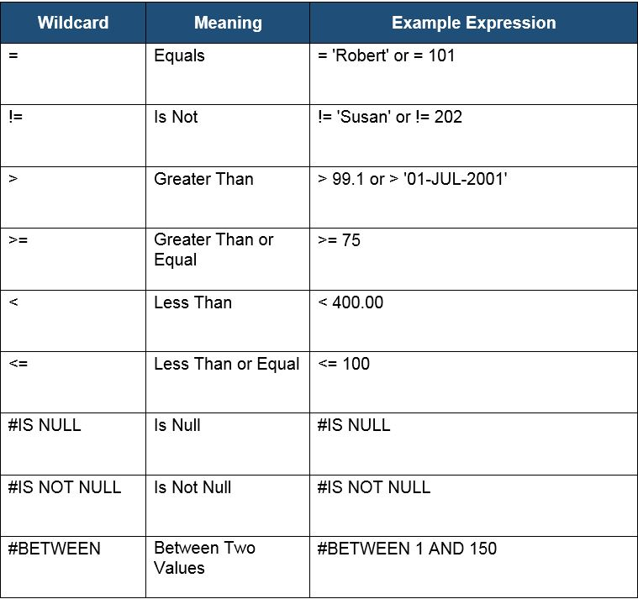
operators

