Slide 1
Android Application for Bangladesh Tourism
An App developed by Khondokar Oliullah

Slide 2
Why developed this app
For the advancement of our country, tourism is a sector of great interest and potential.
Despite the fact that Bangladesh is a land of natural beauty, our tourism infrastructure is considerably poor.
This deficiency is creating a great amount of obstacle for the tourism development of our country.

Slide 3
Why developed this app
No enhanced tourism website or apps are available here.
Hand held devices(smartphone, tab etc) are available to most of the people over the world.
Smartphone users are increasing day by day over the world.

Slide 4
Why developed this app
The number of smartphone users is about 12 millions in Bangladesh.
The number of smartphone users is about 2.4 billions over the world.
So any interested person can easily know all information about bangladesh tourism sector.

Slide 5
Why developed mobile app
Low Investment & High ROI
Open Source
Easy to Integrate
Multiple Sales Channels
Easy Adoption
User Friendly

Slide 6
What technologies are used?
Android Studio
SQLite database
Ajax
Tomcat Server
XML,CSS
EMM (Enterprise Mobility Management) which allows better security.

Slide 7
Features of the app
Providing plan according to current place , choice, expenditure, time, distance etc.
It will work as hub for tour agencies, hotels and transportations.
It will suggest seasonal top places
Advertisement of the agencies.

Slide 8
Features of the app
Random 3 users will get offers.
It will also provide alarming places according to weather.
Users can comment about places.
It also inform about visa process for foreigners.

Slide 9
Features of the app
Anyone can get entrance the websites of any hotel in bangladesh.
Traveller can talk to chatbot to know everything about bangladesh tourism.
You can gather experiences about special things of bangladesh such as coastal , hill tracking , food and cultures as well as history of bangladesh.

Slide 10
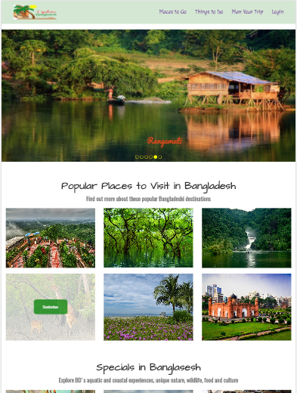
Some Screenshots of app

Slide 11
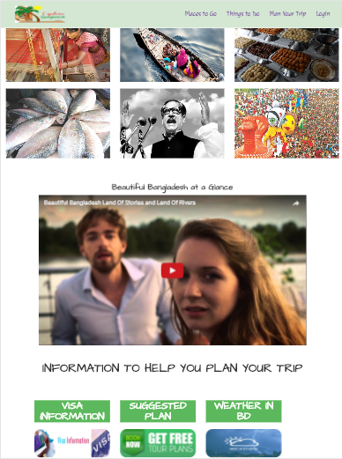
Some Screenshots of app

Slide 12
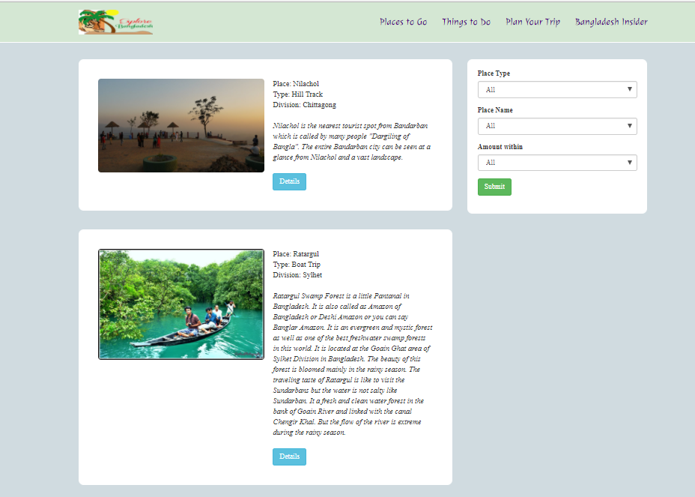
Some Screenshots of app(Searching)

Slide 13
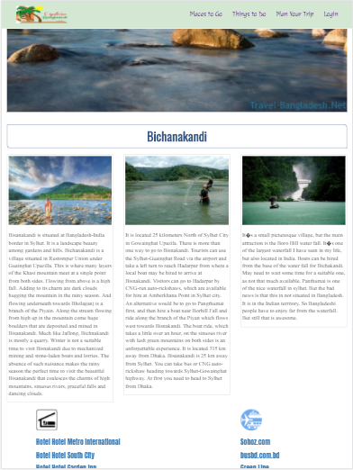
Some Screenshots of app(Place)

Slide 14
Who can use?
Any android user can use the app via internet.
Foreigners users can use english vesion.
Bangladeshi users can use bangli version.

Slide 15
Thank You😊

