Slide 1
Design Recursive Solutions through Backtracking

Slide 2
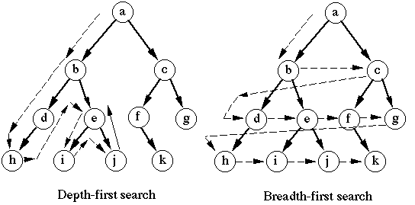
Recursion and Backtracking: DFS
Depth first search (DFS, a way to traverse a tree or graph)
Backtracking can be regarded as a generalization of DFS

Slide 3
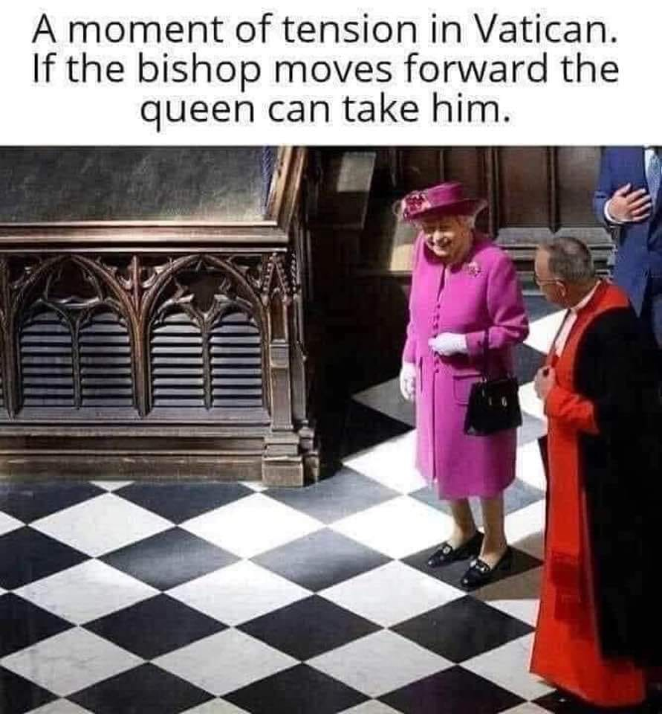

Slide 4
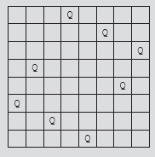
Recursion & Backtracking: 8-Queens Puzzle
8-queens puzzle
  Place 8 queens on a chess-board
    No two queens can attack each other
  Non-attacking queens
    Can not be in same row, same column, same diagonals
FIGURE 6-11 A working solution to the 8-queens puzzle

Slide 5
8-Queens Puzzle (cont’d.)
Backtracking algorithm
  Find problem solutions by constructing partial solutions
  Ensures partial solution does not violate requirements
  Extends partial solution toward completion
  If partial solution does not lead to a solution (dead end)
    Algorithm backs up
    Removes most recently added part
    Tries other possibilities

Slide 6
8-Queens Puzzle (cont’d.)
No two queens on the same row
  Solution: let first queen takes the row 1, second queen takes row 2… k-th queen takes k-th row.
No two queens on the same column
  Solution: check their column numbers, making sure they are not the same
No two queens on the same diagonal
  Solution: need to figure it out…

Slide 7
8-Queens Puzzle (cont’d.)
n-Queens Puzzle
  In backtracking, solution represented as
    n-tuple (x₁, x₂, . . ., x_{n})
    Where x_{i} is an integer such that 1 <= x_{i} <= n
    x_{i} specifies column number, where to place the ith queen in the ith row
  Solution example for Figure 6-11
    (4, 6, 8, 2, 7, 1, 3, 5)
    Number of 8-tuple representing a solution: 8!

Slide 8
4, 6, 8, 2, 7, 1, 3, 5
 |  |  | x
 |  |  |  |  | x
 |  |  |  |  |  |  | x
 | x
 |  |  |  |  |  | x
x
 |  | x
 |  |  |  | x

Slide 9
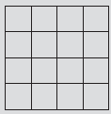


4-Queens Puzzle
n-Queens Puzzle (cont’d.)
  4-queens puzzle
FIGURE 6-13 Finding a solution to the 4-queens puzzle
FIGURE 6-14 A solution to the 4-queens puzzle

Slide 10
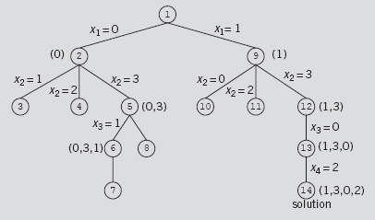
4-Queens Puzzle
Backtracking and the 4-Queens Puzzle
  Rows and columns numbered 0 to 3 (start at 0)
  Backtracking algorithm can be represented by a tree

Slide 11
Ensure the constraints: no two Queens
are not on the same row
  Solution: 1st queen puts onto 1st row; 2nd queen puts onto 2nd row; … k-th queen puts onto k-th row.
are not in the same column
  Queens (i, j) and (k, l): j and l can not be same
are not on the same diagonal…
  How to ensure this?

Slide 12

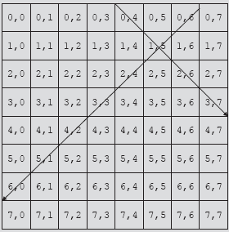
8-Queens Puzzle (cont’d.)
8-Queens Puzzle (cont’d.)
Same diagonal: row & column change at the same rate
|j – l| = |i – k|
FIGURE 6-16 8 x 8 square board

Slide 13
8-Queens Puzzle (cont’d.)
8-Queens Puzzle
  Determine if two queens on same diagonal
    Given queen at position (i, j), (row i and column j ), and another queen at position (k, l) , (row k and column l)
    Two queens on the same diagonal if |j – l| = |i – k|, where |j – l| is the absolute value of j – l and so on
  Solution represented as an 8-tuple
    Use the array queensInRow of size 8
    Where queensInRow[k] specifies column position of the kth queen in row k

Slide 14
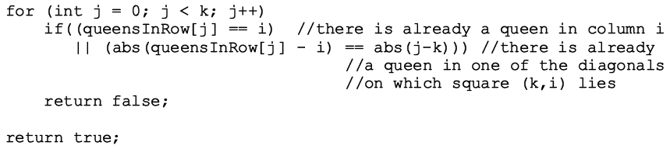
Can we put the k-th queen in i-th column?
Can we put the k-th queen in i-th column?
  canPlaceQueen(k, i)
Same column? then NO
Check the first k - 1 queens
Same diagonal? Then NO
Otherwise, YES

Slide 15
Recursion and Backtracking:
Depth first search
In 4-queen problem, each step, there are up to 4 choices to choose from.
In 8-queen problem, there are up to 8 choices each step.
  The search space is a 8-degree tree
Backtracking
  You should go deep, and if it doesn’t work out at certain step, trace back, cancel last decision, and then try a different one.

Slide 16
nQueenPuzzle: C++ implementation

Slide 17
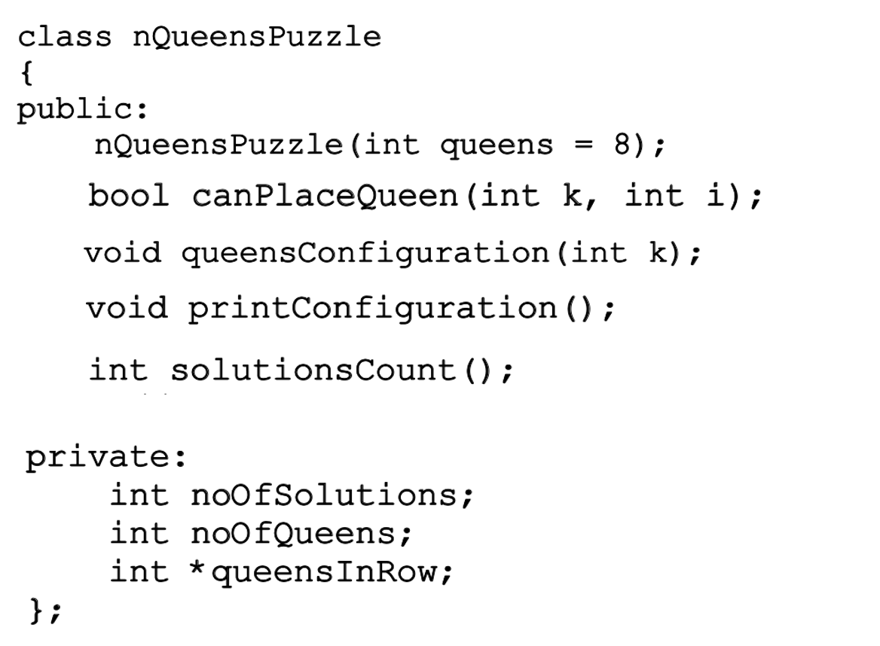
nQueenPuzzle: C++ implementation
Default value: 8
The column assignments;
Shared by recursive calls

Slide 18
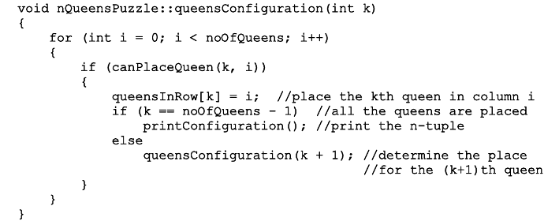
Solution: queensConfiguration(int k)
Backtracking will be taken care of by the recursion.
k: index of queen
i: column
k starts with 0
8 columns, 8 choices, 8 children
If you can NOT put the queen here, skip this choice
Otherwise, place the queen here, move on to next row (queen)

Slide 19
Question: where is the backtracking?
More specifically, in backtracking, we need to cancel the last decision.
  Where does it happen in this program?
  Answer: we’re doing this in an implicit way
    for a given column assignment i, if it doesn’t work out, it will be discarded & replaced by the next column number i + 1.
      the branch started at i no longer matters
    Also, we only look at the previous k queens; assignments beyond the current queen/row do not affect our decisions -- so, we don’t have to cancel/erase them.

Slide 20
Some thoughts
If we just want to find “one” solution, as fast as we can, what strategy (called a heuristic) should we take?
  For example, if there is an available spot in a crowded area and anther spot in a sparse area, which one should you take?

Slide 21
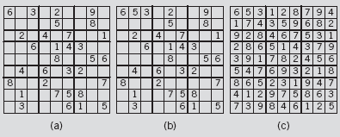
Sudoku through Backtracking
Recursive algorithm
  Start at first row and find empty slot
  Find first number to place in this slot
  Find next empty slot, try to place a number in that slot
  Backtrack if necessary; place different number
  No solution if no number can be placed in slot
FIGURE 6-17 Sudoku problem and its solution

Slide 22
Sudoku code: on page 384
General algorithm in pseudocode
  Find the position of the first empty slot in the partially filled grid
  If the grid has no empty slots (filled up already), return true and print the solution
  Suppose the variables row and col specify the position of the empty grid position

Slide 23
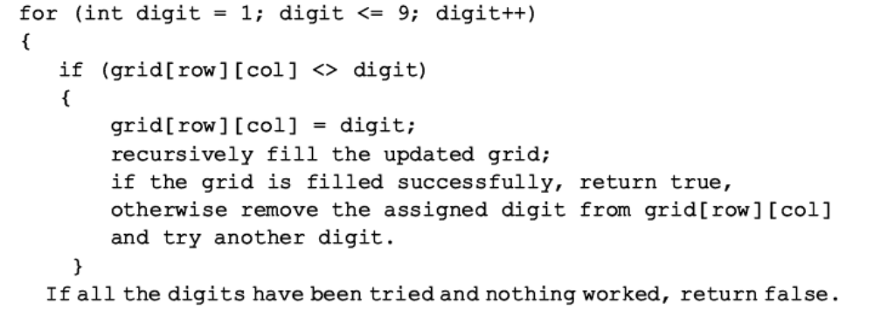
Sudoku: pseudocode
Digit: 1-9
<> digit: not filled yet. Use 0

Slide 24
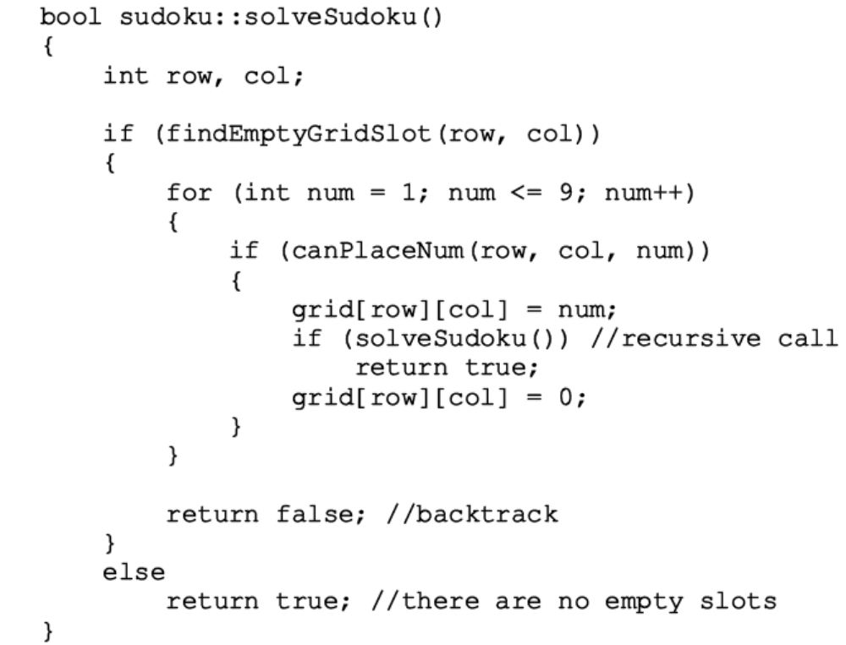
Sudoku (cont’d.)
Function definition
Try all positions
Try all digits, one by one
Legal to put this digit here? Yes, then do it and move on to next
The last assignment doesn’t work; Put the digit back to 0 (unfilled); backtrack

Slide 25
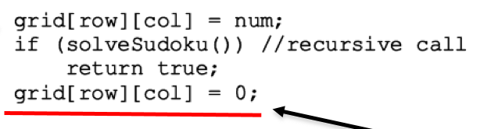
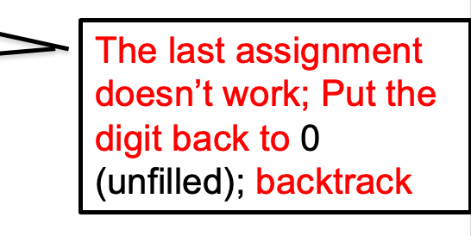
Backtracking in Sudoku
It should be noted that backtracking (i.e., canceling the last decision) is carried out explicitly in this program.
  Why do we have to do this?

Slide 26
Summary
Recursion
  Solve problem by reducing it to smaller versions of itself
Recursive algorithms implemented using recursive functions
  Direct, indirect, and infinite recursion
Many problems solved using recursive algorithms
Choosing between recursion and iteration
  Nature of solution; efficiency requirements
Backtracking
  Problem solving; iterative design technique

