Slide 1

Task Management App
Olive McKenzie

Slide 2
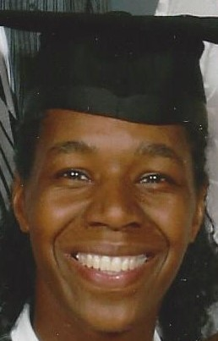
About Me Background
Degree: Computer Science University Wales of Aberystwyth
Masters: Information Technology University of Liverpool
Diploma: Data Birmingham University bootcamp
Presently Learning Web Development with Niyo bootcamp.
Work Experience 10 years in Tech in the areas of
Telecommunications
Vision Science
Computer Networks
Support and Database Consultancy
At present I am re-entering the Tech after a career break caring for elderly parents
Olive McKenzie

Slide 3
Motivation
I took computer studies at school and college as a teenager and was fascinated with coding and engineering. I found the field very interesting with no space for boredom , which I experienced in other roles, and like the fact that one must keep learning.
In my late twenties I decided to take a degree in computer science without the relevant qualifications and enjoyed the course immensely, which then inspired me to do a masters in Information Technology
The industries that really interest me are aerospace and telecommunications, however I will accept roles in other areas.

Slide 4
Knowledge Gained
Knowledge Gained
JavaScript
HTML
Node.js
React
I have enjoyed learning React the most because of its fast development environment and visual facilities

Slide 5
Project Task Management App
This project was given to the web development students by North Grumman.
The technologies used are:
HTML
CSS
JavaScript
Node.js

Slide 6
Functionality
The key functionality of this app is to allow a user to input tasks into an app through a user interface
The app should allow the user to:
Add tasks
Delete Tasks
Update Tasks
Store Tasks
Retrieve Tasks
Set Priority Status
Set Progress Status
Set Deadline Date
Task Status
Not Started
In Progress
Complete
User Input:
Start Date
Deadline Date
Task Title
Task Details
Task Status
Task Priority
Task Priority
High Priority
Medium Priority
Low Priority
System does not allow user to change original task entry date.
Task Manager App Olive McKenzie Niyo Project

Slide 7
Functionality Improvements
Present system improvements necessary
System should automatically enter the date task was entered into the system
System should not allow the user to enter a date earlier than todays date.
System should allow the user to search for tasks with task names which use uses upper or lowercase characters different to those stored in the the file.

Slide 8
Recorded Demonstration of task management App

