Slide 1


Niyo Bootcamp - Web Software
Development
Task Management App
Olive McKenzie

Slide 2

About Me
Olive Mckenzie
Career Break from Software Engineering
Experience :
- Telecommunications
- Database Consultant
- Vision Science
- Computer Network
Qualifications
- BSc Computer Science University of Aberystwyth
- MSc Information Technology University of Liverpool
- University of Birmingham Data Analyst Bootcamp

Slide 3
Motivations
Tech allows me to express the many facets of my character which includes creativity, analytical, adaptability, attention to detail, a team player, curiosity, and the ability to work under pressure.
I enjoy
- solving problems
- learning new skills
- continuous learning
- change
I like wide variety of applications to which Tech is applied
Employment opportunities

Slide 4








The Bootcamp
The main technical skills learnt are :
CSS HTML 5 Bootstrap JavaScript React Nodejs JSX VSC
I enjoyed using React due the fact it facilitates fast development of applications and attractive GUIs

Slide 5

Task Management App
The Task Management App can be used by anyone for managing their everyday tasks and it was developed using the following languages, environments and file types
Node.js is a runtime environment which facilitates synchronous methods storage, deletion, retrieval and editing for task data management in its file system (fs), which is written in JavaScript and acts as the virtual server.
HTML 5(Hyper Text Markup Language) is used as the GUI for user input, delete, retrieve, and edit task data.
CSS for styling the GUI .
JavaScript to capture user data from the GUI and send it to Node.js file system
for storage , deletion, editing and retrieval of task data.
Json file format in which the task data is stored in a json file.
Visual Studio Code for code development, execution and testing app.

Slide 6
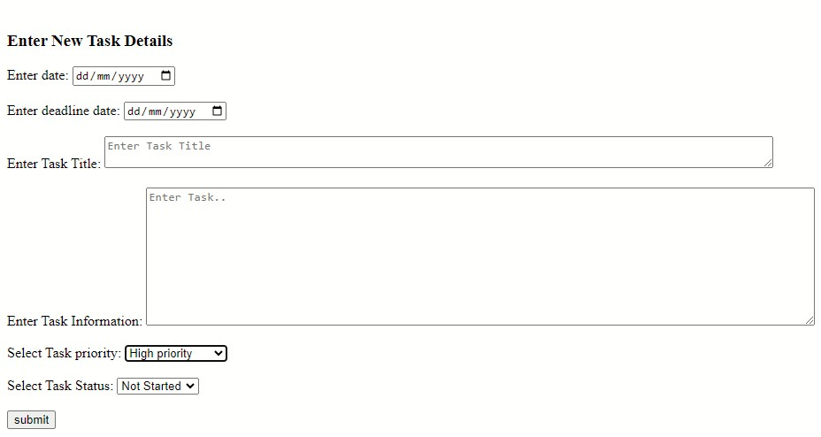
Project Requirements and Functions
The key functionality of this app is to allow a user to input a task into the app, save it to a Json file with additional functionalities for deleting, editing and finding a task.
Task Functions:
Add
Delete
Update
Store
Retrieve
Priority Status:
Low Priority
Medium Priority
High Priority
User Input:
Start Date
Deadline Date
Task Title
Task Details
Priority Status
Task Status
Task Status:
Not Started
In Progress
Completed

Slide 7
Project Demo
https://www.loom.com/share/503ddf812bc14a5dab7a10eb3a5f748a?sid=34f30a8e-65bf-4146-bdad-257b2fc5758e

Slide 8
Achievements/Future
I have learnt how to quickly grasp the concept of a computer language for swift development of applications.
The Bootcamp has opened my appetite for continuous development and improved my knowledge in some areas and in others I have acquired new knowledge.
The next step is to find employment and continue improving my skills
I am open to a wide area of fields in IT, but I do have a special interest in artificial intelligence and embedded software development.

Slide 9
Questions?
Are there any questions ?

