Slide 1

Relationships between Marriage/Birth Rates and Finance
Marlis Vignon, Kason Carter, Nyajha Olive, Jaidel Chestnut, Oluseyi Kataye
Notes:
Jai

Slide 2
Problem Statement
We investigated if there is correlation between the decline of marriage & birth rates and financial instability
Notes:
We investigated if there is correlation between the decline of marriage & birth rates and financial instability
Jai

Slide 3
Data/Analytic Questions
- Question 1: Which age group is most likely to be married ?
- Question 2: What age group has the highest income ?
- Question 3: How do the differences in income relate to marriages and birth trends?
Notes:
Jai

Slide 4
Financial Stability and Marriage Correlation
Marriage rates in the U.S. have been declining since the 1970s. In 2020, the U.S. marriage rate was about 6.1 per 1,000 people, down from 8.2 per 1,000 people in 2000.
Research shows that people with higher incomes are more likely to marry and remain married.
In 2015, 65% of adults aged 25 and older with a four-year college degree were married, compared to 55% of those with some college education and 50% of those whose highest education level was a high school diploma.
Notes:
Nya

Slide 5
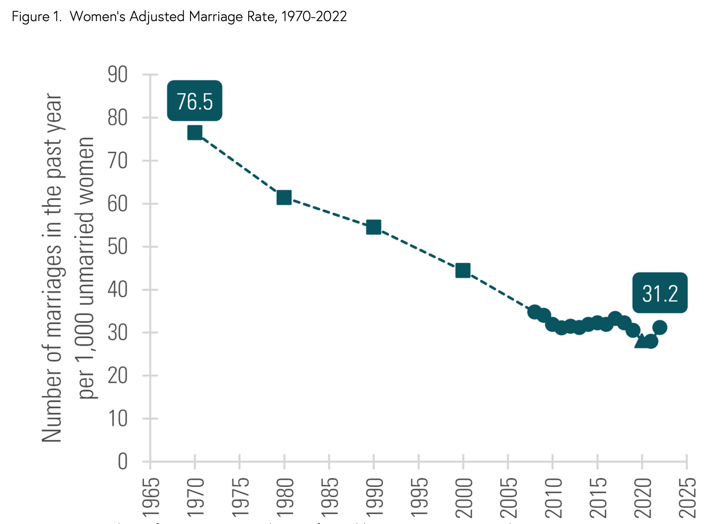
Notes:
Nya
https://www.bgsu.edu/ncfmr/resources/data/family-profiles/loo-marriage-rate-US-geographic-variation-2022-fp-23-23.html#:~:text=After%20reaching%20a%20more%20than,marriages%20per%201%2C000%20unmarried%20women.
After reaching a more than 50-year low rate in 2021 of 28.0 (i.e., 28 marriages per 1,000 unmarried women), the marriage rate trend reversed direction in 2022 increasing to 31.2 marriages per 1,000 unmarried women. The marriage rate has returned to the level observed in 2018 (Allred, 2019).
More than 2 million women (2,322,727) married in 2022, which is an increase of 269,921 women from 2021 when 2,052,806 women married.

Slide 6
Description of the ACS dataset
Data Ingestion:Public Use Microdata Sample (PUMS) from the American Community Survey (ACS) 1-Year Estimates (2022)
Name: U.S. Census Bureau, the primary federal statistical agency responsible for collecting and producing data about the U.S. population and economy.
Data source overview: The ACS is a nationwide survey that collects data on social, economic, housing, and demographic characteristics of the U.S. population. It has been conducted annually since 2005, aimed at understanding the state of the nation’s population trends.
Years of data available: 2005-2024
Instance of data source: 2022 ACS 1-Year Estimates for Vermont and 2022 1-Year Estimates for New york
Notes:
Jai

Slide 7
Specific Project Data Selection
We decided to look into the state of New York and Vermont
    Why: New York has a wide range of salary levels so the high cost of living in the city could significantly impact marriage and birth rates. New York City’s cost of living is around 87.2% higher than the national average, particularly in housing costs.
    Vermont’s combination of rural population, aging demographics, moderate income, and high living costs provides a unique environment to study how financial instability affects marriage and birth rates.Vermont’s cost of living is 16.5% higher than the national average, with higher housing and healthcare costs, though lower than New York’s costs, especially in rural areas.
For the year of data we decided to pick 2022
The year 2022 serves as an excellent choice for this project as it reflects significant socio-economic changes following the COVID-19 pandemic, which had a major effect on family finances, job situations, and household relationships. This time frame enables the examination of marriage and birth rates amid economic recovery, inflation, and changes in work environments, such as remote work, all of which have played a role in influencing personal choices regarding family planning.
Notes:
Oluseyi

Slide 8
Data features included
For our project on the Decline in Marriage and Birth Rates Due to Lack of Financial Stability here are the data features we decided to analyze
Marital Status-Current marital status (married, single, divorced)
Individual income-Average income for individuals or families
Births within the past year
Age
Notes:
Kason

Slide 9
Data Wrangling
Discovery- We will be researching and recognizing the various factors such as the varying income, ages, and how exactly that correlates to the decline in marriage and birth rates.
Cleaning- We might have to sort/discard some related data that might muddle our analysis.
Validating- Making sure the data we have and collect for Vermont is consistent and viable with our points.
We have and will be using and finding varying datasets from the ACS such as:
ACS 1-Year Estimates Public Use Microdata Sample 2022
For our research on the stats of birth and marriage rates.
Feature Engineering/Transformation- As we ran into some problems regarding many blanks and zeros in the data, we created categories for age, financial status and income out of the PUMS data categories such as AGEP - age, PINCP - income, FER - birth rates, MAR - marriage status
Notes:
Oluseyi - we used ages 18 - 60

Slide 10
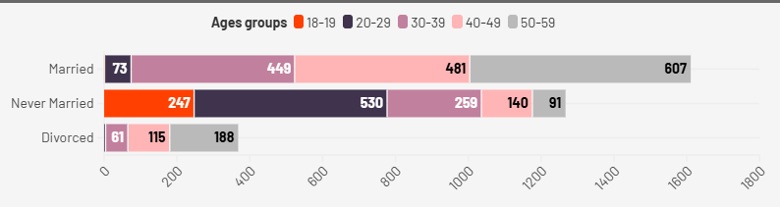
Age Groups and Marriage

Slide 11
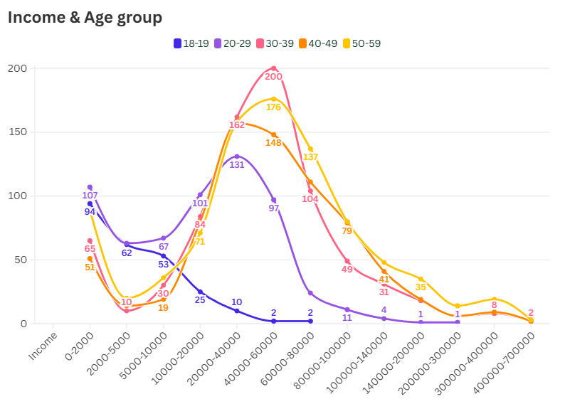
Notes:
People reach their financial peak around their 30s, and are at their lowest in their 20s

Slide 12
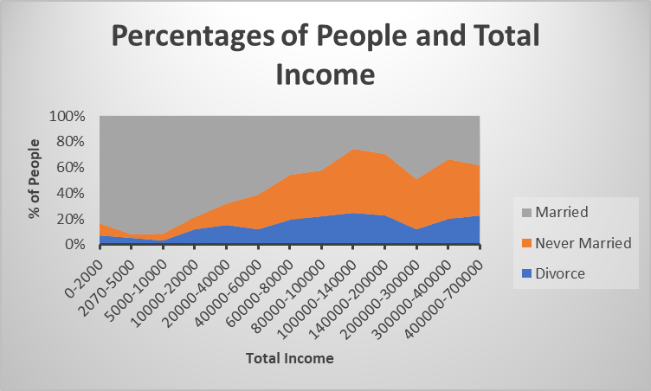

Slide 13
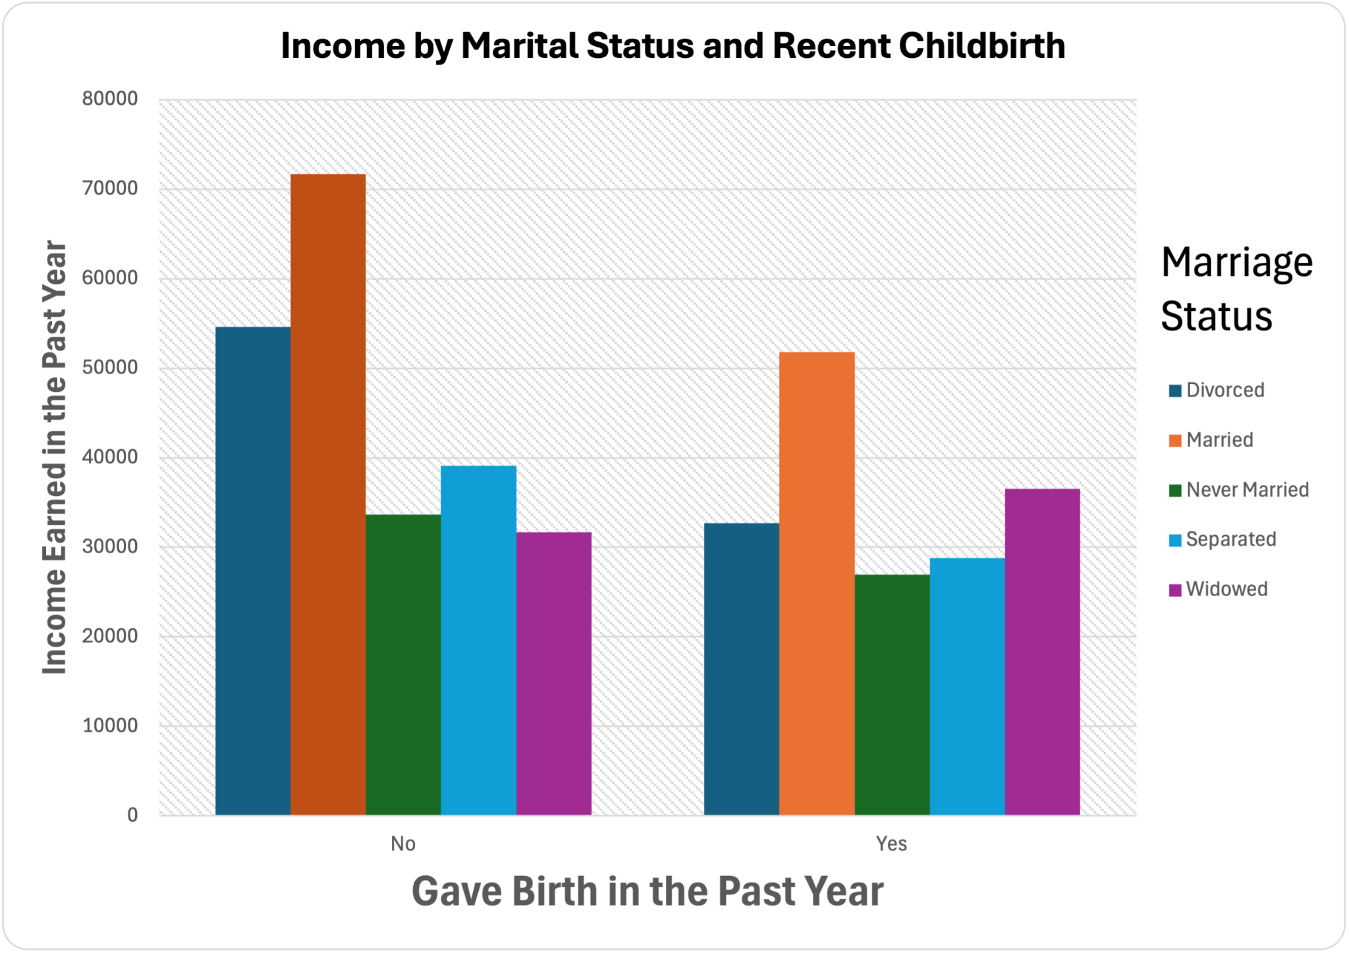
**People who are married, both those who have given birth and not, have higher amounts of income
**The amount of people who have recently gave birth have lower income
Notes:
From ages 18-50 New york data set NYA
1. Married individuals who did not give birth in the past year had the highest average income, earning approximately $70,000 compared to other marital statuses.
2. Divorced individuals who gave birth in the past year had an income of around $40,000, which is lower compared to those who did not give birth.
3. Widowed individuals had a relatively consistent income across both childbirth categories, earning around $30,000-$35,000 regardless of whether they gave birth in the past year.
4. Separated individuals who did not give birth in the past year had an income of around $40,000, while those who gave birth earned slightly less, around $35,000.
5. Never married individuals earned less overall, with income close to $40,000 regardless of childbirth status.

Slide 14
Data Insights/Challenges/Outlook
Data insights are the
Impact disparity based on marriage status and childbirth categories
Impact of childbirth on income
The financial disadvantage of being unmarried/ Those who are married have higher income
People in their 30’s are more likely to reach their financial peak in income.
Challenges would be
Missing data and categories
Correlation vs Causation
In the future we would research the role of gender and career progression in shaping the financial impact of childbirth and marriage, as well as the long-term economic effects of raising children. These insights could inform future policies aimed at reversing the decline in marriage and birth rates.

Slide 15
References
Wang, W. (2024, April 14). Chapter 1: Public Views on Marriage. Pew Research Center. https://www.pewresearch.org/social-trends/2014/09/24/chapter-1-public-views-on-marriage/
Martin, J., Hamilton, B., & Osterman, M. (2024). Births in the United States, 2023. https://doi.org/10.15620/cdc/158789
Marriages in the US are on the decline. Here’s why. (2020, February 7). World Economic Forum. https://www.weforum.org/agenda/2018/11/what-upticks-in-u-s-economic-inequality-and-incarceration-mean-for-marriage/
Mitchell, T., & Mitchell, T. (2024, April 14). 1. The landscape of marriage and cohabitation in the U.S. Pew Research Center. https://www.pewresearch.org/social-trends/2019/11/06/the-landscape-of-marriage-and-cohabitation-in-the-u-s/#:~:text=Over%20the%20past%20few%20decades%2C%20marriage%20rates%20have,these%20age%20groups%20were%2068%25%20and%2065%25%2C%20respectively.
https://www.census.gov/content/dam/Census/library/visualizations/time-series/demo/families-and-households/ms-2.pdf
https://data.census.gov/mdat/#/search?ds=ACSPUMS5Y2022&vv=AGEP(0,18:56)&cv=MAR,MARHM,FER&rv=SCHL,ucgid&nv=POBP&wt=PWGTP&g=0400000US36,50

