Slide 1

A Project on
“BizTrack - A Complete Business Accounting Management System”
For the degree of MSCSE (Professional)
Presented by:
Md. Arifur Rahman
ID: M240105042
Batch: 15th
Supervised By:
Dr. Md. Zulfiker Mahmud
Professor
Department of CSE
Jagannath University, Dhaka
Notes:
[Sources]
- BizTrack project report and author-provided presentation.
[/Sources]
Introduce BizTrack as a complete business accounting management system.

Slide 2
The real problem is "disconnected business records"
SALES
Invoice and payment
STOCK
Quantity record
Sales, stock and accounts are often kept in different books or files.
The same transaction may be entered several times.
Balances and reports become slow to prepare and may not agree.
SEPARATE RECORDS
ACCOUNTS
Journal and ledger
Repeated entry
Mismatch • Delay • Weak traceability
BizTrack • A Complete Business Accounting Management System
02
Notes:
Source: BizTrack project report prepared by the author.
Explain the problem through a familiar sale: invoice, stock reduction and accounting may be recorded separately.

Slide 3
Why BizTrack Was Needed
Introduction
Growing businesses require integrated accounting solutions.
Manual and disconnected systems reduce efficiency and increase errors.
It will reduce-
Manual bookkeeping
Separate inventory and accounting systems
Stock inconsistency
Delayed financial reporting
Human errors
Poor decision support
BizTrack • A Complete Business Accounting Management System
03
Notes:
[Sources]
- BizTrack project report and author-provided presentation.
[/Sources]
Explain how separate sales, stock and accounting records create repeated work and inconsistent balances.

Slide 4
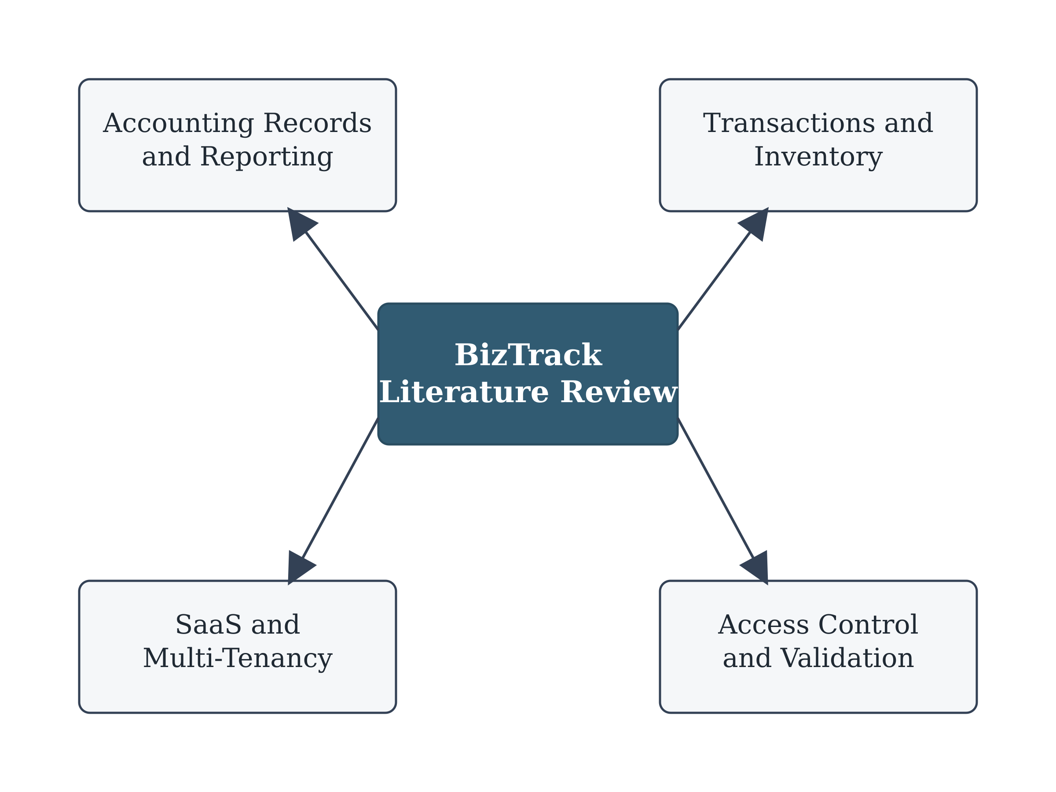
Objectives of the Project
Main Objective
Develop one web-based system that connects daily business work with double-entry accounting.
Three Broad Objectives
Build a multi-tenant SaaS platform with tenant, subscription and user access control.
Connect products, purchases, sales/POS, inventory and recipe-based manufacturing.
Link transactions with accounting and test accuracy, permissions and tenant separation.
BizTrack • A Complete Business Accounting Management System
04
Notes:
[Sources]
- BizTrack project report and author-provided presentation.
[/Sources]
Present the three broad objectives only; detailed functions appear in later slides.

Slide 5
Literature Review & Existing System Comparison
Feature | Manual | Excel | Existing POS | Proposed
Inventory | ✓ | Partial | ✓ | ✓
Manufacturing | ✗ | ✗ | Partial | ✓
Double Entry | ✗ | Partial | Partial | ✓
Financial Statements | ✗ | ✗ | Partial | ✓
Real-time Reports | ✗ | ✗ | Partial | ✓
Multi-user | ✗ | ✗ | Partial | ✓
BizTrack • A Complete Business Accounting Management System
05
Notes:
[Sources]
- BizTrack project report and author-provided presentation.
[/Sources]
Compare manual records, spreadsheets, existing POS tools and the proposed system briefly.

Slide 6
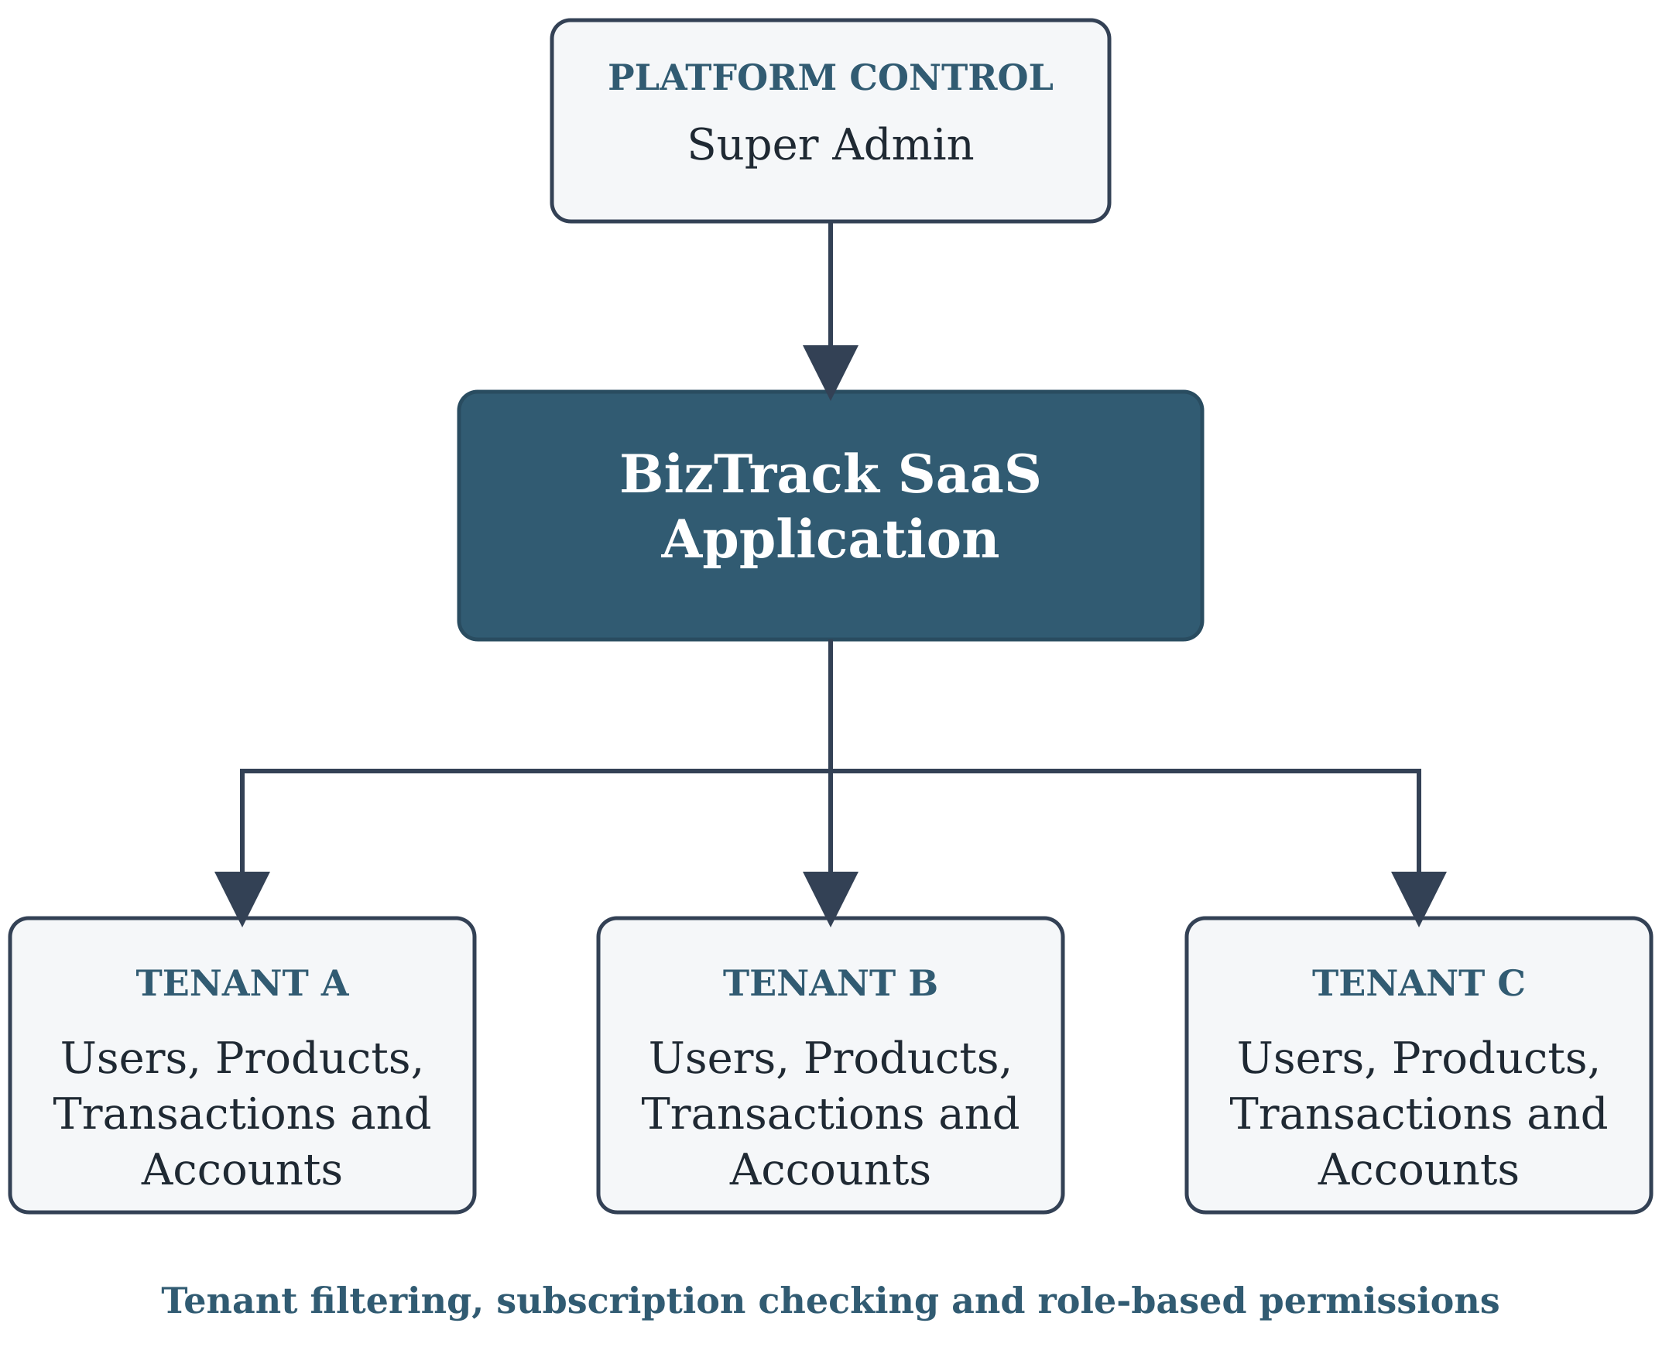
BizTrack as a Multi-Tenant SaaS Application
BizTrack • A Complete Business Accounting Management System
06
Notes:
[Sources]
- BizTrack project report and author-provided presentation.
[/Sources]
The Super Admin controls tenants and subscriptions. Each tenant keeps separate users, transactions and accounts.

Slide 7
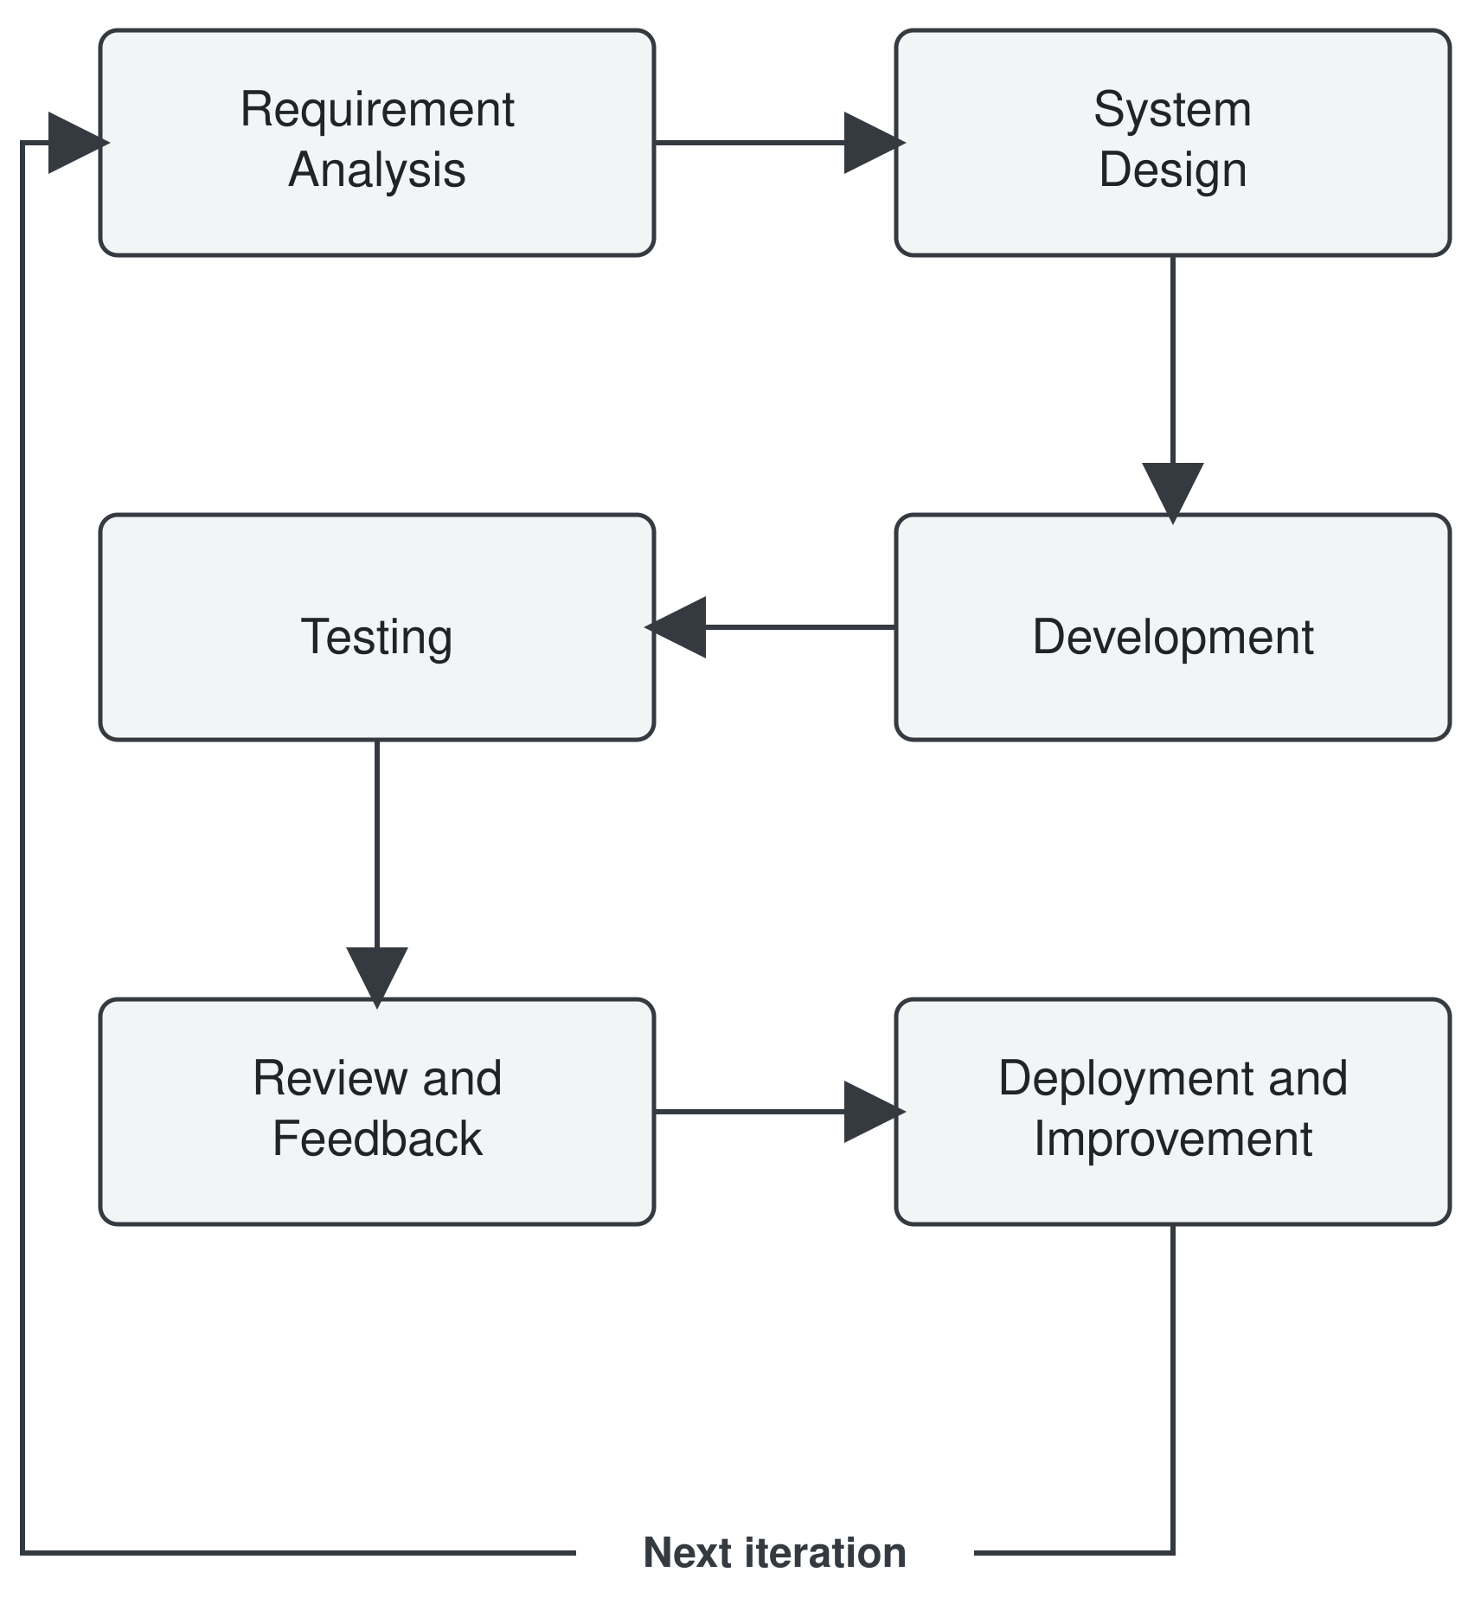
Methodology & Technology Stack
Frontend
HTML5
CSS3
Bootstrap
JavaScript
jQuery
AJAX
Backend
Laravel
PHP
Database
MySQL
Tools
Visual Studio Code, Composer, Git
BizTrack • A Complete Business Accounting Management System
07
Notes:
[Sources]
- BizTrack project report and author-provided presentation.
[/Sources]
Describe the iterative work: analyse, design, develop, test, review and improve.

Slide 8
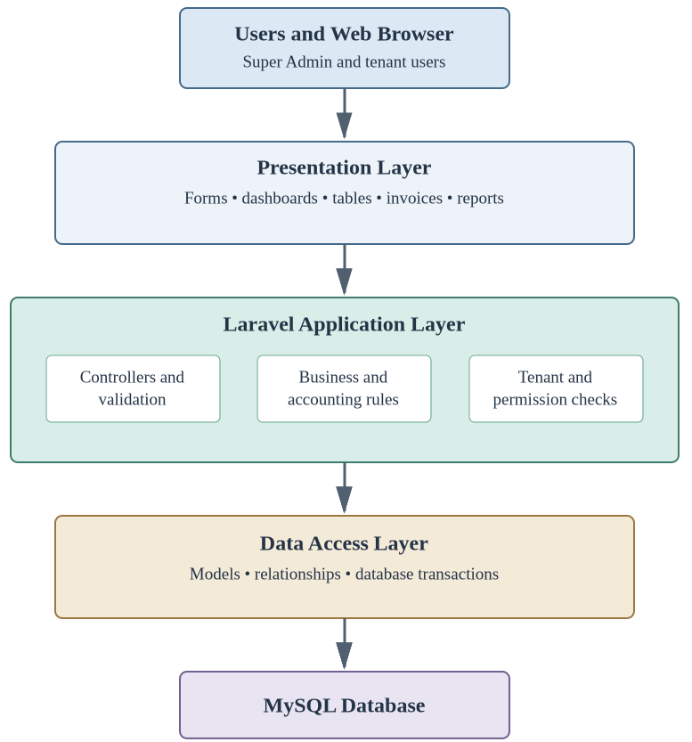
System Architecture
BizTrack • A Complete Business Accounting Management System
08
Notes:
[Sources]
- BizTrack project report and author-provided presentation.
[/Sources]
Explain the route from browser to presentation layer, Laravel application logic, data access and MySQL.

Slide 9
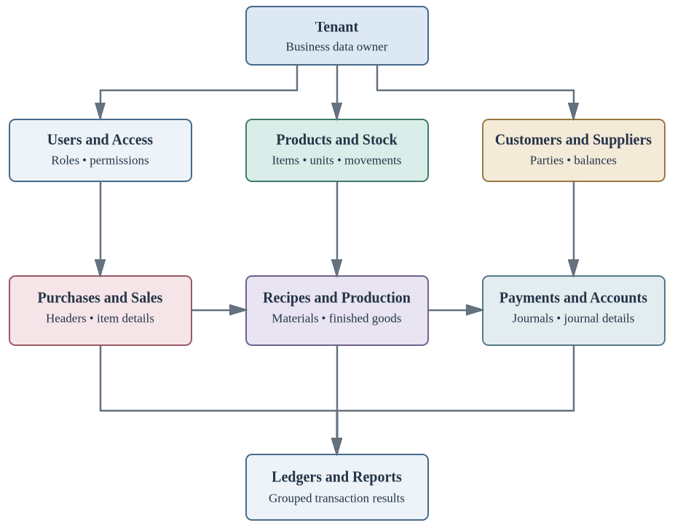
Core Modules and Their Connection
Dashboard and access
Products, purchase and sales
Stock and manufacturing
Customers and suppliers
Journals and ledgers
Trial balance and reports
BizTrack • A Complete Business Accounting Management System
09
Notes:
[Sources]
- BizTrack project report and author-provided presentation.
[/Sources]
Group the functions instead of reading every menu item.

Slide 10
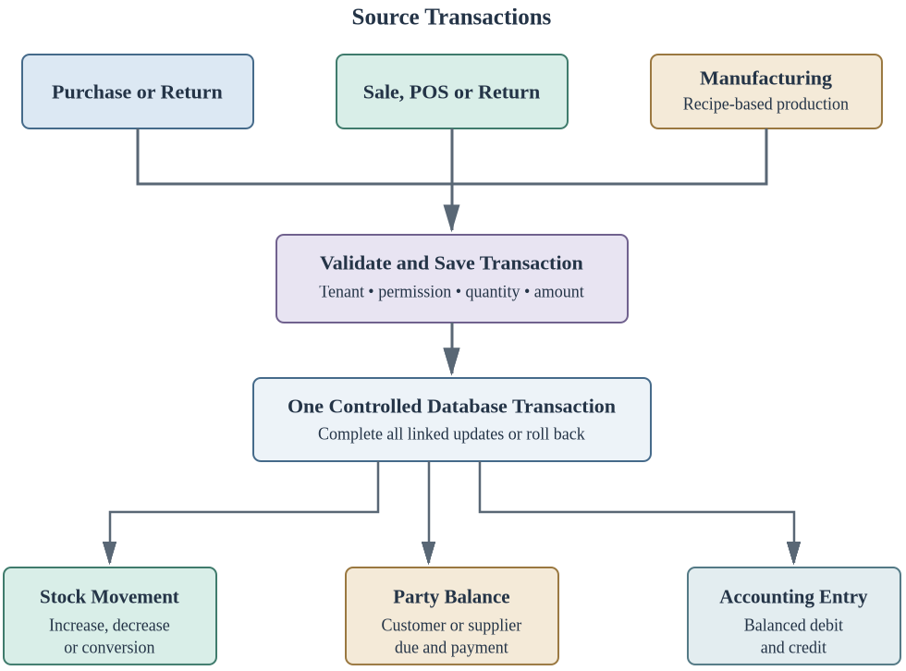
Transaction Flow
BizTrack • A Complete Business Accounting Management System
10
Notes:
[Sources]
- BizTrack project report and author-provided presentation.
[/Sources]
A saved transaction can update stock, party balance and accounting together.

Slide 11
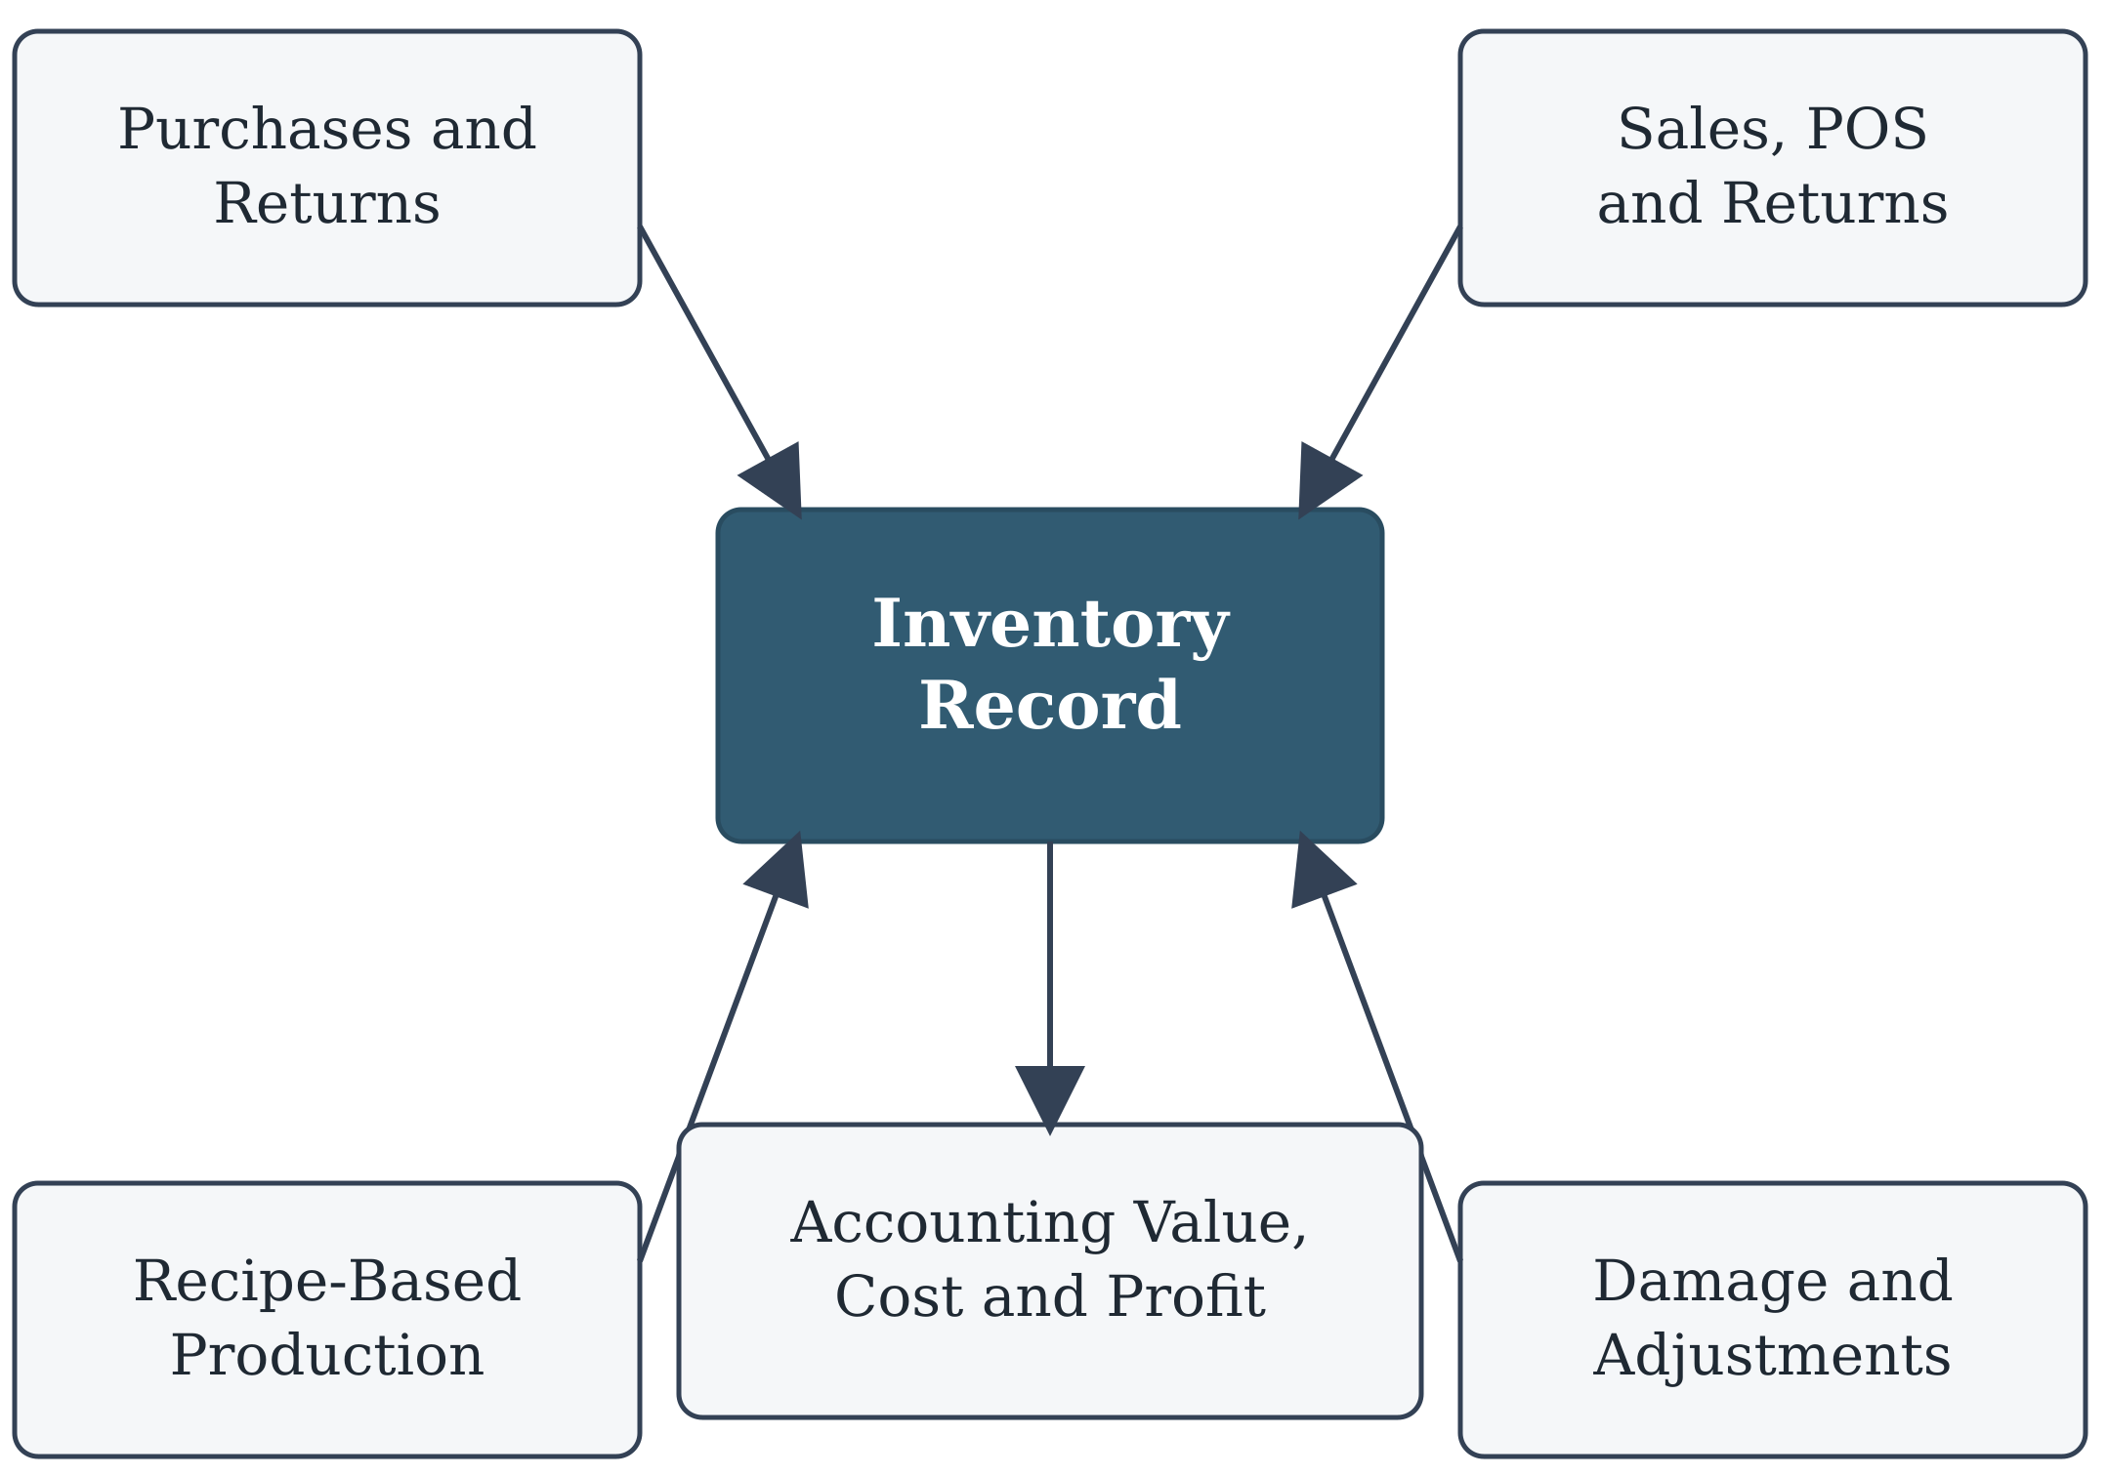
Inventory and Recipe-Based Manufacturing Flow
MATERIAL A
2 units
MATERIAL B
3 units
RECIPE +
PRODUCTION QTY
FINISHED PRODUCT
Stock added
BizTrack • A Complete Business Accounting Management System
11
Notes:
[Sources]
- BizTrack project report and author-provided presentation.
[/Sources]
Show how purchases, sales, returns, damage and recipe-based production meet in the inventory record.

Slide 12
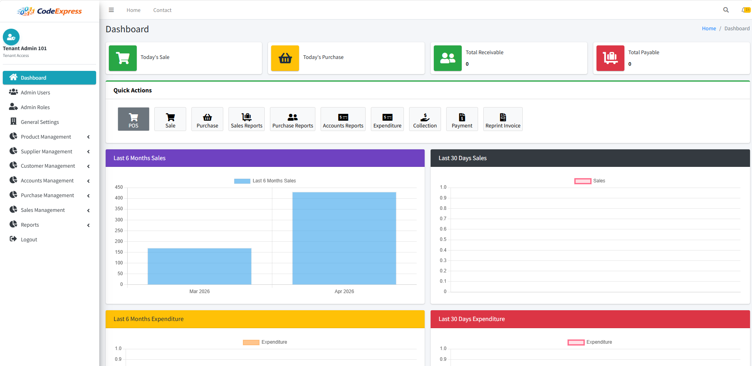
Software Screenshot: Dashboard
Key points
Business summary
Stock and party balances
Recent transactions
Useful reports or alerts
BizTrack • A Complete Business Accounting Management System
12
Notes:
[Sources]
- BizTrack project report and author-provided presentation.
[/Sources]
Replace the empty frame with the real dashboard screenshot. Explain only the listed evidence.

Slide 13
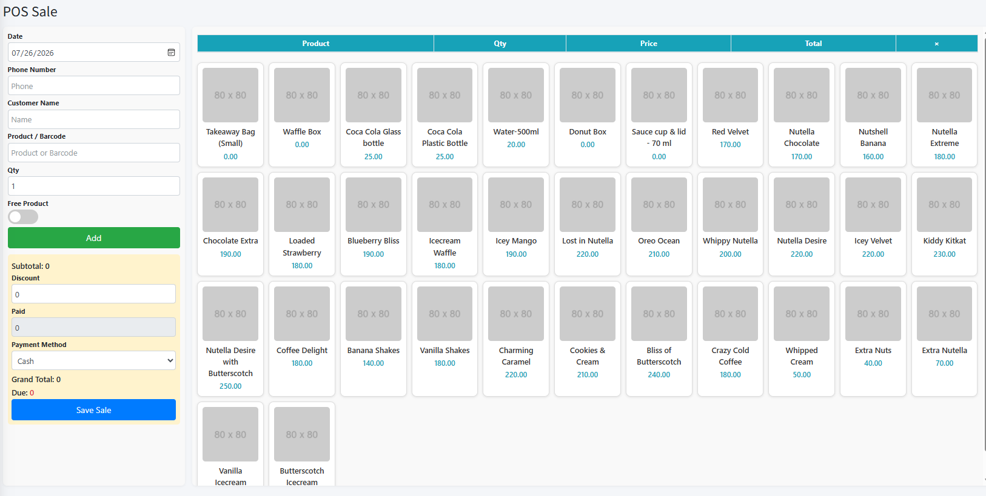
Software Screenshot: Sales and POS
Key points
Product and quantity entry
Cash or credit sale
Invoice completion
Stock and customer update
BizTrack • A Complete Business Accounting Management System
13
Notes:
[Sources]
- BizTrack project report and author-provided presentation.
[/Sources]
Replace the empty frame with the real sales or pos screenshot. Explain only the listed evidence.

Slide 14
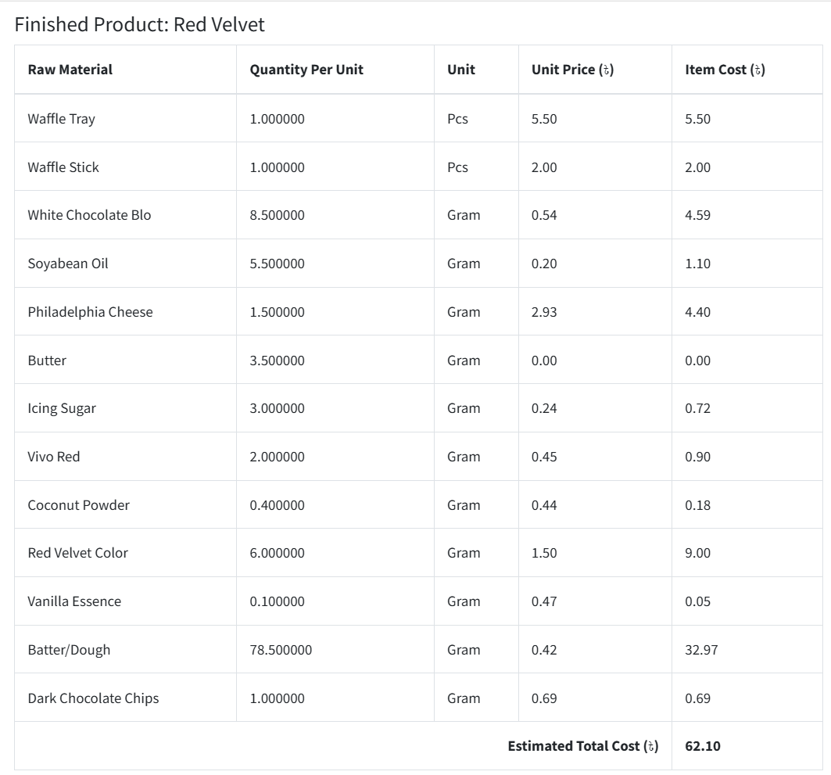
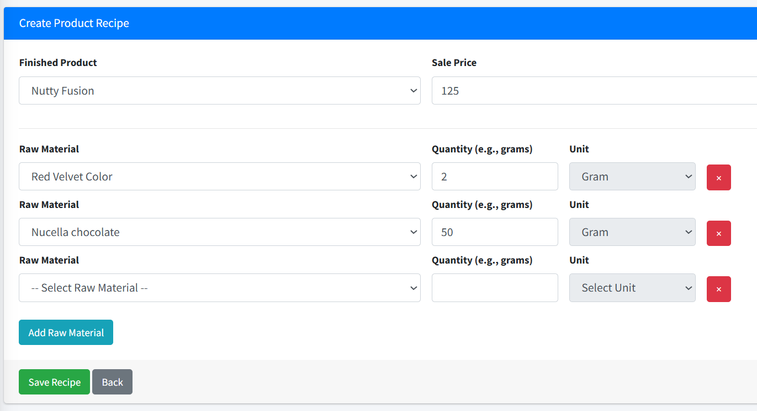
Software Screenshot : Manufacturing
Key points
Recipe materials
Production quantity
Raw stock reduction
Finished stock increase
BizTrack • A Complete Business Accounting Management System
14
Notes:
[Sources]
- BizTrack project report and author-provided presentation.
[/Sources]
Replace the empty frame with the real recipe or production screenshot. Explain only the listed evidence.

Slide 15
Software Screenshot : Manufacturing
Key points
Recipe materials
Production quantity
Raw stock reduction
Finished stock increase
BizTrack • A Complete Business Accounting Management System
14
Notes:
[Sources]
- BizTrack project report and author-provided presentation.
[/Sources]
Replace the empty frame with the real recipe or production screenshot. Explain only the listed evidence.

Slide 16
Software Screenshot : Manufacturing
Key points
Recipe materials
Production quantity
Raw stock reduction
Finished stock increase
BizTrack • A Complete Business Accounting Management System
14
Notes:
[Sources]
- BizTrack project report and author-provided presentation.
[/Sources]
Replace the empty frame with the real recipe or production screenshot. Explain only the listed evidence.

Slide 17
Software Screenshot : Manufacturing
Key points
Recipe materials
Production quantity
Raw stock reduction
Finished stock increase
BizTrack • A Complete Business Accounting Management System
14
Notes:
[Sources]
- BizTrack project report and author-provided presentation.
[/Sources]
Replace the empty frame with the real recipe or production screenshot. Explain only the listed evidence.

Slide 18
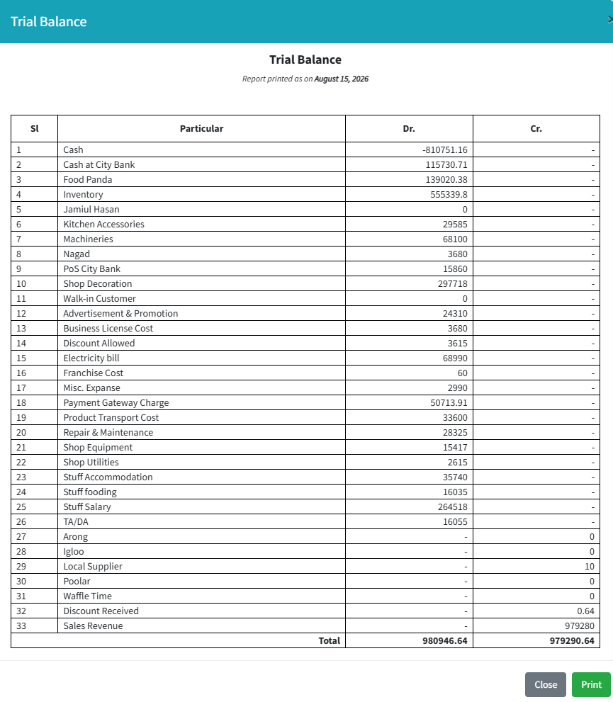
Software Screenshot: Accounting
Key points
Related source transaction
Debit and credit effect
Account or party ledger
Balanced report
Real BizTrack software evidence
BizTrack • A Complete Business Accounting Management System
15
Notes:
[Sources]
- BizTrack project report and author-provided presentation.
[/Sources]
Replace the empty frame with the real journal, ledger or trial balance screenshot. Explain only the listed evidence.

Slide 19
Software Screenshot: Accounting
Key points
Related source transaction
Debit and credit effect
Account or party ledger
Balanced report
Real BizTrack software evidence
BizTrack • A Complete Business Accounting Management System
15
Notes:
[Sources]
- BizTrack project report and author-provided presentation.
[/Sources]
Replace the empty frame with the real journal, ledger or trial balance screenshot. Explain only the listed evidence.

Slide 20
Software Screenshot: Accounting
Key points
Related source transaction
Debit and credit effect
Account or party ledger
Balanced report
Real BizTrack software evidence
BizTrack • A Complete Business Accounting Management System
15
Notes:
[Sources]
- BizTrack project report and author-provided presentation.
[/Sources]
Replace the empty frame with the real journal, ledger or trial balance screenshot. Explain only the listed evidence.

Slide 21
Software Screenshot: Accounting
Key points
Related source transaction
Debit and credit effect
Account or party ledger
Balanced report
Real BizTrack software evidence
BizTrack • A Complete Business Accounting Management System
15
Notes:
[Sources]
- BizTrack project report and author-provided presentation.
[/Sources]
Replace the empty frame with the real journal, ledger or trial balance screenshot. Explain only the listed evidence.

Slide 22
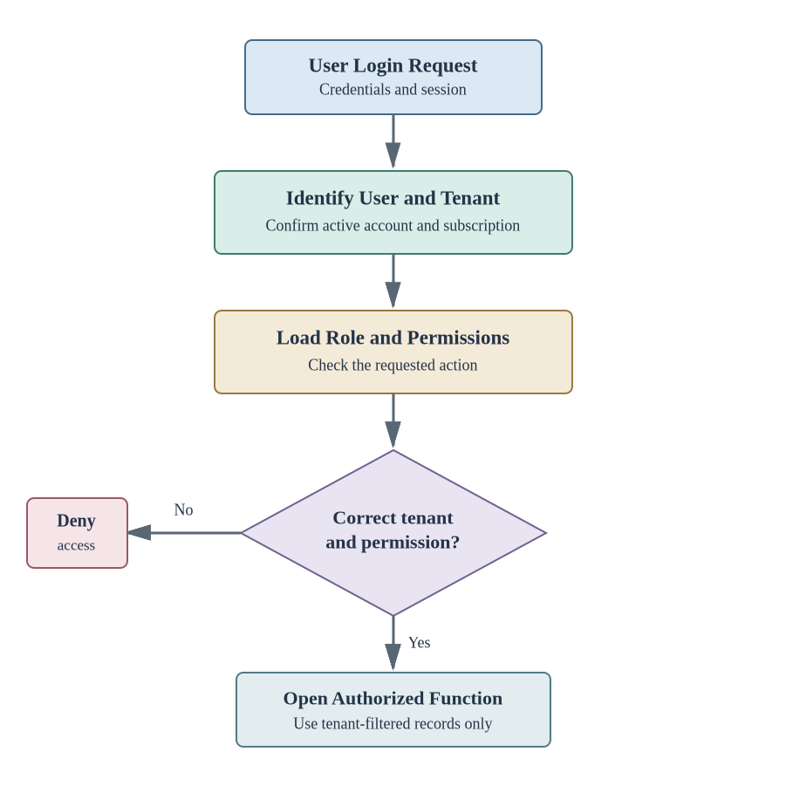
Implementation, Security & Testing
Security
Authentication
Role-Based Access Control
Password Hashing
CSRF Protection
Validation
Audit Trail
Testing
Unit Testing
Integration Testing
System Testing
User Acceptance Testing
BizTrack • A Complete Business Accounting Management System
16
Notes:
[Sources]
- BizTrack project report and author-provided presentation.
[/Sources]
Discuss authentication, roles, tenant separation and testing of connected workflows.

Slide 23
EVALUATION
The three project objectives were achieved in the test environment
OBJECTIVE
EVIDENCE
RESULT
Multi-tenant access
Tenant, subscription, role and isolation tests
ACHIEVED
Connected operations
Purchases, sales, returns, stock and production
ACHIEVED
Accounting and reports
Balanced journals, ledgers and report checks
ACHIEVED
BizTrack • A Complete Business Accounting Management System
17
Notes:
Source: BizTrack project report prepared by the author.
Evaluation from Chapter 6. State the limits of the evidence clearly.

Slide 24
NEXT STEPS
Future work should strengthen reliability before adding complexity
STAGE 1
STAGE 2
STAGE 3
Strengthen
Extend operations
Add services
Wider testing
Backup and recovery
Security review
Audit records
Multi-branch
Warehouse transfer
Batch and expiry
Bank reconciliation
Online subscription payment
Mobile access
Advanced reports
Integration APIs
Present limitations: web-only, no offline POS, limited manufacturing cost, sample-data testing and no formal security audit.
BizTrack • A Complete Business Accounting Management System
18
Notes:
Source: BizTrack project report prepared by the author.
Future roadmap follows Chapter 7. Emphasise staged improvement rather than a long feature wish list.

Slide 25
Conclusion and Contribution
BizTrack connects day-to-day business work with accounting in one web application. It supports separate SaaS tenants and brings purchases, sales/POS, inventory, manufacturing and financial records into a common flow. Its main contribution is not only the number of modules. A transaction can also update the related stock, party balance and accounting records without repeated entry. The system worked in the project test environment, while wider testing and operational preparation are still needed before large-scale use.
BizTrack • A Complete Business Accounting Management System
18
Notes:
[Sources]
- BizTrack project report and author-provided presentation.
[/Sources]
Return to the original problem and explain the main contribution in plain language.

Slide 26
Demonstration
Questions & Discussion
https://biztrack.codeexpress.net/
Notes:
Source: BizTrack project report and author-provided presentation.
Move to the live demonstration or invite questions.

