Slide 1
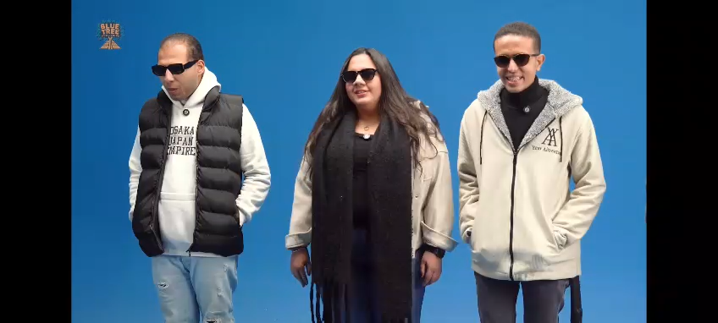


Slide 2
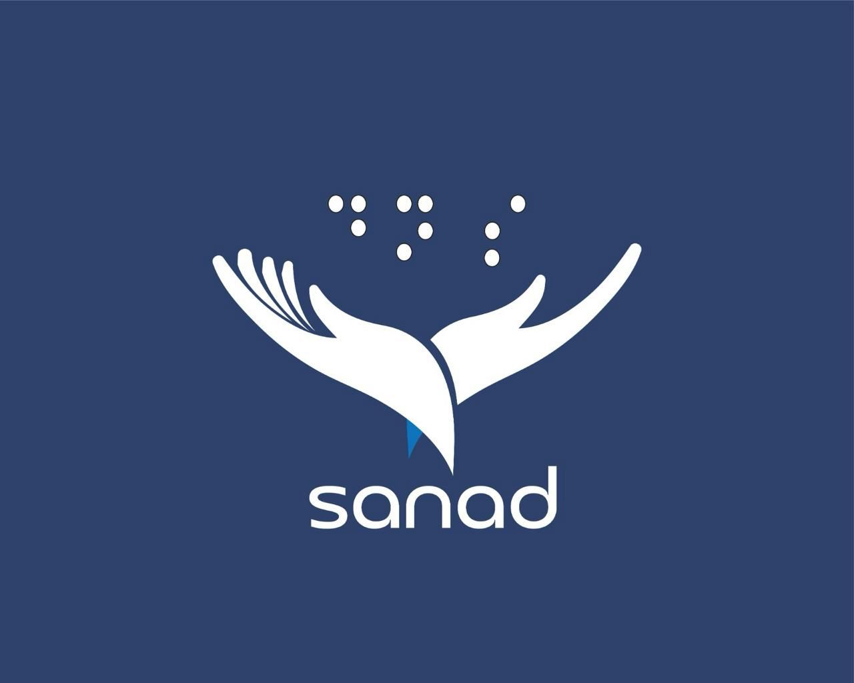
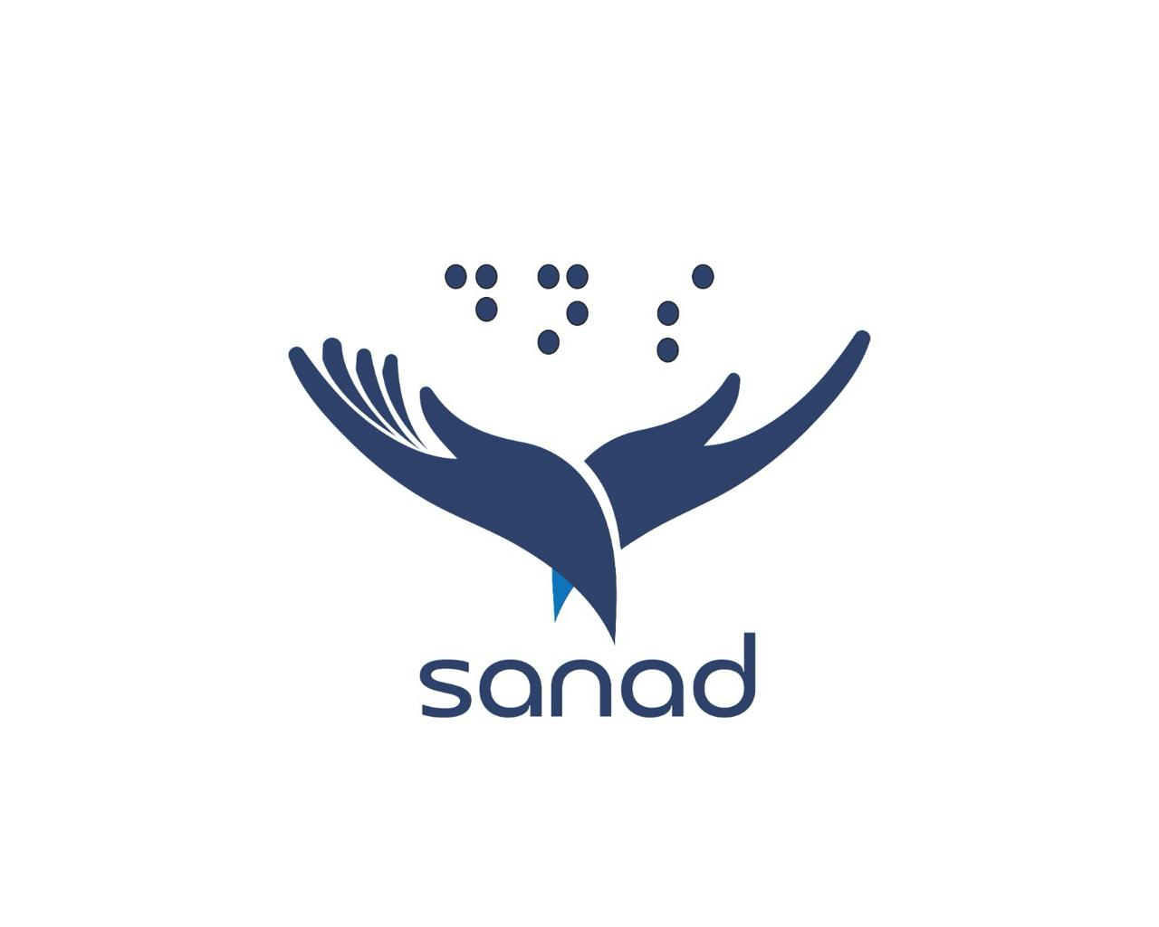
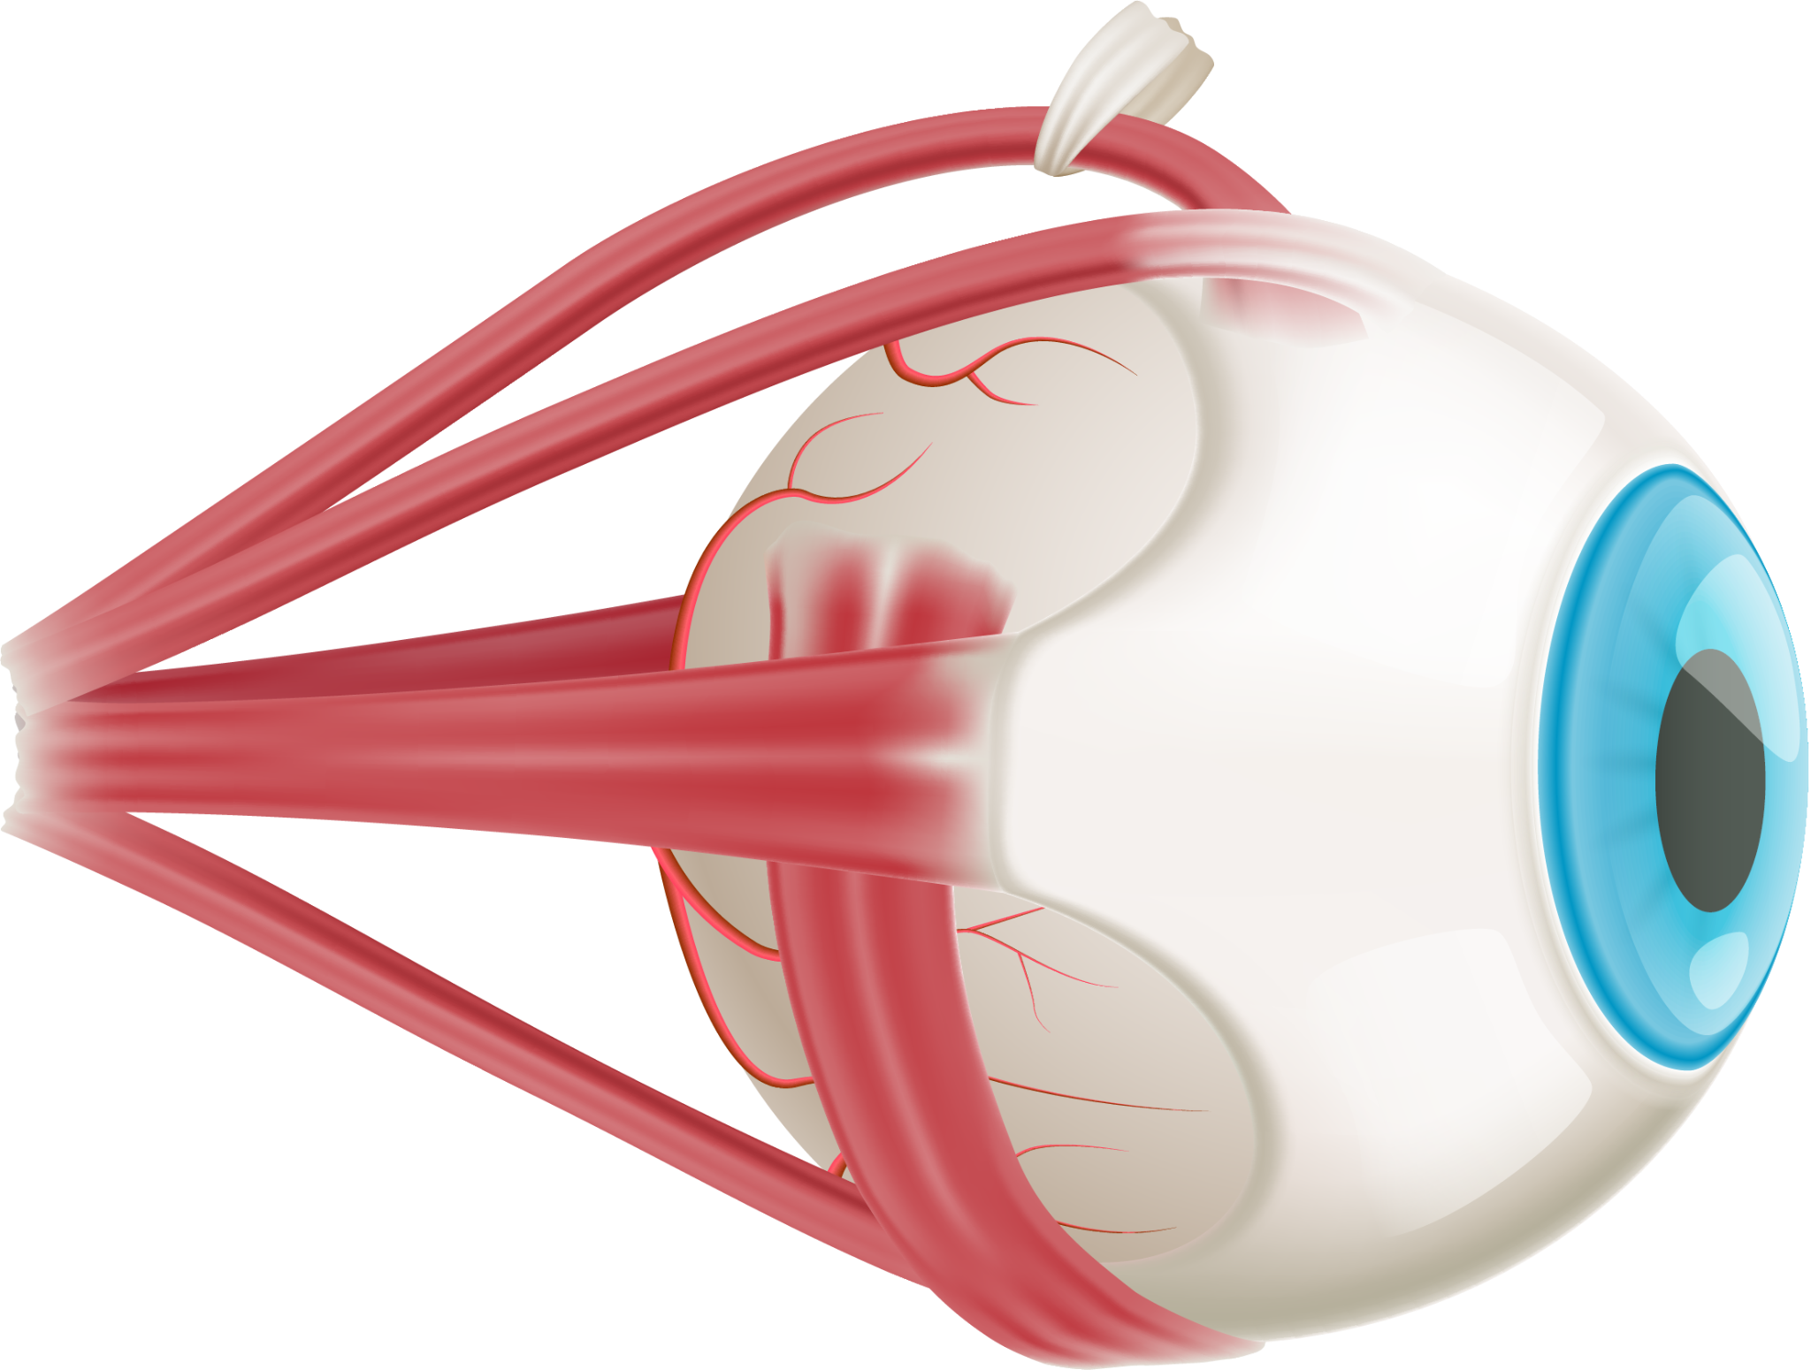
Sanad Mobile Application

Slide 3
Team Members
Rawan Yasser Basma Aldoushy Arsany Ehab
Mira Mamdoh
Abanoub Bekhiet
Youssef Elgammal
Supervisors
Prof. Ibrahim Selim
Dr. Heba Askr

Slide 4


Table of contents
01
02
03
04
05
Problem Statement
Objectives
Related Work
Features
Research

Slide 5

01
Problem Statement

Slide 6

01
Problem Statement
Visually impaired individuals face daily challenges in performing simple tasks independently.
They struggle with:
Identifying surrounding objects
Reading written information
Recognizing money
Navigating safely in different environments
These challenges limit their independence and increase their reliance on others in everyday life.
تحديد الأشياء المحيطة بهم .
قراءة المعلومات المكتوبة .
التعرف على النقود .
التنقل بأمان في بيئات مختلفة .

Slide 7

02
Objectives
Sanad aims to empower visually impaired individuals by enhancing their independence and safety.
من خلال تطبيق جوال مدعوم بالذكاء الاصطناعي، يقوم بما يلي:
اكتشاف الأشياء في الوقت الفعلي .
قراءة النصوص العربية بدقة .
التعرف على العملة المصرية .
توفير تفاعل صوتي بسيط .
تمكين المستخدمين من أداء مهامهم اليومية باستقلالية وثقة.

Slide 8
S.M.A.R.T Project Objectives
Specific: Develop a fully accessible AI-powered app that recognizes objects, text, and currency for visually impaired users.
Time-Constrained: Complete development in 8 months, with phased delivery: analyze, train AI models, integrate OCR/TTS/STT, refine UI, and deploy Sanad app.
S
T
M
Measurable: Ensure high accuracy: 90% for object detection, 95% for currency recognition, 95% for Arabic text reading, with 80% positive user feedback.”
R
A
Relevant: Address real needs of visually impaired users in Egypt by enabling independent navigation, text reading, and currency identification in Arabic.
Achievable: Implement incrementally: start with core AI functions (object, currency, text), then add voice & gesture navigation with stable system deployment.

Slide 9
💡 يعني إيه SMART Objectives أصلاً؟
SMART دي طريقة بنستخدمها علشان نتأكد إن هدف المشروع واضح وقابل للتنفيذ، وكل حرف ليه معنى:
S – Specific → هدف واضح (هتعمل إيه بالظبط؟)
M – Measurable → ينفع يتقاس (هتعرف نجحت ولا لأ إزاي؟)
A – Achievable → قابل للتنفيذ (مش خيال)
R – Relevant → ليه لازمة (بيحل مشكلة حقيقية)
T – Time-bound → له وقت محدد

Slide 10



03
Related Work
3.1 Seeing AI
3.2 Be My Eyes
3.3 Envision AI

Slide 11
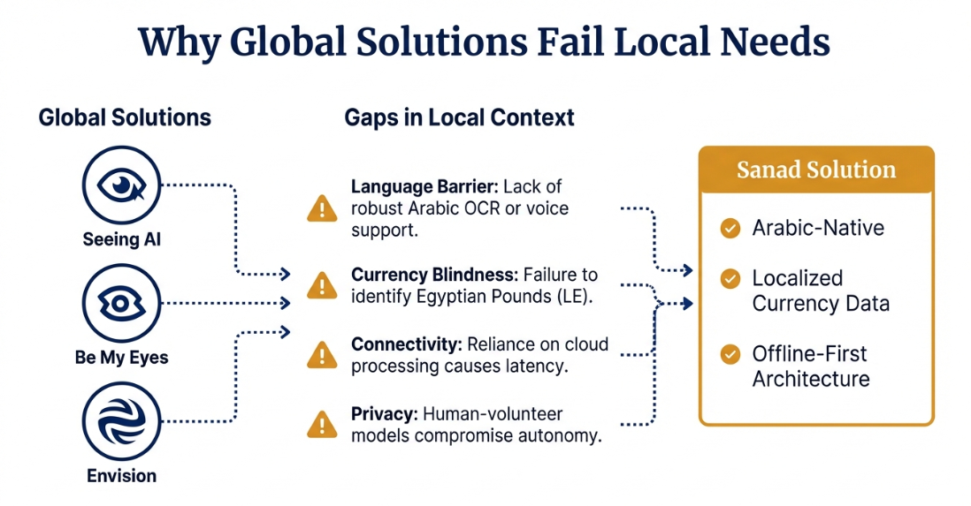
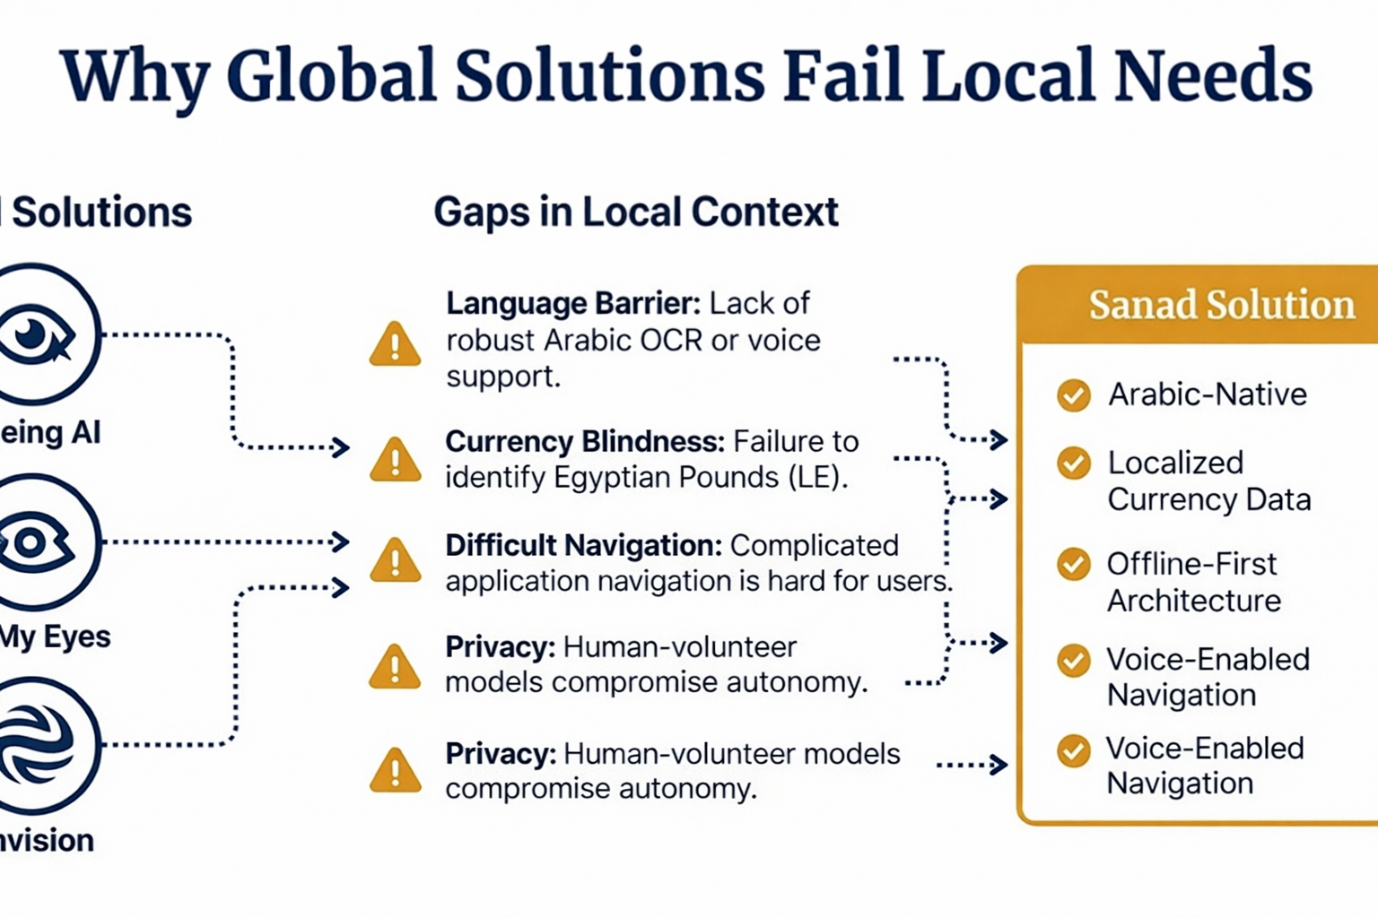

Slide 12
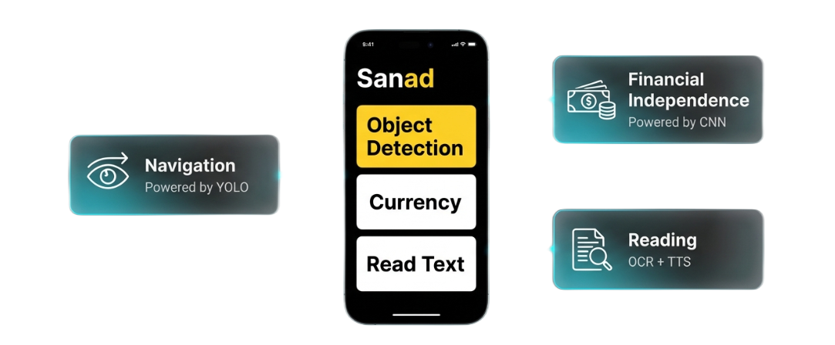
04
Features
Real-Time Object Detection
Swipe-Based Gesture Control
Currency Recognition
Arabic Text Reading (OCR)
Voice-Controlled Navigation
Audio Feedback System

Slide 13
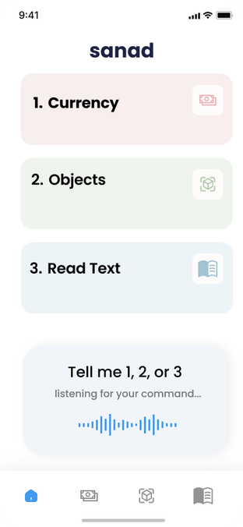
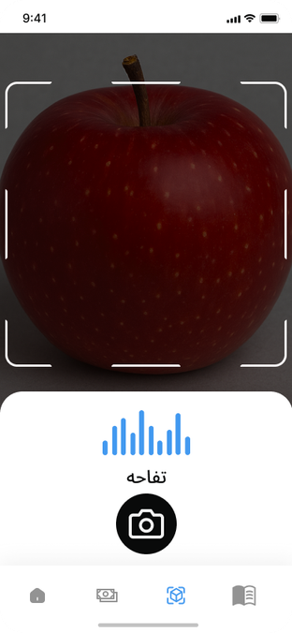
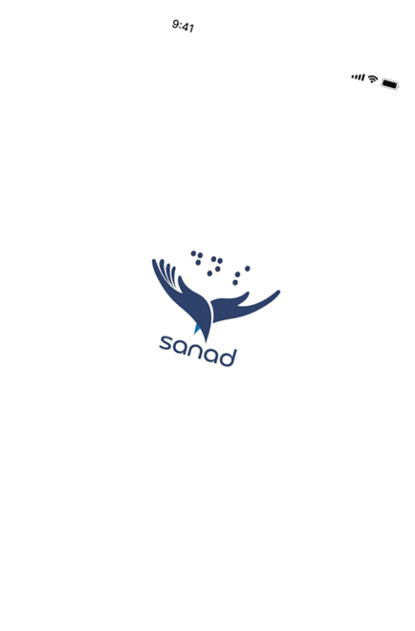
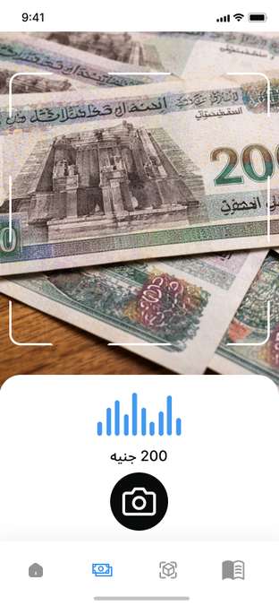
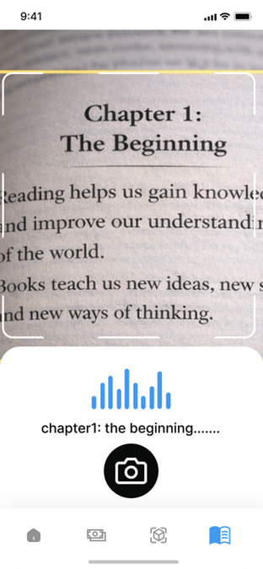
Ingoude Company
APP UI
Home
Service
About Us
Contact

Slide 14
05
Research
5.1
Trends & Statistics in Egypt
Egypt has an estimated 8–9 million people with visual impairment, including approximately 0.4–0.6 million blind individuals, according to recent global health estimates.
Smartphone penetration exceeds 99% of the population, making mobile-based assistive solutions highly scalable without requiring additional hardware.
Regional reports highlight a growing demand for Arabic voice guidance and real-time AI assistance, especially for accessibility applications.
How Sanad Meets Egypt’s Needs
Sanad provides real-time Arabic object detection, Egyptian currency recognition, Arabic text reading, and voice-based interaction, enabling greater independence in navigation, financial transactions, and access to printed information.

Slide 15
05
Research
5.2
Limitations of Existing Assistive Apps
Although applications like Seeing AI, Supersense, and Envision provide helpful features, they still have significant limitations:
Weak or limited Arabic language support, especially in OCR accuracy.
Dependence on manual photo capture, causing processing delays instead of continuous real-time detection.
Complex, multi-step navigation that can be difficult for blind users without assistance.
How Sanad Meets Egypt’s Needs
Sanad overcomes these challenges by offering real-time detection with instant voice feedback, full Arabic support, and simplified voice and gesture-based navigation—allowing users to identify objects, read text, and recognize currency independently.

Slide 16
05
Research
5.3
Challenge of Local Currency Recognition in Egypt
Egyptian banknotes are difficult for visually impaired individuals to distinguish due to similar sizes and complex designs. Physical solutions like tactile modifications are impractical and cannot be applied to existing currency.
How Sanad Meets Egypt’s Needs
Sanad uses AI-based image recognition to identify banknotes in real time under different lighting and viewing conditions, providing a practical and scalable solution without modifying physical money.

Slide 17
05
Research
5.4
Challenge of Usability in Assistive Applications
Many assistive applications have complex interfaces and multi-step navigation, making them difficult for visually impaired users who rely entirely on non-visual interaction.
How Sanad Meets Egypt’s Needs
Sanad simplifies interaction through Arabic voice commands and swipe-based navigation, enabling users to switch features easily and use the app independently without external assistance.

Slide 18
Resources
IAPB Vision Atlas – Egypt Country Data (2025-2026 updates): https://visionatlas.iapb.org/country-data/egypt
DataReportal – Digital 2025 & 2026: Egypt (mobile/internet stats): https://datareportal.com/reports/digital-2025-egypt
The New Arab – "Visually impaired Arabs turn to AI for empowerment and equality" (Nov 2025): https://www.newarab.com/features/visually-impaired arabs-turn-ai-empowerment-and-equality
Accessibility evaluation of major assistive mobile applications available for the visually impaired

Slide 19
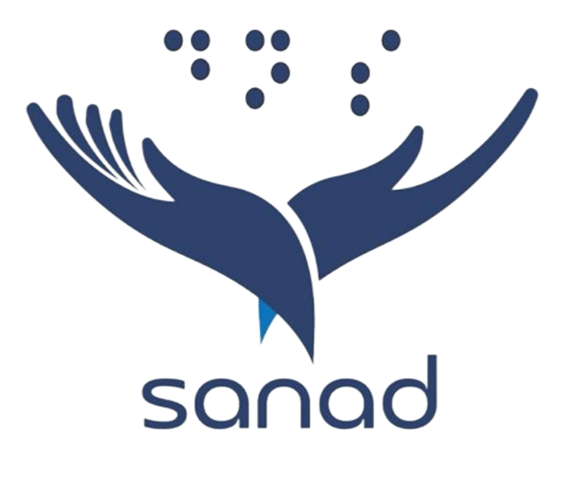
Thanks

