Slide 1
HTML 5 RECAP

Slide 2
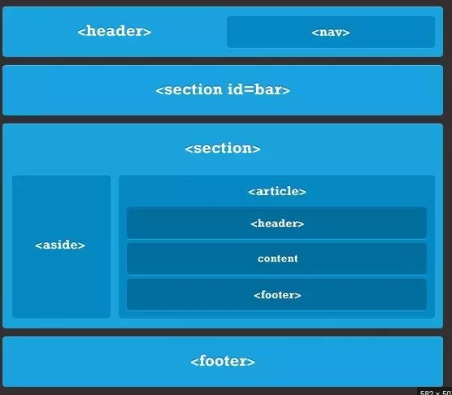
HTML Semantic Elements
<section>
A <section> is a “generic document”. You could use <section> to mark up, oh, say a Guide to HTML. Or to enclose the HTML for a game. A <section> is not a generic container—that’s <div>’s job. And remember, use <div> ifyou’re just grouping elements together for styling purposes.

Slide 3
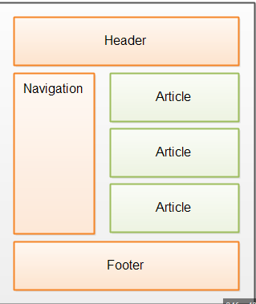
HTML Semantic Elements
<article>
An <article> is a self-contained chunk of content that you might want to share with another page or web site. Perfect for blog posts and news articles.

Slide 4
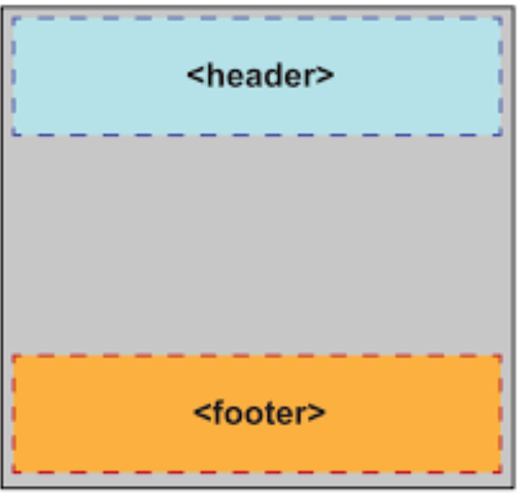
HTML Semantic Elements
<header>
<header> is for the tops of elements like <section> and
<article>. You might also use <header> at the top of the
body to create the main header for your page.

Slide 5
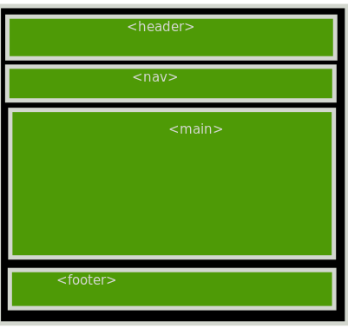
HTML Semantic Elements
<footer>
<footer> is for the bottoms of things. Things like
<section>s, <article>s and <div>s. You might think you’re
only allowed one on a page; in fact, you can use it
whenever you need footer content on a section of your
page (like a bio or references for an article).

Slide 6
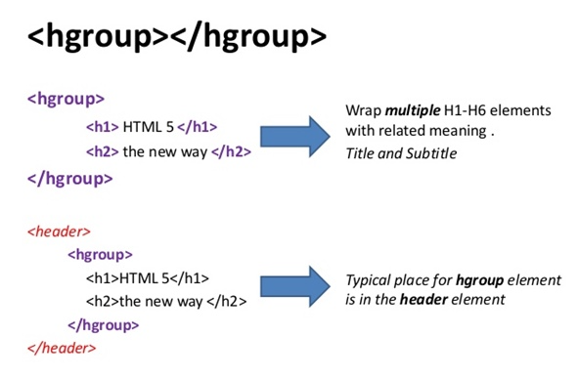
HTML Semantic Elements
<hgroup>
This one can be tricky. Unlike <header>, which can contain any elements related to a header, <hgroup> is specifically for grouping headings (<h1>...<h6>) together inside a <header>. Good for outlines.

Slide 7
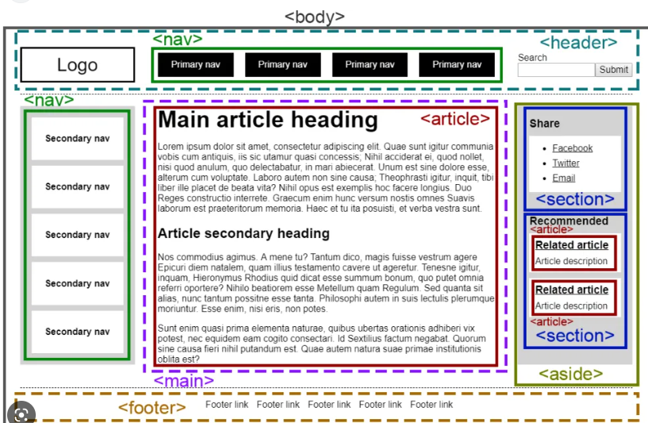
HTML Semantic Elements
<nav>
<nav> is navigation and for links, of course. But not just any links: use <nav> when you have a group of links, like navigation for your site, or a blogroll. Don’t use it for single links in paragraphs.

Slide 8
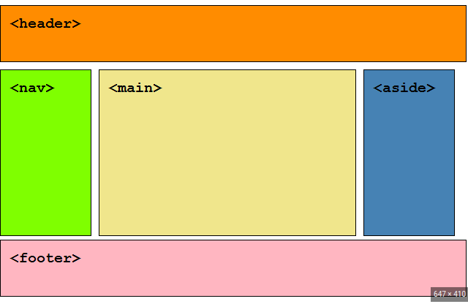
HTML Semantic Elements
<aside>
<aside> is handy for all kinds of things that are chunks of content outside the main flow of your page, like a sidebar, a pull quote, or an after-thought.

Slide 9
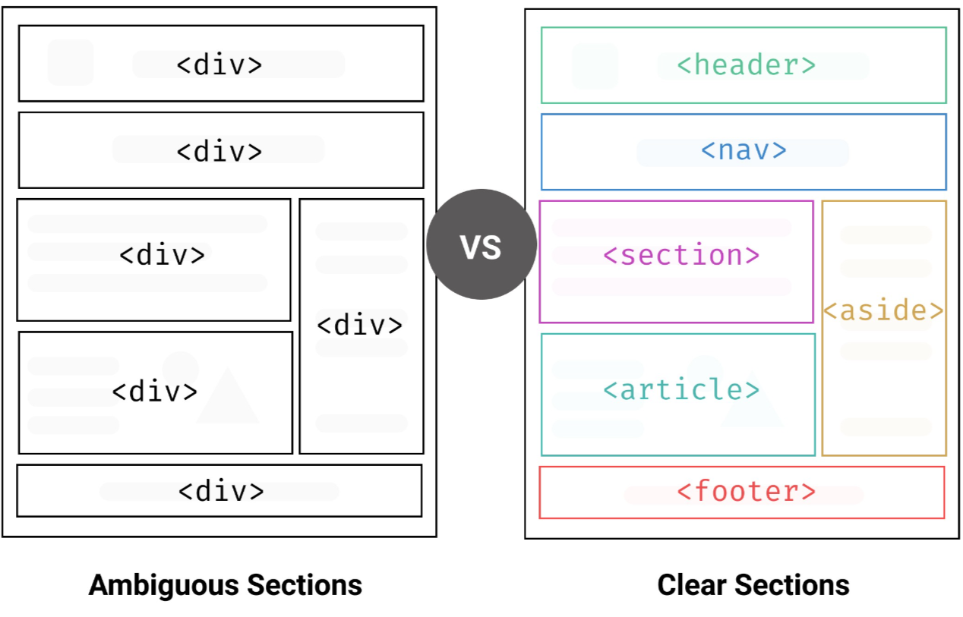
HTML Semantic Elements

Slide 10
The Basics of CSS
What is CSS
Cascading Style Sheets (CSS) is a language used to describe the presentation of an HTML document. Most people who dabble in the Web start by using CSS to change the appearance of text on a page.
They quickly discover that they can set a style rule for all paragraphs in a site, instead of specifying a rule for each paragraph in hundreds of pages. That’s just the tip of the iceberg. You can use CSS to add color and images to your document, or even to change the entire structure and layout.

Slide 11
CSS Selectors
The selector is the part of the rule that specifies what element or elements the rule should apply to. A selector can be a reference to an HTML tag, an ID, or a class.

Slide 12
Types of Selectors
A reference to an HTML tag
A selector that refers to an HTML tag consists of the tag itself without the angle brackets. In this example, all the h1 tags will be blue.
p, h1, and body are all examples of selectors that refer to HTML tags.
h1{
color:#009 ;
}

Slide 13
Types of Selectors
References an ID
Selectors that reference an ID in the HTML document always start with a hash mark. The example code defines the width of the element on the page with the ID of page.
#page, #header, and #footer all refer to IDs.
#page{
width:900px;
}

Slide 14
Types of Selectors
References a Class
Finally, selectors that reference a class start with a period as with the following code example.
.box, .important, and .newsitem all apply the rule to elements with the specified class.
.box{
border:1px solid #000 ;
}

Slide 15
Declarations: Properties and Values
A declaration defines the style you apply to the selector. Each declaration sets a value to a CSS property, so if you want to set the text color of all h1 elements to red, you set the color property to #F00, the shorthand hex notation for red. You can see the rule in action in this snippet:
h1{
color:#F00;
}

Slide 16
Declarations: Properties and Values
In a declaration, the property and value are separated by a colon, and each property-value pair is separated by a semicolon.1 If you have multiple declarations in a single rule, you can place them all on their own lines, like this:
h1{
font-size:24px;
font-weight:bolder;
color:#f00 ;
}
Or, you can cram the entire thing on one line, like this:
h1{font-size:24px;font-weight:bolder;color:#f00 ;}

Slide 17
Precedence Order
ID Selectors
Selectors with IDs are more specific than other selectors. For example, if you define all h2 tags to be blue but you want a specific one to be red, you might consider applying an ID to that heading using the ID in the selector:
<h2>Products</h2>
<h2>Clearance Items</h2>
<h2 id="special_promotion">Hot Deals!</h2>
Class Selectors
Class selectors are more specific than regular HTML selectors, but not as specific as an ID. We can use the promo class on our headings, as in the following example:
<h2>Products</h2>
<h2 class="promo">Clearance Items</h2>
<h2 class="promo" id="special_promotion">Hot Deals!</h2>
And we can define the styles for these headings:
h2{color:#00 F;}
#special_promotion{color:#F00;}
.promo{color:#0 F0;}

Slide 18
Precedence Order
This time we have a blue Products heading, a green Clearance Items heading, and the Hot Deals! heading remains red, the class overrides the rules for the h2 tag, but the rule attached to the ID selector still wins out.

Slide 19
Order Matters
When no precedence can be determined, the cascade picks the most recently defined style. This is the part that lets you override styles on a per-page or per-element basis, and it’s one of the most useful features of CSS. A style sheet can be split across multiple files, and the browser will apply the rules to elements as it finds them. As long as you’re careful and you understand how the cascade works, you can take advantage of the flexibility. For example, let’s say that the styles for our headings look like this:
h2{color:#00 F;}
#special_promotion{color:#F00;}
.promo{color:#0 F0;}
Then, you add a new style at the page level:
#special_promotion{color:#FF0;}
The rule at the page level takes precedence over the rule in the stylesheet because it’s defined again. The Hot Deals! heading is yellow instead of red

Slide 20
The Importance of !important
Sometimes you need to change how the cascade works so that you can get a rule to apply as you see fit. CSS provides the !important keyword to force the cascade to apply the rule regardless of precedence. On our previous example, our rule tied to the promo class couldn’t override the rule attached to the special_promotions ID because ID selectors always win. However, we can force the promo rule to apply by appending !important to each declaration we want to force to the top of the precedence order:
h2{color:#00 F;}
#special_promotion{color:#F00;}
.promo{color:#0 F0 !important;}
This time, the Hot Deals! heading is green

Slide 21
How Browsers Use CSS
Inline Styles
HTML elements all have a style attribute that allows you to define CSS properties as part of an element’s declaration:
<h1 style="color:#f00;font-size:18px;">Welcome</h1>
This method is often used by application developers when they design helper functions and tag libraries. Although this is a nice feature, it’s one of the worst ways to apply styles to a document. Imagine seeing this in a document:
<h3>Services</h3>
<ul>
<li style="color:#300;">Computer repair</li>
<li style="color:#300;">Small business networking support</li>
<li style="color:#300;">Computer hardware sales</li>
<li style="color:#300;">Web development</li>
</ul>
You use the same style declaration repeatedly, increasing the amount of code in the HTML document. By doing it this way, you lose the ability to reuse this style information.

Slide 22
How Browsers Use CSS
The Style Tag
HTML also has a style tag that you can use to define an entire style sheet within the header of your document:
<style>
body{
font-family: Arial, Helvetica, sans-serif;
font-size:12px;
line-height: 18px;
}
h1{font-size:18px; line-height:36px;}
h2{font-size:16px;}
h3{font-size:14px;}
#page{
width:900px;
}
</style>

Slide 23
How Browsers Use CSS
This method is extremely useful in those cases where you want to have a page with its own style elements that don’t belong in the sidebar stylesheet. The problem here is the same one you encountered with inline styles: you are mixing content with presentation, and you lose the ability to share these styles with another page in your site.This is also an excellent method to use when first implementing some CSS rules on a template, because you don’t have to create any additional files. The CSS code you use in the style element can be cut and pasted into a separate CSS file when you are ready to build additional pages.

Slide 24
How Browsers Use CSS
External CSS Files
Using the link tag, you can attach a style sheet to your HTML document just as you’d attach an external JavaScript file. Your user’s browser will download the external file and apply it to your page. Subsequent requests to the same file should be cached by the user’s browser. If you use the same file across multiple pages, you can improve your user’s experience significantly because you have to send only the content of your page and not the extra CSS code.

Slide 25
Guide to CSS3 Properties
New properties
There are quite a few new properties in CSS3, many of which do what web
page authors have been doing for years with various contortions of HTML,
images, and JavaScript. Examples:
Opacity: 0.5; Makes an element 50% opaque
border-radius: 6px; Creates a rounded effect with 6px curavature on each corner
box-shadow: 5px 5px 10px #373737; A shadow 5px long, 5px high, a blur of 10 px, and a dark grey color

Slide 26
Guide to CSS3 Properties
New layouts
There are a couple of powerful new ways to lay out your page with CSS that go beyond positioning and are much easier to use. Examples:
display: table;
display: table-cell; Both give you table layout without HTML table
display: flexbox;
flex-order: 1; With flexbox you have greater control over how the browser flows boxes like <divs> onto the page

Slide 27
Guide to CSS3 Properties
New animations
With animations, you can animate between property values. For instance you can make something disappear by transitioning the opacity from opaque to translucent:
transition: opacity 0.5s ease-in-out; The transition property specifies the property to transition into and out of, how long it take to do the trnasition, and the easig function, so its gradual
opacity: 0; By saetting opacity to 0, say on a hover event, we can create a disappear/reappear animation

Slide 28
CSS Layout – float and clear
The float Property
In its simplest use, the float property can be used to wrap text around images.
The following example specifies that an image should float to the right in a text:
img {
float: right;
margin: 0 0 10px 10px;
}

Slide 29
CSS Layout – float and clear
The clear Property
The clear property is used to control the behavior of floating elements.
Elements after a floating element will flow around it. To avoid this, use the clear property.
The clear property specifies on which sides of an element floating elements are not allowed to float:
div {
clear: left;
}

Slide 30
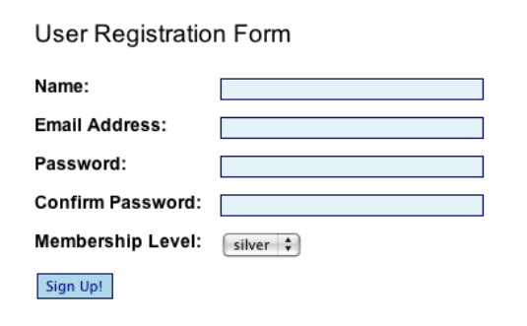
Exercise 1
How do I lay out a two-column form using CSS instead of a table?
Desired Output:

Slide 31
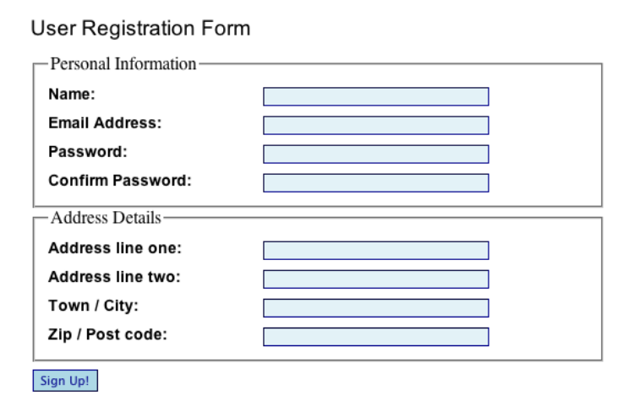
Exercise 2
How do I group related fields in a form?
Desired Output:

Slide 32
End of Session
Thank you

