Slide 1
The effect of limb position on myoelectric prosthetic control using linear regression
Scientific Methods and Communication Conference 2017
December 14, 2017
Group 7404
Irene Uriarte, Martin Garenfeld, Oliver Damsgaard and Simon Bruun
School of Medicine and Health
Aalborg University, Denmark

Slide 2
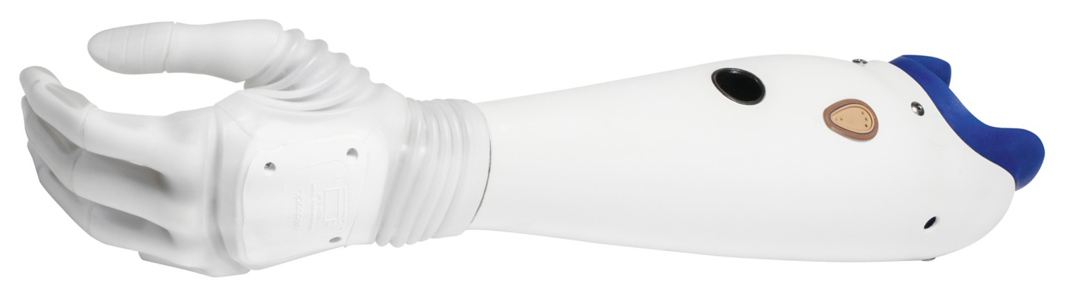
Introduction
Myoelectric Prosthetics

Slide 3
Introduction
Variations in limb position lowers accuracy [1]
[1] Fougner et al. IEEE TNSRE (2011)

Slide 4
Introduction
Variations in limb position lowers accuracy [1]
Classification [1] VS regression [2]
[1] Fougner et al. IEEE TNSRE (2011)
[2] Hahne et al. IEEE TNSRE (2014)

Slide 5
Introduction
Variations in limb position lowers accuracy [1]
Classification [1] VS regression [2]
Test performance of linear regression- based control across different limb positions
[1] Fougner et al. IEEE TNSRE (2011)
[2] Hahne et al. IEEE TNSRE (2014)

Slide 6
Methods and Materials

Slide 7
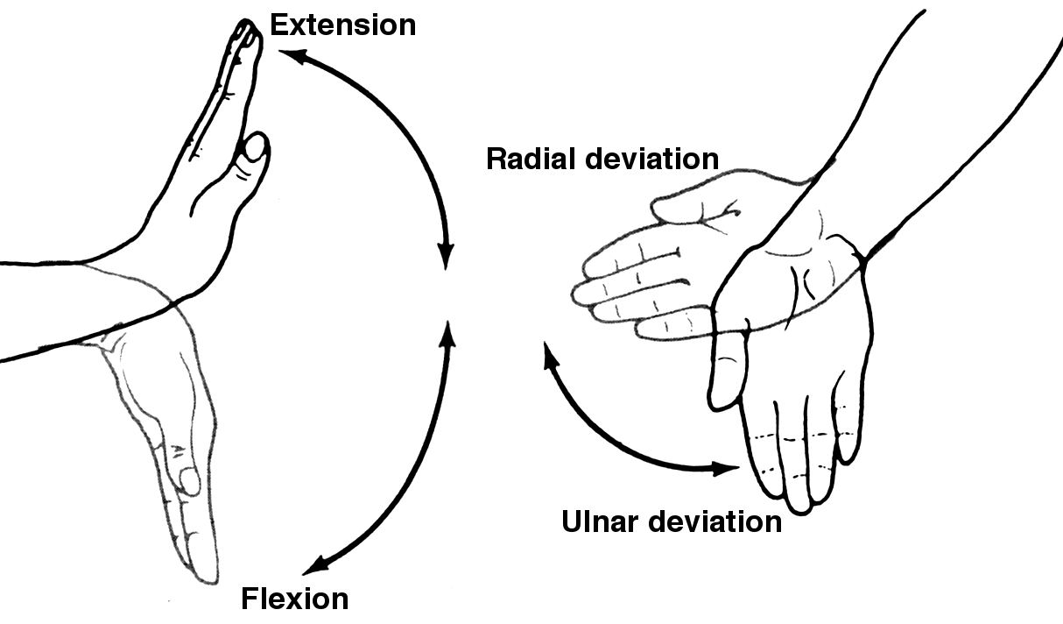
Methods and Materials

Slide 8
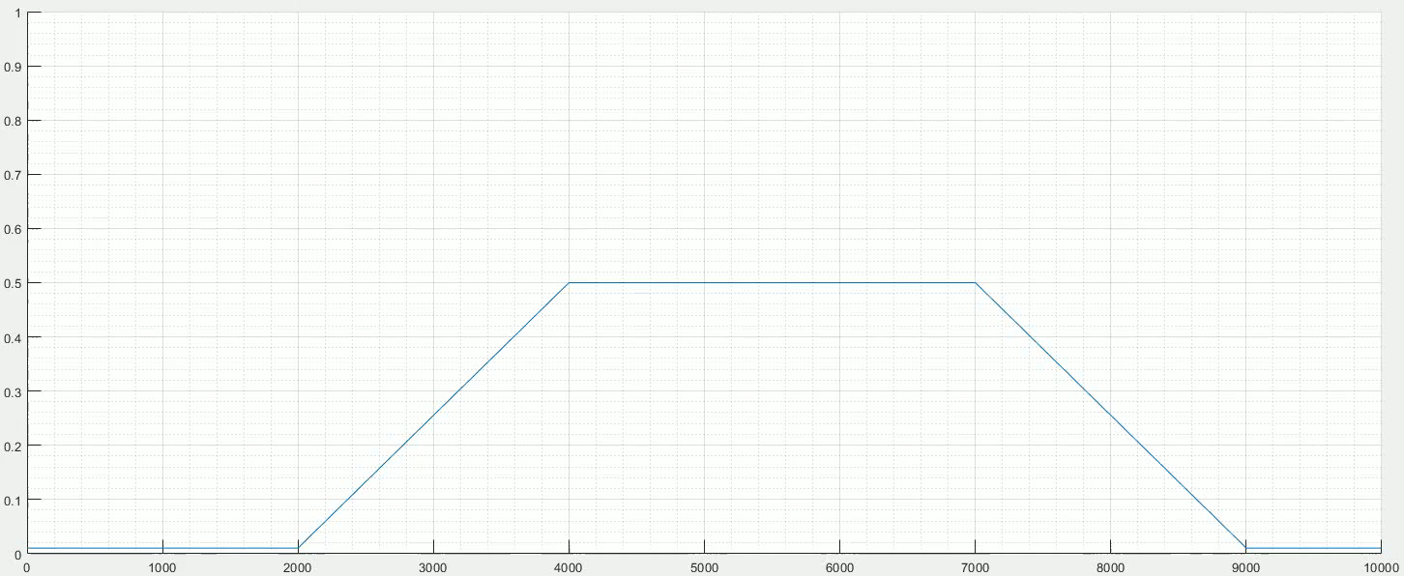
Methods and Materials

Slide 9
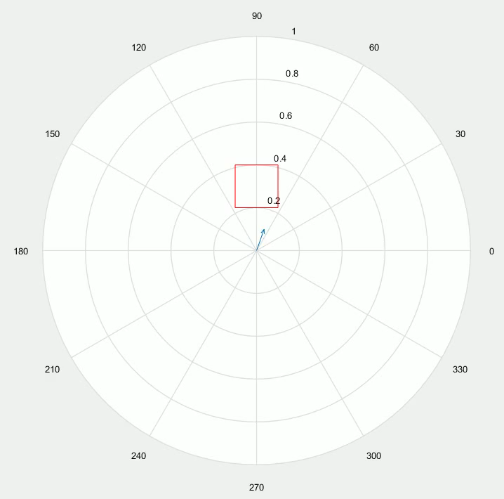

Slide 10
Results

Slide 11
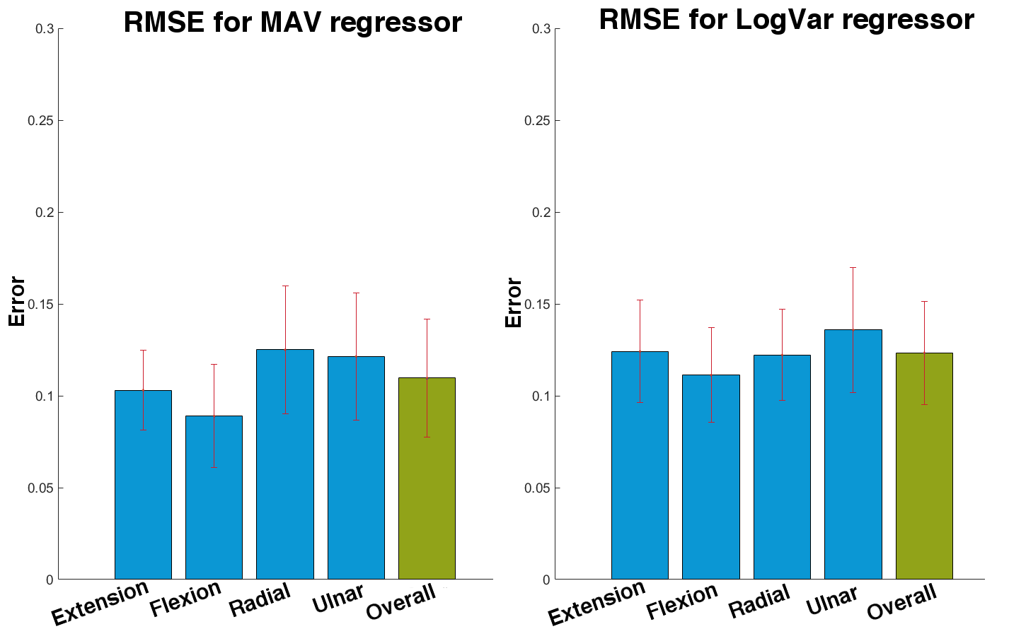
Results
Significant difference between MAV and LogVar (p = 0.0007)

Slide 12
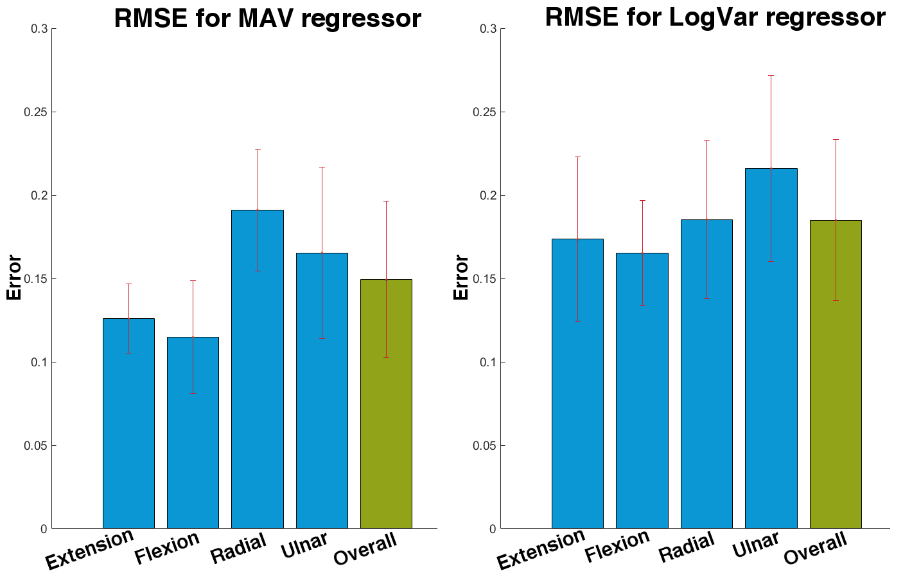
Results
Significant difference between MAV and LogVar (p = 0.00082)

Slide 13
Results
Significant difference between MAV training and MAV test data (p = 0.0002)
Significant difference between LogVar training and LogVar test data (p = 0.0002)

Slide 14
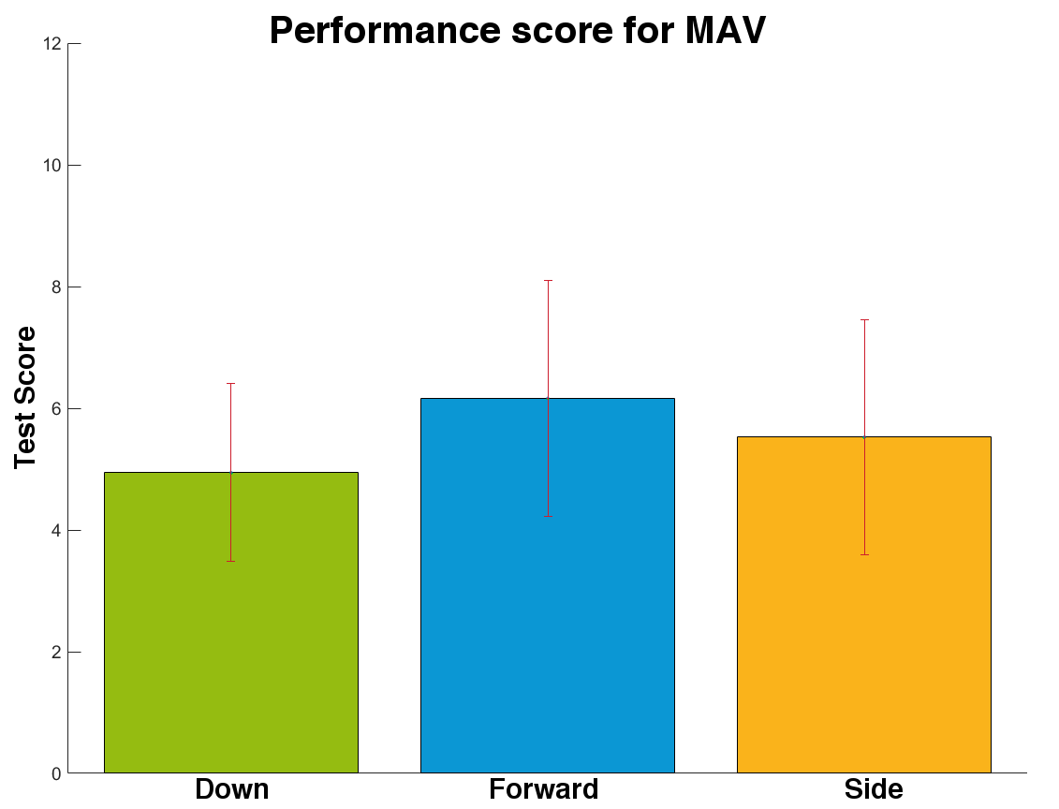
Results
No significant difference between limb positions (p = 0.16)

Slide 15
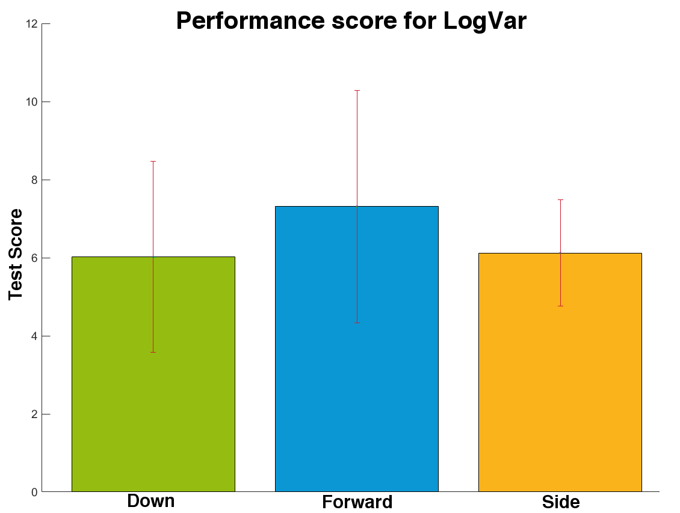
Results
No significant difference between limb positions (p = 0.56)

Slide 16
Results
No significant difference between MAV and LogVar (p = 0.13)

Slide 17
Discussion
No significant difference in performance across limb positions
[3] Hwang et al. PLoS ONE (2017)

Slide 18
Discussion
No significant difference in performance across limb positions
No correlation between offline and online test
[3] Hwang et al. PLoS ONE (2017)

Slide 19
Discussion
No significant difference in performance across limb positions
No correlation between offline and online test
Findings agree with recently published study [3]
[3] Hwang et al. PLoS ONE (2017)

Slide 20
Discussion
No significant difference in performance across limb positions
No correlation between offline and online test
Findings agree with recently published study [3]
No significant difference in performance between the MAV and LogVar feature
[3] Hwang et al. PLoS ONE (2017)

Slide 21
Discussion
No significant difference in performance across limb positions
No correlation between offline and online test
Findings agree with recently published study [3]
No significant difference in performance between the MAV and LogVar feature
Large potential in linear regression-based myoelectric prosthetic control
[3] Hwang et al. PLoS ONE (2017)

Slide 22
Acknowledgement
Supervisors: Strahinja Dosen, Jakob Dideriksen and Lotte Struijk
SMH for providing equipment
Test subjects and Mikkel Birkedal

Slide 23
Thank you

